Slide 1






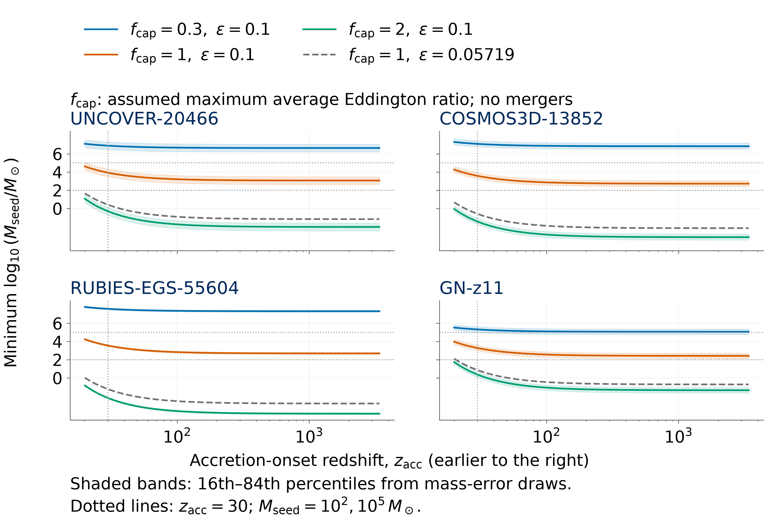
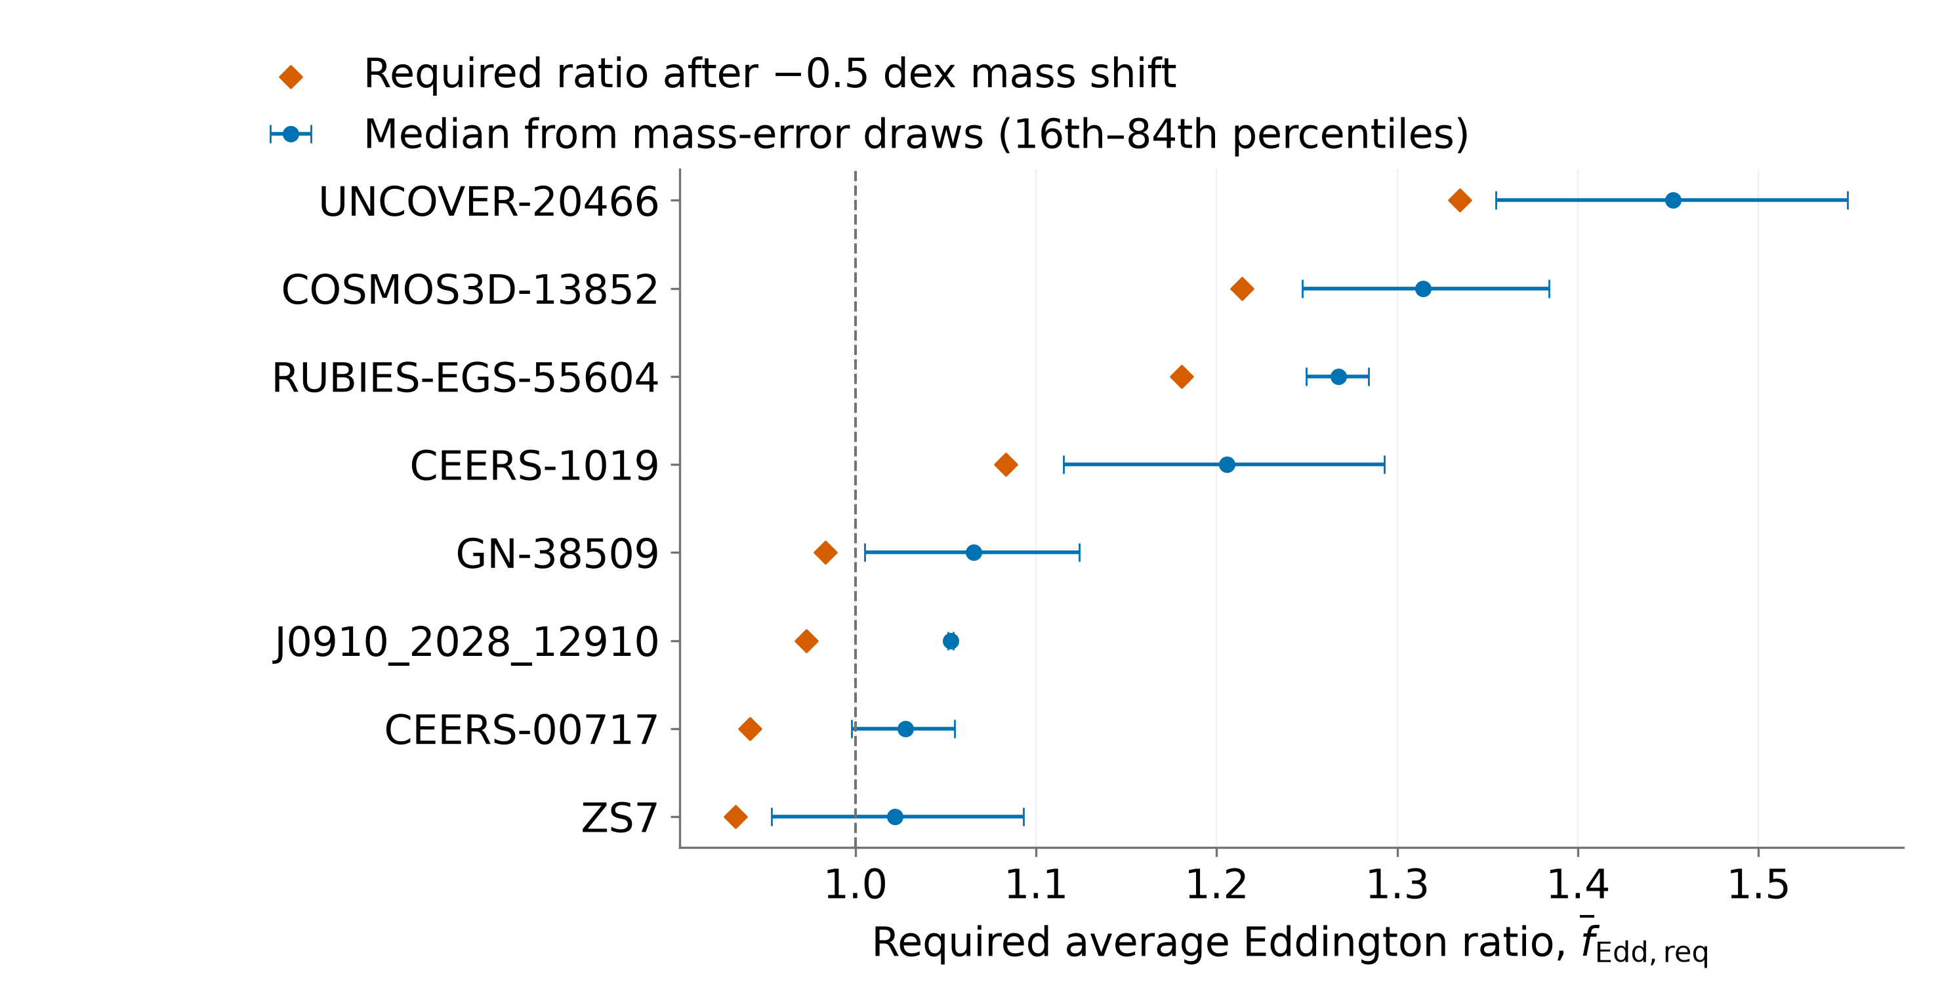
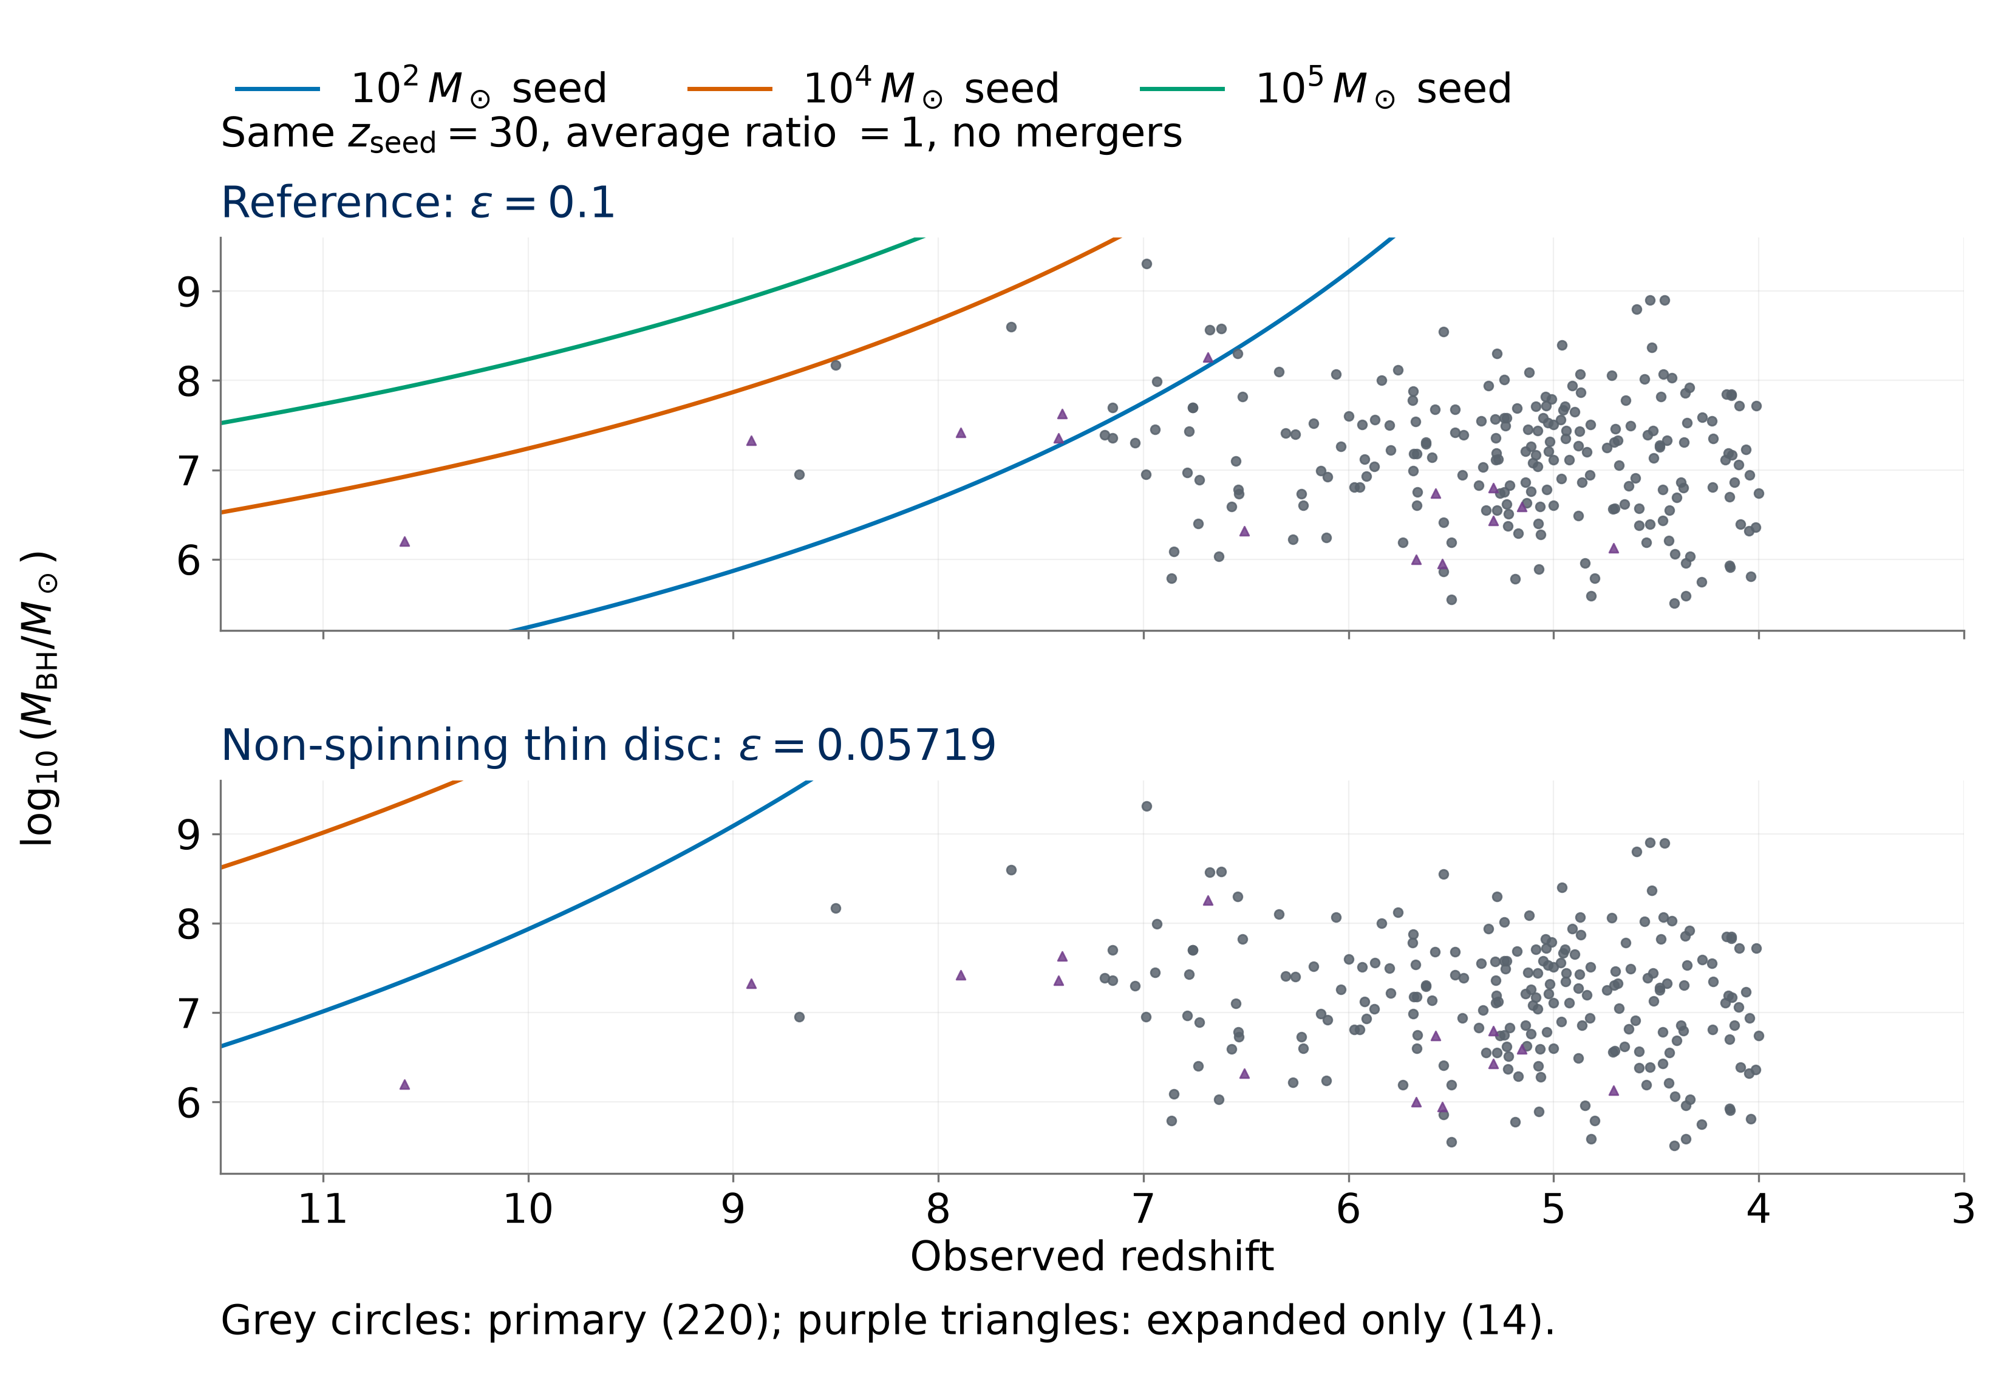
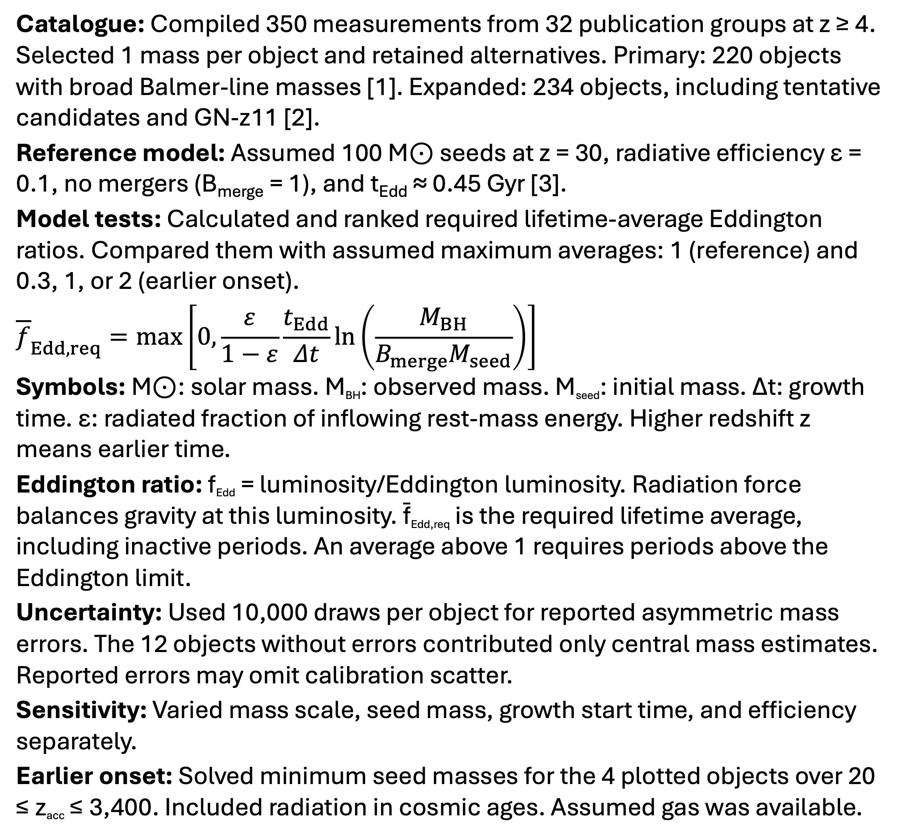
Early Black-Hole Growth Constraints from JWST
Nicole Jiang; University of Toronto
Introduction
Results
How did early black holes grow so big, so fast? The James Webb Space Telescope (JWST) has revealed massive black holes with little time to grow. I compiled published mass estimates and calculated the average accretion needed to reach each mass under different seed masses (initial masses), start times, and radiative efficiencies.
Reference: 212/220 primary objects require average Eddington ratios ≤ 1. The other 8 require averages above 1, including 5 in ≥ 95% of mass-error draws.
Mass sensitivity: After reducing masses by a factor of 3.2 (0.5 dex), UNCOVER-20466, COSMOS3D-13852, and RUBIES-EGS-55604 still require averages above 1 in ≥ 95% of mass-error draws.
Seed mass: 1,000 M⊙ seeds leave 3/220 above 1. With 100,000 M⊙ seeds, no objects in either sample require averages above 1.
Growth start time: Starting later (z = 20) increases the primary count above 1 to 18/220. GN-z11 requires the highest average in the expanded sample.
Efficiency: At ε = 0.05719 (non-spinning thin disc) [4], all 234 central mass estimates require averages below 1 from 100 M⊙ seeds at z = 30.
Earlier-onset test: Starting growth at z = 3,400 (matter–radiation equality) requires 270–1,200 M⊙ seeds for the 4 plotted objects (ε = 0.1, average ratio ≤ 1, no mergers).
Methods
Catalogue: Compiled 350 measurements from 32 publication groups at z ≥ 4. Selected 1 mass per object and retained alternatives. Primary: 220 objects with broad Balmer-line masses [1]. Expanded: 234 objects, including tentative candidates and GN-z11 [2].
Reference model: Assumed 100 M⊙ seeds at z = 30, radiative efficiency ε = 0.1, no mergers (B_{merge} = 1), and t_{Edd} ≈ 0.45 Gyr [3].
Model tests: Calculated and ranked required lifetime-average Eddington ratios. Compared them with assumed maximum averages: 1 (reference) and 0.3, 1, or 2 (earlier onset).
$${\overline{f}}_{Edd,req}=\max\left[0,\frac{ε}{1−ε}\frac{t_{Edd}}{Δt}\ln\left(\frac{M_{BH}}{B_{merge}M_{seed}}\right)\right]$$
Symbols: M⊙: solar mass. M_{BH}: observed mass. M_{seed}: initial mass. Δt: growth time. ε: radiated fraction of inflowing rest-mass energy. Higher redshift z means earlier time.
Eddington ratio: f_{Edd} = luminosity/Eddington luminosity. Radiation force balances gravity at this luminosity. f̄_{Edd,req} is the required lifetime average, including inactive periods. An average above 1 requires periods above the Eddington limit.
Uncertainty: Used 10,000 draws per object for reported asymmetric mass errors. The 12 objects without errors contributed only central mass estimates. Reported errors may omit calibration scatter.
Sensitivity: Varied mass scale, seed mass, growth start time, and efficiency separately.
Earlier onset: Solved minimum seed masses for the 4 plotted objects over 20 ≤ z_{acc} ≤ 3,400. Included radiation in cosmic ages. Assumed gas was available.
Earlier starts lower the required seed mass, but the decrease becomes smaller.
Independent mass check: Under the reference model, A2744-QSO1’s broad-line mass (2.0 × 10⁷ M⊙) requires an average Eddington ratio of 0.929. Its dynamical mass (5.0 × 10⁷ M⊙) requires 0.9996 (ratio’s 16th–84th percentiles: 0.947–1.052) [5]. This interval includes 1.
After lowering masses by 0.5 dex, 3 targets require averages above 1 in ≥ 95% of mass-error draws.
Growth at two radiative efficiencies
Conclusions
Seed masses: Most adopted masses are compatible with growth from small stellar seeds under the reference assumptions.
Accretion physics: Lower radiative efficiency allows faster mass growth at the same Eddington ratio. Seed-mass requirements therefore depend on how efficiently accretion produces radiation.
Earlier growth: Even the earliest tested start leaves 100 M⊙ seeds insufficient for the 4 targets at ε = 0.1 and average ratio ≤ 1. Larger seeds or super-Eddington episodes remain possible.
Further observations: Independent mass measurements could change which objects require averages above 1. Counts from different surveys cannot establish how common these black holes are.
References
[1] Shen (2013), BASI, 41, 61.
[2] Maiolino et al. (2024), Nature, 627, 59.
[3] Dayal (2024), A&A, 690, A182.
[4] Bardeen et al. (1972), ApJ, 178, 347.
[5] Juodzbalis et al. (2025), arXiv:2508.21748.
Catalogue sources and code: QR link above.
Only efficiency changes between panels. Points below a curve can be reached with a lower average Eddington ratio.
Notes:
Poster figure inputs: results/manuscript/tables/publication_object_selection.csv; mass_offset_object_sensitivity.csv; results/v3/tables/v3_object_point_ranking.csv and v3_object_uncertainty_ranking.csv; results/v4/tables/v4_minimum_seed_mass.csv. Controlled growth comparison uses src.models.predicted_log_mbh with mean ratio 1, z_seed=30, B_merge=1 and efficiencies 0.1 and 1-sqrt(8/9). Independent dynamical mass: https://arxiv.org/abs/2508.21748.

Slide 2
Early Black-Hole Growth Constraints from JWST
Nicole Jiang; University of Toronto
Introduction
Results
How did early black holes grow so big, so fast? The James Webb Space Telescope (JWST) has revealed massive black holes with little time to grow. I compiled published mass estimates and calculated the average accretion needed to reach each mass under different seed masses (initial masses), start times, and radiative efficiencies.
Reference: 8/220 primary objects require average Eddington ratios above 1, including 5 in ≥ 95% of mass-error draws.
Mass sensitivity: Lowering masses by a factor of 3.2 leaves 3 objects above 1 in ≥ 95% of draws.
Seed mass: 1,000 M⊙ seeds leave 3/220 above 1. With 100,000 M⊙ seeds, neither sample has objects above 1.
Growth start time: Starting at z = 20 raises the primary count above 1 to 18/220. At this start, GN-z11 requires the highest average in the expanded sample.
Efficiency: At ε = 0.05719 [4], all 234 central mass estimates require averages below 1 under the other reference assumptions.
Earlier-onset test: Starting at matter–radiation equality (z = 3,400) still requires 270–1,200 M⊙ seeds for the 4 plotted objects (ε = 0.1, average ratio ≤ 1, no mergers).
Methods
Catalogue: Compiled 350 measurements at z ≥ 4. Selected 220 primary objects with broad hydrogen (Balmer) line masses. Expanded sample: 234 objects, including these 220, tentative candidates and GN-z11 [1,2].
Reference model: Assumed 100 M⊙ seeds at z = 30, ε = 0.1, no mergers [3]. M⊙ denotes solar mass. Higher redshift z means earlier times. ε is the radiated fraction of accreted rest-mass energy.
Growth test: Ranked objects by f̄_{Edd,req}, the required lifetime-average Eddington ratio, including inactive periods. Tested against an assumed maximum of 1.
Eddington ratio: f_{Edd} = luminosity/Eddington luminosity. At this limit, radiation force balances gravity. Averages above 1 require super-Eddington episodes.
Uncertainty: Sampled reported mass errors 10,000 times each. Missing errors yielded central estimates only. Reported errors may omit calibration scatter.
Earlier growth: Calculated minimum seed masses for 4 targets at start redshifts 20–3,400. Included radiation in cosmic ages and assumed gas availability.
Earlier starts lower the required seed mass, but the decrease becomes smaller.
Independent mass check: A2744-QSO1’s broad-line mass (2.0 × 10⁷ M⊙) requires an average of 0.929 under the reference model. Its dynamical mass (5.0 × 10⁷ M⊙) requires 0.9996 [5]. Its required average spans 0.947–1.052 (16th–84th percentiles), including 1.
Orange points show the same objects after lowering masses by a factor of 3.2.
Growth at two radiative efficiencies
Conclusions
Main finding: Most adopted masses allow growth from 100 M⊙ seeds under the reference assumptions. Seed requirements depend on mass estimates and accretion efficiency.
Accretion physics: Lower radiative efficiency leaves more accreted mass in the black hole, allowing faster growth at the same Eddington ratio.
Earlier growth: Even the earliest tested start leaves 100 M⊙ seeds insufficient for the 4 targets at ε = 0.1 and average ratio ≤ 1. Larger seeds or super-Eddington episodes remain possible.
Further observations: Independent mass measurements could change which objects require averages above 1. Counts from different surveys cannot establish how common these black holes are.
References
[1] Shen (2013), BASI, 41, 61.
[2] Maiolino et al. (2024), Nature, 627, 59.
[3] Dayal (2024), A&A, 690, A182.
[4] Bardeen et al. (1972), ApJ, 178, 347.
[5] Juodzbalis et al. (2025), arXiv:2508.21748.
Catalogue sources and code: QR link above.
Only efficiency changes between panels. Points below a curve can be reached with a lower average Eddington ratio.
Notes:
Poster figure inputs: results/manuscript/tables/publication_object_selection.csv; mass_offset_object_sensitivity.csv; results/v3/tables/v3_object_point_ranking.csv and v3_object_uncertainty_ranking.csv; results/v4/tables/v4_minimum_seed_mass.csv. Controlled growth comparison uses src.models.predicted_log_mbh with mean ratio 1, z_seed=30, B_merge=1 and efficiencies 0.1 and 1-sqrt(8/9). Independent dynamical mass: https://arxiv.org/abs/2508.21748.

