Slide 1






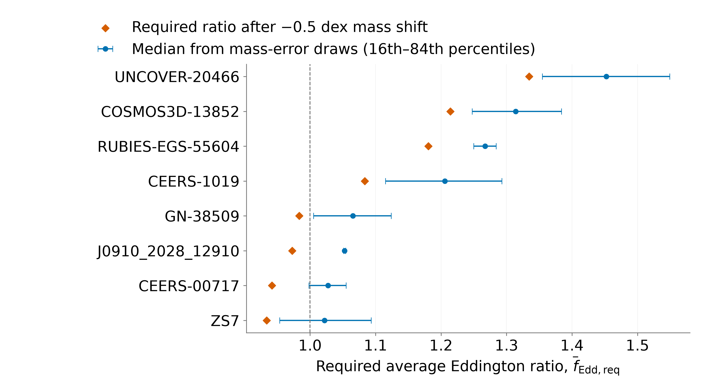
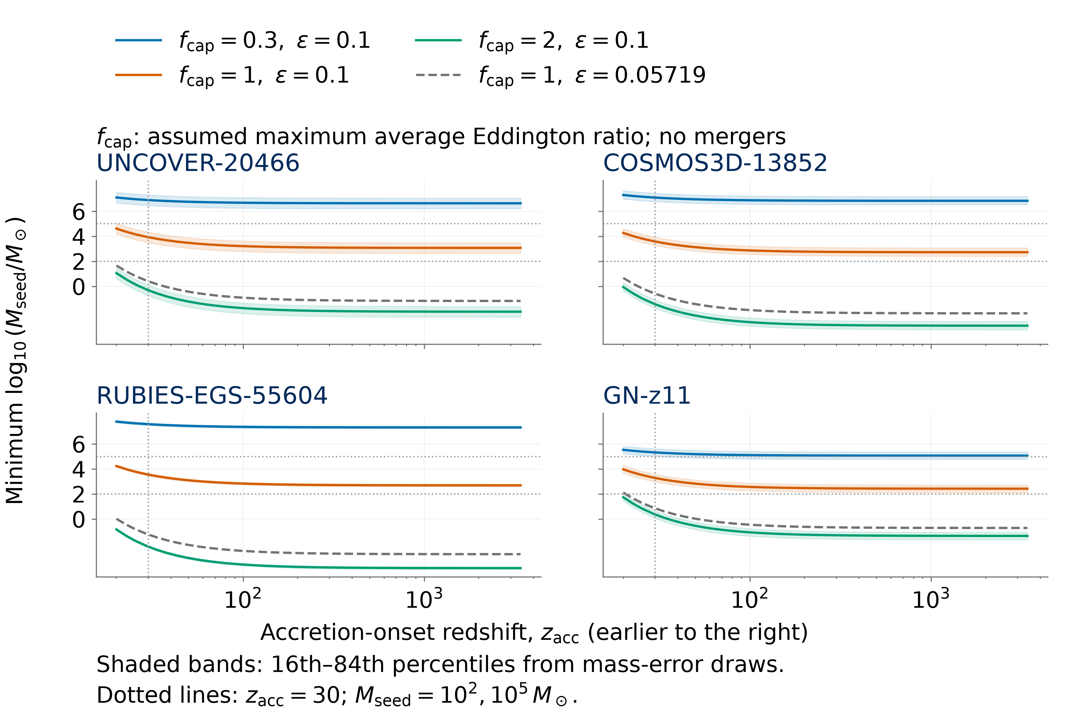
Early Black-Hole Growth
Constraints from JWST
Nicole Jiang; University of Toronto
Introduction
Results
How did early black holes grow so big, so fast? The James Webb Space Telescope (JWST) has revealed massive black holes with little time to grow.^{[2]} I compiled published mass estimates and calculated the average accretion needed to reach each mass under different seed masses (initial masses), start times, and radiative efficiencies.
Reference model: 8/220 primary objects require average Eddington ratios above 1, including 5 in ≥ 95% of mass-error draws.
Mass sensitivity: Lowering masses by 0.5 dex (a factor of 3.2) leaves 3 primary objects requiring averages above 1 in ≥ 95% of draws.
Seed mass: 1,000 M⊙ seeds leave 3/220 above 1. With 100,000 M⊙ seeds, neither sample has objects above 1.
Growth start time: At z = 20, 18/220 primary objects require averages above 1, and GN-z11 requires the highest average in the expanded sample.
Efficiency: At ε = 0.05719 (non-spinning thin disc) ^{[4]}, all 234 central mass estimates require averages below 1 under the other reference assumptions.
Methods
Catalogue creation and sampling
350 measurements from 32 source families at z ≥ 4
338 provisional objects
234 expanded-sample objects
Outside the
growth sample
98 without an
eligible mass
6 with uncertain
identity
220 primary
Broad hydrogen (Balmer) line masses ^{[1]}
14 additional
7 masses with uncertain line origins, assuming gas orbiting the black hole
6 tentative broad-line detections
GN-z11: ultraviolet-line mass ^{[2]}
Symbols: M⊙ denotes solar mass. Higher redshift z means earlier times. ε is the radiated fraction of accreted rest-mass energy.
Eddington ratio: f_{Edd} = luminosity/Eddington luminosity, where radiation force balances gravity. Averages above 1 require super-Eddington episodes.^{[3]}
Earlier-onset test: Starting at matter–radiation equality (z = 3,400) still requires 270–1,200 M⊙ seeds for the 4 plotted objects (ε = 0.1, average ratio ≤ 1, no mergers).
Growth test and uncertainty
Standardized mass, redshift and reported errors;
Checked identity, adopted one mass per object, retained alternatives
Central mass estimate
10,000 mass-error draws
per object with reported errors
Calculated the required lifetime-average
Eddington ratio, including inactive periods ^{[3]}
Reference: 100 M⊙ seeds at z = 30
ε = 0.1, no mergers
Ranked central estimates
Compared required average with 1
Calculated the fraction of
mass-error draws above 1
Earlier starts lower the required seed mass, but the decrease becomes smaller.
Uncertainty: 208 primary / 222 expanded objects. The other 12 enter central-mass tests only. Reported errors may omit calibration scatter.^{[1]}
Independent mass check: A2744-QSO1’s broad-line mass (2.0 × 10⁷ M⊙) requires an average of 0.929 under the reference model. Its dynamical mass (5.0 × 10⁷ M⊙)^{[5]} requires 0.9996. Its required average spans 0.947–1.052 (16th–84th percentiles), including 1.
Earlier onset: Solved minimum seed masses for 4 targets at start redshifts 20–3,400. Included radiation in cosmic ages and assumed gas was available.
Conclusions
References
Seed masses: Most adopted masses allow growth from 100 M⊙ seeds under the reference assumptions.
Accretion physics: Lower radiative efficiency leaves more accreted mass in the black hole, allowing faster growth at the same Eddington ratio.^{[3]}
Earlier growth: Even the earliest tested start leaves 100 M⊙ seeds insufficient for the 4 targets at ε = 0.1 and average ratio ≤ 1. Larger seeds or super-Eddington episodes remain possible.
Further observations: Independent mass measurements could change which objects require averages above 1. Counts from different surveys cannot establish how common these black holes are.
[1] Shen (2013), BASI, 41, 61.
[2] Maiolino et al. (2024), Nature, 627, 59.
[3] Dayal (2024), A&A, 690, A182.
[4] Bardeen et al. (1972), ApJ, 178, 347.
[5] Juodzbalis et al. (2025), arXiv:2508.21748v2.
Catalogue sources and code: QR link above.
Notes:
Poster figure inputs: results/for_manuscript/tables/publication_object_selection.csv; results/for_manuscript/tables/mass_offset_object_sensitivity.csv; results/v3/tables/v3_object_point_ranking.csv; results/v3/tables/v3_object_uncertainty_ranking.csv; results/v4/tables/v4_minimum_seed_mass.csv. Scientific inputs are pinned in data/poster_inputs.json. The uncertainty panel is generated by src.internal.poster_figures. The earlier-onset panel holds the stated average cap and radiative efficiency constant along each track. The external dynamical comparison uses the adopted arXiv v2 measurement; the required ratios and intervals are calculated by this project.
[1] Shen (2013), The Mass of Quasars: https://arxiv.org/abs/1302.2643 — broad-line virial mass methods and calibration scatter.
[2] Maiolino et al. (2024), A small and vigorous black hole in the early Universe: https://doi.org/10.1038/s41586-024-07052-5 — GN-z11 ultraviolet-line mass and early JWST context.
[3] Dayal (2024), Exploring a primordial solution for early black holes detected with JWST: https://doi.org/10.1051/0004-6361/202451481 — exponential accretion growth relation. The project inverts the growth relation; its reference seed and growth-test thresholds are analysis assumptions.
[4] Bardeen, Press & Teukolsky (1972): https://doi.org/10.1086/151796 — ideal thin-disc efficiency for a non-spinning black hole, 1-sqrt(8/9).
[5] Juodzbalis et al. (2025): https://arxiv.org/abs/2508.21748v2 — adopted independent A2744-QSO1 dynamical mass. The poster's average Eddington ratios are project calculations, not measurements quoted from this paper.

