Slide 1
Download and Install
Open Refine :
https://github.com/OpenRefine/OpenRefine/releases/download/3.1/openrefine-mac-3.1.dmg
(You may need to ‘right click’ to open the application.
Download `menus.csv` data from: https://github.com/nniiicc/LIS-530-2019/
(You may need to right click and ‘save data as’ )

Slide 2
Data Curation with Open Refine
LIS 530
02.20.2019

Slide 3
Cleaning data
Data often needs to be normalized, or standardized for analysis, publication and sharing
This is a fundamental part of data curation
Excel is often not good for this
Notes:
Say what normalized is
Talk about how normal it is to get data in Excel – and encourage them to work with excel – and think of this as something you can teach your clients

Slide 4
Open Refine (formerly Google Refine)
Powerful, free & open source tool for manipulating and cleaning data
Looks like a spreadsheet (Excel), acts like a database
Runs in a browser but does not require internet connection
Does NOT require access to Google
http://openrefine.org/

Slide 5
In this demo
We’ll learn:
The basics of Open Refine
Creating a project, basic faceting and normalization
“What’s on the Menu” dataset

Slide 6
I. Open Refine Basics
Creating a New Project
Basic Normalization
Faceting and Clustering
Records vs. Rows
Advanced Transformations
Notes:
-- Note that it runs on desktop but opens in browser.
-- Demonstrate how to create a new project; how to do basic normalization; how to facet and cluster
-- Hands on exercise for 15 minutes (if there are advanced users, start a break-out discussion group)

Slide 7
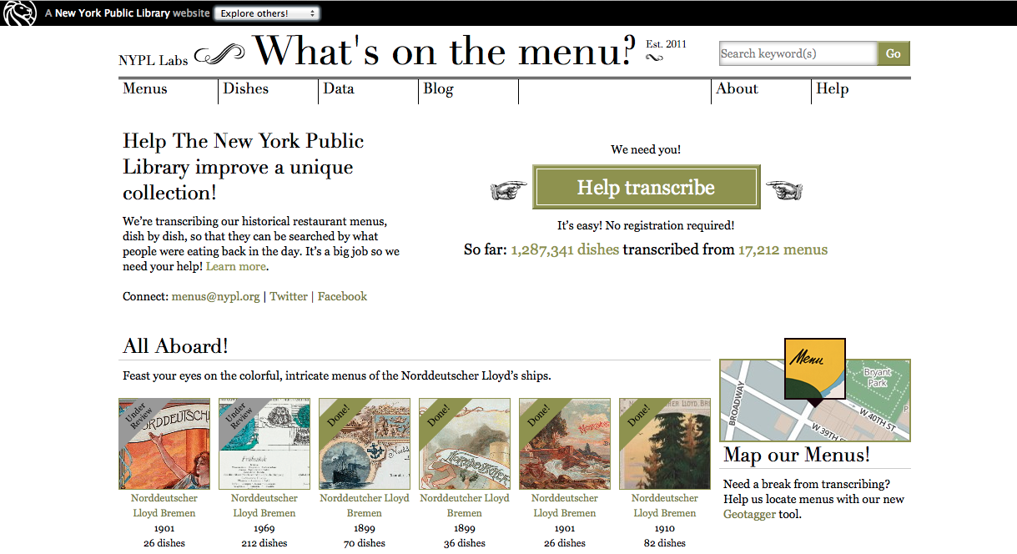
http://menus.nypl.org/
Notes:
-- NYPL has some 45,000 menus from 1840-present
-- Crowdsource project launched in April 2009
-- Creating a database of dishes

Slide 8


Crowdsourced transcription
Volunteer transcription can mean inconsistent data entry.
Even well-transcribed data needs cleaning (synonyms and spelling variants, etc.)
Changes over time:
vs.

Slide 9
Activity – get to know your data
Step 1: NYPL menus data
Open “Menus.csv” in Excel or Notepad and review data
Step 2: Discuss – what’s in this dataset? How hard / easy is it to identify what is inconsistent with this data? What could be standardized?

Slide 10
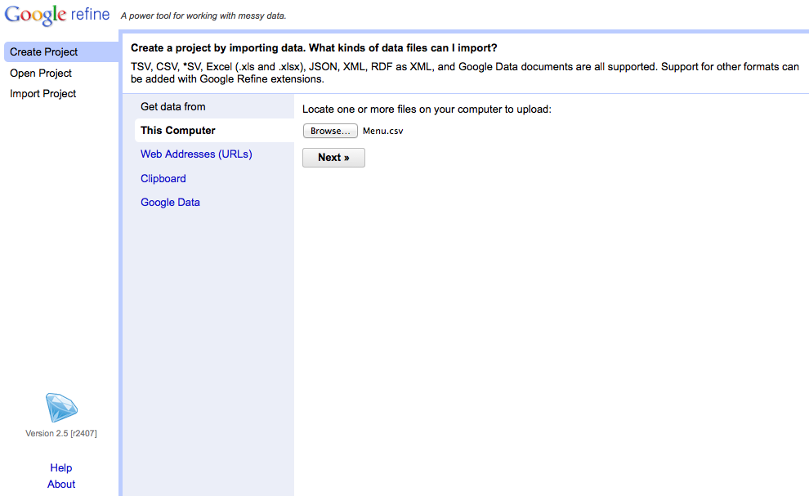
Creating a Project
Notes:
-- Choose create project (notice that you can also open projects you’ve worked on previously or import projects. The import feature is especially useful for collaboration)
-- Upload “Menu.csv”. Caveat: the other files are very large. It’s possible to allocate additional memory to Open Refine when working with large datasets, but not for the purposes of this demo. If this is important to you, we can discuss it during the hands-on session.

Slide 11
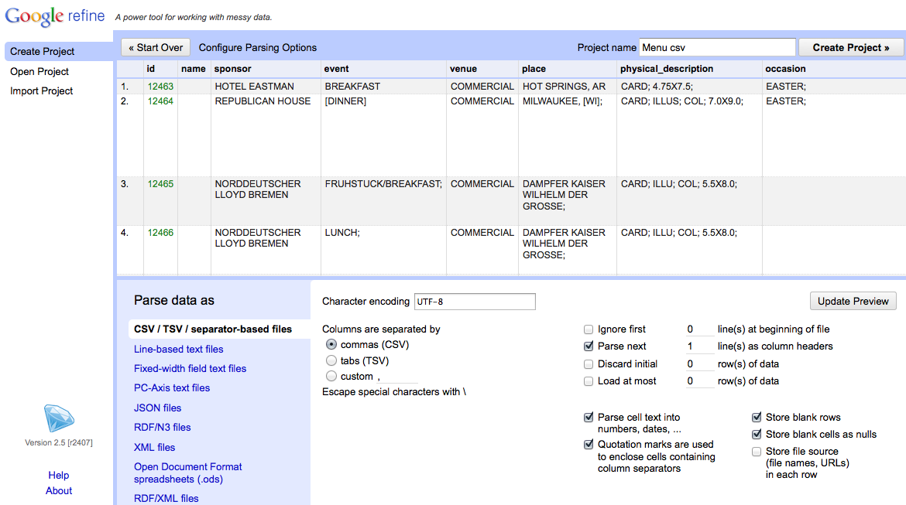
Creating a Project
Notes:
-- Use the preview window to review the data
-- Notice the parse options
-- for this data set, be sure that character encoding is UTF-8, Columns are set as CSV, and first line is parsed as a header
-- note quotation marks option. In this case, we have it checked, but it you use quotations in your data set for other purposes it may cause parsing issues
-- When you selected among options, click “update preview”, review again, and if all looks well, choose a project name and click “create project”

Slide 12
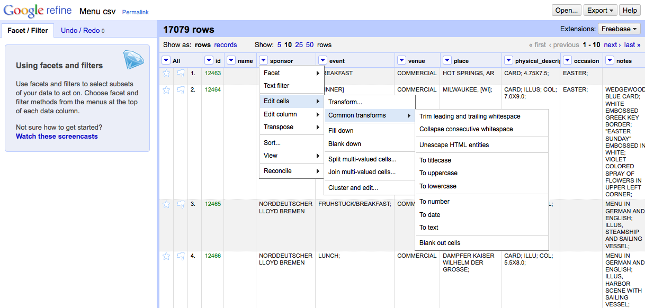
Basic Normalization
Notes:
-- click the arrow to the left of sponsor for a drop-down menu (notice the option your menu options)
-- choose edit cells
-- choose common transforms
-- start by trimming whitespace (you’ll notice that 14 cells were effected)
-- collapsing whitespace effects another 126 cells. Computers are better than humans at detecting white space.
-- also play with uniformly setting the cases

Slide 13
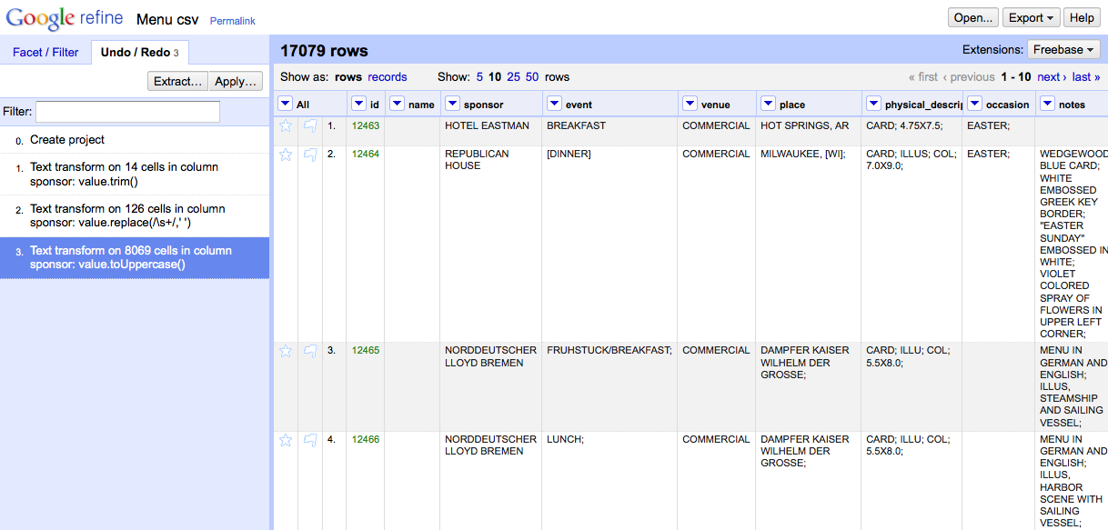
Tracking Project History
Don’t be afraid to make mistakes!
Notes:
Caveat: if you choose to navigate backward in your project history, you won’t be able to access any steps you’d taken after that point once you’ve made another change.

Slide 14
Extract and Apply!
Notes:
Note that you can extract your steps! This can save huge amounts of time for repetitive tasks

Slide 15
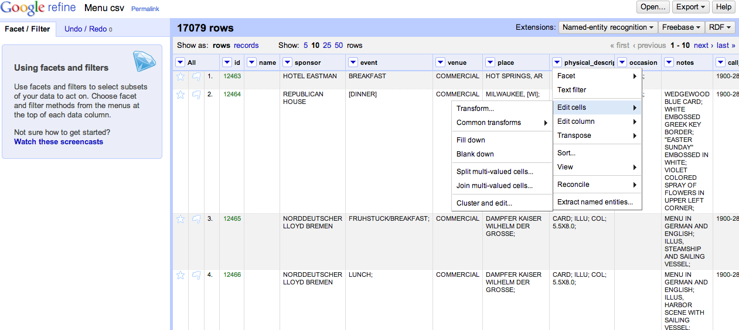
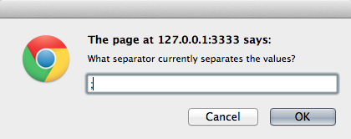
Records vs. Rows
Notes:
-- this likely won’t be needed today, but FYI: review the different between records and rows, beginning by splitting some multi-valued cells

Slide 16
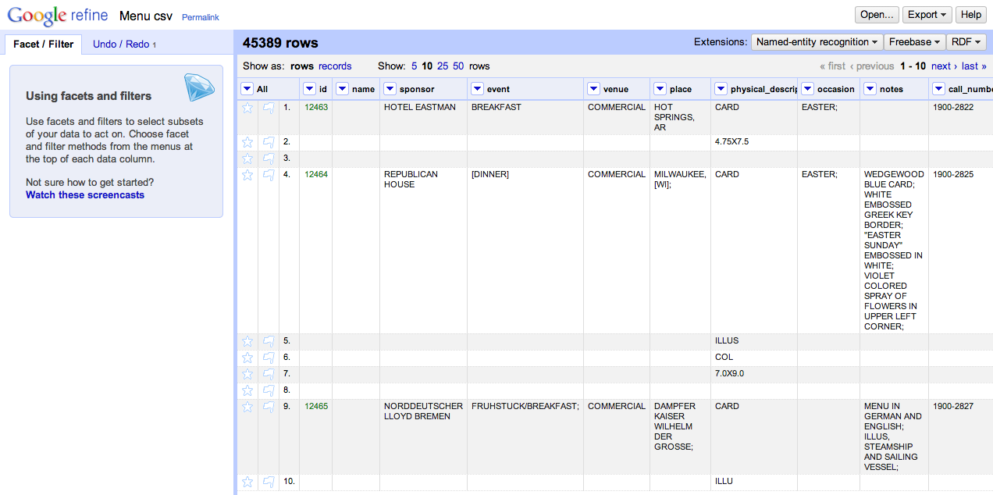
Multiple Values, Multiple Rows
Notes:
This is good if you’re only interested in specific values from the physical description, like whether or not menus are illustrated.
BUT, notice how the rest of rows 5, 6, and 7 are blank

Slide 17
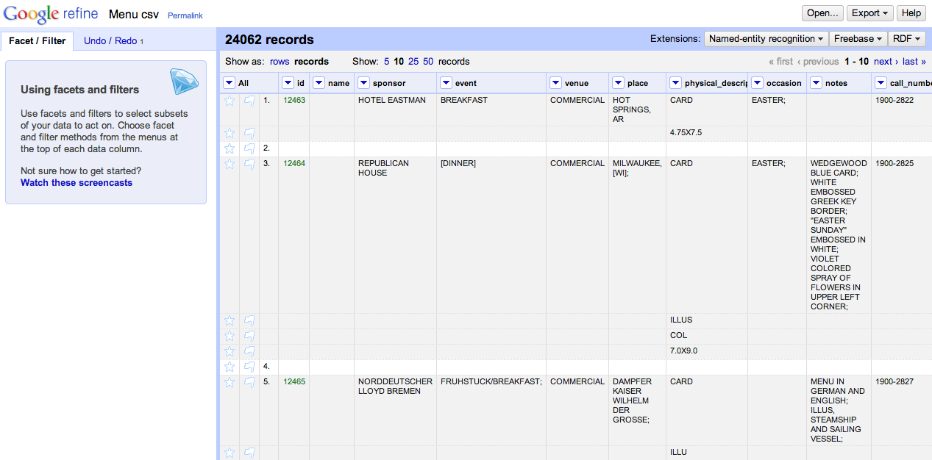
One Record, Multiple Rows
Notes:
Switching to the records view gives you the flexibility of gathering multiple rows together under the same ID.

Slide 18
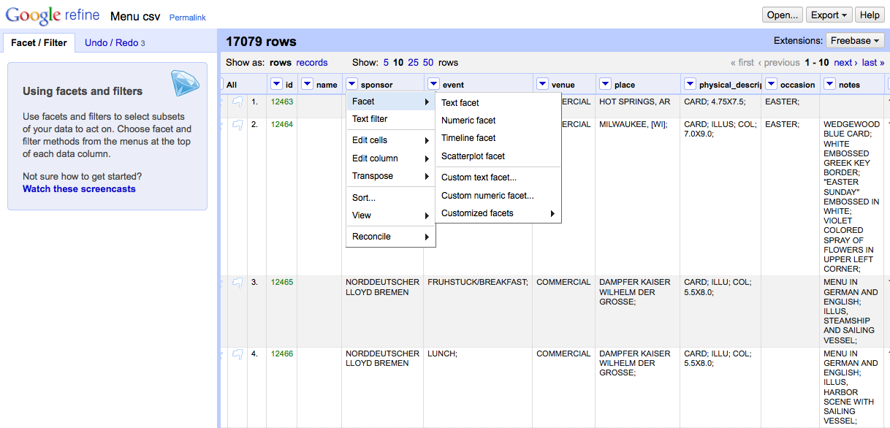
Faceting and Clustering
Notes:
-- Navigation to “Facet → Text facet”

Slide 19
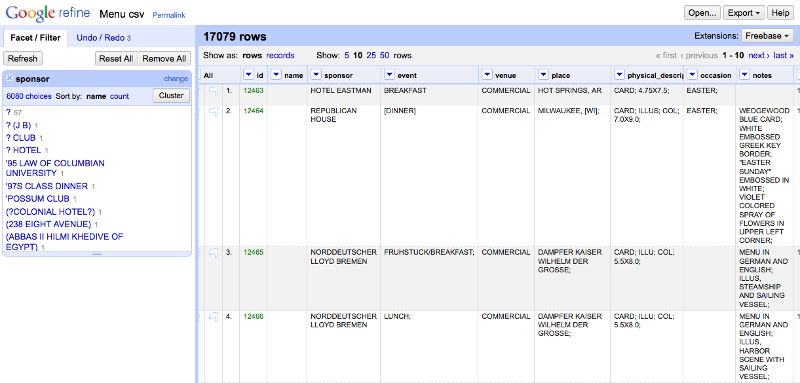
Faceting and Clustering
Notes:
-- Click “Cluster”

Slide 20
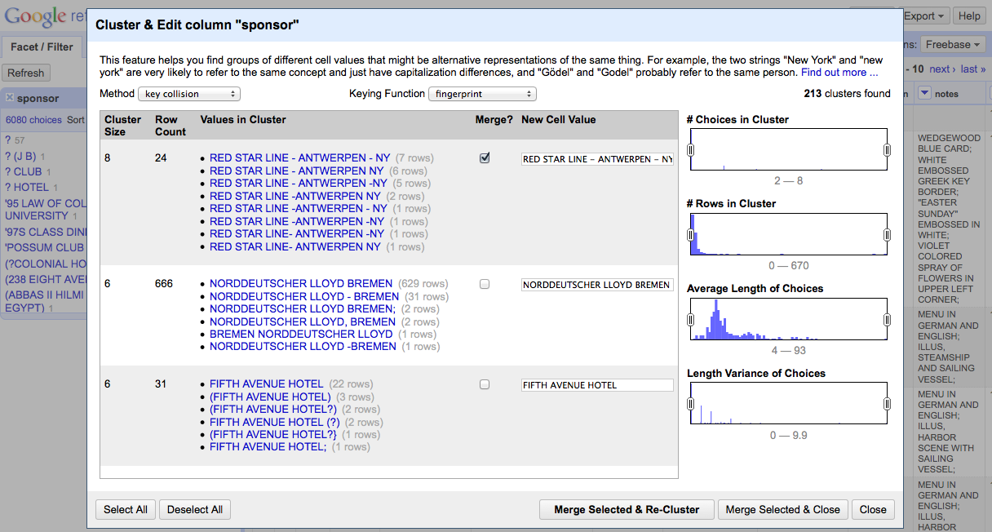
Faceting and Clustering
Notes:
-- For each cluster, review the values in the cluster, and (where needed) determine the preferred cell value.
-- Select the “Merge?” check box
-- Then select “Merge Selected and Re-Cluster”

Slide 21
Kinds of clustering
Key collision (fastest, safest)
Fingerprint, Ngram Fingerprint = defaults
Match normalized strings in different ways
Metaphone = English pronunciation
Nearest Neighbor
PPM = Partial matching
Levenshtein = edit distance

Slide 22
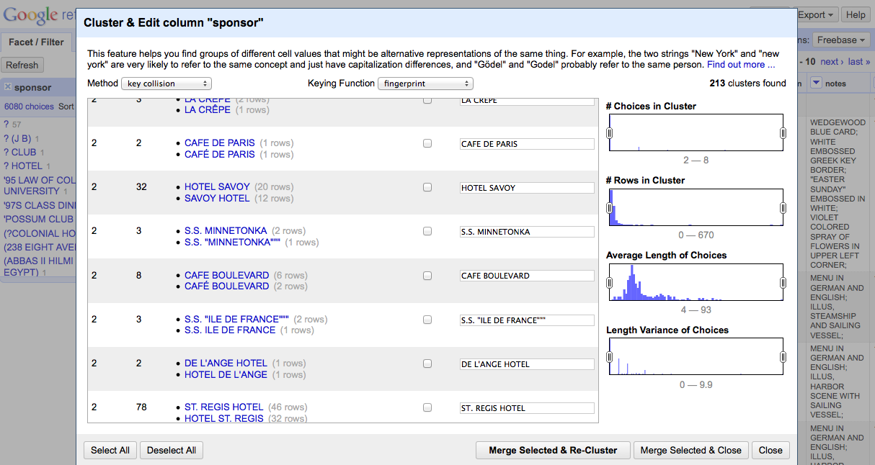
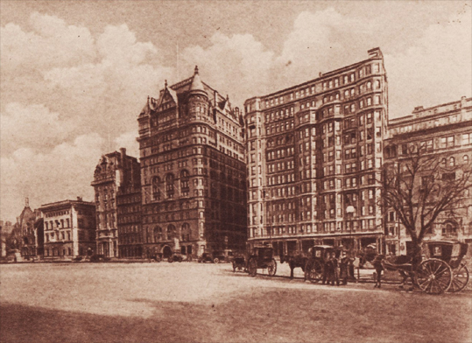
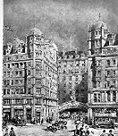
Check your clusters!
Hotel Savoy
59th St. & 5th Ave.
New York, New York
Savoy Hotel
Strand
London WC2R 0EU
United Kingdom
Notes:
Just because their names are similar doesn’t mean they’re the same!
-- Today the Hotel Savoy is an Apple Store. The Savoy Hotel is still in operation.

Slide 23
Walkthrough: Explore Open Refine
Using the NYPL dataset, try clustering and cleaning other columns
What transformations need to be made?
What clustering methods work best?
Try extracting your operations

