Slide 1
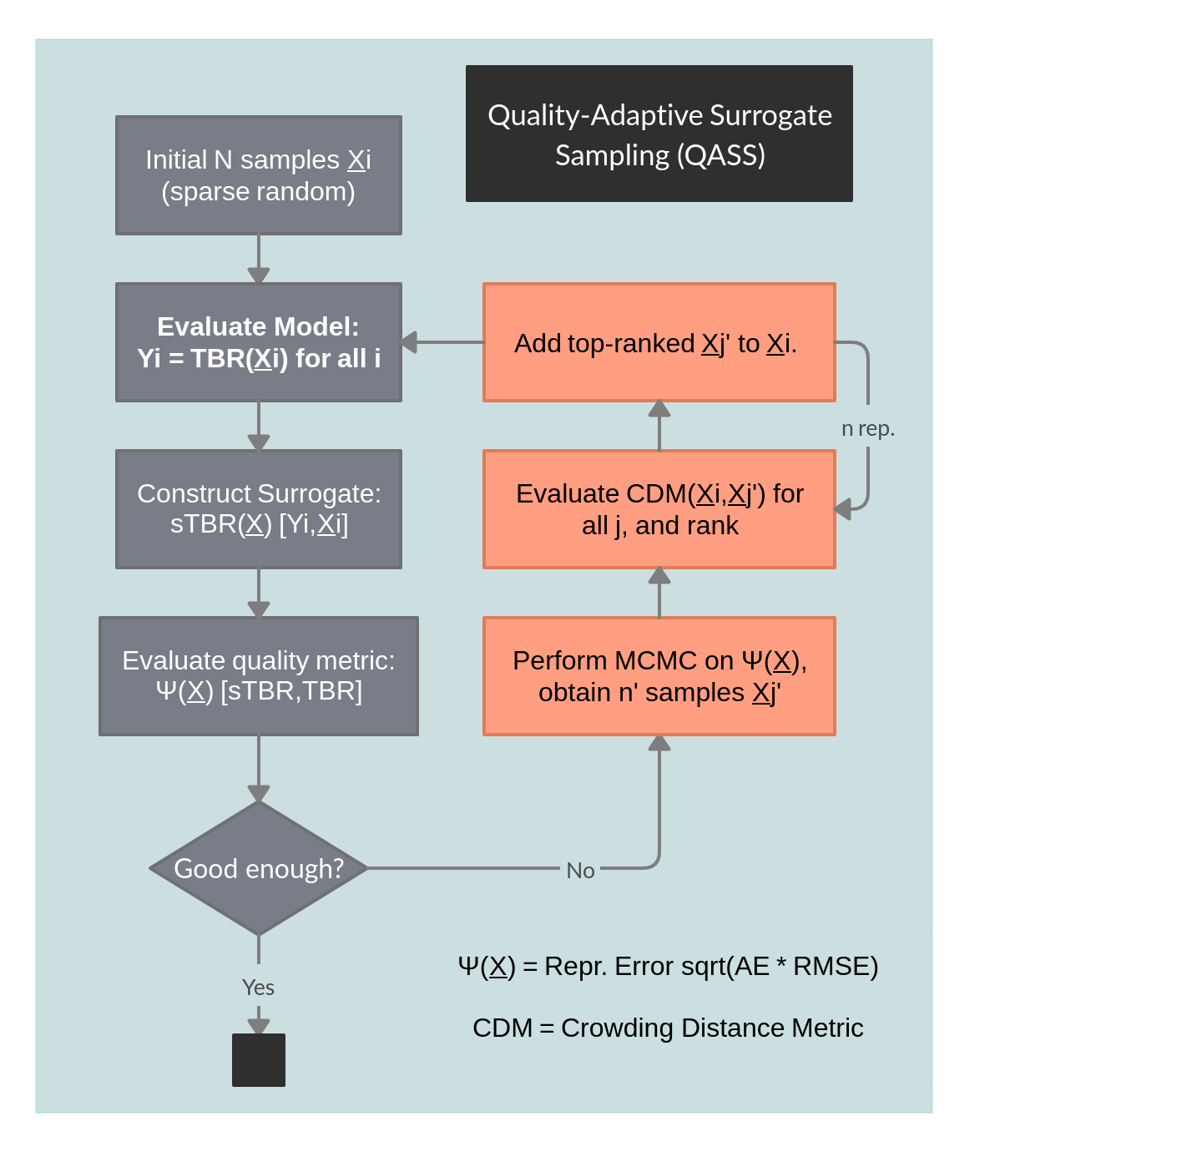
Adaptive Sampling: Methodology
Number of samples needed to train a surrogate can be lowered by choosing smarter samples.
Samples are selected incrementally during training, rather than upfront.
Adaptive sampling techniques in the literature use mostly deterministic error and crowding metrics to identify new sample points.
Markov-Chain Monte Carlo (MCMC) statistical methods use random walks to generate representative samples of probability distributions.
Quality-Adaptive Surrogate Sampling (QASS): a novel algorithm which takes advantage of MCMC stochasticity to optimise sample selection.
A surrogate quality distribution is constructed by nearest-neighbour interpolation.2
Sampling is then prioritised in regions where surrogate error is the greatest.

Slide 2
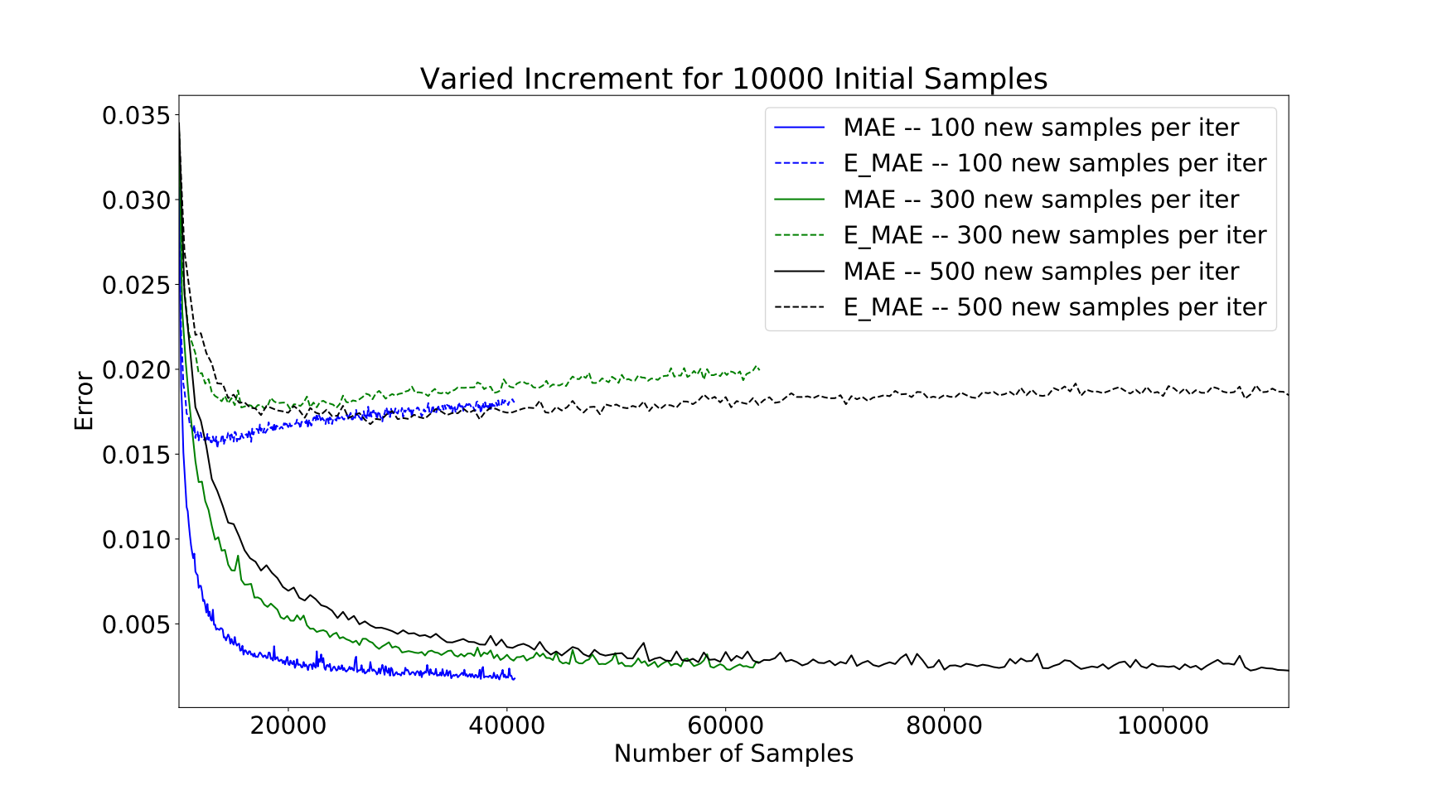
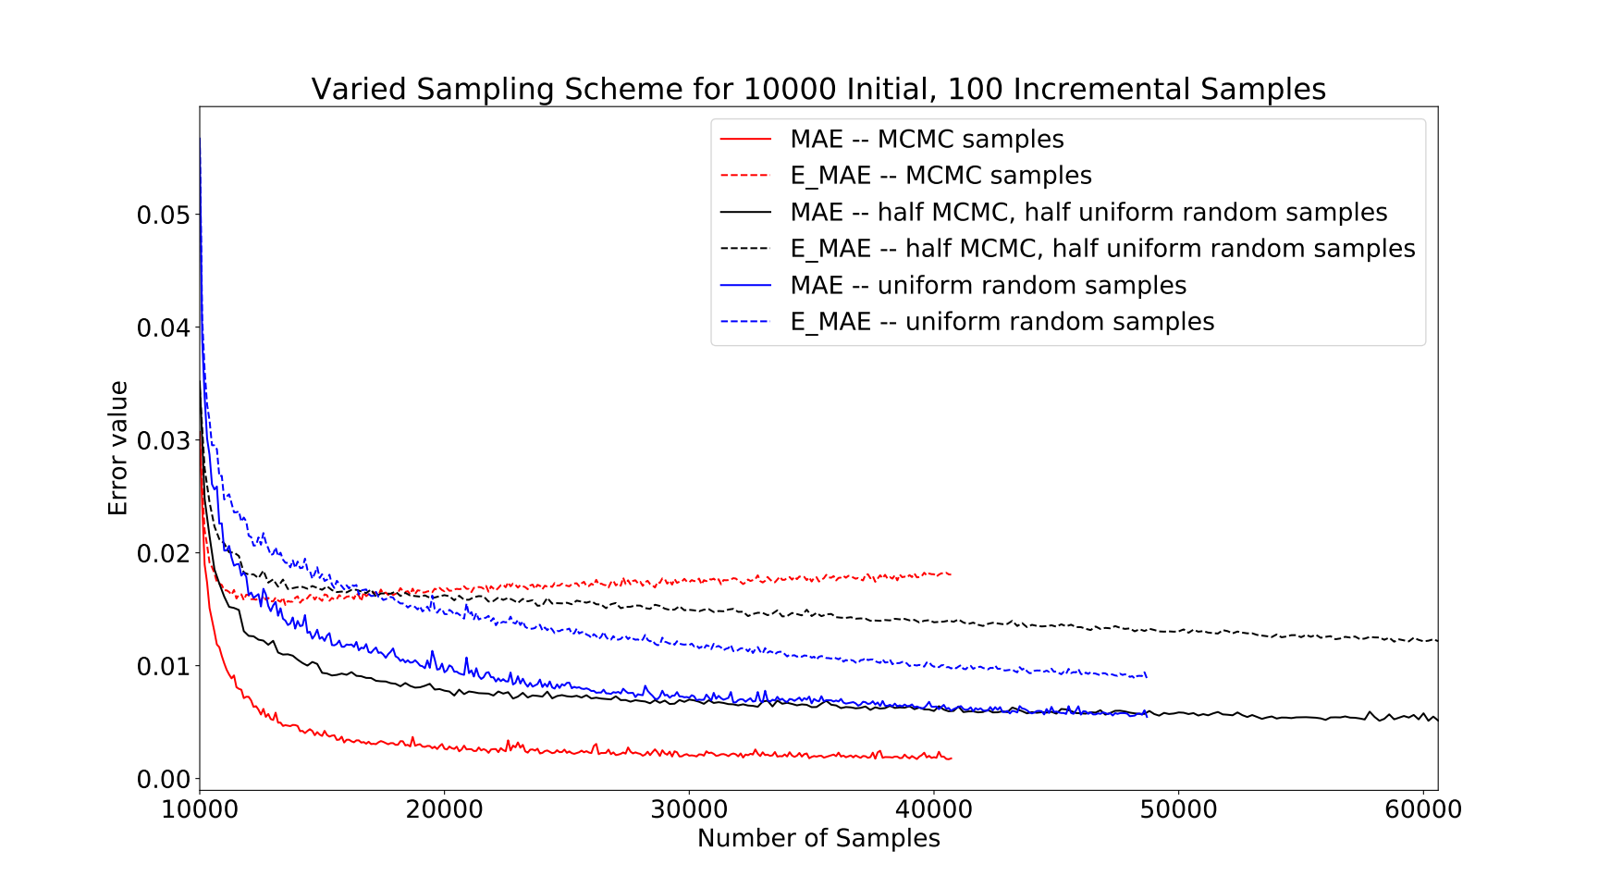
Adaptive Sampling: Results
Basic functionality demonstrated on a sinusoidal toy model for the Paramak TBR parameter space.
Performance varied only weakly with MCMC depth on each iteration, avoiding a potential bottleneck.
QASS was compared with a baseline scheme of uniformly-random incremental sampling.
QASS achieved better precision on its own validation set, but lost out on a uniformly-random baseline set.
A 50/50 mixed scheme of adaptive and uniform incremental samples captured the best of both worlds.
Interpretation: QASS improves surrogate quality in hard-to-reach places at the cost of broad overall precision.
Baseline validation set
Adaptive validation set

