Slide 1

Cloud Native Apps
- Nilabh Nikunj
Sr. Member Tech Staff at Vmware Cloud Services BU(R&D)

Slide 2

Agenda
What is Cloud native APP
Does cloud native app works only in public cloud eco system
Brief glimpse of 12 factor app
scratching the containers
Containers with Docker (Hello world App)
Disadvantages
Questions

Slide 3
Cloud Native App
Modern apps which are designed for scalability in mind.
Packaged as lightweight containers
Designed as loosely coupled microservices
Centered around APIs for interaction and collaboration
Architected with a clean separation of stateless and stateful services
Isolated from server and operating system dependencies
Deployed on self-service, elastic, cloud infrastructure
Managed through agile DevOps processes(CI/CD)
Defined, policy-driven resource allocation

Slide 4
Does cloud native app works only in public cloud eco system
NO
Can Run Any Where
Generally such apps require elastic resources

Slide 5
Brief glimpse of 12 factor app
1.Code base 9. Disposability
2.Dependencies 10. Development/Production Parity
3.Config 11. Logs
4.Backing services 12. Admin Processes
5.Build, release, run
6.Processes
7. Port binding
8. Concurrency

Slide 6
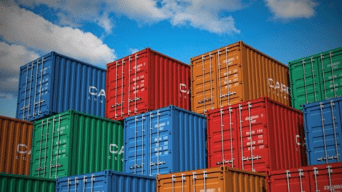
Scratching the containers
They are not VMs
They are used for Shipping apps
Takes care of N/W
Uses same kernel
Docker is not the only technology (Mesos/podman/rocket)
Its never VM vs Contianer its always VM and Container(Google example)
1 Container 1 Process

Slide 7
Containers with Docker
docker run -it centos:latest
https://github.com/nnikunj/fdp
docker rm fdp-app -f
docker run --restart=always --name fdp-app -p 6443:8181 -d -v /opt/fdp/logs/:/opt/fdp/logs/ fdp-app:1.0.0

Slide 8

Disadvantages
Complex Service to service communications
Debugging such system is complex
Difficult to manage large number of services
The developer needs to solve the problem, such as network latency and load balancing.

Slide 9

Questions?

