Slide 1
Unit-2

Slide 2
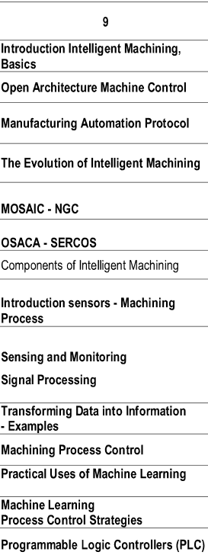
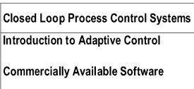
Topics in unit-2

Slide 3
Introduction to Intelligent Machining
Intelligent machining is a branch of manufacturing that uses sensors, data acquisition systems, and artificial intelligence (AI) to optimize and automate machining processes. It aims to improve the efficiency, quality, and safety of machining operations.

Slide 4
Introduction to Intelligent Machining
Intelligent machining is a rapidly evolving field that is transforming the manufacturing industry.
It is the integration of advanced technologies, such as sensors, data acquisition systems, and artificial intelligence (AI), into traditional machining processes.
This allows machines to monitor themselves, make decisions, and adapt to changing conditions in real-time, resulting in:
Increased productivity: By optimizing process parameters and identifying potential problems early on, intelligent machining can significantly reduce production time and waste.
Improved quality: Intelligent machines can monitor the quality of the parts they are producing and make adjustments to ensure that they meet specifications.
Reduced costs: By reducing waste and downtime, intelligent machining can lead to significant cost savings.
Enhanced safety: Intelligent machines can detect and prevent potential safety hazards, making the workplace safer for workers.

Slide 5
key components of an intelligent machining system
Sensors: Sensors collect data about the machining process, such as cutting forces, vibrations, and temperature.
Data acquisition system: The data acquisition system collects and stores the data from the sensors.
Control system: The control system uses the data from the sensors to make decisions about the machining process, such as adjusting the feed rate or spindle speed.
AI: AI can be used to analyze the data from the sensors and make more complex decisions about the machining process.

Slide 6
Open Architecture Machine Control
Open Architecture Machine Control: An Enabler for Intelligent Machining
Open architecture machine control refers to a design philosophy where the underlying control platform and communication protocols are standardized and accessible. This approach contrasts with traditional proprietary systems, where specific hardware and software are tightly coupled, limiting flexibility and customization.
Open architecture brings several key benefits to intelligent machining:
1. Interoperability and Flexibility: Open standards allow different components (sensors, actuators, controllers) from various vendors to seamlessly integrate and communicate. This promotes flexibility in system design and enables easier upgrades or expansion with new technologies.
2. Innovation and Customization: Openness fosters a vibrant ecosystem of developers and manufacturers, which fuels innovation and development of specialized components and functionalities tailored to specific needs. Users are no longer locked into single-vendor solutions and can customize their systems based on their unique requirements.

Slide 7
Open Architecture Machine Control
3. Cost-Effectiveness: Open source platforms and readily available components can often be more cost-effective than proprietary systems. Additionally, competition among vendors drives down prices and incentivizes continuous improvement.
4. Reduced Vendor Lock-in: Open architectures prevent dependence on a single vendor, reducing the risk of being locked into specific hardware or software and empowering users to switch providers more easily.
5. Enhanced Security: Open standards and widely used platforms enable better security practices and facilitate the implementation of robust security measures.

Slide 8
Open Architecture Machine Control
Implementation and Examples:
Open architecture principles are increasingly implemented in various machine control systems, including:
CNC machines: Standardized protocols like MTConnect allow for easier data exchange and integration with other systems, facilitating data-driven decision making and process optimization.
Industrial robots: Open Robotic Operating System (ROS) promotes robot interoperability and enables the reuse of code and components across different robot platforms.
Smart factories: The Industrial Internet of Things (IIoT) relies on open communication protocols for seamless data exchange between machines, sensors, and software platforms, enabling intelligent operations and automation.

Slide 9
Open Architecture Machine Control
Challenges and Considerations:
Standardization and Compatibility: Ensuring compatibility between different components and vendors requires constant collaboration and development within the open architecture community.
Security and Reliability: Openness can also create potential security vulnerabilities, requiring robust security protocols and practices.
Complexity and Expertise: Designing and operating open architecture systems might require more technical expertise compared to traditional closed systems.
Overall, open architecture machine control plays a crucial role in enabling the development and implementation of intelligent machining systems. Its benefits in terms of flexibility, innovation, and cost-effectiveness make it a key driver for the future of the manufacturing industry.

Slide 10
Manufacturing Automation Protocol
The Manufacturing Automation Protocol (MAP) was a groundbreaking computer network standard launched in 1982 for connecting devices from various manufacturers within a manufacturing environment.
Its primary aim was to combat the proliferation of incompatible proprietary communication protocols used by diverse automation equipment vendors.
Purpose and Development:
Developed by General Motors to address the challenge of integrating automation equipment from different vendors in their factories.
Aimed to establish a common standard for communication, simplifying integration and facilitating data exchange between various devices.
Technical Details:
Employed a token-bus network topology, ensuring reliable and orderly data transmission.
Defined a layered architecture based on the Open Systems Interconnection (OSI) model, providing structured communication.
Comprised multiple layers, including physical, data link, network, transport, session, presentation, and application layers, each with specific functionalities.

Slide 11
Manufacturing Automation Protocol
Benefits and Achievements:
Promoted interoperability between devices from different vendors, enabling seamless communication and data exchange.
Facilitated the development of complex manufacturing systems with integrated functionalities.
Gained significant traction in the 1980s, with major manufacturers like Boeing and others adopting it.
Demonstrated the feasibility of open communication standards in industrial automation.
Legacy and Significance:
Although not widely adopted in its original form, MAP paved the way for future industrial communication standards like Ethernet/IP and PROFINET.
Its layered architecture and focus on open communication principles served as a foundation for subsequent developments in industrial networking.
The lessons learned from MAP's development and challenges continue to inform the design and implementation of modern industrial communication protocols.

Slide 12
Evolution of intelligent machining
Early Stage (Pre-1950s):
Manual machining: Skilled craftspeople relied on hand tools and jigs for manufacturing parts.
Limited automation: Early forms of automation, like water-powered mills and steam engines, assisted in powering rudimentary machinery.
Foundational Stage (1950s-1970s):
Numerical Control (NC): The introduction of NC machines in the 1950s allowed for programmed control of machining processes using punched tapes.
Computer Numerical Control (CNC): In the 1960s, CNC machines replaced punched tapes with computers, enabling more complex and precise machining operations.
Early sensors and feedback systems: Sensor integration started emerging, providing basic feedback on things like spindle RPM and feed rate.

Slide 13
Evolution of intelligent machining
Development Stage (1980s-2000s):
Programmable Logic Controllers (PLCs): Replacing complex relay logic, PLCs provided more flexible and programmable control systems for CNC machines.
Industrial Automation Protocol (MAP): This pioneering open communication standard aimed to connect devices from different vendors, promoting data exchange and integration.
Advanced sensors and diagnostics: More sophisticated sensors were developed, monitoring factors like tool wear, vibration, and cutting forces.
Early Artificial Intelligence (AI) applications: Limited AI systems were introduced for simple tasks like tool wear detection and process optimization.

Slide 14
Evolution of Intelligent Machining
Modern Stage (2010s-Present):
Internet of Things (IoT) and Industrial Internet of Things (IIoT): Networked sensors and devices collect and share vast amounts of data in real-time, enabling comprehensive process monitoring and analysis.
Big Data and Analytics: Advanced data analytics tools process and interpret sensor data, providing insights for process optimization, predictive maintenance, and anomaly detection.
Machine Learning (ML) and Deep Learning (DL): AI algorithms learn from data to make intelligent decisions in real-time, optimizing parameters, adapting to changing conditions, and even predicting potential failures.
Open Architecture Machine Control: Standardized communication protocols and modular systems empower flexible and customizable intelligent machining setups.

Slide 15
Evolution of Intelligent Machining
Future Trends:
Edge computing: Processing data closer to its source (on machines themselves) allows for faster decision-making and reduced reliance on centralized systems.
Digital twins: Virtual representations of physical machines and processes enable simulation, optimization, and testing in a digital environment.
Human-machine collaboration: Collaborative robots and augmented reality interfaces assist human operators, leveraging their expertise while optimizing workflow and safety.
Overall, the evolution of intelligent machining reflects a continuous push towards greater automation, efficiency, and adaptability. With the ongoing integration of advanced technologies like AI, IoT, and advanced analytics, the future of manufacturing promises even more intelligent and dynamic machining systems.

Slide 16
MOSAIC - NGC
MOSAIC stands for Machine Open Systems Architecture for Intelligent Control.
It was originally developed during 1989 to facilitate research related to expert planning systems and quality related sensor data.
The MOSAIC architecture was based on a memory mapped backplane architecture (VMEbus) with specialized hardware for axis control, machine input / output, and a general purpose processor running a real time POSIX compliant operating system.
Access to the controller functions was provided by a library of C language routines. These routines formed part of a larger ’machine’ operating system that, being POSIX compliant, was able to freely exchange information with workstation based software for expert system based process planning and part probing.

Slide 17
MOSAIC - NGC
NGC stands for Next Generation Machine/Workstation Controller.
The NGC program was initiated by the U.S. government to restructure and revitalize the US machine tool industry through the enabling of technologies in the areas of computer hardware and software, and process controls.
Extensive consultation with industry experts resulted in a specification of 175 requirements for the NGC. These requirements addressed a wide range of issues including hardware and software architectures, networking capabilities, and provisions for task planning, process control, fault management. and sensor interfaces.

Slide 18
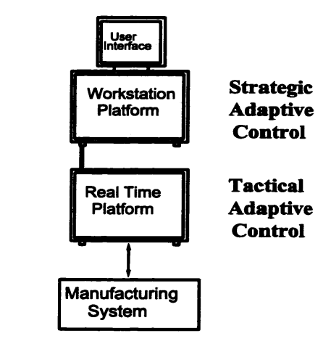
NGC Architecture

Slide 19
NGC Architecture – Contd.
The proposed controller system consisted of separate Workstation and real time computing facilities.
As a modular architecture, the NGC was intended to provide well defined interfaces and guidelines to direct scalability and third party product development. While hardware interfaces were to be chosen from existing standards, software interfaces were to be built around a syntax referred to as the Neutral Manufacturing Language (NML).
The purpose of NML, being similar to the MAP VMD concept, was to provide a standardized software interface to the services of the virtual machine through which end users could expand and enhance the software base of their systems.

Slide 20
NGC Architecture – Contd.
Regarding process control, the NGC requirements specified provision for Tactical adaptive control (real time), and Strategic adaptive control (non real time). The tactical control element was aimed at providing on line compensation for volumetric and surface finish errors, to monitor for tool breakage and chatter, and to allow for the implementation of optimization strategies. Technologies such as neural networks, multi- variate statistical process control, adaptive control. and sensor fusion were identified.
The strategic control element was aimed at providing the future strategic approach to the manufacturing process through longer term analysis of the processed results of sensor data. Technologies such as rule based and knowledge based decision making systems, and process modeling and planning systems were identified.

Slide 21
OSACA
OSACA stands for Open Systems Architecture for Controls within Automation systems.
The European manufacturing community has embarked on research initiatives geared towards the definition and development of OAC systems. This research has involved a detailed open system definition of the entire manufacturing process using a seven layer, hierarchical model adopted from the OSI-ISO communications standard.

Slide 22
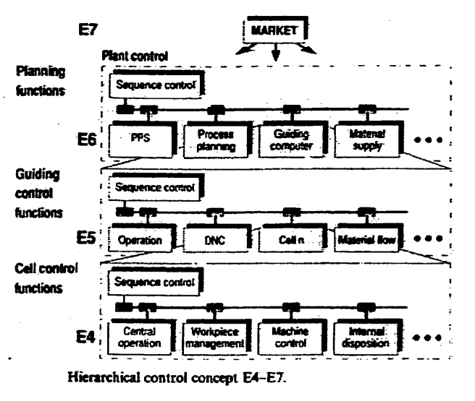
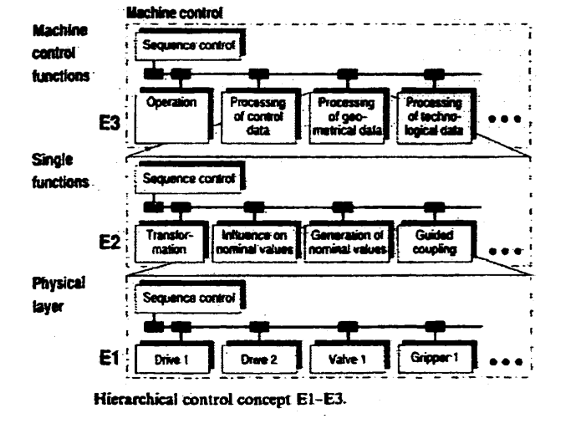
OSACA Architecture
Layer E4, the Cell Function Layer, corresponds to the machine to machine communication layer occupied by communications standards such as MAP. Layers E3 to E1 represent the functionality concerned with machine control.

Slide 23
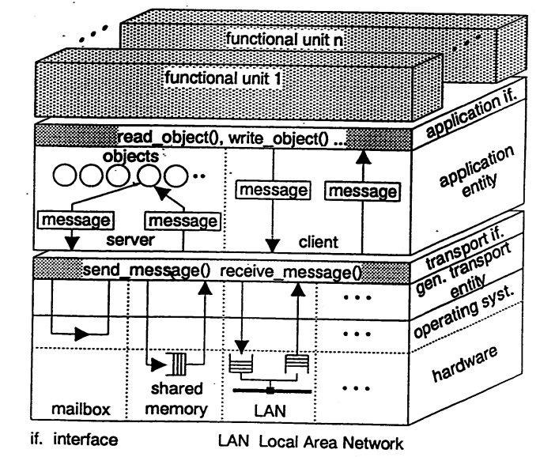
OSACA Architecture – Cube Model
The Cube Model involves the provision of standardized ordering of functionality, similar to the OSI communications standard, at the machine controls level.

Slide 24
SERCOS
SERCOS stands for Serial Realtime Communication System.
The SERCOS (Serial real-time communication system) interface is a globally standardized open digital interface for the communication between industrial controls, motion devices (drives) and input output devices (I/O).
This standardization effort outlined the protocols and physical specifications of a communication network for interconnection of servo drive sub systems and other processor components.
The physical layer of the SERCOS system is a 2 Mbits/sec fibre optic link. A ring topology transfers data packets with a 32 bit data field and an 8 bit addressing field, for a total allowable number of 255 “slave” drive units. Each slave may service one or more actual drive units. A master computer on the ring is intended to perform interpolation and other CNC duties such as user program processing. The original standard, at 2 Mbits/sec, allows for 8 slaves to be updated at a rate of 500 Hz.

