Slide 1




International conference on Artificial Intelligence and Data Engineering – AIDE 2026
5th - 7th February 2026
Paper ID: 589
Paper Title: EASEL:- Effective Actionable Surveillance with Enhanced Layered User Interfaces for Secure Remote Drone Identifciation using LoRa Communication
Author Names: Dr K N Rajanikanth, N Nishchit, Meghana Sathish, Shourya K S
Presenter: N Nishchit
Affiliation: Dept. of Electronics and Communication Engineering, BMS College of Engineering, Bengaluru, India

Slide 2
International conference on Artificial Intelligence and Data Engineering – AIDE 2026
5th - 7th February 2026
Agenda
01: Introduction and Problem Statement
05: GUI and Work Load Assessment
02: Prior Work / Literature
06: Results of Performance Metrics and User Interface Evaluation
03: Proposed Work (System Overview)
07: Comparative Summary
04: Methodology (Flowchart)
08: Conclusion
09: References

Slide 3
International conference on Artificial Intelligence and Data Engineering – AIDE 2026
5th - 7th February 2026
Rapid proliferation of civilian and tactical drones requires robust monitoring.
Current "Remote ID" standards (WiFi/BLE) lack range for rural/border surveillance.
Operator cognitive overload is a critical failure point in multi-drone tracking.`
Introduction
Range Limitation: Standard Remote ID is effective only <300m (Line of Sight).
Lack of Actionable Visualization: Raw telemetry data overwhelms operators; existing tools lack "friend-or-foe" context.
Security Vulnerability: Unencrypted broadcasts allow spoofing and unauthorized tracking
Problem Statement

Slide 4
International conference on Artificial Intelligence and Data Engineering – AIDE 2026
5th - 7th February 2026
Prior Work / Literature
Chen et al. [25]: "Human-in-the-loop UAV Ground Control Systems" – Highlights the need for reducing operator workload in GCS design.
Endsley [19]: "Designing for Situation Awareness" – Establishes the 3-level model (Perception, Comprehension, Projection) used in our UI.
Parasuraman & Riley [24]: Discusses "Humans and Automation," warning against over-reliance on automated filtering without human oversight.
FAA Part 89 [1]: Mandates digital license plates but fails to define visualization standards for the receiver side.

Slide 5
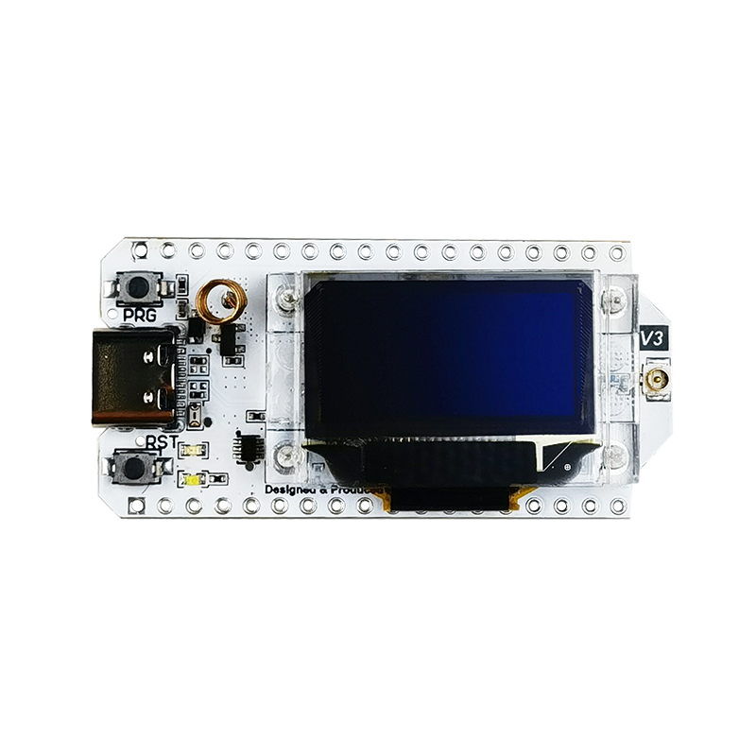
International conference on Artificial Intelligence and Data Engineering – AIDE 2026
5th - 7th February 2026
Proposed Work: EASEL Overview
EASEL Framework: A layered UAV identification framework integrating long-range LoRa telemetry with a human-centered interface.
Key Innovation: Combines secure, encrypted transmission (AES-128) with a real-time, map-driven dashboard.
Architecture Layers:
UAV Transmitter: ESP32 + SX1278 LoRa (868 MHz).
Ground Receiver: Arduino Uno + SX1278.
Backend: Python-based processing for decryption and geofencing.
Interface: Browser-based Leaflet.js dashboard.

Slide 6
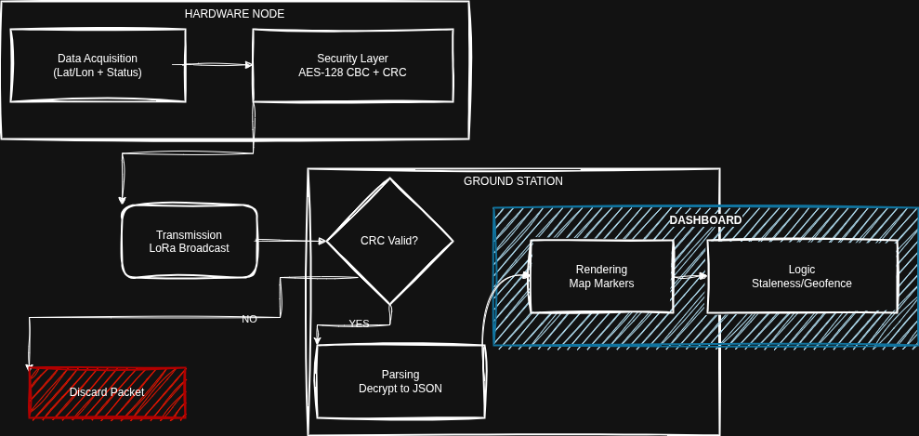
International conference on Artificial Intelligence and Data Engineering – AIDE 2026
5th - 7th February 2026
Methodology - Flowchart

Slide 7
International conference on Artificial Intelligence and Data Engineering – AIDE 2026
5th - 7th February 2026
GUI & Workload Assessment
Design Philosophy: Focus on Situational Awareness (SA) using Endsley’s three-level model (Perception, Comprehension, Projection).
Cognitive Load Management: Designed using principles from NASA-TLX and Bedford Workload Scale.
Problem: High mental workload leads to missed detections.
Solution: Replaced raw text data with Pre-attentive Visual Cues:
Color Coding: Red (Hostile), Green (Friendly), Amber (Stale Data).
Geofence Pulsing: Visual alarm triggers before cognitive recognition is required.
Impact: Reduces "Search" time and lowers operator fatigue score.

Slide 8
International conference on Artificial Intelligence and Data Engineering – AIDE 2026
5th - 7th February 2026
Results: Performance Metrics
Parameter | Measured Value | Conditions
Max Range Possible | 5.2 km | Rural Line-of-Sight (LoS)
Packet Success Rate | > 92% | Distances < 4km
End-to-End Latency | 0.82 s | Average (processing + flight time)
Frame Rate (GUI) | 55 FPS | 50 Simultaneous Drones
Re-acquisition Time | < 2 s | After temporary signal loss

Slide 9
International conference on Artificial Intelligence and Data Engineering – AIDE 2026
5th - 7th February 2026
Results - User Interface Evaluation
Usability Testing: Evaluated against standard text-based logs.
Reaction Time: Operators identified "Hostile" intrusions 40% faster using the EASEL map interface compared to raw lists.
Error Rate: Misinterpretation of drone heading reduced by 60% due to vector arrows.

Slide 10
International conference on Artificial Intelligence and Data Engineering – AIDE 2026
5th - 7th February 2026
Comparative Summary
Feature | Standard Remote ID (WiFi/BLE) | EASEL (Proposed)
Range | < 0.5 km | > 5.0 km
Security | None / Open Broadcast | AES-128 Encrypted
Operator View | Raw List / Basic App | Tactical Map (SA Optimized)
Infrastructure | Requires Density | Point-to-Point (No Internet)

Slide 11

International conference on Artificial Intelligence and Data Engineering – AIDE 2026
5th - 7th February 2026
Conclusion
EASEL successfully extends Remote ID ranges to proposed distances (>5km). (field tests are in the works)
The system bridges the gap between Hardware Telemetry and Human Cognition by applying workload assessment theories (NASA-TLX).
Future scope includes integrating ADSB-In for mixed-airspace safety.

Slide 12
International conference on Artificial Intelligence and Data Engineering – AIDE 2026
5th - 7th February 2026
References
Y. Chen, J. Li, and H. Wang, "Human-in-the-loop UAV Ground Control Systems: A Review," IEEE Access, vol. 10, pp. 99584-99601, 2022.
R. Parasuraman and V. Riley, "Humans and automation: Use, misuse, disuse, abuse," Human Factors, vol. 39, no. 2, pp. 230-253, 1997.
M. R. Endsley, "Designing for Situation Awareness: An Approach to User-Centered Design," CRC Press, 2016.
S. G. Hart and L. E. Staveland, "Development of NASA-TLX: Results of Empirical and Theoretical Research," Advances in Psychology, vol. 52, pp. 139-183, 1988.
Mosaic ATM, "Remote ID Demonstration and Validation Report," FAA UTM Project Report, 2021.

