Slide 1

Soundcloud music player
Group 9: Nguyen Nhu Khoa Lecturer: Dr.Tran Giang Son
Nguyen Thanh Son
Nguyen Van Quang

Slide 2
Outline
Introduction
Architecture
Activity
Networking
Demo
Conclusion

Slide 3

Introduction
Soundcloud music player app
Access newest soundcloud tracks
To keep up-to-date on-the-fly

Slide 4
Architecture
User Interface
Application Layer: Soundcloud API
Storage Layer: Retrieve data through Soundcloud API

Slide 5
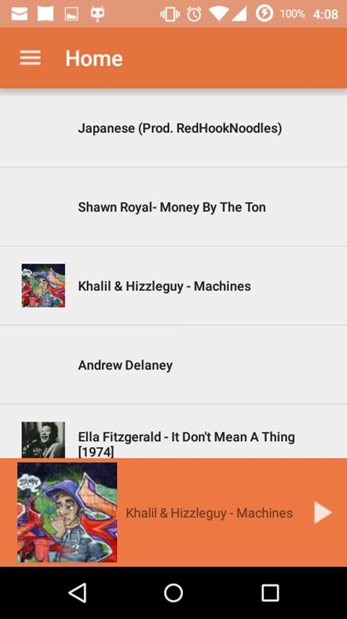
Activities
Home activity to get recent tracks
Display by list
A player control bar to play,
pause track.

Slide 6
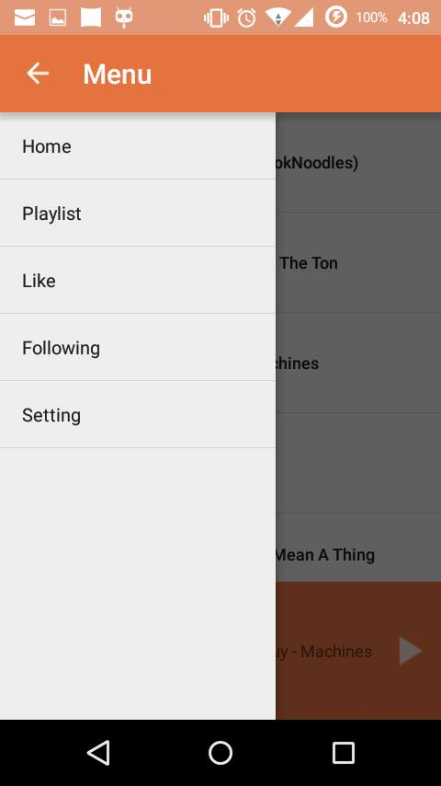
Activities
Drop-down menu to navigate

Slide 7
Networking
Connect to the back-end of Soundcloud
Use api.soundcloud.com
Using gson (google open source json-to-java converter)

Slide 8
Networking (cont.)
Using Picasso library to download and cache android image
Use Retrofit library to simplify HTTP communication
RestAdapter is the class that transforms an API interface into an object which actually makes network requests

Slide 9
Demo

Slide 10
Conclusion
What was not done:
Navigation Drawer’s correct behavior
Playlist Fragment
Media Player Fragment
Player Control’s correct behavior when switching between fragment

Slide 11
Thank you for listening!

