Slide 1
SLAM 3D-Map Visualization
in Broser
by nnn112358
Notes:
My Presentation is Slam 3D-map visualization in broser.

Slide 2
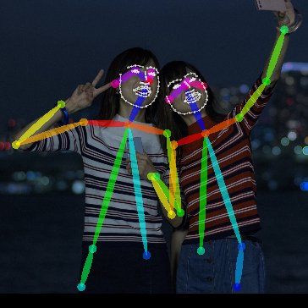

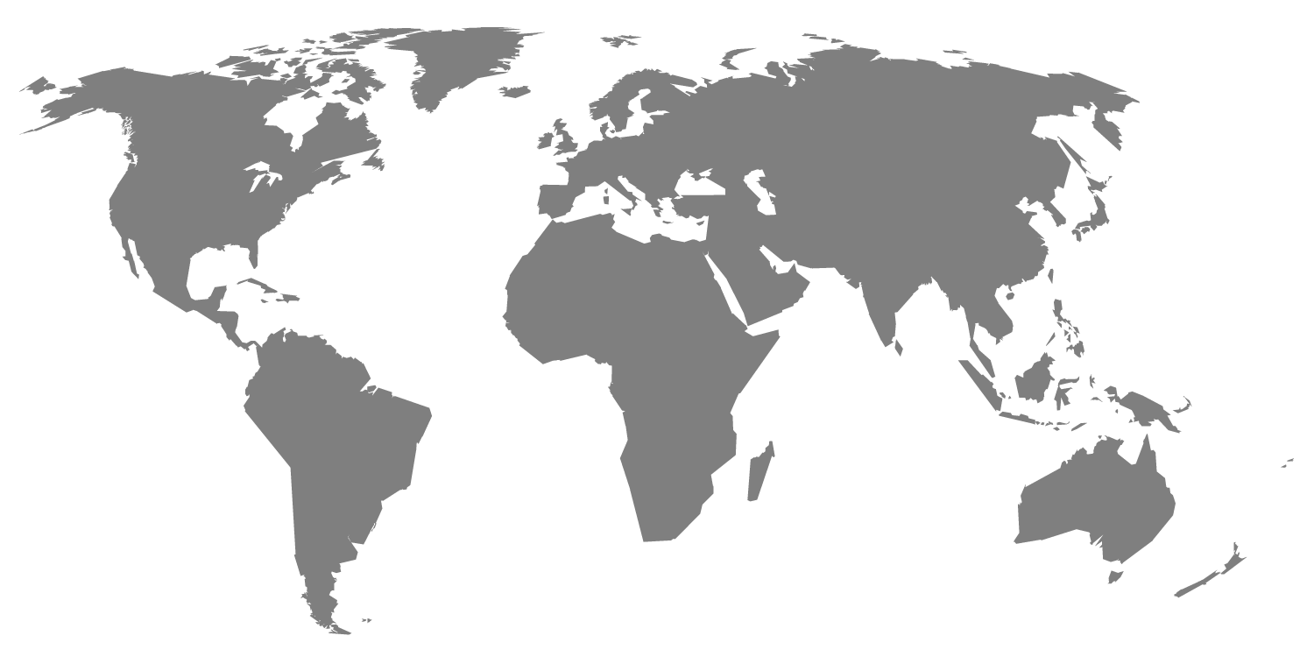
I am ＠nnn112358
My ROS Japan User Group History
ROS Japan UG #10 「OpenPose de ROS」
・・・Using OpenPose in ROS.
ROS Japan UG #11 「シミュレーションでSLAMを試す」
・・・Try SLAM in my original simulation.
Notes:
MY twitter account is nnn112358.
Number 112358 is Fibonacci number.
But ,There is no meaning
I hacve presentationed twotimes.
My ROS Japan User Group History is this one.

Slide 3
First, This URL Click
https://nnn112358.github.io/pages/potree-develop/examples/lion_laz.html
You can also see this web site on mobile.
Today, My presentaion is how to make this page.
Notes:
Today , My presentaion is how to make this page.

Slide 4
Abstoraction
1.”RtabMap “: 3D SLAM Software
2.”Potree”: 3D vitualization tool in broser
3.”GitPage”: Web service
Rtabmap is OSS 3D Slam Software using Kinect or other RGB-D Camera.
Rtabmap generates 3D Point Cloud Map.
Potree is 3D Point Cloud Viewer tools in broser using javascript.
Potree is using octree database.
GitPage is Github Webservice. GitPage can use javascript include potree.
Notes:
This slide is abstraction
At first, rtabmap.
Rtabmap is

Slide 5
RtabMap
RTAB-Map (Real-Time Appearance-Based Mapping)
is a RGB-D Graph-Based SLAM .
This Software won the ”IROS 2014 Kinect Challenge”.
Feature：
- The loop closure detector uses a bag-of-words approach.
- This software can be used stand-alone with a hand-held Kinect or RGBD Camera.
- Of course, this corresponds to ROS
See below for details
http://introlab.github.io/rtabmap/
Notes:
At first, I take about rtabmap.
See below for details

Slide 6
RtabMap Install
Environment：
-OS: Ubuntu1604 or Ubuntu1404
（You can use in the Mac or Windows without ROS）
-ROS: kinetic Kame or indigo
(I do not confirm others, probably it will move.)
-Device: Kinect version 1
（I use freenect driver）
Install : We can install by just this.
ROS kinetic Kame:
$ sudo apt-get install ros-kinetic-freenect-launch
$ sudo apt-get install ros-kinetic-rtabmap-ros
ROS indigo:
$ sudo apt-get install ros-indigo-freenect-launch
$ sudo apt-get install ros-indigo-rtabmap-ros
Notes:
At first, I take about rtabmap.

Slide 7
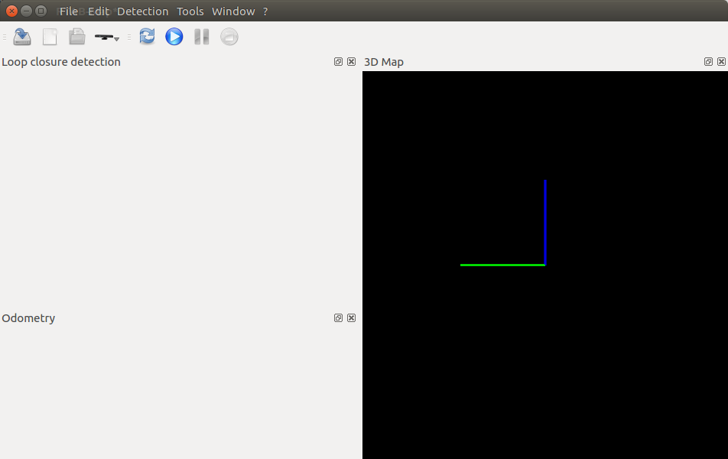
RtabMap Operation
①New DataBase
②Start
It starts with this.
$ rtabmap
③ply File Save
File→Export 3D cloud

Slide 8
RtabMap Operation
Introduce a Video
I prepared a video

Slide 9
RtabMap
Potree
Potree is include two tools
-Potree
Potree is HTML and javascript files.
https://github.com/potree/potree
-Potree 1.3 Install
$ wget https://github.com/potree/potree/archive/1.3.zip
$ unzip potree-1.3.zip
-PotreeConverter
Builds a Potree file-format from 3D Point Cloud files.
https://github.com/potree/PotreeConverter

Slide 10
RtabMap
Potree
-PotreeConverter Install
Please execute this command
lastools
$ cd ~/dev/workspaces/lastools
$ git clone https://github.com/m-schuetz/LAStools.git master
$ cd master/LASzip
$ mkdir build
$ cd build
$ cmake -DCMAKE_BUILD_TYPE=Release ..
$ make
$ sudo make install
PotreeConverter
$ cd ~/dev/workspaces/PotreeConverter
$ git clone https://github.com/potree/PotreeConverter.git master
$ cd master
$ mkdir build
$ cd build
$ cmake -DCMAKE_BUILD_TYPE=Release -DLASZIP_INCLUDE_DIRS=~/dev/workspaces/lastools/master/LASzip/dll
-DLASZIP_LIBRARY=~/dev/workspaces/lastools/master/LASzip/build/src/liblaszip.so .. $ make
$ sudo make install
-PotreeConverter converts ply to potree.
$ PotreeConverter cloud.ply -o /home/potree --generate-page pageName

Slide 11
RtabMap
Potree
-HTML File edit
$emacs ./potree-1.3/examples/lion.html
84 var sceneProperties = {
85 path: "../resources/pointclouds/pageName/cloud.js",
86 cameraPosition: null,
87 cameraTarget: null,
88 sizeType: "Adaptive",
89 quality: "Interpolation",
My File location

Slide 12

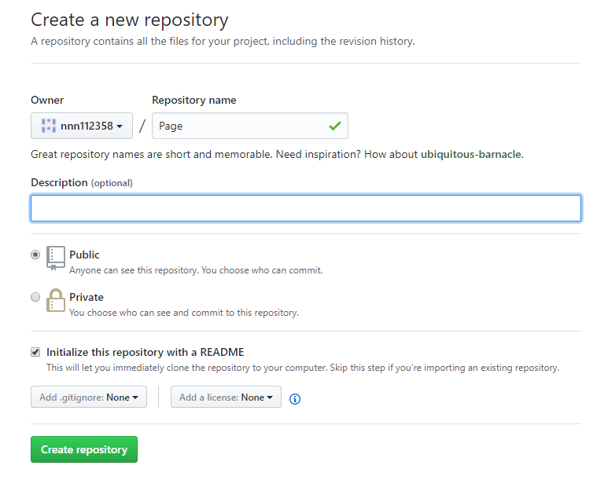
RtabMap
Potree
GitPage

Slide 13
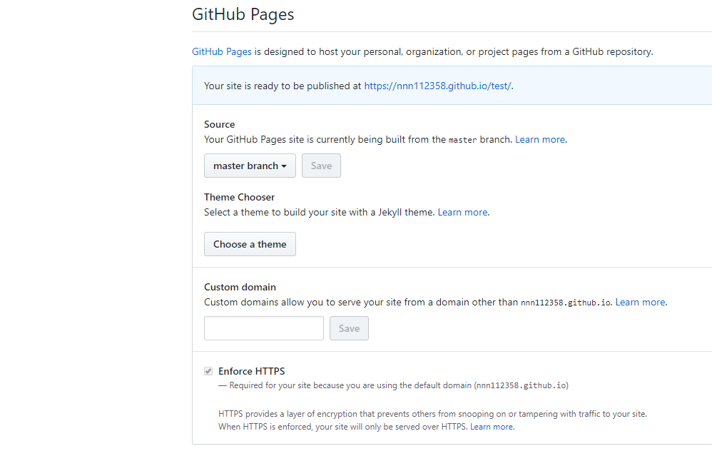
RtabMap
Potree
GitPage

Slide 14
Conclusion
SLAM 3D-Map Visualization in Broser
= RtabMap+Potree+GitPage
Let's make a cool Web site with this tools.
Thank you for listening.

Slide 16

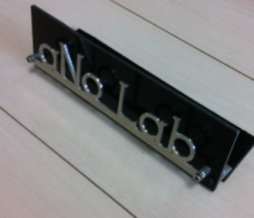
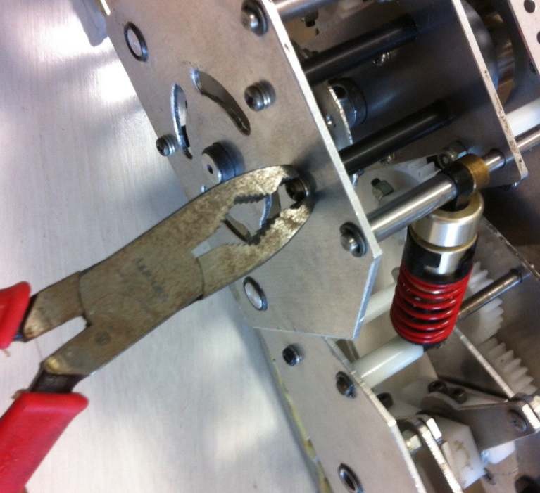
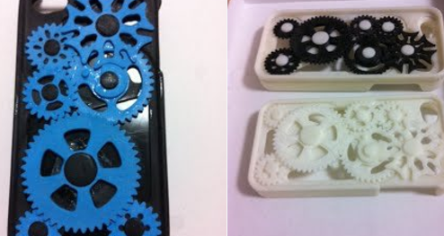
I am ＠nnn112358
History
ROS Japan UG #10 「OpenPose de ROS」
ROS Japan UG #11 「シミュレーションでSLAMを試す」
Recently ,I made Maker’s Commminuty “Ano Lab”
with my friends.
We want to make amazing robots,
and surprise everyone.
Follow me on Twitter , and wait for completion !!
@anoken2017
Notes:
I am nnn112358.

Slide 17
SlidesCarnival icons are editable shapes.
This means that you can:
Resize them without losing quality.
Change fill color and opacity.
Change line color, width and style.
Isn’t that nice? :)
Examples:

