Slide 1
Applicant Visit Day
Getting to grips with code!
Dr. Nonso Nnamoko
Notes:
Activities files also available in Github at: https://github.com/scienceguyrob/ProgrammingTasterEHU

Slide 2
Welcome
Welcome to the virtual applicant visit day!
This session aims to introduce you to computer programming, giving you an idea of the type of work you’ll do as a first-year undergraduate studying here.
The session aims to:
Help you understand the importance of coding.
Help you understand how coding relates to our degree programmes.
Introduce some basic coding terminology.
Give you the opportunity to solve some coding challenges for yourself.
We have only 1 hour, but I encourage you to take up independent study after the session, whether you join us here or not. It pays to get a head start!

Slide 3
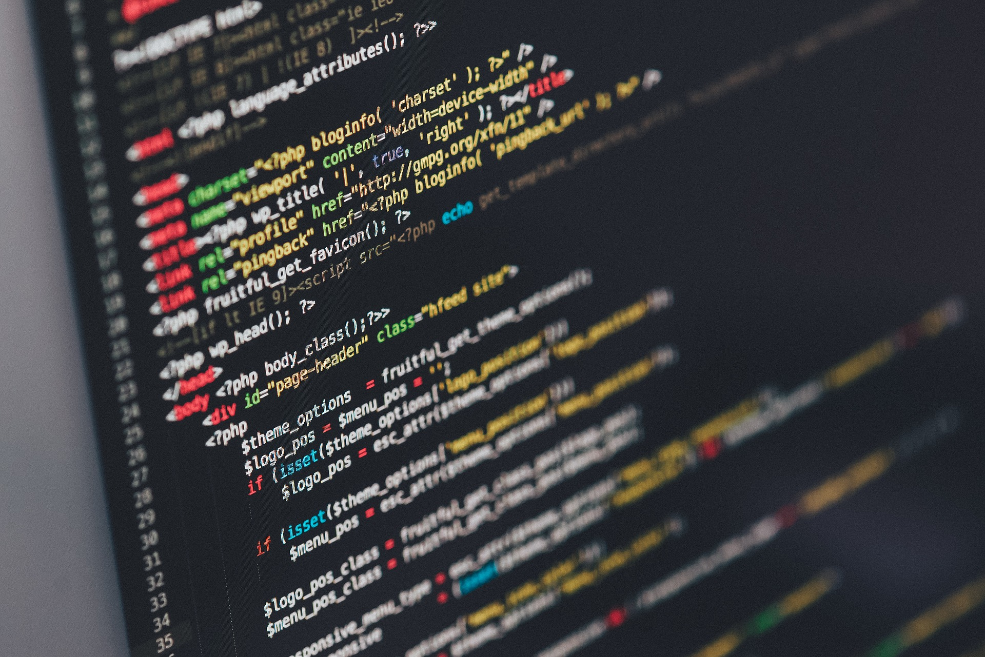
Programming in a Nutshell
Programming involves the writing of instructions as code, that orchestrate the actions of a computer and its hardware components.
The instructions are written with the aim of accomplishing a specific goal or completing a specific task.
Ultimately, the code we write controls a computers’ CPU, to carry out the tasks.
There are a few different ways we can “talk” to a computer…

Slide 4
Talking to a Computer
Machine code:
01001000 01100101 01101100 01101100 01101111 00100000 01000011 01001001 01010011 00110001 00110001 00110001 00110010
Assembly language:
MOV AL, 1h;
MOV CL, 2h;
MOV DL, 3h;
Natural Language:
Hi computer, please could you tell students on the visit day that coding is actually fun but also a powerful skill to learn?
01100001 01101100 01101001 01100011 01100101 00100000 01110011 01110101 01100011 01101011 01110011 00001010
Notes:
When talking to a computer, what do we mean? Well, we mean communicating to the machine in a language it understands. This is generally known as machine code. Machine code is very hard for us as humans to understand, thus we normally use what we call ”higher-level” languages to talk with machines. For instance, we could use assembly language to talk to the computer. But this must still be translated into machine code for the computer to understand.
Low-level languages such as machine code and assembly language are hard for us as humans to understand. They are too low-level. We’d rather communicate to machines using natural language if we could. Wouldn’t it be great if we could just talk to the computer, and have it do what we ask. That natural language could then be translated to machine code for a computer to understand.
Unfortunately it’s not yet possible for us to talk to a computer and control it this way. It is a very difficult problem to solve as human language is so expressive. Thus, we make a compromise. We use computer programming languages that mix low and high-level elements together, to create a programming language. Today we’ll use one such language – Python.

Slide 5

Python – a high-level language
Python is an interpreted, high-level programming language.
The Python code we write it is interpreted line by line and executed by a computer.
First, we write human readable Python source code files. These end with the .py extension.
The program known as the Python interpreter takes these files and converts them into machine readable byte code files ending with the .pyc extension.
This output is read by the CPU so it can carry out tasks – this is what we’ll do today.

Slide 6
Why is programming important?
We live in an increasingly digitised world - from the mobile phones in our pockets, the computers we use and even home appliances (.e.g. smart fridges!).
Such technologies are only made possible through software – software that,
Controls these systems.
Allows them to interact with each other.
Allows us to interact with them.
Software is comprised of computer code written by programmers. Thus, without code and programmers, all these amazing systems would simply not exist.
The importance of software is also increasing over time.
We therefore have a choice – do we want to just be users of the software (with no control), or, do we want to help shape the software all around us….
Given that our world is becoming increasingly automated due to software, I would suggest that it’s advantageous to be skilled in software creation – it will make us more employable.

Slide 7
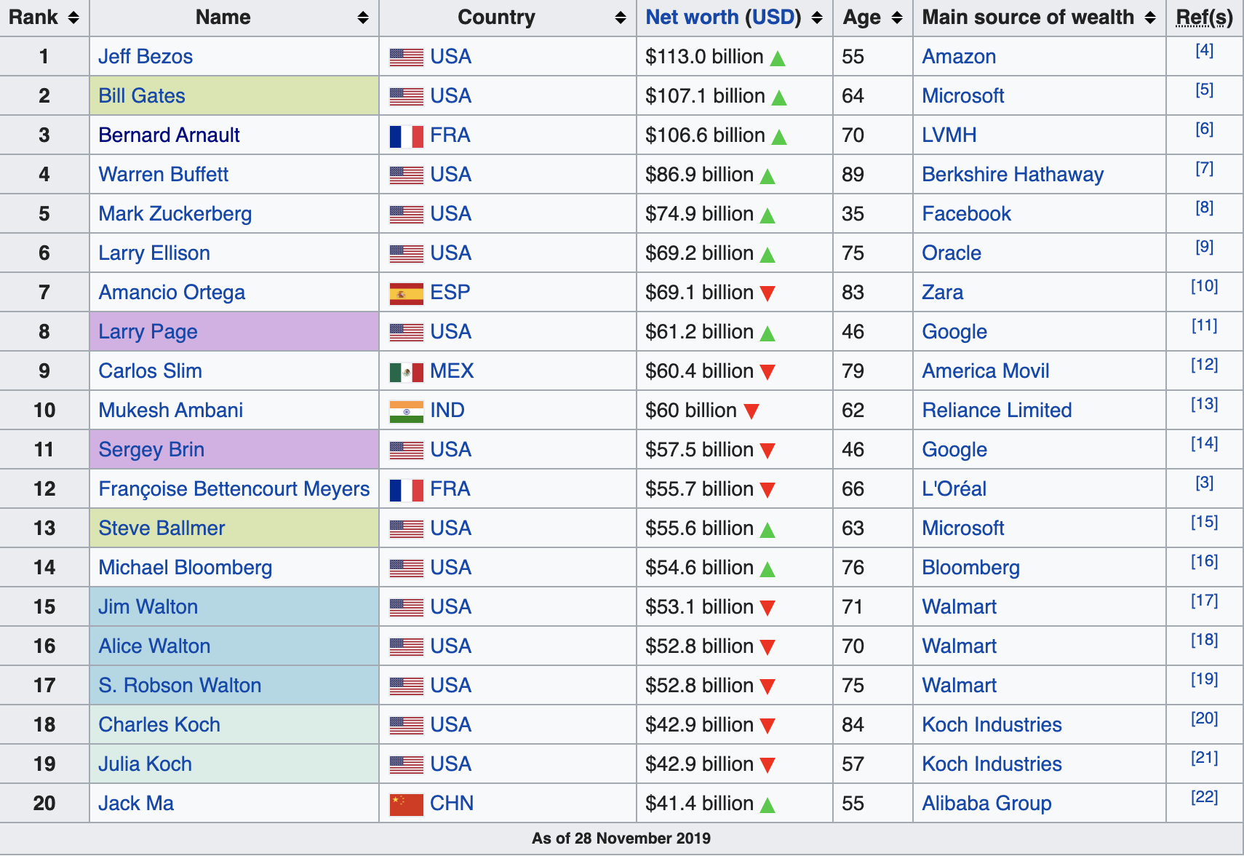
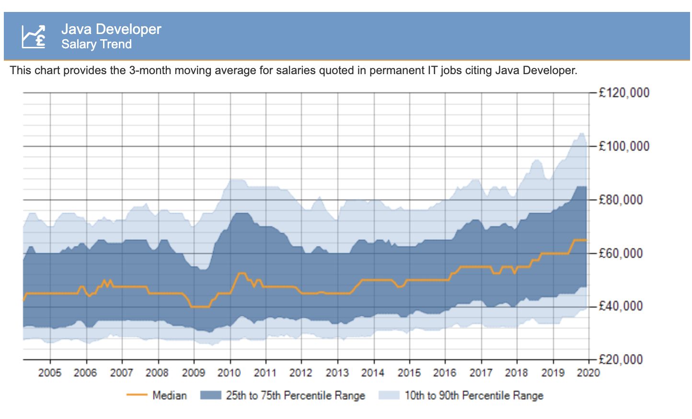
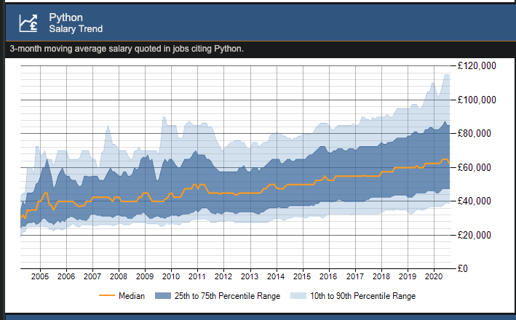
A good career path?
As of January 2020, the median salary for a Java developer is £65,000.
As of Sept. 2020, the median salary for a Python developer is £62,000.
The prospects are amazing – if you work hard.
Of the worlds 20 richest people, 8 are in software engineering.

Slide 8
Our Degree Paths
Python Programming
(everyone)
Java / Python / C# Programming
(multiple modules)
Java / Python / C# Programming
(multiple modules)
Year 1
Year 2
Year 3
Graduate
Semester 1
Semester 2
Semester 1
Semester 2
Semester 1
Semester 2
Java Programming
(everyone)
Java / C# Programming
(varies my path)
Final year project
(everyone) – often
has a programming
component
Your module choices influence the programming you do – but everyone does some!

Slide 9
Review
You now know what programming is – a process that produces code that we can use to control a computer.
We know how programming relates to our degree programmes.
We know why coding is important.
Next, we turn our attention to giving you the chance to write some code – we’ll first need to get access to a development environment that we can use to write / run code.

Slide 10
Coding Activities
Hopefully, you’ll find this fun and interesting!

Slide 11
Software Development Environment
To develop code, we need a couple of tools.
A tool we can use to write code – a little like using Microsoft Word to write essays.
A tool that converts the code files we write, into machine code.
A tool that allows us to run the machine code.
We typically think about these tools together as a single development toolkit.
Such toolkits operate in a development environment – i.e. a software environment set up on a computer that we can use.
We don’t have the time to setup our own environments – instead, we’re going to use a pre-installed, development environment that allows us to write Python code.
This tool is called Jupyter Notebook.

Slide 12
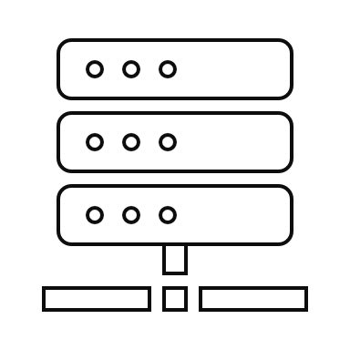

Jupyter Notebook
Jupyter Notebook has its own code editor and a range of tools for writing and running code.
It runs a local server on your machine and is accessed through a web browser via a local address (e.g., http://localhost:8888)
It provides an interactive environment for coding.
It a great platform for beginners to learn and experiment with programming.
Language Tools
External Libraries
Tools (Code Editors)

Slide 13
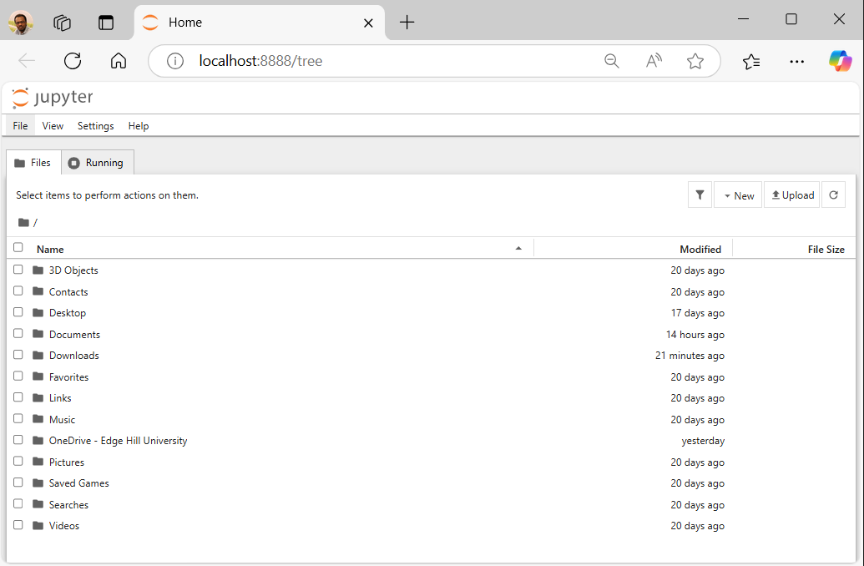
Launching Jupyter Notebook
Press “Windows + S” and type “Jupyter Notebook” in the search bar.
Click on Jupyter Notebook to launch it in your default web browser.
You should see a user interface that looks a little like this:

Slide 14
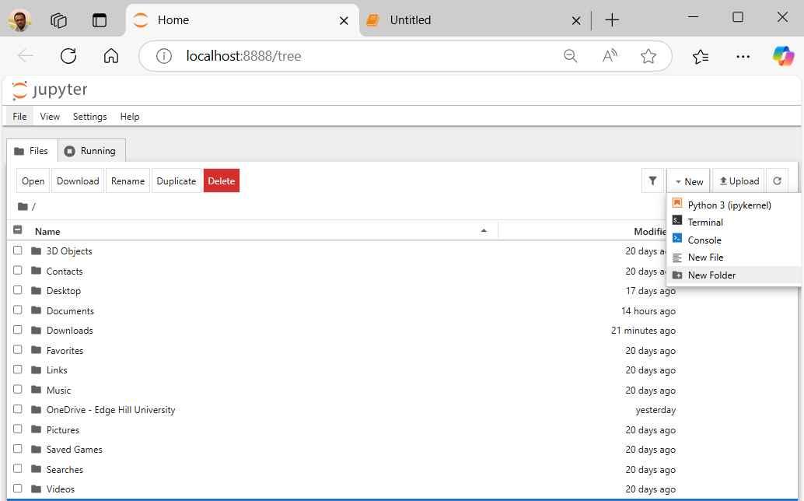
Creating a Notebook in Jupyter Notebook
Select the "Documents" folder
This is where you will create the notebook.
Click on the "New" button (top right corner).
Select "Python 3 (ipykernel)".
A new untitled notebook will open in a new tab.

Slide 15
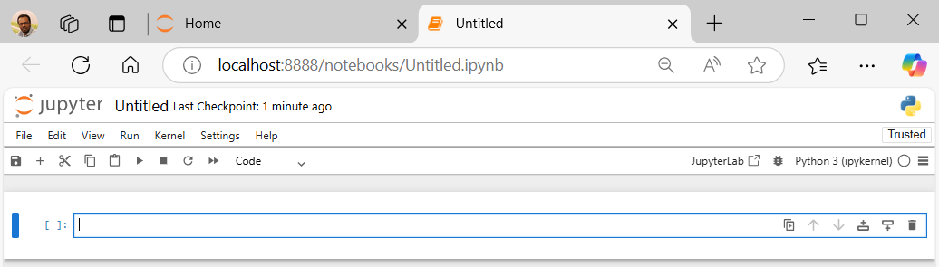
Showing you around…
A cell – a place where you can write code / text.
How to “run” a cell.
How to create a new cell.
Run button
New cell
Cell

Slide 16
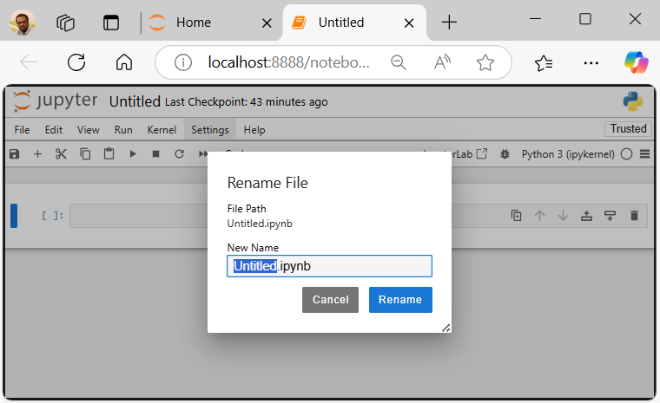
Rename your Jupyter Notebook
Click on "Untitled" at the top of the notebook.
Enter a meaningful name for your notebook.
Click “Rename” button to save the new name.

Slide 17
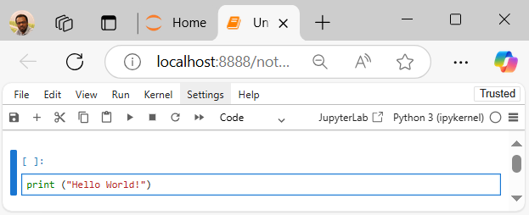
Start Coding!
In each cell, type the Python code print (“Hello World!”)
Press “Shift + Enter” to run the cell.
Click "Save" (or press Ctrl + S) to save your work.

Slide 18
What we’ve seen…
We have now learnt how to Launch Jupyter Notebook and create our own notebook.
We have also seen a code cell and learned how to run it using the “Run” button or “Shift + Enter” keyboard shortcut.
Next, we get you working in this environment.
To do that, we ask you to first load a notebook I made earlier….

Slide 19
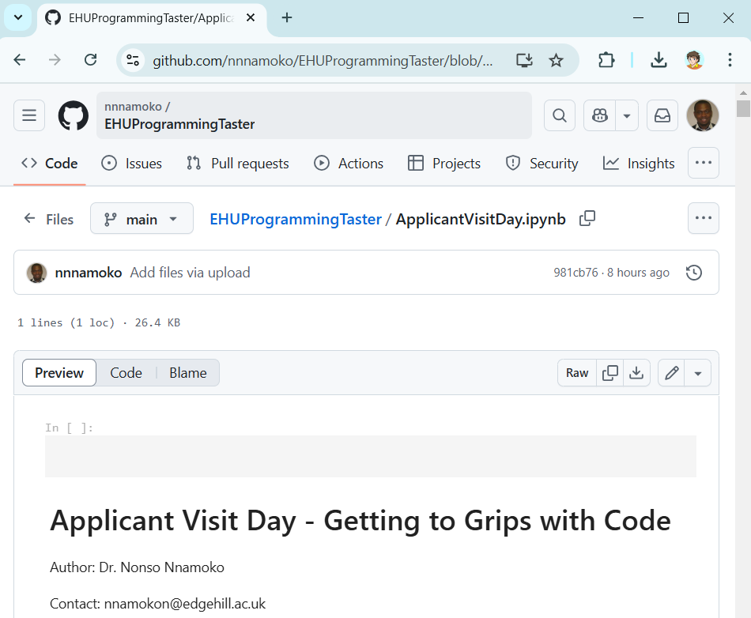
Download the pre-made notebook
Go to https://github.com/nnnamoko/EHUProgrammingTaster
Click the file ‘’ApplicantVisitDay.ipynb’’
Then, click the ‘’Download raw file’’ button (see image).
The file should save in your “Downloads” folder.

Slide 20
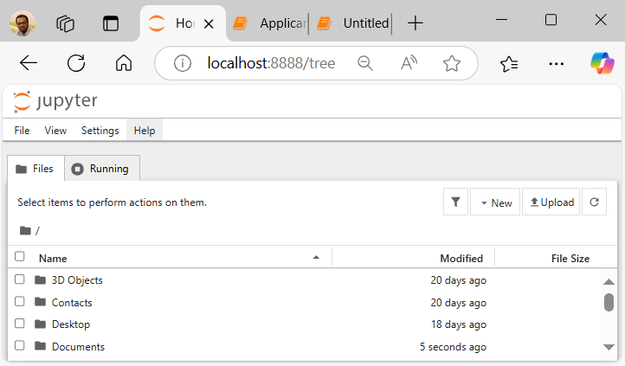
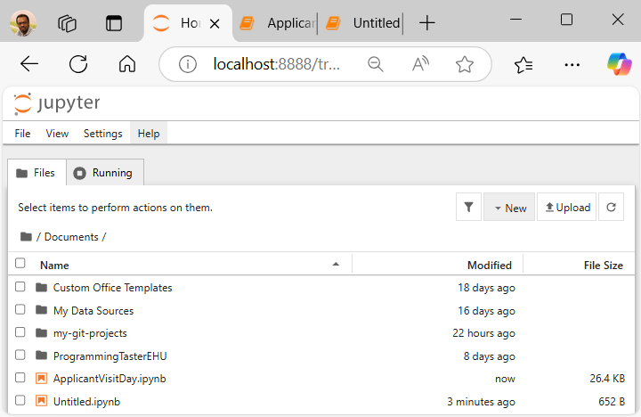
Load the pre-made notebook on Jupyter
Return to Jupyter Notebook (Home Tab)
Select the "Documents" folder
This is where you will create the notebook.
Click the “Upload” button at the top right
Navigate to the ‘’Downloads’’ folder and select “ApplicantVisitDay.ipynb”.
The file should now appear in “Documents”.
Click the file to open

Slide 21
Next steps
You should have loaded the “ApplicantVisitDay.ipynb”notebook successfully.
The notebook itself contains instructions on what to do next – there are also some coding challenges and some learning material.
It is your job to read through this, with my support, and to solve the challenges.
We will give you some time to do this, just like we would in class during a real lesson.
Then with around 10 minutes to go, we will come back together to finish up and give you the opportunity to ask questions.
So, on your marks, get set…. GO!

Slide 22
Reflecting on today
You may not realise but today you’ve done the following:
Used an industry standard software environment for writing Python code – it is especially used in Data Science and for Machine Learning research.
Learned how to write some basic Python statements and run code in this environment.
Learned why coding is so important and how it relates to your (potential) degree programme.
Not bad for an hour? Maybe if you join us, you’ll learn a whole lot more!

Slide 23
Follow-up Learning
No matter where you decide to study, getting a head start is beneficial.
Here are some resources you can use to help prepare you and build your programming knowledge:
A free eBook called “Think Python”, by A. Downey, 2nd Edition, Green Tea Press.
Code academy – free programming tutorials available online: https://www.codecademy.com/
The Solo Learn mobile application: https://www.sololearn.com/

Slide 24
Learning Aims
By the end of this session, I want you to understand / be aware of:
The basic principles computer programming – how we write code.
Why we write code (to control a CPU) and what that gives us.
How coding is used throughout our degree programmes.
How coding is beneficial to you and your career / employability.
A tool used to write code – Jupyter Notebook.
How to write some basic computer programs in the Python programming language.

Slide 25
Applicant visit day – DONE.
Find out more details about our department on-line.
I hope you enjoyed today and now understand what it might be like to study with us!
Do you have any questions?

