Slide 1
ENGI 301 “EZ Cool” Proposal
9/25/23
Nate Miller

Slide 2
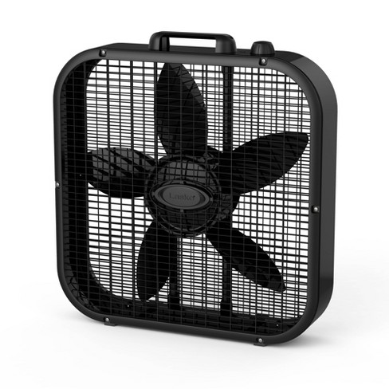
Background Information
The knob
What is being proposed? – Bluetooth enabled Box Fan control.
https://www.hackster.io/iotprojectteam46/automatic-light-switch-9c2c4e
https://www.hackster.io/babs-ogunbanwo/pocketbeagle-automatic-light-switch-f0588f
I was inspired to try and make something that I would use more than once, at least for the remainder of my time at Rice, which led me to try and think of a tool of some kind, or an improvement to some part of my life. It may sound silly, but I am serious about my box fan. I am currently on my second box fan in ~3 years at Rice because I keep one blowing in my room almost constantly. I do the same thing at home. I really enjoy an extremely cold room, and when I am asleep the white noise that the fan provides is unmatched. However, I am on my second fan because I am sure that running it constantly is not good for the internals, they are in fact relatively cheap devices.
These thoughts, as well as the existing automatic light switch projects I listed, inspired me to propose a device that can be attached to the box fan, more specifically the knob on top, and allow me to turn the fan or off, or switch the fan speed, with a small remote or with my phone (diagrams have phone in mind). This would allow me to get nice and cozy in bed and then control the fan from there!

Slide 3
System Block Diagram
Adjustable Voltage Adapter
Unnecessary if microusb port is sufficient
Emergency stop/shutoff button
PocketBeagle
Bluetooth USB adapter
Female Bluetooth reception port
SYS VIN
1.5A stepper or servo motor
USB1
PWM1
GPIO 64
Fan Speed level interface
Using either the number display or a series of LEDs to display current fan speed
GPIO 112
- I am not sure how the motor + driver module combination works/when it needs to be used. I will need the motor to turn only slightly in both directions, the knob for the fan does not need much force nor does it need to be turned far to reach the different settings.
- I would like to be able to plug this in and keep it powered on, so I can use my phone whenever to connect to the fan.
- I am confused on how a non-usbc external power source is connected. I am assuming that the micro usb port is not sufficient on its own.

Slide 4
Power Block Diagram
Adjustable Voltage Adapter
5V
Emergency stop button
PocketBeagle
3.3 V
Bluetooth USB adapter
Female Bluetooth reception port
SYS VIN (P 1.1)
1.5A stepper or servo motor
1.5 V
Fan Speed level interface
5V
VIN (P 1.7)
PWM1 (P 2.1)
Using either the number display or a series of LEDs
GPIO 64 (P 2.20)
5 V
GPIO 112 (P 2.32)
*Read online that IFTTT app can be used for Bluetooth connection and control.
- I have never done something like this before, I am sorry in advance if it is completely off base.
- I am not sure if the motor needs the other component I listed or not.

Slide 5
Components / Budget
Component | Need to Buy | Cost
HiLetgo Stepstick Stepper Motor Driver Module with Heat Sink https://a.co/d/7Gf3lpG | 1? | $10.19 (5)
STEPPERONLINE 0.9deg Nema 17 Stepper Motor Bipolar 1.5A 30Ncm with 1 Meter Cable for 3D Printer CNC or alternative https://a.co/d/isdb892 | 1 | $16.99
Bluetooth USB Adapter https://a.co/d/b1SqFEx | 1 | $9.99
USB female socket https://a.co/d/cLsgAAR | 1 | ~$6.99
Adjustable voltage adapter https://a.co/d/6iy7ppo | 1 | $13.99
Housing Unit (3D printed, with some kind of rubber grip for the knob of the fan. Alternatively, I may be able to remove the knob and interface directly with the internal rotating switch) | ? | ? (I will shoulder this cost)

Slide 6
System Diagram
Rough demonstration of systems, classes, and components:

Slide 7
