Slide 1
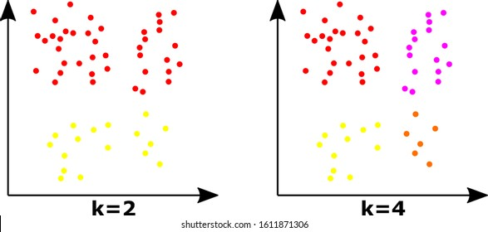
K Means Algorithm : Unsupervised Learning
An iterative algorithm that divides the unlabeled dataset into k different clusters in a way that each element belongs to a single group that has similar properties.
N observations, k clusters
1: Select random K points i.e. centroids/means. 2: Assign each element/data point to their closest centroid, which will form the initial K clusters.
3: Calculate the variance and place a new centroid of each cluster.
4: Repeat step 2, which means reassign each element to the new closest centroid of each cluster.
Step-6: If any reassignment occurs, repeat from 3, else END.

