Slide 1
ENGI 301 Smart Vanity Mirror PCB Proposal
December 14, 2021
Nneoma Ome

Slide 2
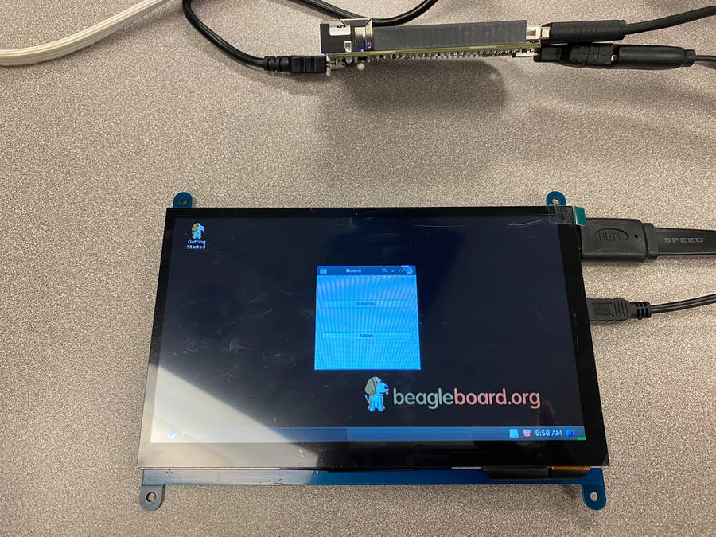
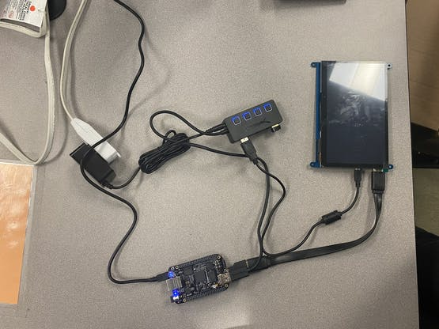
Background Information
The goal of this project is to develop a smart vanity/desk mirror that allows a user to view their appearance and displays information that may be relevant for daily use (i.e., calendar date, time, temperature, weather forecast etc.
Although there are existing projects centered around developing smart mirrors, many of the projects have large monitors, mirrors, and frames that make it difficult for the vanity to be portable. Additionally, the mirrors made in the existing projects are not intended to be vanity mirrors, so they tend to lack a lighting component and those that do include lighting strips use them for backlighting and not for enabling the user to have better visibility of their image.
Although the final version of my prototype was different from the original proposal, the following components will be included in the PCB to create an ideal circuit board for an ideal device:
Power button
LED power button
LED
Buzzer
LCD Display
The features listed above will make the device particularly useful to students and people that move frequently as its portable size allows for it to be used on many surfaces as opposed to being mounted on a wall or to a table.
Links:
Hackster page: https://www.hackster.io/nome2/portable-smart-vanity-mirror-using-beaglebone-black-9d8d6f
GitHub page: https://github.com/nnome/ENGI301/tree/main/project_01
Notes:
Image 1 Source: https://www.wayfair.com/Wrought-Studio™--Lighted-Makeup-Mirror-Hollywood-Mirror-Vanity-Makeup-Mirror-With-Lights-Smart-Touch-Control-3Gear-Dimable-Light-360°Rotation-X117120506-L41-K~W006019495.html?refid=GX549028497019-W006019495&device=c&ptid=1433750947875&network=g&targetid=pla-1433750947875&channel=GooglePLA&ireid=154294577&fdid=1817&gclid=CjwKCAjw7--KBhAMEiwAxfpkWLjBEYm1Xq9WalA8pvTOkeKmulVKo5y5C-w93s0YvRn4ij1e_SkN7xoC8qQQAvD_BwE
Image 2 Source: https://www.thisiswhyimbroke.com/uk/allure-smart-makeup-mirror/
Image 3 Source: https://www.hackster.io/mprocter12/smart-mirror-using-beaglebone-black-e379a3
Image 4 Source: https://www.hackster.io/eben-kouao/smart-mirror-touchscreen-with-face-recognition-6c84cc

Slide 3
System Block Diagram
USB to Computer
For Development
USB Client
P9
P8
Beagle
Bone
Black
USB Host
HDMI
WiFi Adapter
WiFi
USB Hub
Touch
LCD Display
Wall Outlet

Slide 4
Power Block Diagram
USB to Computer
5 V
5 V
USB Client
P9
P8
Beagle
Bone
Black
USB Host
HDMI
WiFi Adapter
5 V
USB Hub
5 V
LCD Display
5 V
Wall Outlet
120 V
60 Hz

Slide 5
Mechanical Block Diagram (Front)
129.54 mm
Beagle Bone Black
USB Client
HDMI
53.3.mm
USB Host
15.24mm
86.40 mm
LED
35.56 mm
1.27mm
121.92 mm
22.86 mm
12mm
12mm
Buzzer
LED Button
Power Button
12 .7mm
12 mm
12 mm
113.11 mm
3”
LCD Display
77.93 mm

Slide 6
Mechanical Block Diagram (Back)
129.54 mm
121.92 mm

Slide 7
Components Required
Create a list of all the components that you require for the PCB
List:
BeagleBone Black
USB Client connector
USB Host connector
HDMI connector
LED
2 Buttons
Buzzer
LCD Display

