Slide 1
Autoencoding and Image Classification

Slide 2

Our aim was to extract features from human faces into the smallest possible compressed representation and use it in image clustering.

Slide 3
1. Facial Autoencoding
Architecture Enhancement and Experiments

Slide 4
Architecture Enhancement:
Adam (Adaptive Momentum Estimation)
Batch Normalization
Tied Weights
Stacked Autoencoder

Slide 5
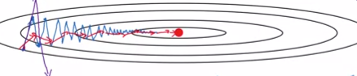
Adam (Adaptive Momentum Estimation)
Momentum : tends to decrease vertical oscillations and increases horizontal movement
by taking advantage of weighted average

Slide 6
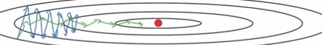
Adam (Adaptive Momentum Estimation)
RMS-Prob:tends to reduce parameters that has large slope in vertical axis by dividing them by square root of exponentially weighted average.

Slide 7
Adam (Adaptive Momentum Estimation)
Adam: composed of both momentum and RMS-Prob optimizers, it greatly reduces number of steps taken to reach minimum.

Slide 8
Stacked Autoencoder
Deep Architectures tends to learn complex features
Stacked mechanism helps to avoid vanishing gradients problems
Gready-Layer-Wise mechanism is used in the training history.

Slide 9
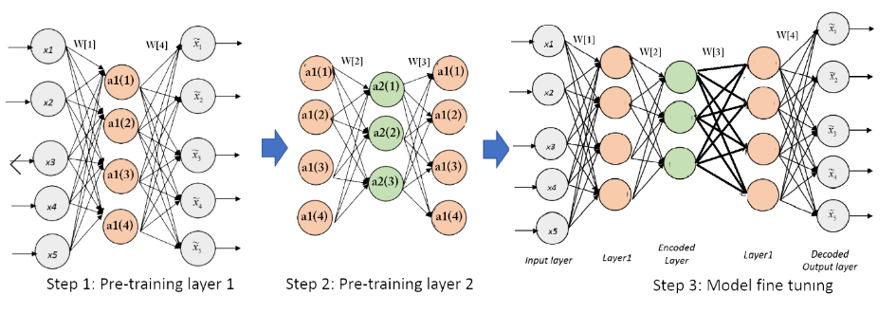
Stacked Autoencoder

Slide 10
Batch Normalization
What is Batch Normalization ?
Why we need it ?
- Solving Covariance shift problem
- Increasing speed of convergence.
- Less sensitive to weight initialization
How to implement ?

Slide 11
Tied Weights
What is Tied-Weights?
Why we need it?
Regularization
Faster learning
Less Memory

Slide 12
Training :
Hyper Parameters
Increasing Data Set
Different Architectures
Experiments and Results

Slide 13
Training :
Batch size =200
Learning rate =0.005, decay rate =0.725
Tied Weights
Batch Normalization
Adam

Slide 14
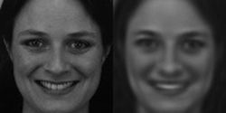
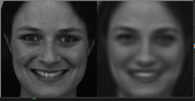
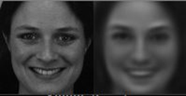
Training :
Latent layer = 500
Error = 2.725%
Latent layer = 200
Error = 3.15%
Latent layer = 100
Error = 3.91%

Slide 15

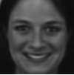
Training :
Latent layer = 500 (Stack)
Error = 2.706
Latent layer = 500
Error = 2.459

Slide 16
2. Image Classifier
Clustering Similar Faces

Slide 17
Image Classifier:
Creating Data Set
Different Architectures
Error Measurement
Results

Slide 18
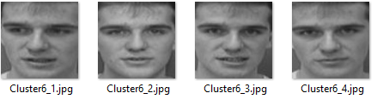
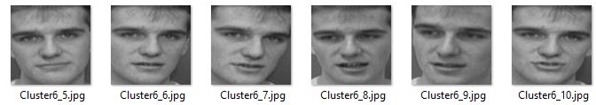
Image Classifier:
Results on ORL Data Set:
Same person in one cluster

Slide 19
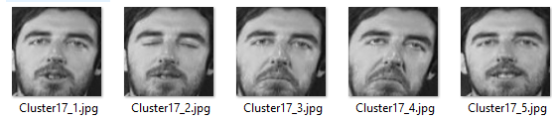
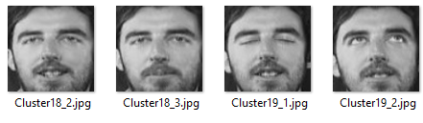
Image Classifier:
Results on ORL Data Set:
Same person in 2 different clusters

Slide 20
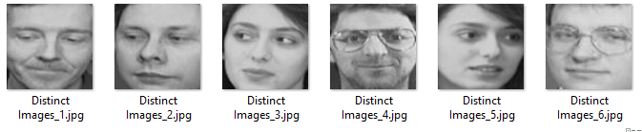
Image Classifier:
Results on ORL Data Set:
Unrecognized persons

Slide 21
THANKS! Any questions?

