Slide 2
Web Application or Web Service ?
01
Willl learn about the difference of both

Slide 3
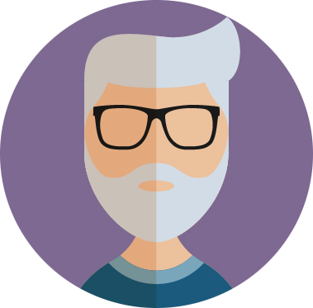

Hey Way2Automation! Can you help me to understand the difference between Web Application and Web Service ?
Umm! Yeah. So, Web Application contains a GUI, whearas Web Services do
not provicde any GUI.
Okay! I guess examples are the best way to get things. So, to make my concepts more clear, would love to welcome some examples.

Slide 4
SBI ATM
SBI DB
Request for verification of user
Request for money
Response with money
Response with Authenticated details
SBI USER
A Bank user can only use specific bank's ATM
ICICI ATM
ICICI DB
Request for verification of user
Request for money
Response with money
Response with Authenticated details
ICICI USER

Slide 5
So, In this case, the Bank user is directly communicating to a GUI based application. Hence, this is a web based application.
But what in case if the ICICI User wants to withdraw money from an SBI ATM ?
Yeah! Nice Question. That's exactly where the Web Services HOP's IN. Lets move on.

Slide 6
SBI ATM
SBI DB
SBI USER
ICICI ATM
ICICI DB
ICICI USER

Slide 7
SBI ATM
SBI DB
Publically available SBI Services
SBI USER
ICICI ATM
ICICI DB
Publically Available ICICI Services
ICICI USER

Slide 8
SBI ATM
Request for verification of user
Request for money
Publically Available ICICI Services
Request for verification of user
Response with details
ICICI DB
Response with Authenticated details
ICICI USER

Slide 9
SBI ATM
Application 1
COMMUNICATES TOGETHER WITHOUT A GUI
Publically Available ICICI Services
ICICI DB
Application 2

Slide 10
Introduction to Python
02
Will learn why should we learn Python ?

Slide 11
So, Python has the following advantages over other programming languages.
General Purpose Language
OOP Language
Cross Platform Language
Dynamic Language
Open Source Language
Multipurpose Language
Interpreted Language
Expressive Language

Slide 12
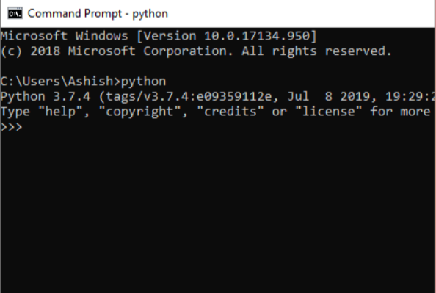
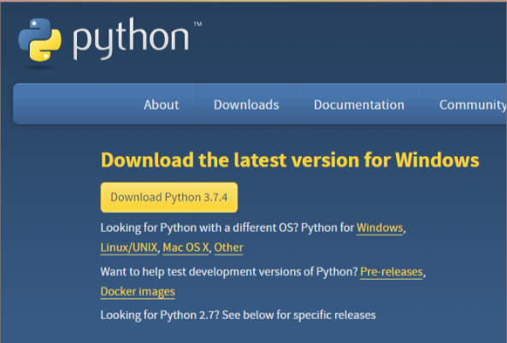
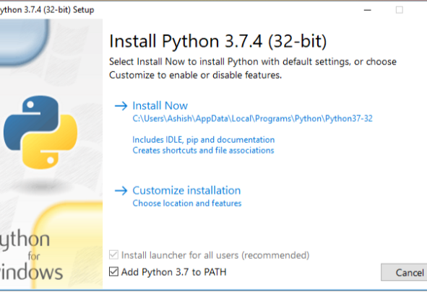
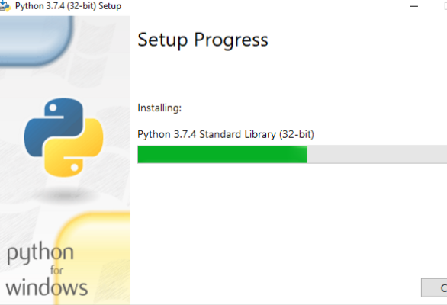
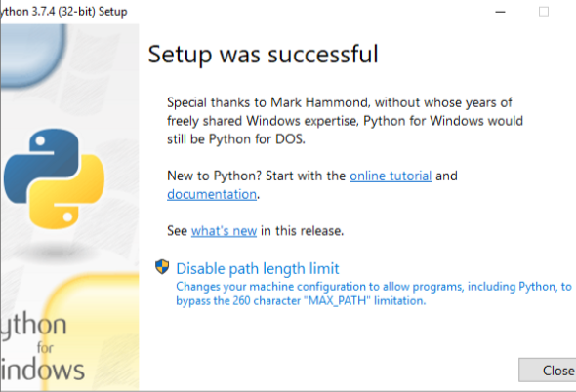
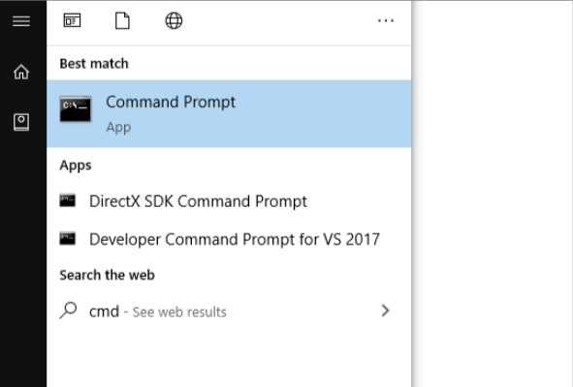
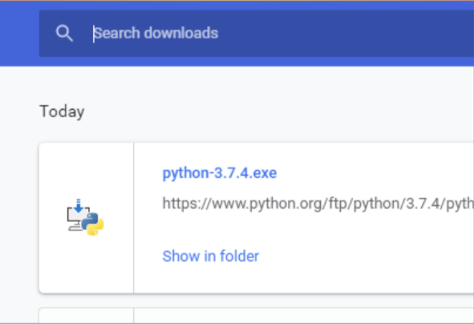

Slide 13
