Slide 1
Introduction to Lab 1
Flashing LED
09/10/2018
Presented by: Mahmoud KhalafAlla
E-mail: mkhalafa@uwaterloo.ca
ECE 222 Fall 2018

Slide 2
Outline
Objective
Status Flags & Conditional branching
I/O port addressing and configuration
Flashing LED flowchart
What to deliver
PAGE 2

Slide 3
LAB 1 Objective
Write some THUMB assembly language instructions
Use different memory addressing modes
Test and debug the code on the Keil board
The on-board RAM is used instead of Flash memory.
PAGE 3

Slide 4
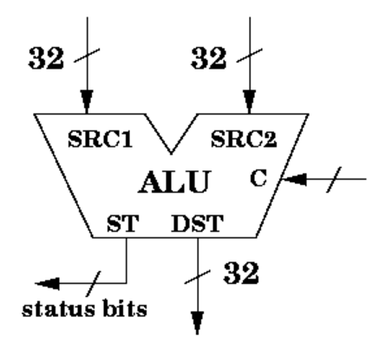
Status bits & conditional branching
Status Bits are output from ALU after every computation.
Depends on the type of instruction being executed
Flags are:
Z – Zero – was the result zero
N – Negative – the highest bit which may indicate the sign of the number
C – Carry – was a carry (overflow) generated by an operation
V – Overflow (only used for signed math)
https://www.cs.umd.edu/class/sum2003/cmsc311/Notes/Build/alu.html
SUBS R1,R1,#1
PAGE 4

Slide 5
I/O port addressing and configuration
I/O ports and peripherals have assigned unique addresses from memory address space (memory-mapped I/O).
To communicate (write/read, configure) a specific peripheral, its address must be used (similar to writing to memory, but it is not a memory access operation).
Every I/O port has a Status register to configure the functionality of the port (input port, output port, in-out port, etc…)
The configuration of I/O port must be done first before starting any operation on it
The value of the port to be used can be written using the port address (Again, similar to writing values to memory, except it is not a memory access operation)
PAGE 5

Slide 6
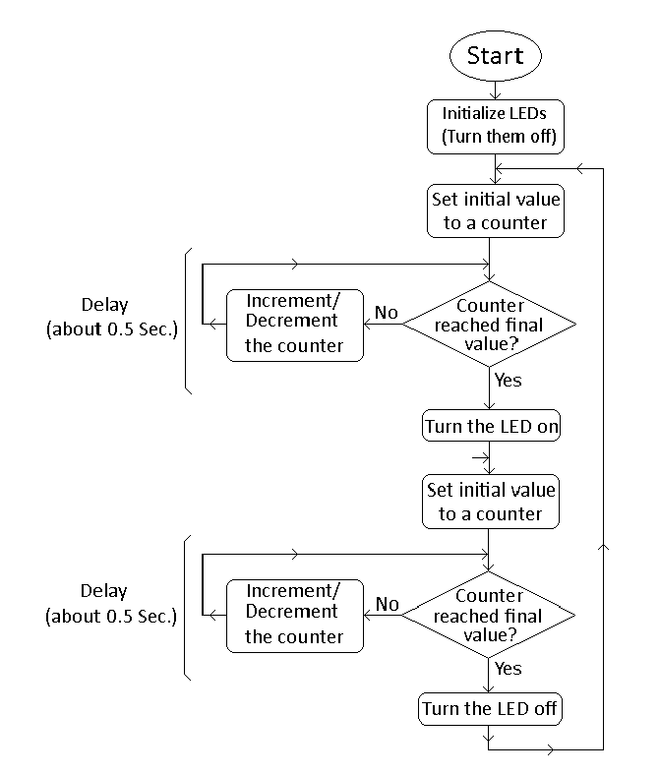
Flashing LED flowchart
Configure ports and write OFF value to port
Use the appropriate value to have 1HZ frequency
write ON value to port
Can we do one loop instead of two? How?
PAGE 6

Slide 7
Deliverables
Lab report:
Your code, well documented.
Hand assembly of instruction: ADD R4, R4, R2.
Exact 1 HZ frequency is not required
Read your lab manual carefully and use the code skeleton supplied
Report is submitted on Learn.
Make sure you understand your code for demo questions
USE RAM not FLASH
PAGE 7

