Slide 1
Introduction to Lab 2
Morse Code Transmitter
09/24/2018
Presented by: Mahmoud KhalafAlla
E-mail: mkhalafa@uwaterloo.ca
ECE 222 Fall 2018

Slide 2
Outline
Objective
Subroutines and parameter passing
Lookup Tables & ASCII codes
Morse code flowchart
What to deliver
PAGE 2

Slide 3
LAB 2 Objectives
Learn structural programming
Big problems consist of smaller ones
Using subroutines to tackle every single small problem
Parameter passing and context switching
Traversing arrays
PAGE 3

Slide 4
Subroutines & parameter passing
Program executes instructions serially (in order).
Calling subroutine → context switching to the subroutine
1- Set Program Counter PC = 0XA0
2- Set Linking register LR = 0xC
3- Execute subroutine
4- Return by placing the value of LR into PC
Subroutine
Instr 1
Addr = 0xA0
Main Program
Instr 2
Addr = 0xA4
Addr = 0x0
Instr 1
Addr = 0x4
Instr 2
return
Addr = 0x8
Instr 3 Call subroutine
Addr = 0xC
Instr 4
How is this done in assembly?!
PAGE 4

Slide 5
Subroutines & parameter passing (Cont.)
STMFD: Push elements into stack
(F → SP points to the last element)
(D → Descending stack starts with higher address then progress to lower one)
LDMFD: Pop from a descending stack
Do not forget to call subroutine using: BL
subroutine1
STMFD SP!, {R0-R3,LR}
Instr1
Instr2
.
.
.
LDMFD SP!, {R0-R3,PC}
Subroutine
Push registers and LR into stack
Pop back registers , LR → PC
PAGE 5

Slide 6
Subroutines & parameter passing (Cont.)
Passing parameters to a subroutine can be done as follows:
Memory: write values in specific addresses using STR and read them back using LD (memory access Not efficient)
Stack: Push values into stack and Pop it back in subroutine. (complex management of SP!)
Registers: limited number of them!
PAGE 6

Slide 7
Lookup Tables & ASCII code
American Standard Code for Information Interchange (ASCII)
Every character is represented by a byte value.
‘A’ → 0X41 … ‘Z’ → 0X5A
We are only concerned with capital values
Morse codes are stored in a lookup table (LUT) in an alphabetic order.
You use the character ASCII value to know which index to be used to access the LUT
PAGE 7

Slide 8
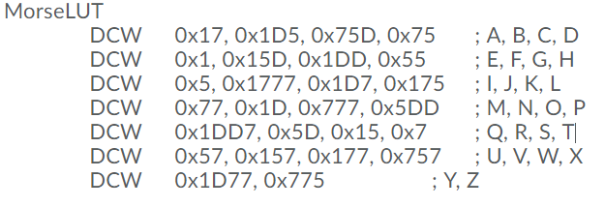
Lookup Tables & ASCII code
A
B
ASCII value – 0X41 → gives the position of the character (first, second..)
Multiply by element size (DCW → word = 2 Bytes) → to get to the correct LUT index.
Example: ‘B’ ASCII = 0x42 → 0x42 – 0x41 = 0x1 multiply by 2, then index = 2
0x17
0x1D5
0,1
2,3
PAGE 8

Slide 9
Pre-Lab
Practice subroutines by re-implementing Lab 1 using subroutines:
Switch-on LED subroutine
Switch-off LED subroutine
Delay subroutine : takes one parameter in R0 and waits R0*500ms
PAGE 9

Slide 10
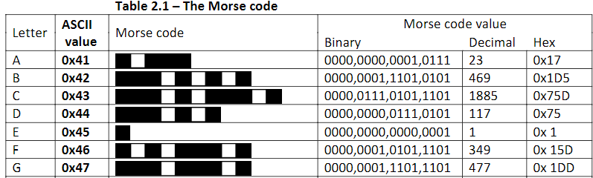
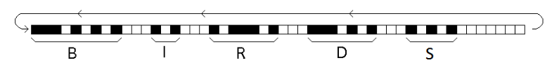
Reading Morse code
You have to shift left all leading zeros and start switching on/off from the first occurrence of ‘1’
Use suffix ‘s’ in shifting to set carry status flag , then use BCC or BCS
Delays (500ms = 1 dot)
1 dot between every consecutive bits
3 dot between every two characters
4 dots between every two words
PAGE 10

Slide 11
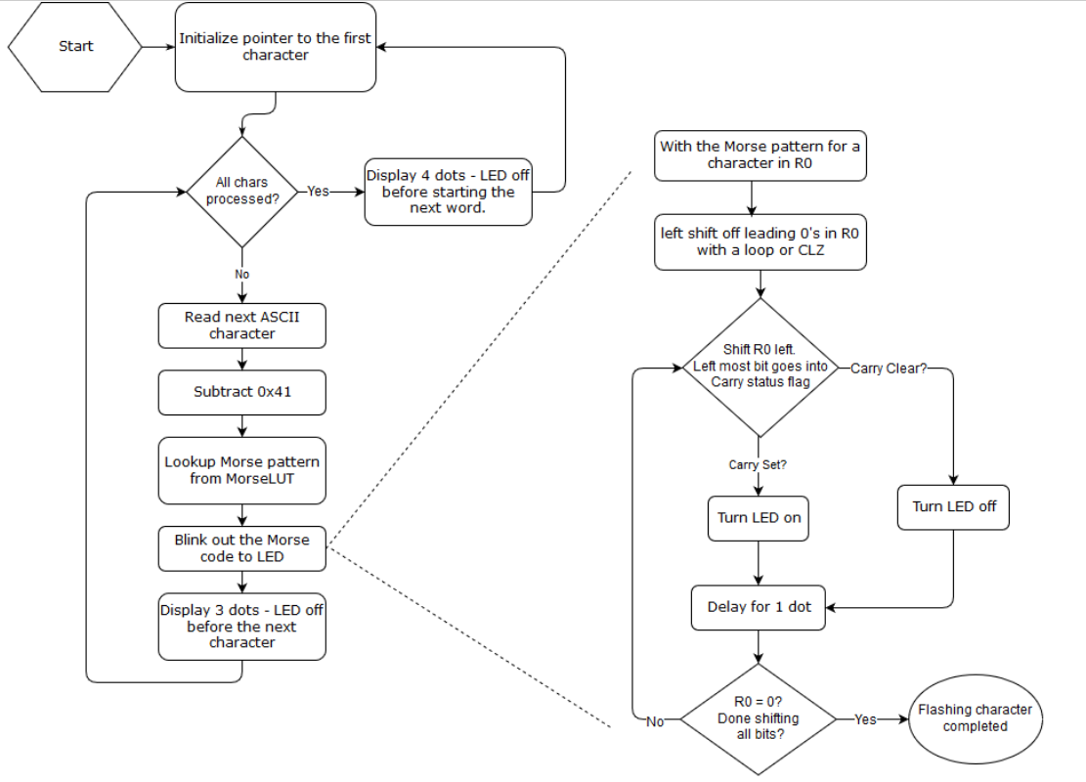
Morse Code Flow Chart
PAGE 11

Slide 12
Deliverables
Lab report:
Your code, well documented.
Make sure you respect delay rules
Read your lab manual carefully and use the code skeleton supplied
Report is submitted on Learn.
Make sure you understand your code for demo questions
Penalty for using flash is -20 marks!
PAGE 12

