Slide 1

EMPLOYEई
Khaaता

Slide 2

INTRODUCTION
Full Stack Application -EMPLOYEई
Khaaता
A employee management system is an application that is designed to manage all the functions of a company. It helps to maintain the database of new employee ,update existing employee,view and delete the record.This system completely automates all the process .
The basic functions of employee management include necessary operations and managing data.

Slide 3
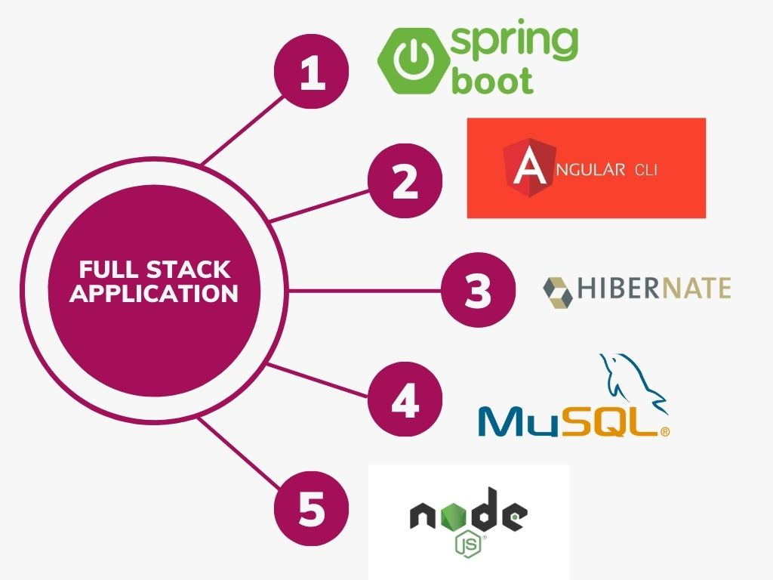
Technologies Used

Slide 4
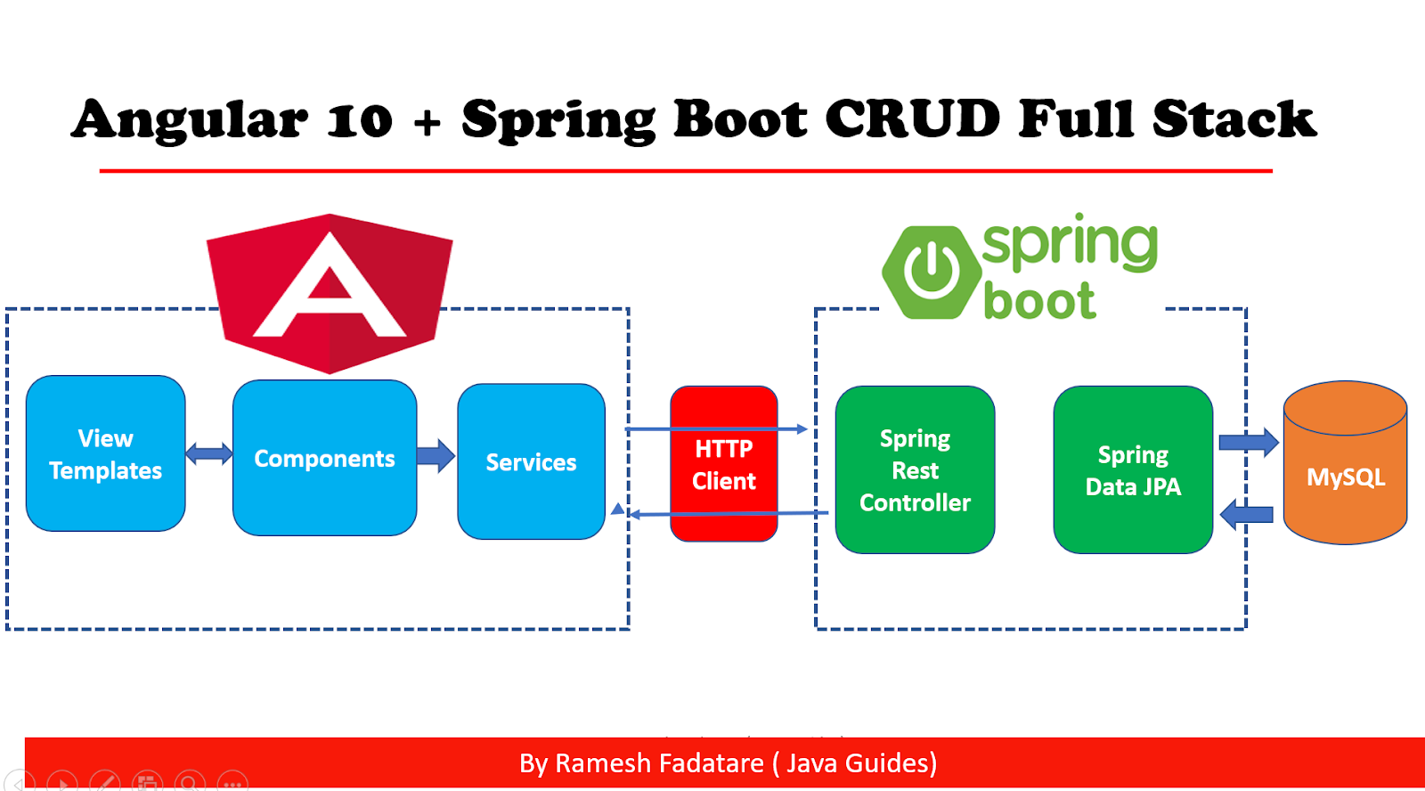


The Architecture of Angular, Spring
& database(MySQL)

Slide 5
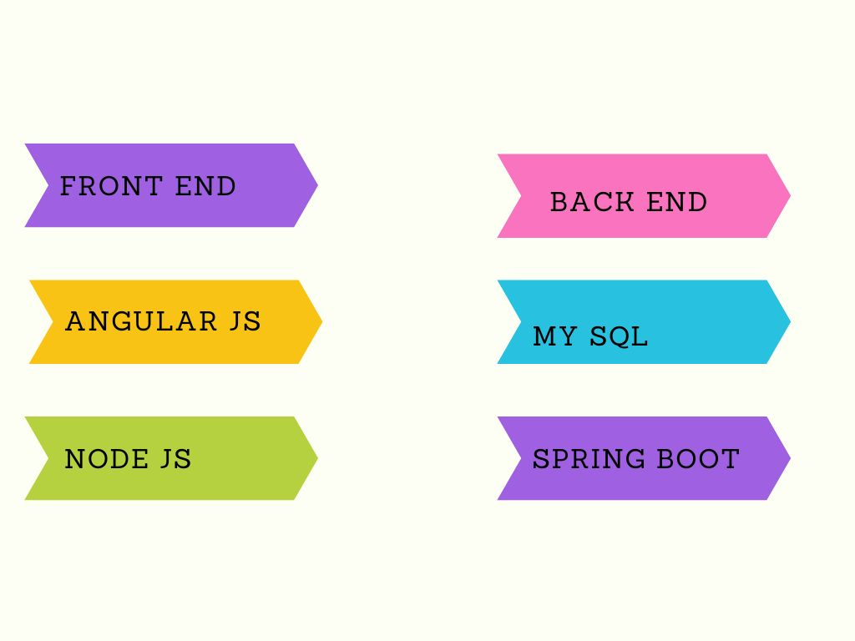
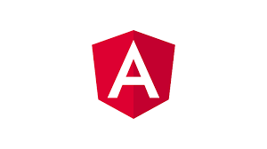



The Architecture of the Project

Slide 6
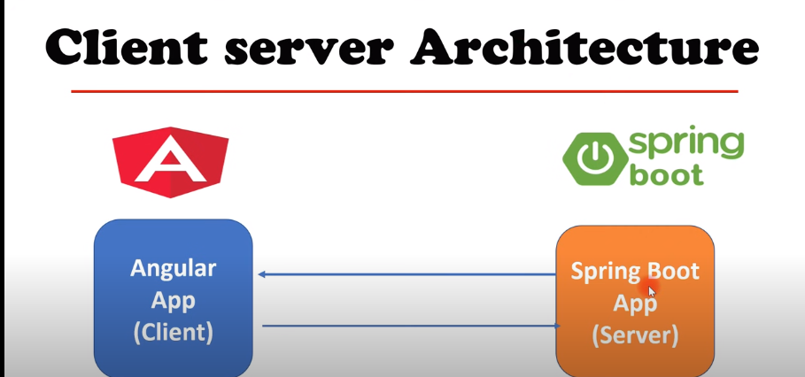

Slide 7
CRUD Operations
View Record
Update Record
Delete
Employee
CRUD
Add Employee

Slide 8
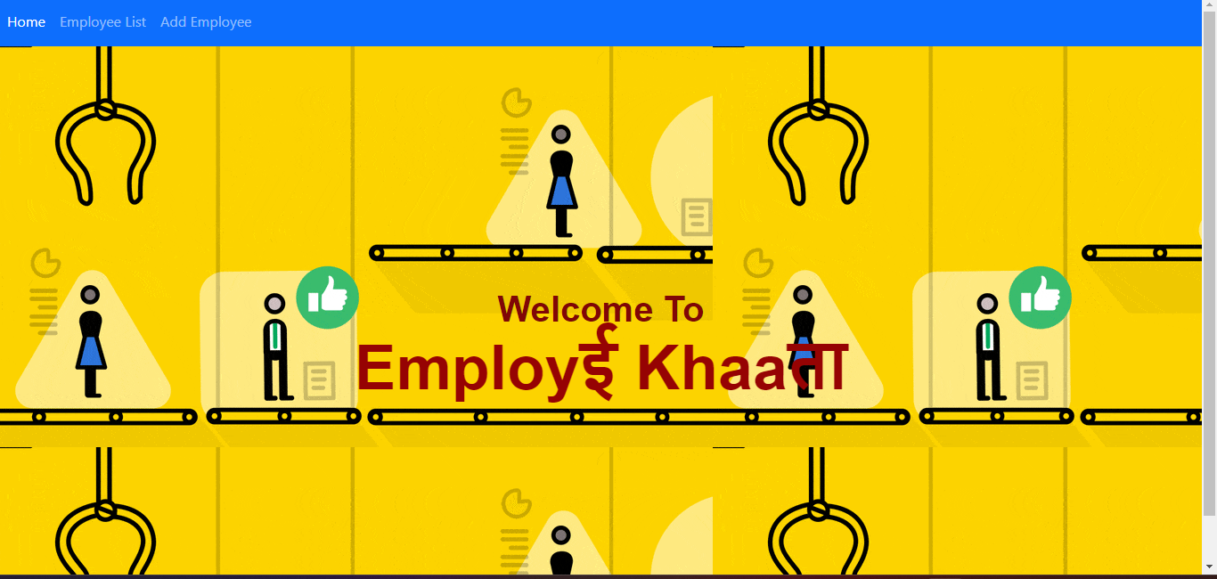
Home Page

Slide 9
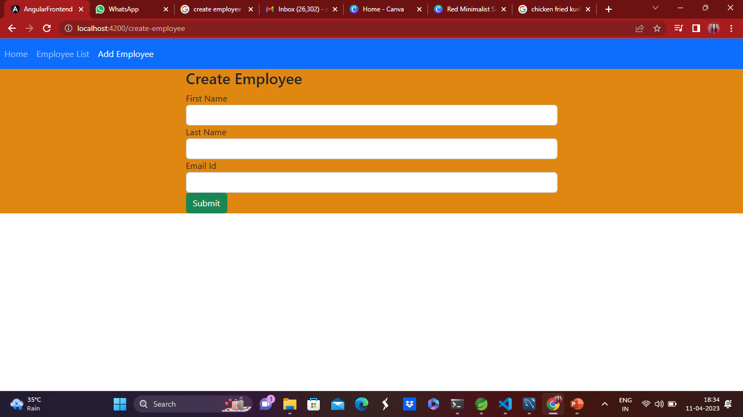
Create Employee

Slide 10
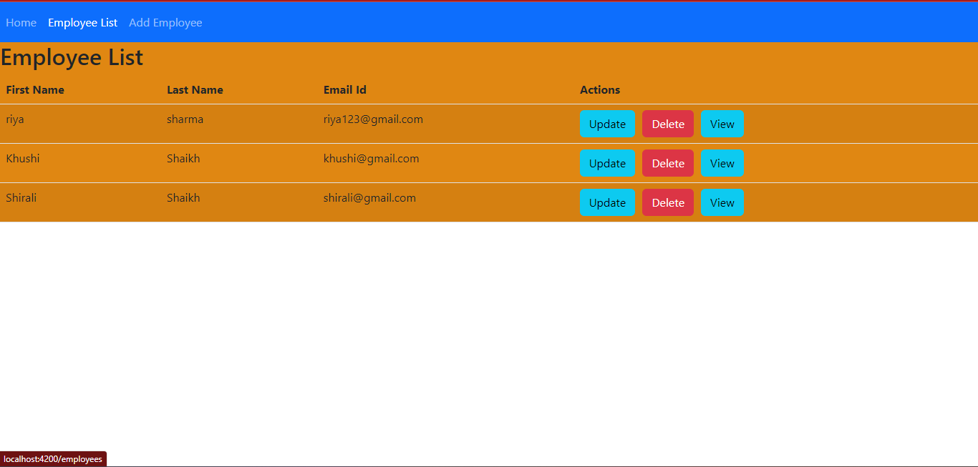
Employee List

Slide 11
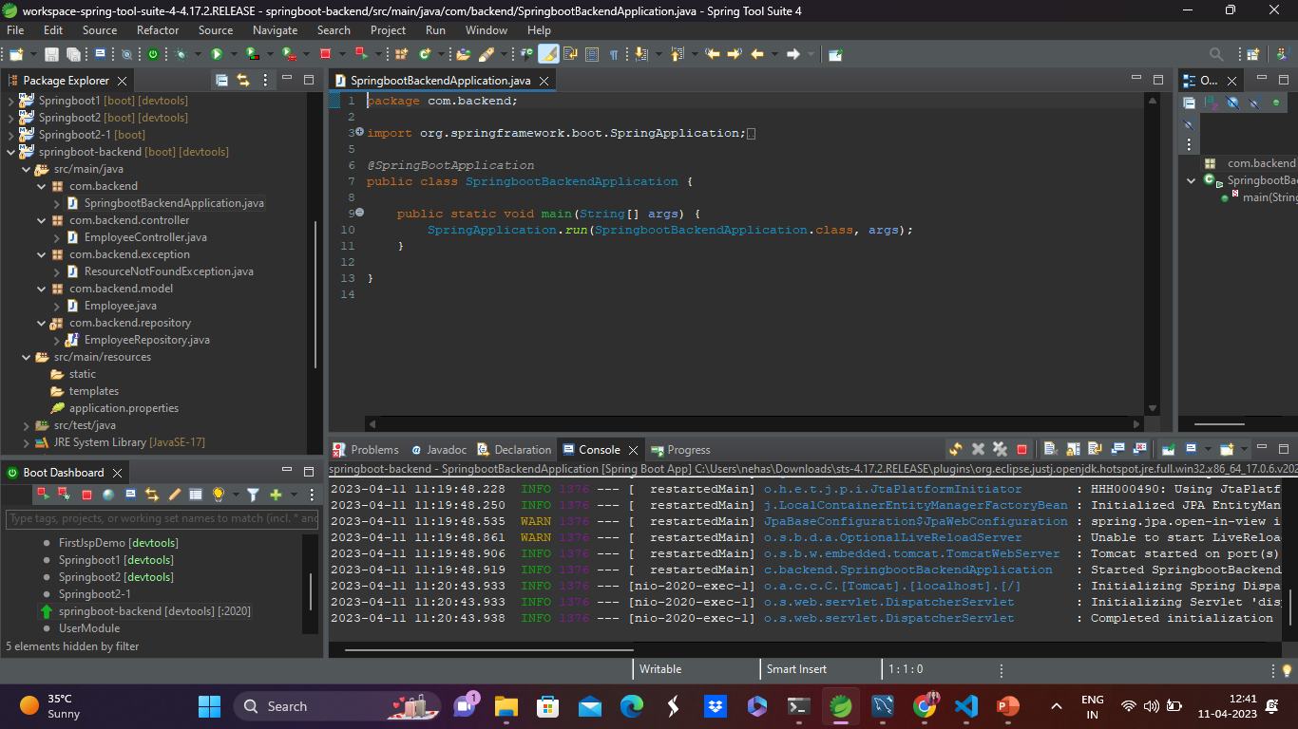
Spring Boot Application

Slide 12
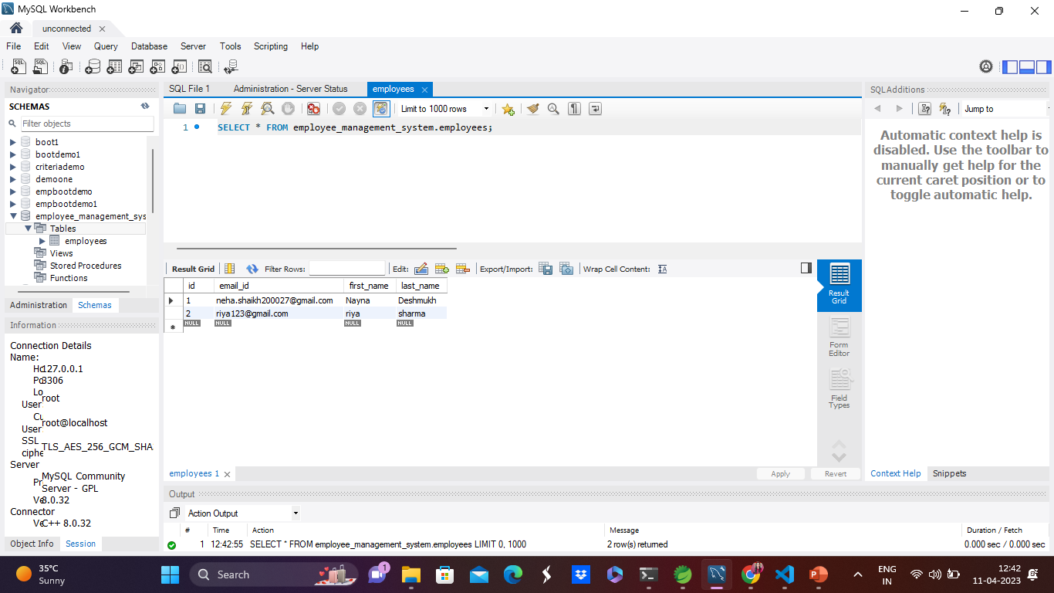
MySQL Code

Slide 13
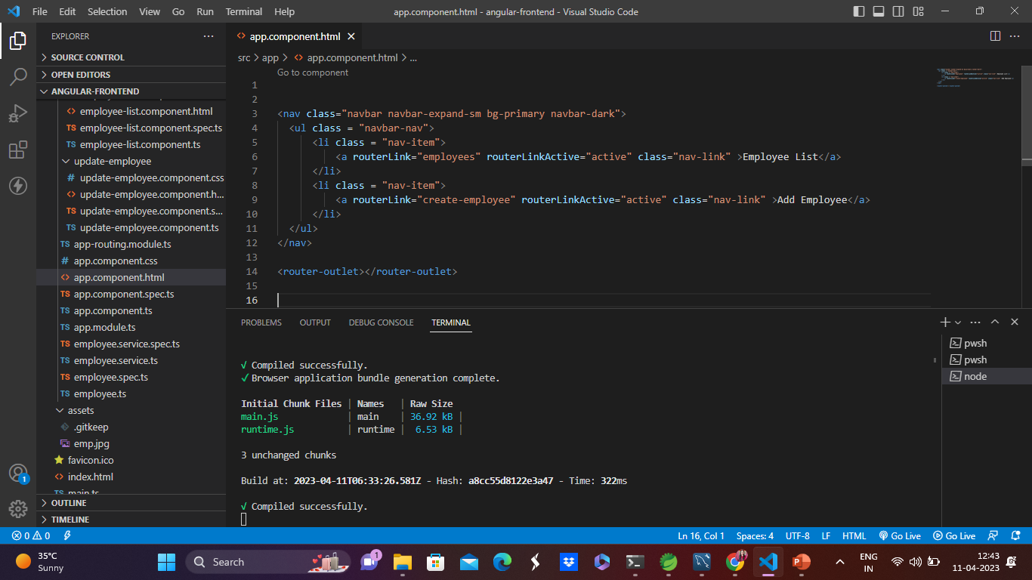
Frontend – Angular JS

Slide 14
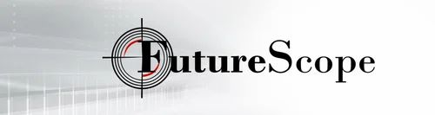
The scope of this project is as follows:
To utilize resources in an efficient manner by increasing their productivity through automation.
The system generates types of information that can be used for various purposes.
It helps us to add , delete, view and update the records efficiently

Slide 15

GitHub Link
https://github.com/nnsskkrr/EmployeeKhata.git

Slide 16

Thank you.

