Slide 1
Linux Daemon
Introduction
Windows Service
PID1 – Init process
Sample: baodaemon
Hanoi, September 2018

Slide 2
History
Change History
Revision | Date | Author | Comments
0.1 | 02.10.2018 | tuan1.le | Initial version

Slide 3
Introduction
Background process.
Supervises the system or provides functionality to other processes.
Type of daemons:
Traditional daemons: SysV Unix.
Modern daemons: Upstart, systemd.

Slide 4
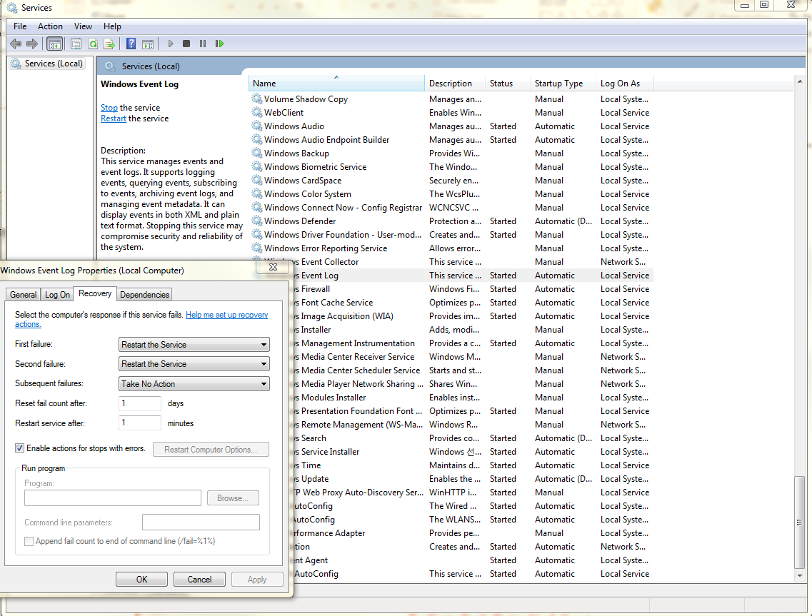
Windows Service
Run > services.msc

Slide 5
Process Identifier 1 – Init process
Unix like system.
By the kernel.
Parent process for all process.
Can do and must do special system works.
Daemon should be child of init process.

Slide 6
Sample: baodaemon

Slide 7


Slide 8
Daemon Management
If we designed a daemon as important one, how can it auto-start with system bootup?
Could a daemon respawn if it is crashed?
How can a daemon communicate with outside?

Slide 9
SysV Init - Linux System Process Initialization
Scripts make the world crawl.
Debian 6, Ubuntu 6.06, CentOS 5.
/sbin/init
read file /etc/inittab for scripts:
/etc/rc.d/rc.sysinit for system initialization tasks.
/etc/rc.d/rc with runlevel T.
/rc.d/rcT.d > Kxxdaemon “stop” > Syydemon “start”
bootup done.
Cons:
start-up serialize.
Shell scripts are slow in execution.
Pros:
Shell scripts are fast to hack.

Slide 10
Traditional daemons
Implementations (see source code sysV_daemon.c)
script at /etc/init.d
#update-rc.d service enable
entry to /etc/inittab file:
id:2345:respawn:/bin/sh /path/to/application/startup
after minutes

Slide 11
Upstart
event-driven model, asynchronously
Ubuntu 6.10 to Ubuntu 14.10, CentOS 6
/etc/init/service.conf
start on runlevel [2345]
respawn
after seconds.

Slide 12
systemd
system and service manager
From Debian 7, Ubuntu 15.04, CentOS 7
Implementations: easier than sysV.
/etc/systemd/system, /run/systemd/system, /usr/lib/systemd/system
#systemctl enable service.service
/etc/systemd/system/multi-user.target.wants/service.service -> /usr/lib/systemd/system/service.service
Restart=always
Immediately.

Slide 13
systemd
Software watchdog
device, mount, target

Slide 14
Interface
IPC
mq
Socket

Slide 15
Conclusions and Discussions
In conclusion, the document guides user to prepare the training document for a training course. User should follow the template as much as possible
This is the first version of the document and sure that there are many issues in this. So, if you have any comment to improve the quality of the document, please:
Send an email to:
Le Anh Tuan
Email: tuan1.le@lge.com
Or make a talk with me any time

Slide 16
References
https://www.freedesktop.org/software/systemd/man/daemon.html
http://0pointer.de/blog/projects/systemd.html
http://glennastory.net/boot/init.html
https://www.digitalocean.com/community/tutorial_series/how-to-configure-a-linux-service-to-start-automatically-after-a-crash-or-reboot
http://www.netzmafia.de/skripten/unix/linux-daemon-howto.html

Slide 17
<Thanks page – Please use your all ability of imagination to make it creativeness>

