Slide 1
Design pattern Adapter and Observer
Adapter pattern
Observer pattern
2020.06.15

Slide 2
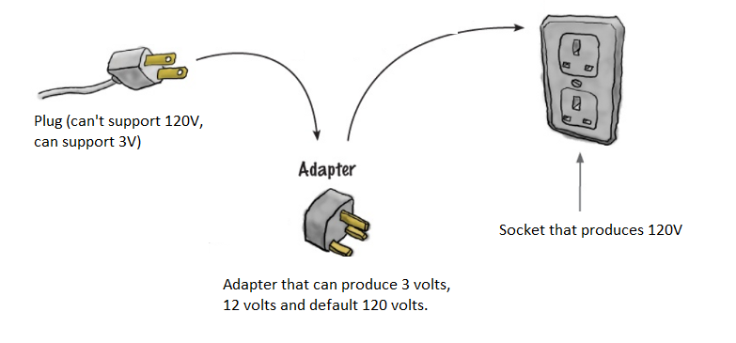
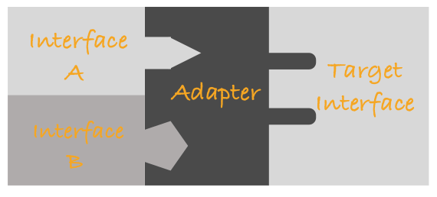
1. Adapter pattern – Problem?
No code changes
No code changes
New code

Slide 3
Definition
An adapter allows two incompatible interfaces to work together. This is the real-world definition for an adapter. Interfaces may be incompatible, but the inner functionality should suit the need. The adapter design pattern allows otherwise incompatible classes to work together by converting the interface of one class into an interface expected by the clients
- Wikipedia

Slide 4
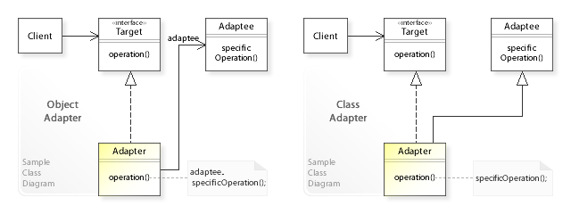
Definition
Two Way Adapter Pattern while implementing Adapter pattern, there are two approaches – class adapter and object adapter – however both these approaches produce same result.

Slide 5
Practice
Replace Current Logger with a Third Party Logger
Current implementation with Console logger
class ConsoleLogger
{
public:
ConsoleLogger() {}
virtual ~ConsoleLogger() {}
virtual void LogError(string message);
virtual void LogInfo(string message);
};
TARGET
class Client
{
private:
ConsoleLogger *_logger;
public:
Client(ConsoleLogger *logger): _logger(logger) {}
~Client() { delete _logger; }
void sampleMethod();
};
void Client::sampleMethod() {
try {
// some code
_logger->LogInfo("This is a log message.");
} catch (const std::exception &ex) {
_logger->LogError(ex.what());
}
}
CLIENT

Slide 6
Practice
Replace current Console logger with Serial Logger class which has different interfaces?
class SerialLogger
{
public:
virtual ~SerialLogger() {}
void error(string message);
void info(string message);
};
Adaptee

Slide 7
Practice
Adapter:
Inherit from Target class as public class
Associate with Adaptee
Convert Adaptee interface to Target interface using polimerphism
class SerialLoggerAdapter : public ConsoleLogger
{
private:
SerialLogger *_logger;
public:
SerialLoggerAdapter(SerialLogger *logger): _logger(logger) {}
~SerialLoggerAdapter() { delete _logger; }
void LogError(string message);
void LogInfo(string message);
};
void SerialLoggerAdapter::SerialLoggerAdapter::LogError(string message) {
_logger->error(message);
}
void SerialLoggerAdapter::SerialLoggerAdapter::LogInfo(string message) {
_logger->info(message);
}

Slide 8
Practice
Usage:
SerialLogger *slogger = new SerialLogger();
SerialLoggerAdapter *sloggerAdapter = new SerialLoggerAdapter(slogger);
Client *newclient = new Client(sloggerAdapter);
newclient->sampleMethod();

Slide 9
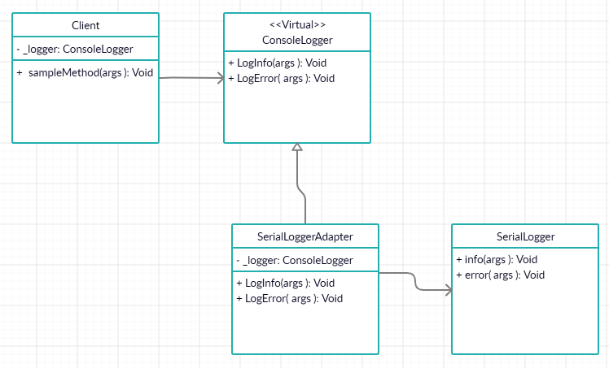
Practice - UML

Slide 10
Practice - Demo
Show the sample code

Slide 11
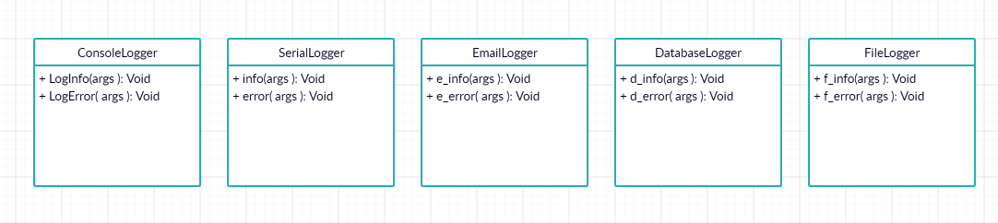
Practice – Improvement
Problem: Let says we want to support more logger types, what should we do?

Slide 12
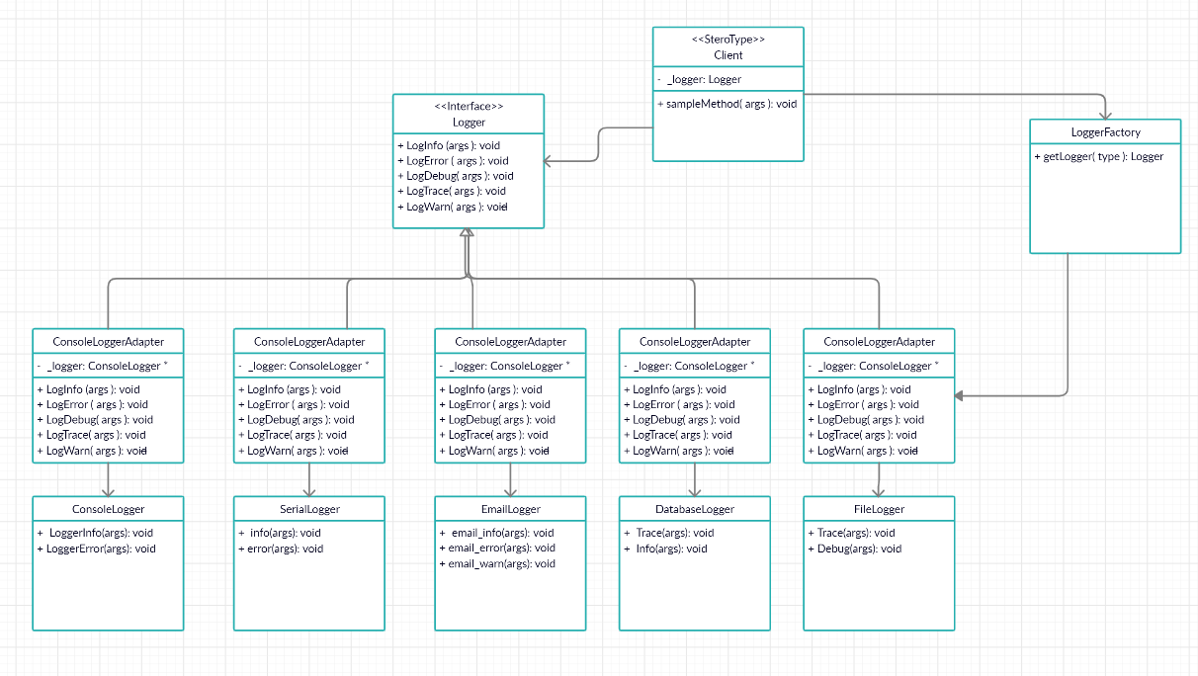
Practice – Improvement
Factory + Adapter + Polymorphism

Slide 13
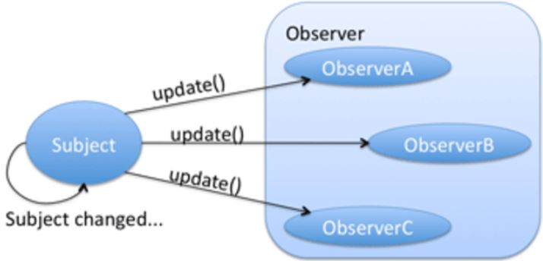
2. Observer – Problem
The Observer pattern addresses the following problems:
A one-to-many dependency between objects should be defined without making the objects tightly coupled.
state an open-ended number of dependent objects are updated automatically. It should be ensured that when one object changes
It should be possible that one object can notify an open-ended number of other objects.
There is no need to modify Subject to add or remove observers.

Slide 14
2. Observer – Definition
The Observer Pattern defines a one-to-many dependency between objects so that when one object changes state, all of its dependents are notified and updated automatically.

Slide 15
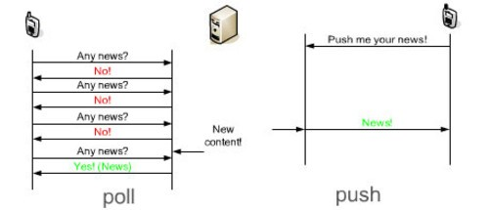
2. Observer – Polling vs Notification
Subject does not need to maintain a list of observers.
Observer take the responsibility to sync state with subject its self.
To be sync in real-time, increase the frequency of polling.
Subject need to maintain a list of observers.
Sync states immediately after changes
Less reusability of subject since it only be used with observer interface.

Slide 16
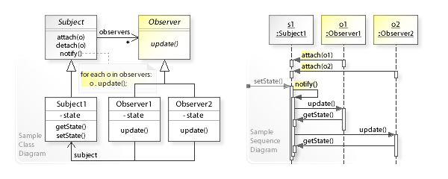
2. Observer – Definition

Slide 17
2. Observer – Practice
/**
* Interface for the Subject
*/
class Subject {
public:
/**
* Register an observer
* @param observer the observer object to be registered
*/
virtual void registerObserver(Observer *observer) = 0;
/**
* Unregister an observer
* @param observer the observer object to be unregistered
*/
virtual void removeObserver(Observer *observer) = 0;
/**
* Notify all the registered observers when a change happens
*/
virtual void notifyObservers() = 0;
};

Slide 18
2. Observer – Practice
/**
* Interface for the Observer
*/
class Observer {
public:
/**
* Update the state of this observer
* @param temp new temperaure
* @param humidity new humidity
* @param pressure new pressure
*/
virtual void update(float temp, float humidity, float pressure) = 0;
};

Slide 19
2. Observer – Practice
Show the sample code

Slide 20
2. Observer – Improvement 1
Problem1:
Subject must know common data that all observers interested in -> less reusability of Subject class.
Performance issue if subject has a large amount of data to be published.

Slide 21
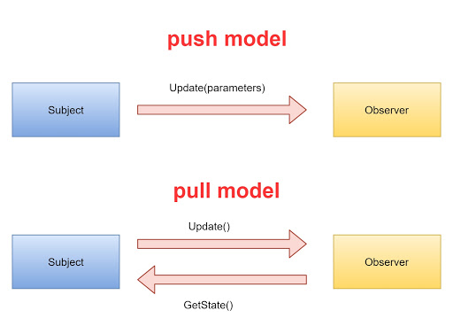
2. Observer – Improvement 1
Solution:
Use pull model to get necessary data instead to a void redundant data.
Subject only need to notify that it has been changed something.
Observer will query its required data via public interface.

Slide 22
2. Observer – Improvement 2
Problem 2:
Redundant Notification
void OptimizedWeatherData::setState(float temp, float humidity, float pressure) {
// Set all
this->setStateTemp(temp);
this->setStateHumidity(humidity);
this->setStatePressure(pressure);
notifyObservers();
}
void OptimizedWeatherData::setStateTemp(float temp){
// Set temp
this->temp = temp;
notifyObservers();
}
void OptimizedWeatherData::setStateHumidity(float humidity){
// Set humidity
this->humidity = humidity;
notifyObservers();
}
void OptimizedWeatherData::setStatePressure(float pressure){
// Set pressure
this->pressure = pressure;
notifyObservers();
}

Slide 23
2. Observer – Improvement 2
Solution:
Subject implement a change tracker to determine actual changes so we can avoid multiple unneccesary notification. (see more in sample code)
class ChangeTracker
{
protected :
uint32_t m_changeCount;
virtual void startChange() = 0 ;
virtual void finishChange() = 0;
ChangeTracker() { m_changeCount = 0; }
virtual ~ChangeTracker() {}
};

Slide 24
Thank you!

