Slide 1
Database representation
Nhóm 4
Trần Đức Anh
Đặng Sỹ Duy
Bùi Minh Thành

Slide 2
INTRODUCTION
Inspired by Netflix website, our website was released to help users find and watch movies/shows with some example videos included.
The name Chilix was inspired by the famous original motto: “Chill with Netflix”

Slide 3
some main functions:
Login / Sign in
Register / Create new account / Sign up
Search movie/show to watch (Videos can be played by clicking buttons)
TV shows or Movies button to categorize
Profile section for user information and update passwords
Log out to sign in a differnet account
With some more functions coming soon in the future such as physical DVDS for rental, so we will create a new button “Rent” in every movie/TV show for users to rent. When users decide to rent a DVD, they click “Rent” button and then get to a store to rent. The store information is in `store` table. Some tables which are not in use at the moment this website was shown (`rental` , `payment`, `store`,…) will be used to record infotmation related to user’s rental => Future Work

Slide 4
DATABASE
- Database name: netflix_clone
With some main tables which are used:
`users`: includes users records who are signed up to get into web.
`entities`: includes movie/show-related information.
`category`, `videos`, `videoprogress`,...
- With some more tables that we learned from Sakila database, most of them will be used for future work (which I mentioned before): `rental`, `payment`, `store`,…

Slide 5
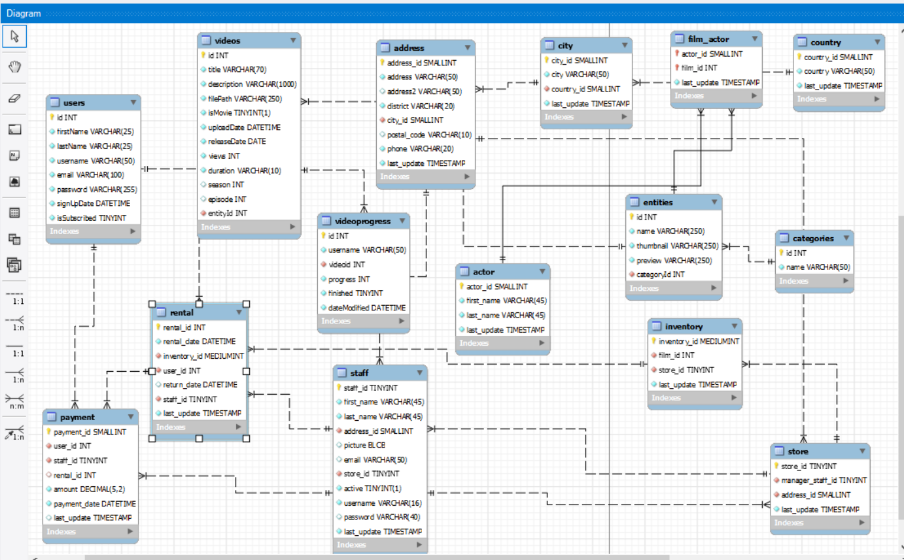
Relational database

Slide 6
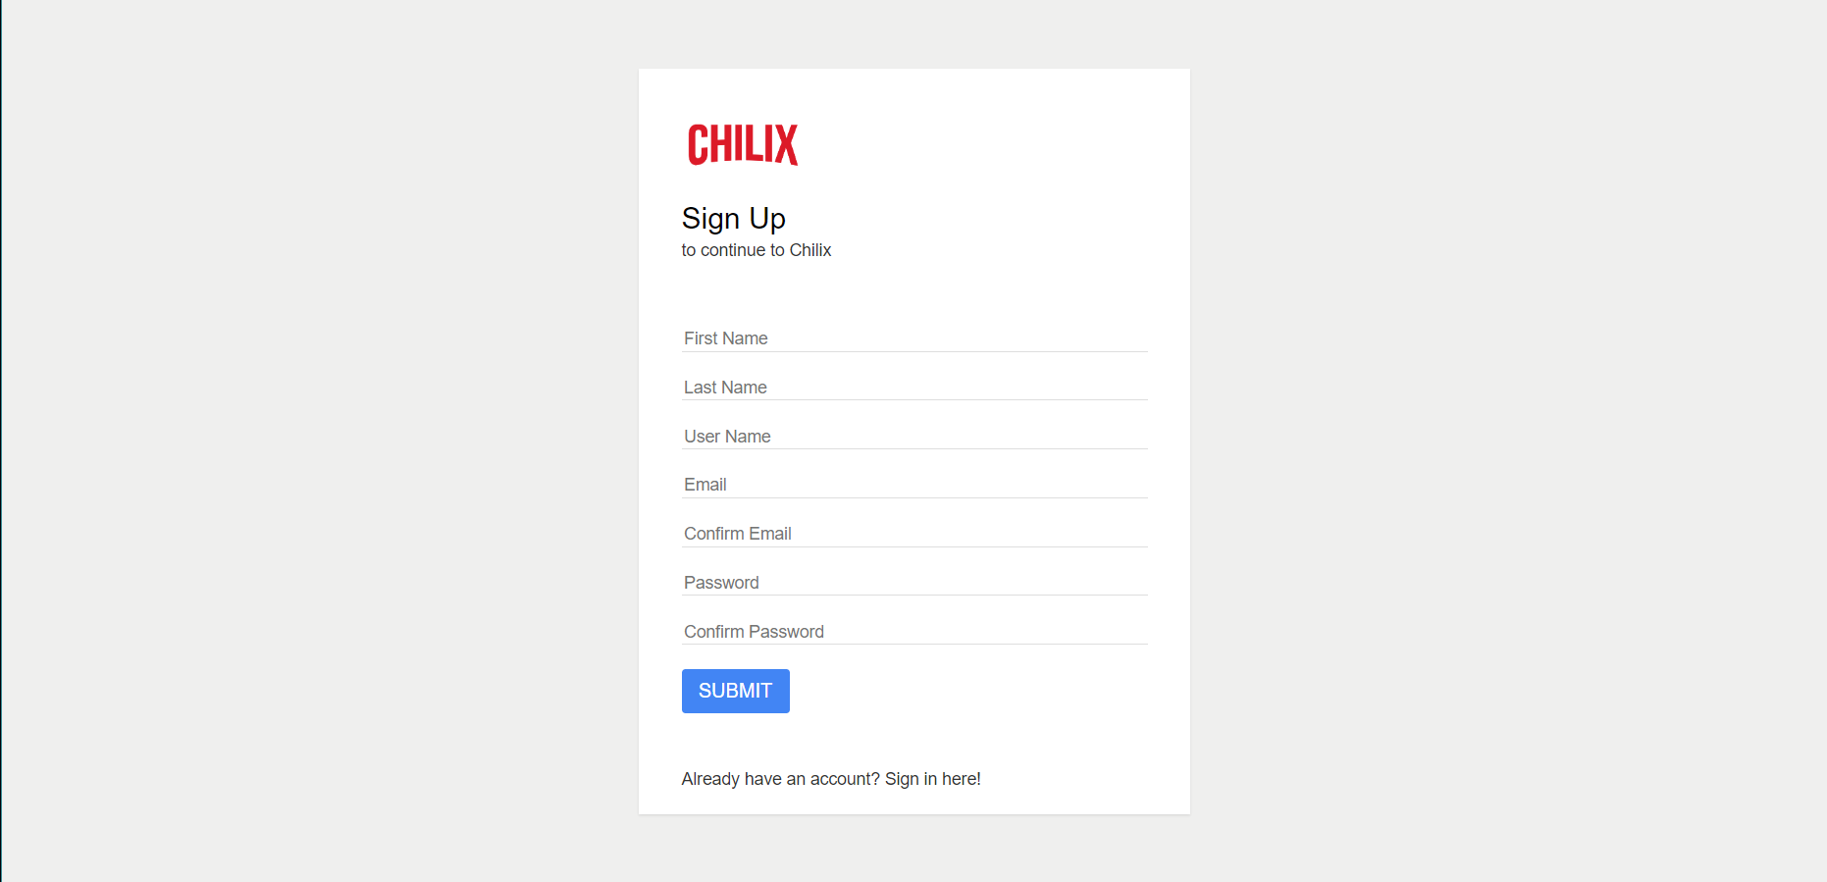
Preview pages

Slide 7


Slide 8
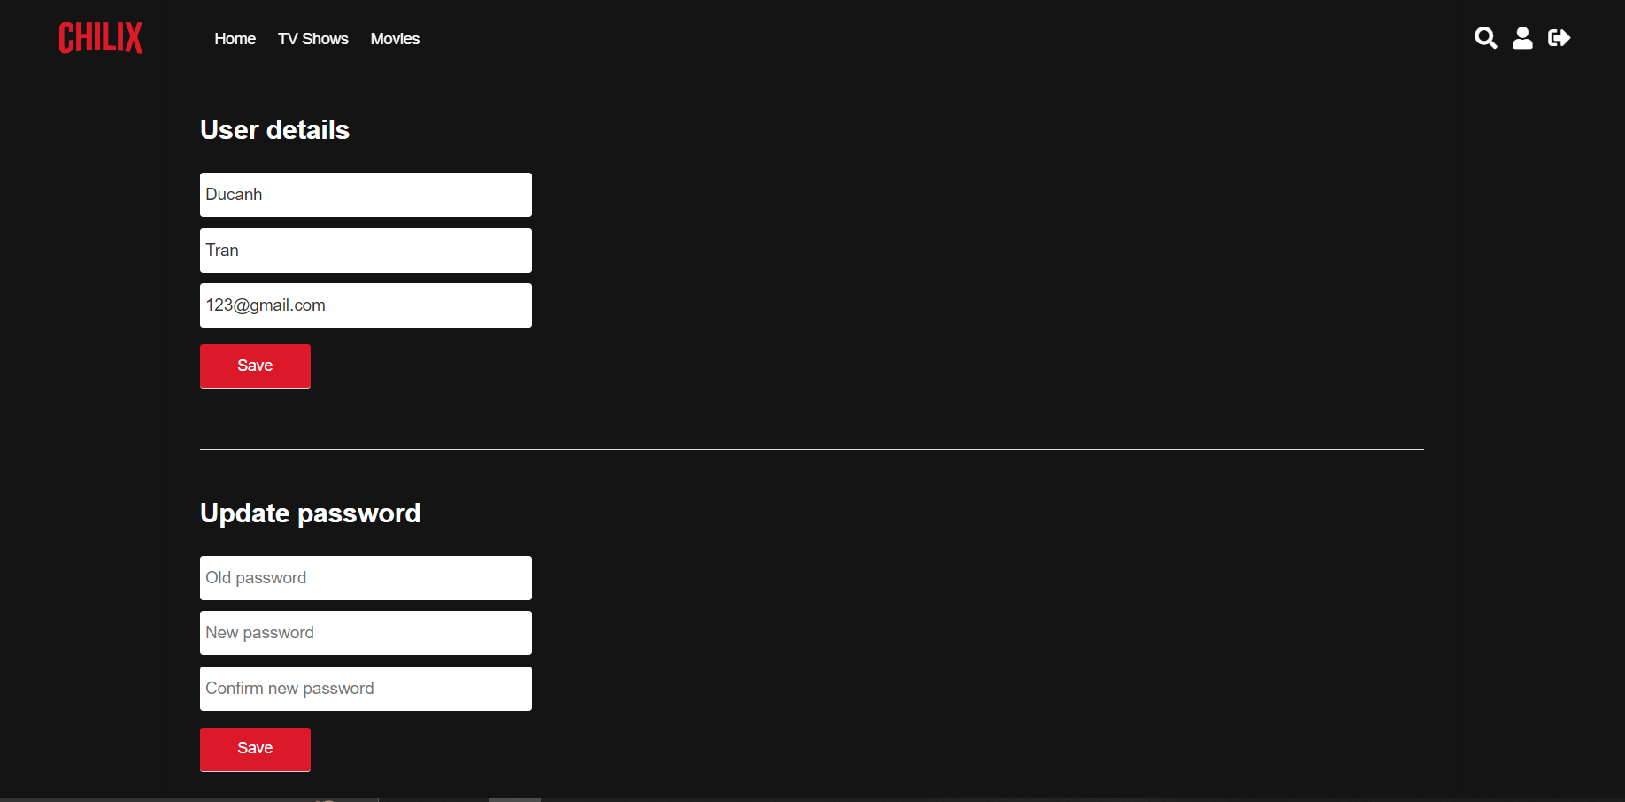

Slide 9


