Slide 1
Solar Power Generation
Understanding Controls on Power Generation and Predicting Future Power Generation

Slide 2
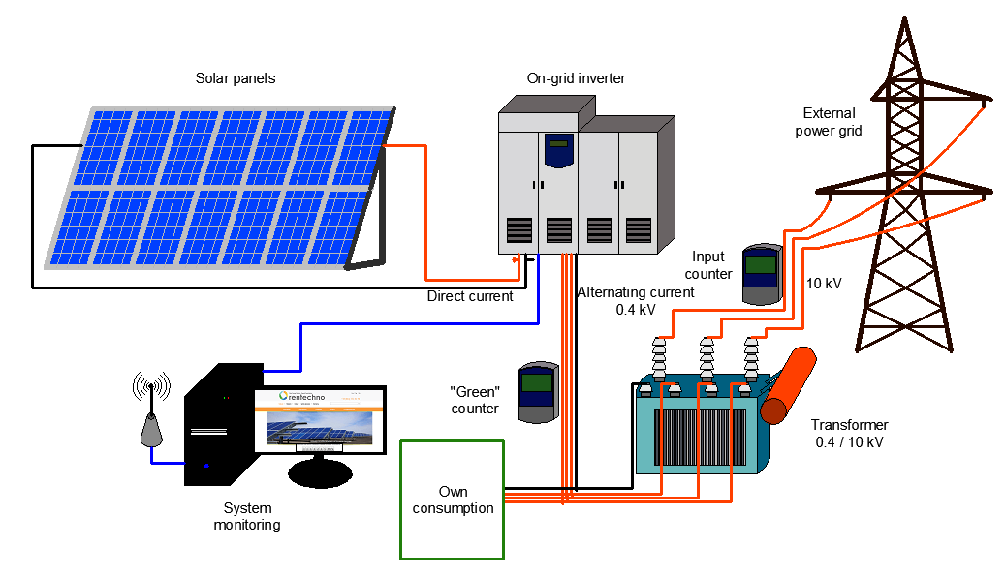
Solar Power Generation

Slide 3
Objectives
Understand controls on power generation
Identify sub-optimal equipment
Create a model to predict daily yield
Predict daily yield for 3 days

Slide 4
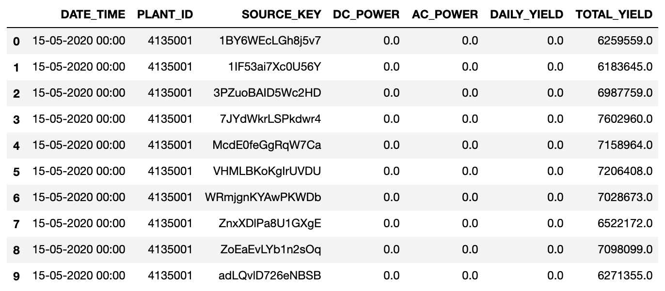
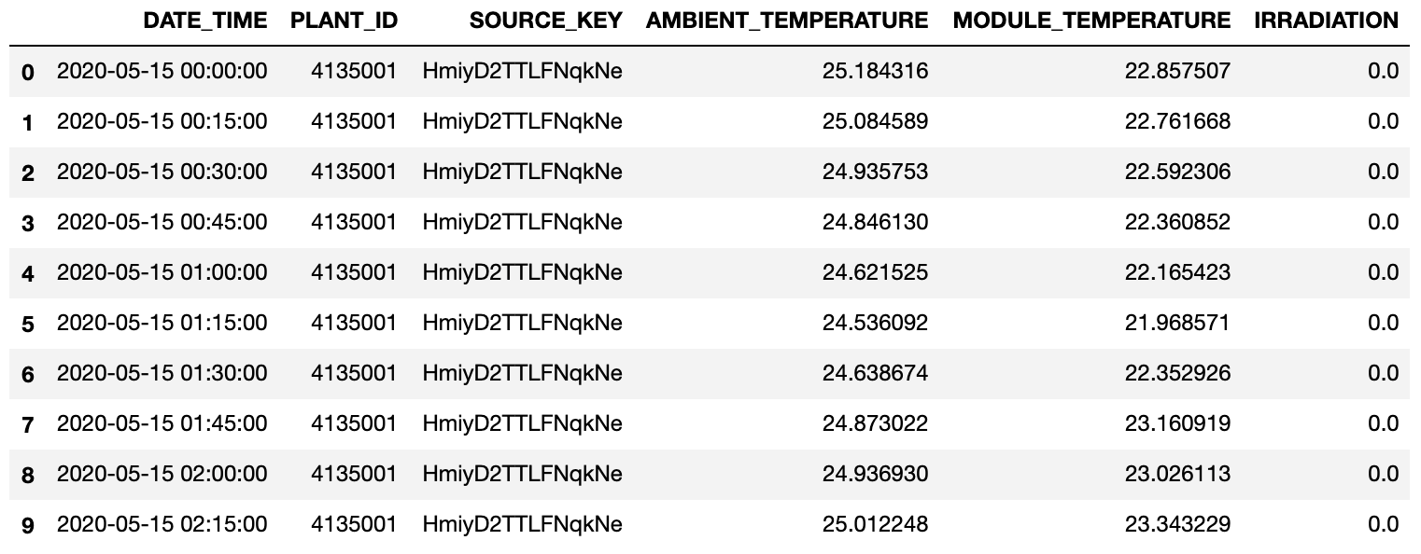
Datasets
Power Generation Data
Weather Sensor Data
Details
15-minute increments
Per solar module

Slide 5
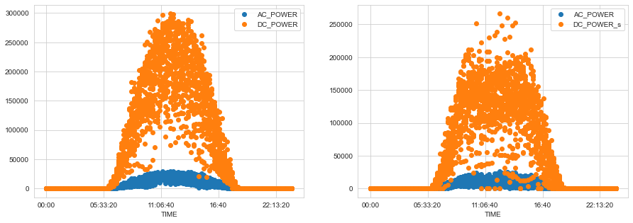
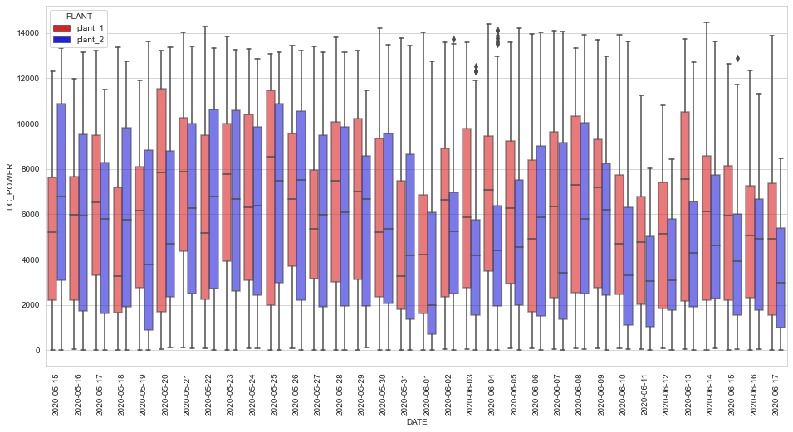
DC & AC Power Generation
Power generation window
Plant 2 is generating less DC power, on average
Plant 1 is more consistent

Slide 6
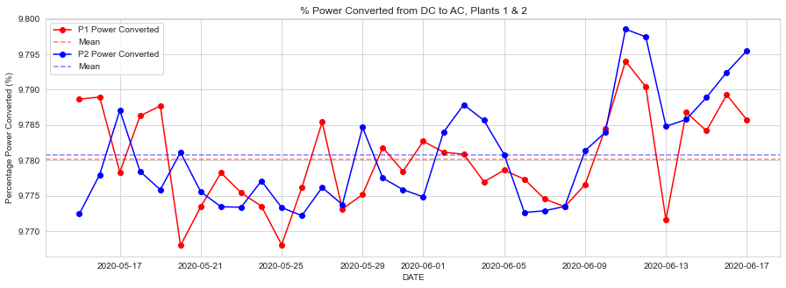
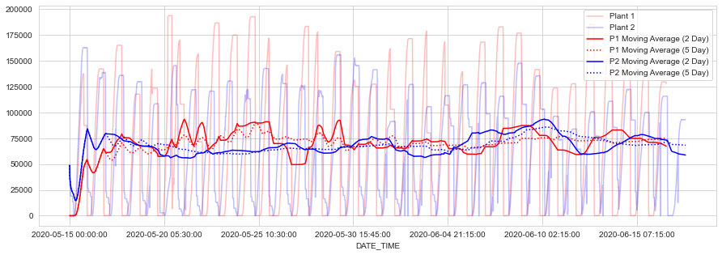
Converted Power and Power Trends
Converted power (DC -> AC )
Average for both plants is approximately 9.78%

Slide 7
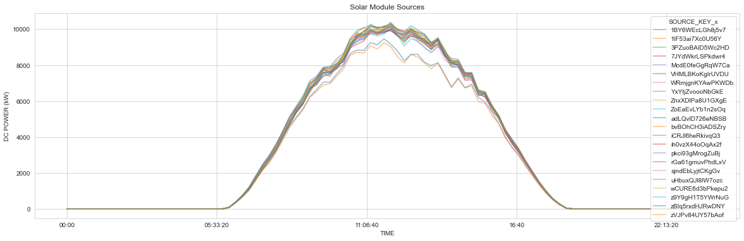
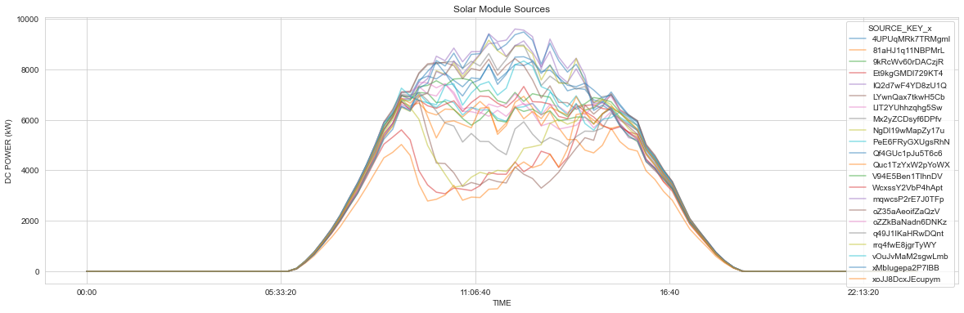
Module-Level Generation
Plant 1 more consistent generation by module
Only 2 underperforming modules
Many underperforming modules in Plant 2

Slide 8
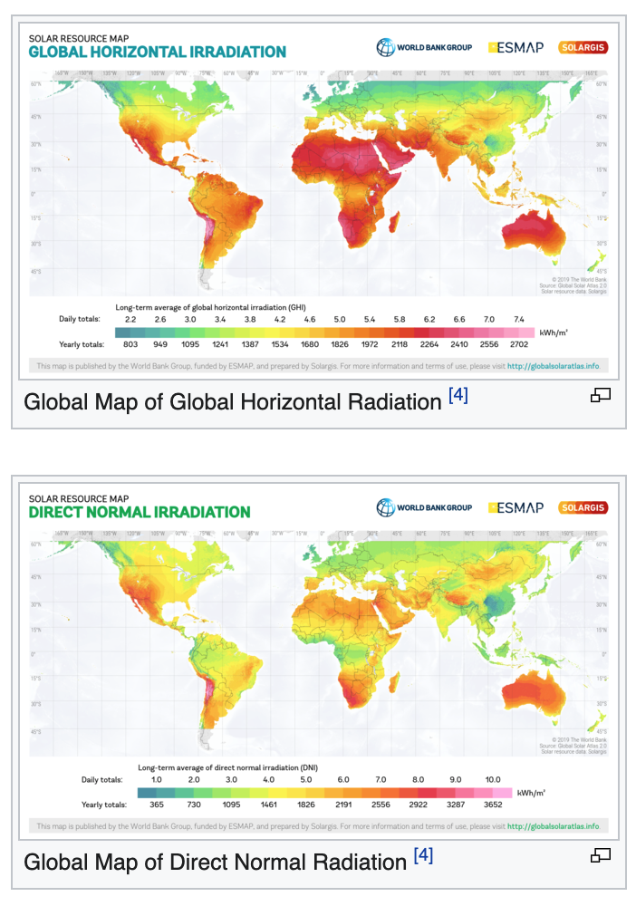
Weather Sensor Terminology
Irradiation
‘Power per unit area received from the sun’
Measured in W/m^2
Module Temperature
Temperature of the solar panel module
Ambient Temperature
Air temperature
Delta Temperature
Abs(Module Temp – Ambient Temp)

Slide 9
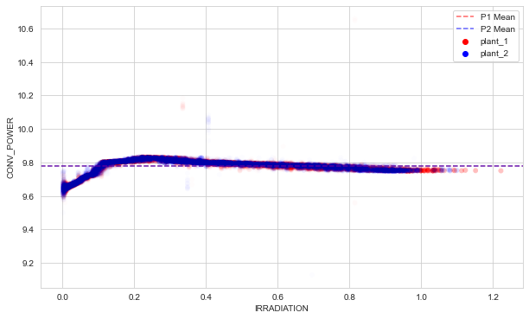
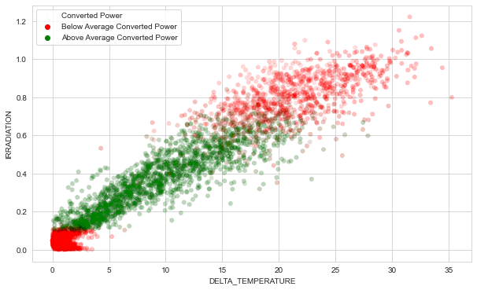
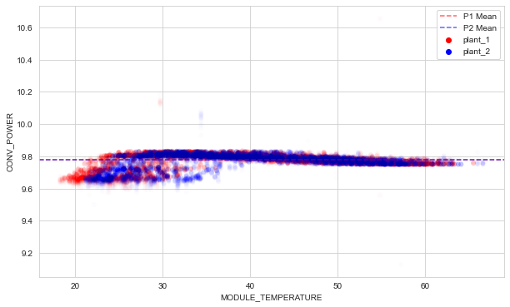
Weather Sensor Data Controls on Power Generation

Slide 10
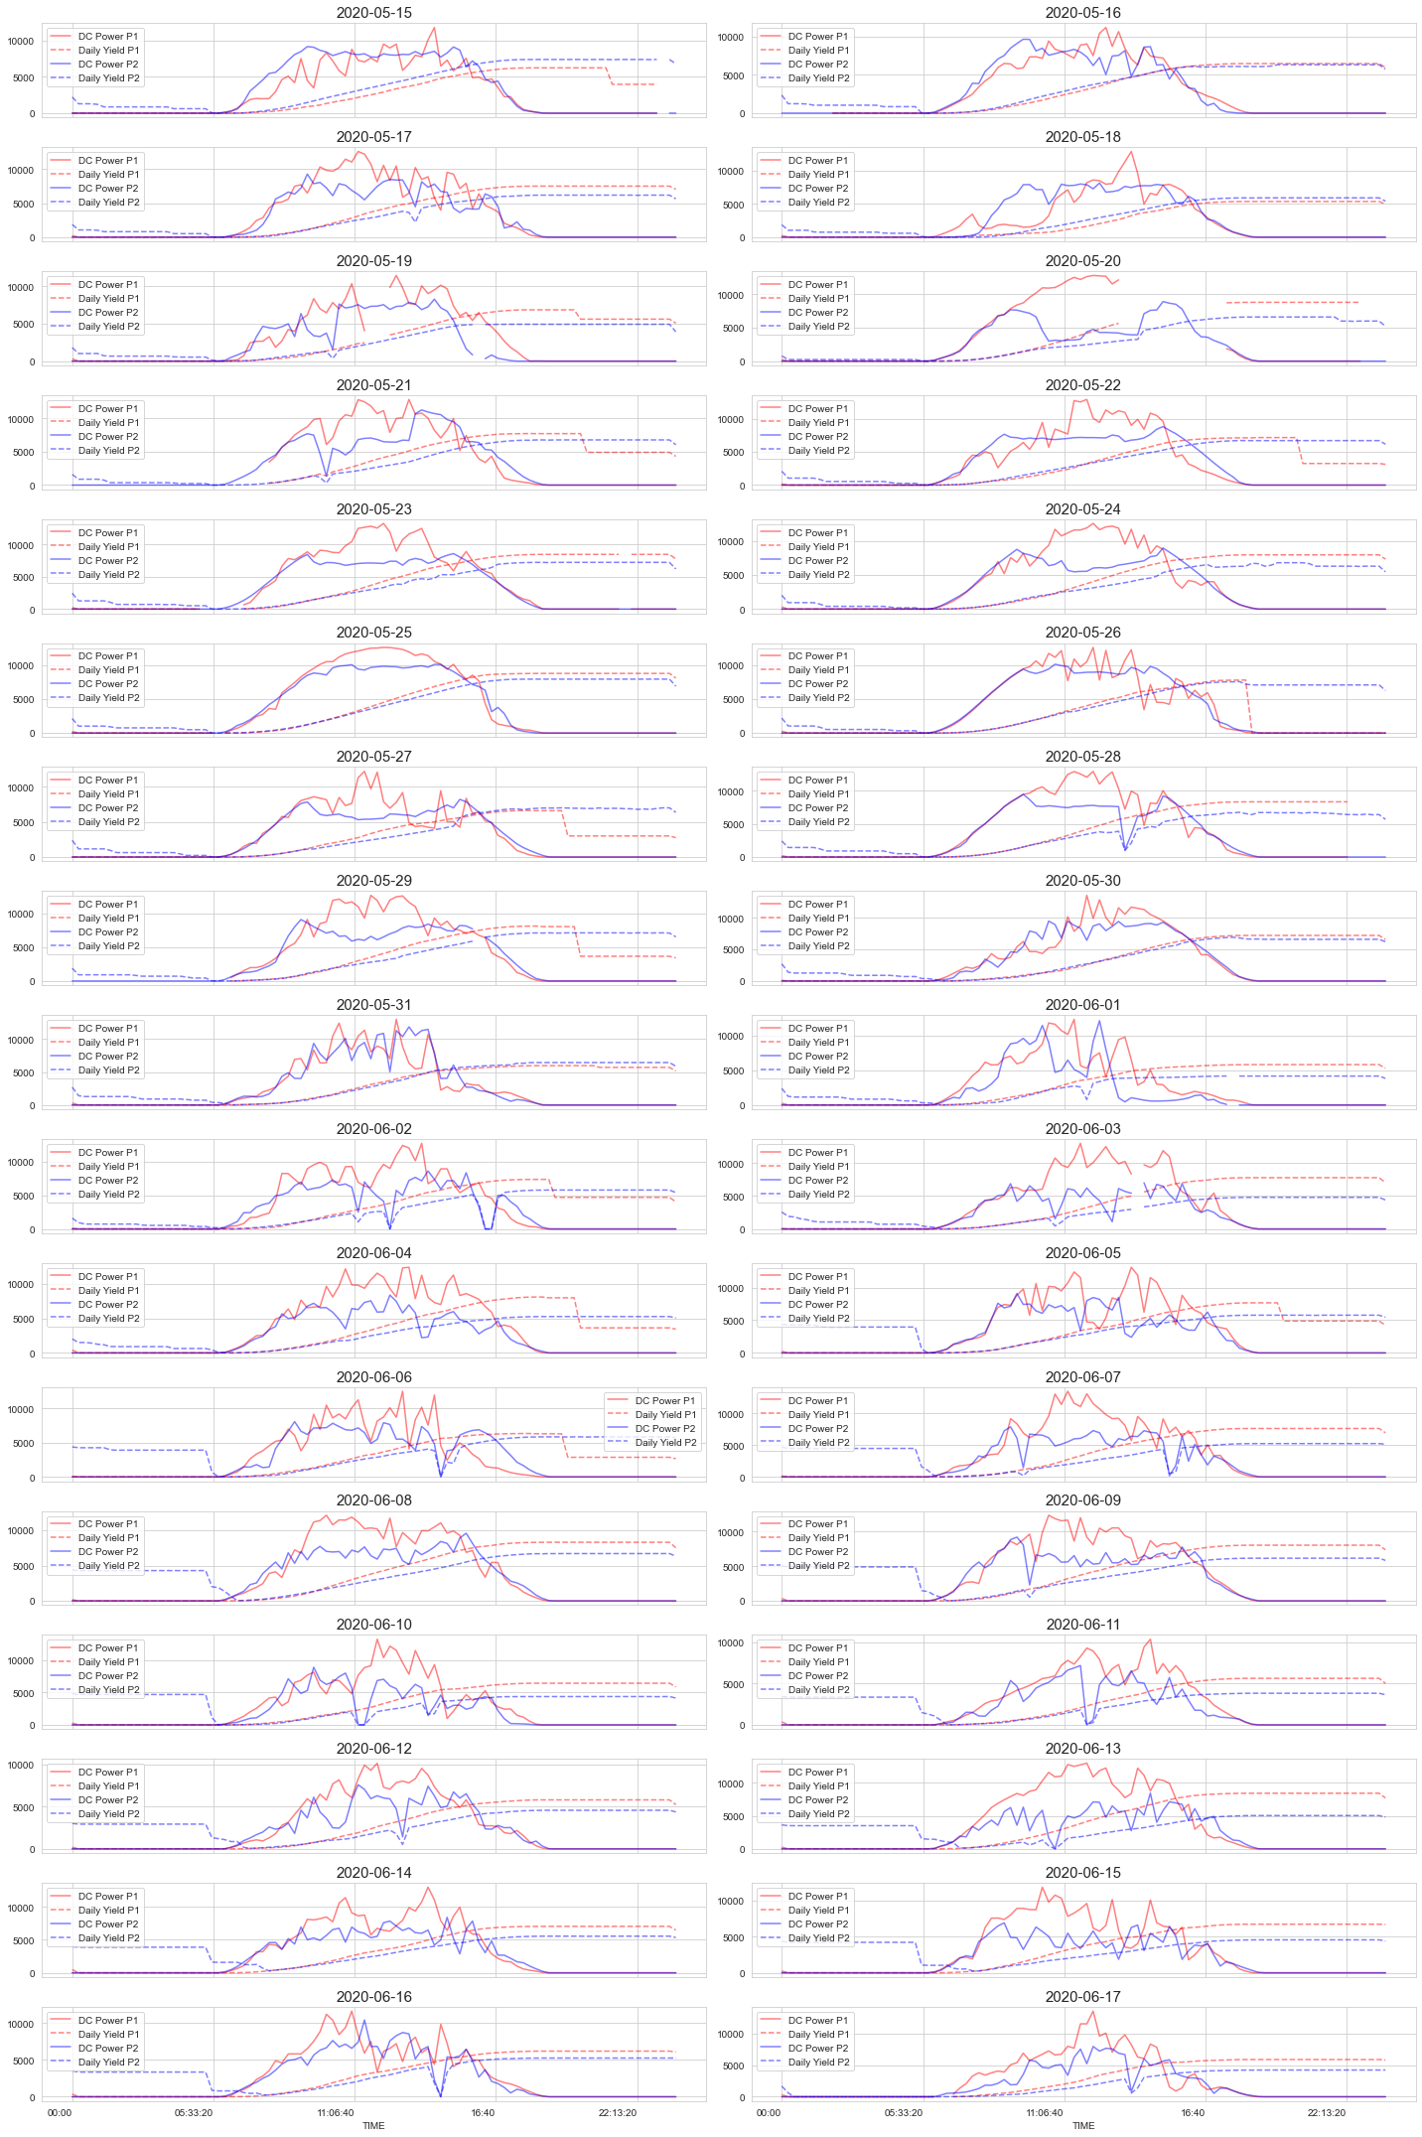
Training and Testing Considerations
Extreme values/change in values
Missing Daily Yield values
Length of training set/cross-validation
Testing different models (SARIMAX and Prophet)
Error values and model selection

Slide 11
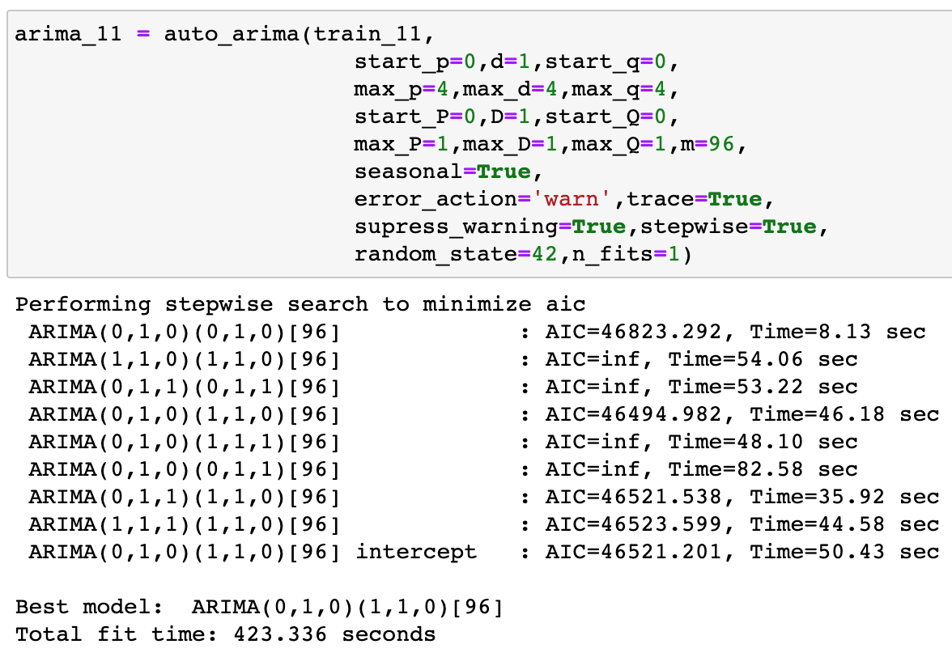
Training and Testing – ARIMA Model Generation
Auto-ARIMA model selection
Time-intensive, but clear information about iteration

Slide 12
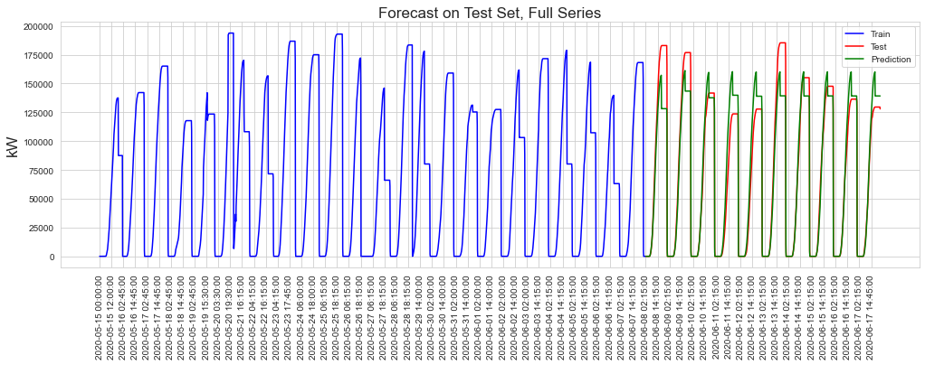
Training and Testing – Full Data Series
SARIMAX(0, 1, 0)x(1, 1, 0, 96)
R2 = 0.928394 , MAE = 10648.491978, RMSE = 17024.627626

Slide 13
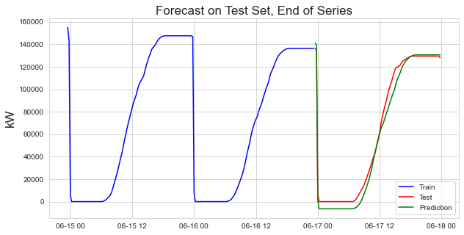
Training and Testing – Full Data Series
SARIMAX(4, 1, 0)x(0, 1, 1, 96)
R2 = 0.986854 , MAE = 5473.729280, RMSE = 6801.701425

Slide 14

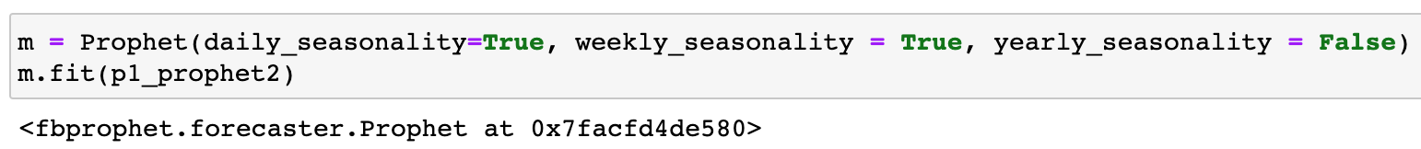
Training and Testing – Prophet Model
Open-source model from Facebook
Pros: fast, versatility for seasonality
Cons: “Black Box”, not intuitive or interpretive

Slide 15
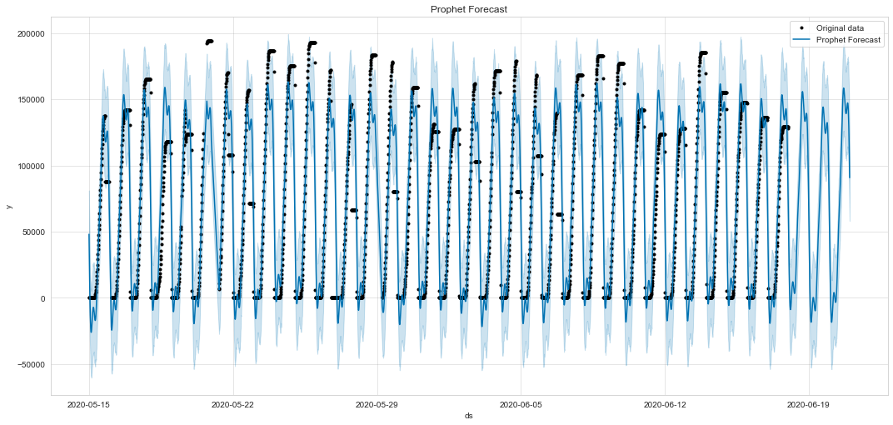
Training and testing – Prophet Model
R2 = 0.889538 , MAE = 15177.635454, RMSE = 22184.559460

Slide 16
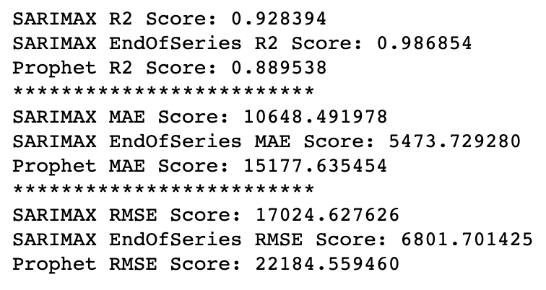
Model Metrics
Prophet model runs quickest, easiest
“Black Box” style model process
SARIMAX generalizes better, easier to understand model
‘End of Series’ train/test has lowest error metrics
Full Series performs better than Prophet

Slide 17
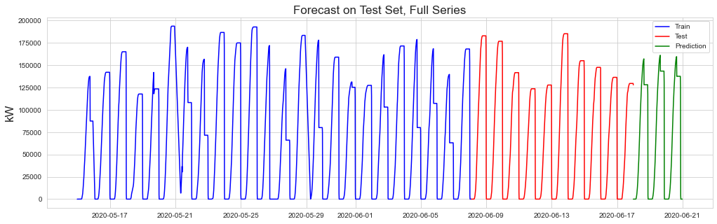
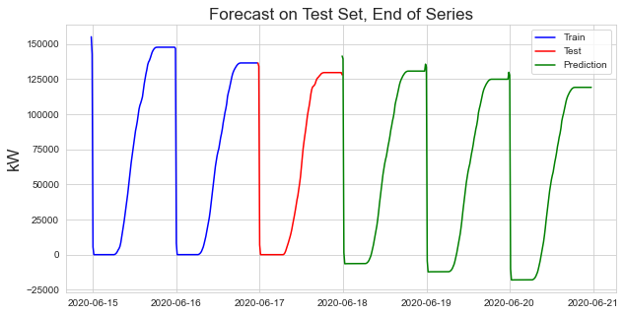
Prediction 3 Days of Daily Yield
Different predictions for each model
Full-Series SARIMAX is only model with no negative values

Slide 18
Solar Plant Summary
Each plant has similar converted power percentage
Plant 2 has sub-optimally performing equipment
Ideal irradiation range for converted power optimization
Both SARIMAX and Prophet models have pros/cons
SARIMAX full-series is ideal model for predicting future power generation

Slide 19
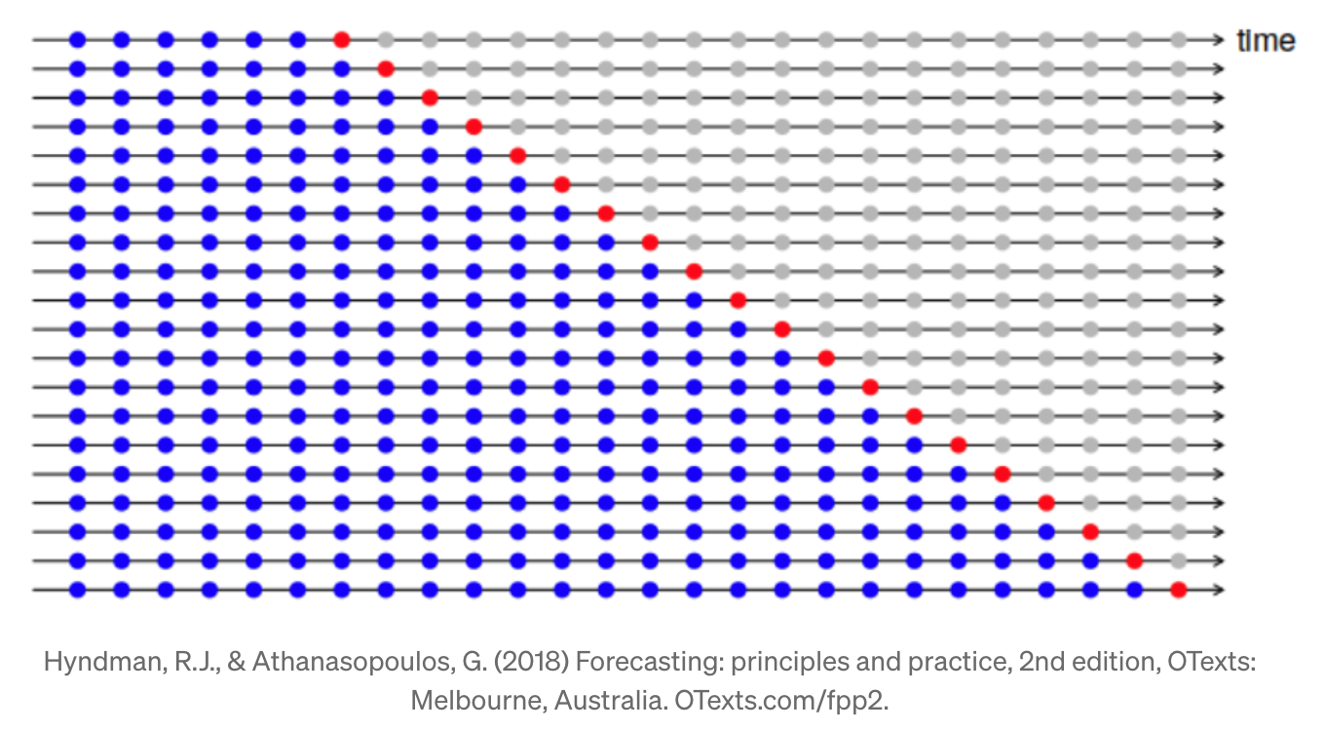
Next Steps
More rigorous cross-validation in Auto-ARIMA
Compare cumulative forecast yield with similar windows in dataset

