Slide 1

Diamond Price Prediction
Understanding Controls on Diamond Price and Diamond Price Prediction

Slide 2
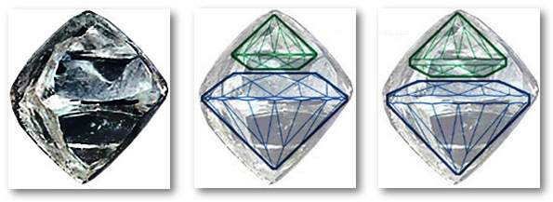
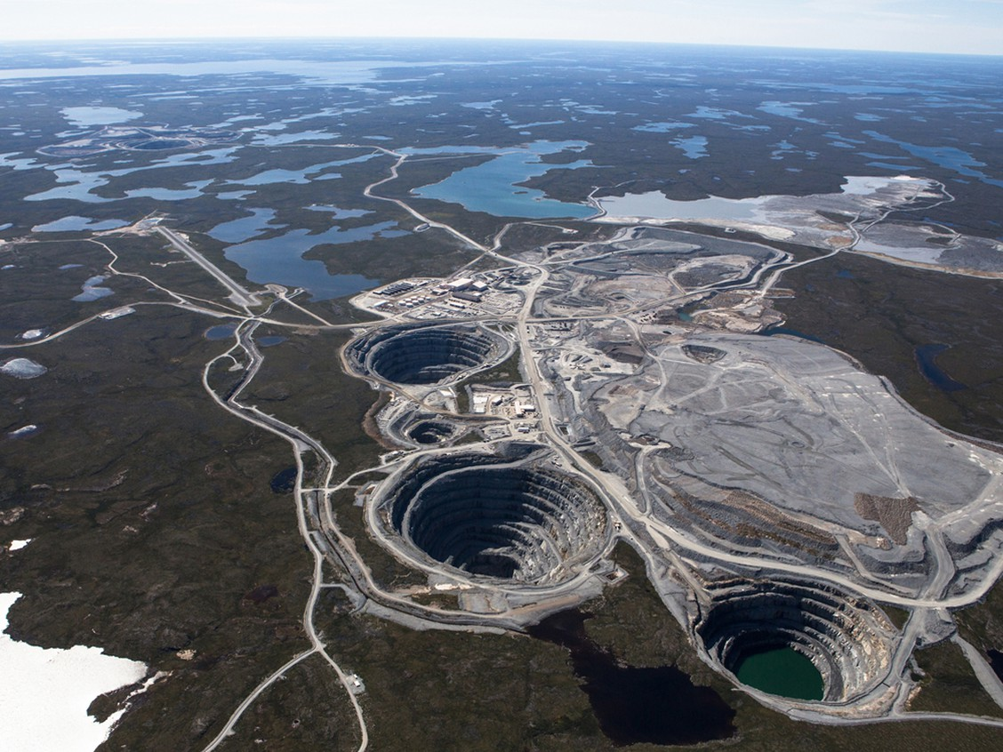
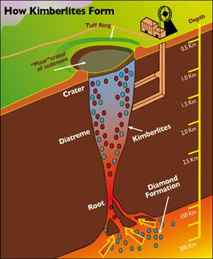
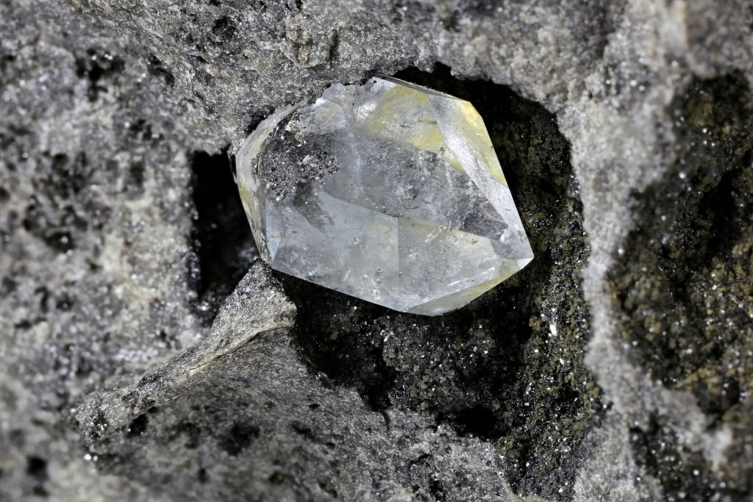
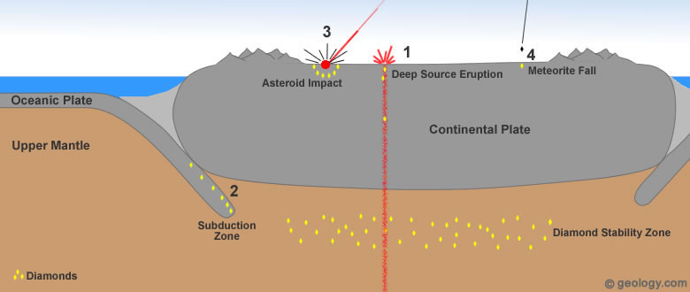
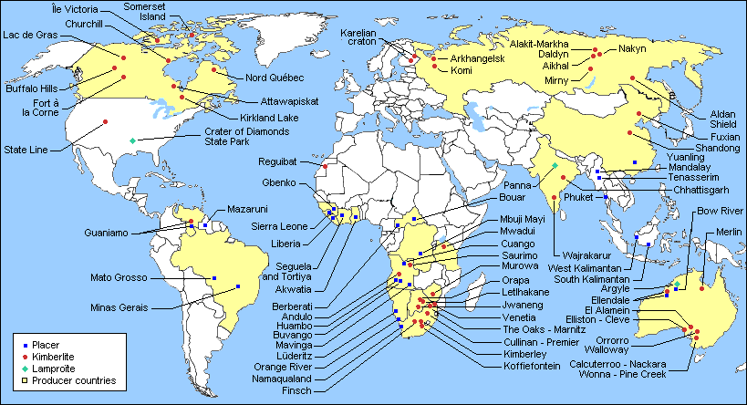
Diamond Genesis
Diamonds created billions of years ago
Brought to surface through deep source eruptions
Mined in open pits, diamonds come out ‘rough’
Diamonds are cut into desired shape

Slide 3
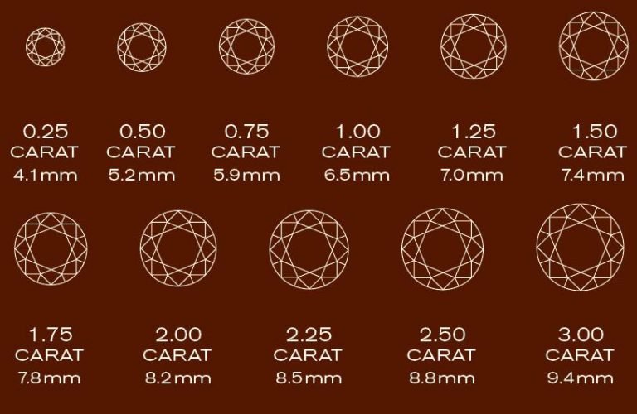
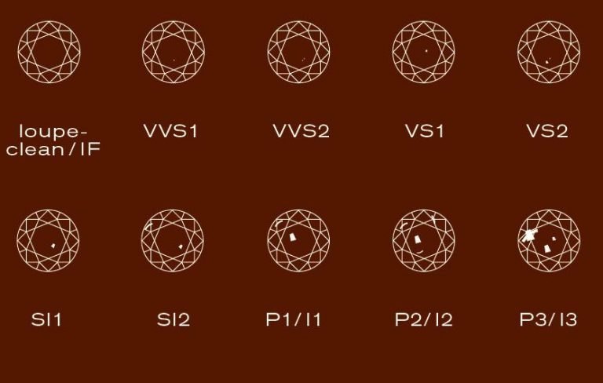
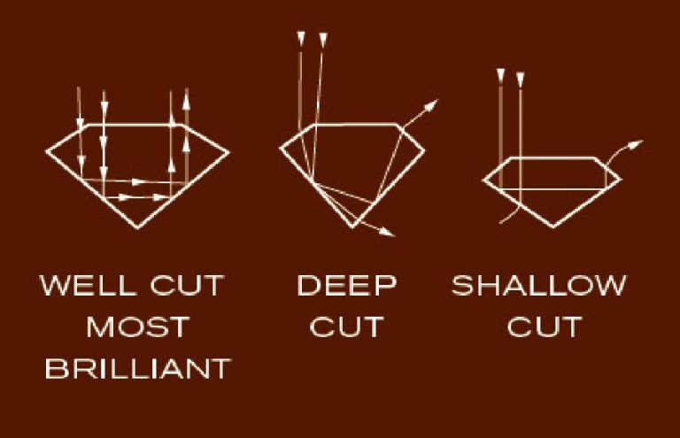
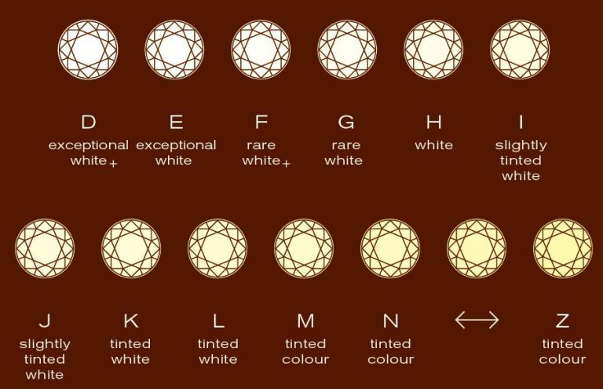
The “Four C’s” of Diamond Quality
Carat
Clarity
Cut
Colour

Slide 4
Objectives
Understand controls on diamond pricing
Identifying any significant outliers in size or symmetry
Create a model to predict diamond price

Slide 5
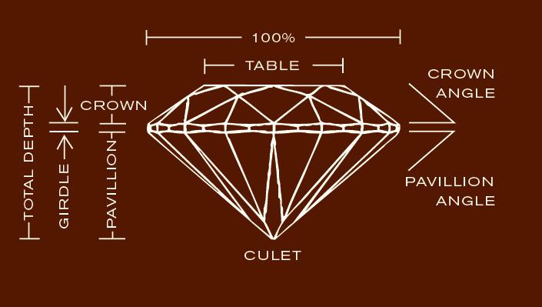
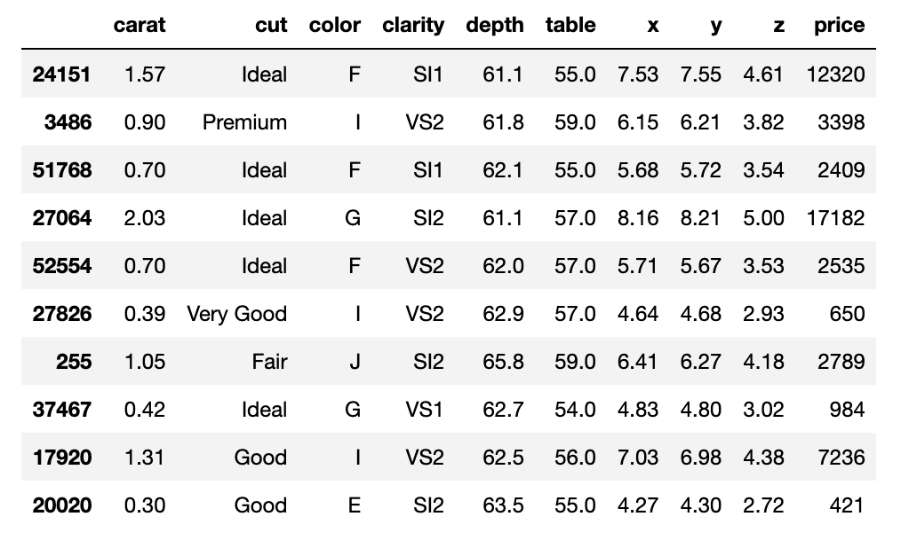
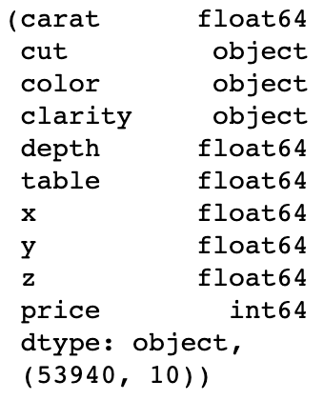
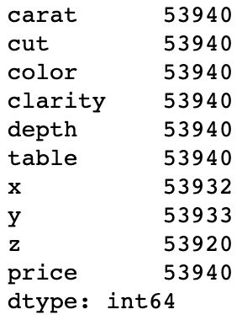
Dataset
Diamond dataset
53,940 diamond records

Slide 6
Training and Testing Considerations

Slide 7
Objectives

Slide 8
Objectives

Slide 9
Objectives

Slide 10
Objectives

Slide 11
Objectives

Slide 12
Objectives

Slide 13
Objectives

Slide 14
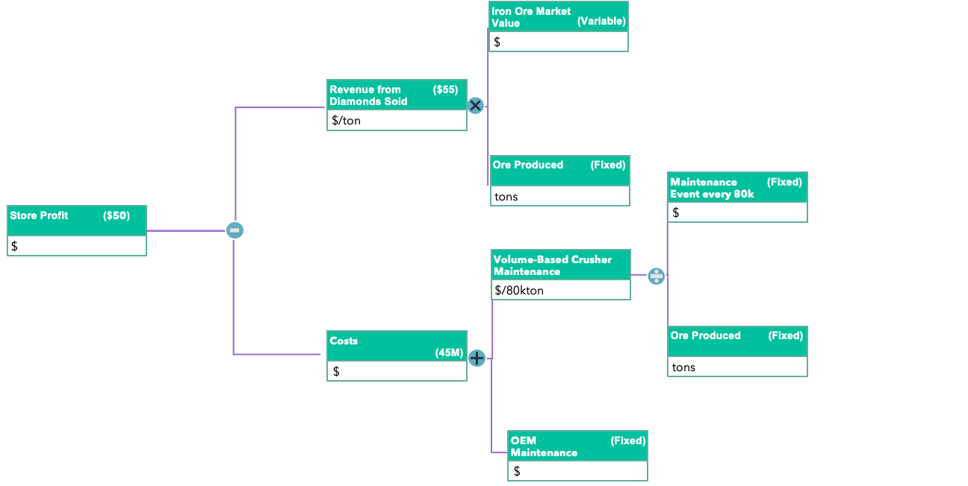
Value Driver Tree
Revenue
Store Profit
Costs

Slide 15
Value Driver Tree
Iron Ore Market Value
(Variable)
Coal based costs
($)
$
Revenue from Ore Sold
($55)
Coal based costs
($)
$/ton
Ore Produced
(Fixed)
Coal based costs
($)
tons
Maintenance Event every 80k
(Fixed)
Coal based costs
($)
Breakeven Price
($50)
Coal based costs
($)
$
$/ton
Volume-Based Crusher Maintenance
Coal based costs
($)
$/80kton
Production Maintenance Costs
Coal based costs
($)
Ore Produced
(Fixed)
Coal based costs
($)
$
(45M)
tons
OEM Maintenance Recommendation
(Fixed)
Coal based costs
($)
$

