Slide 1

Diamond Price Prediction
Understanding Controls on Diamond Price and Diamond Price Prediction

Slide 2
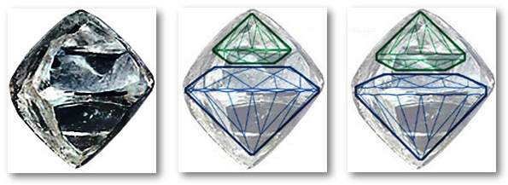
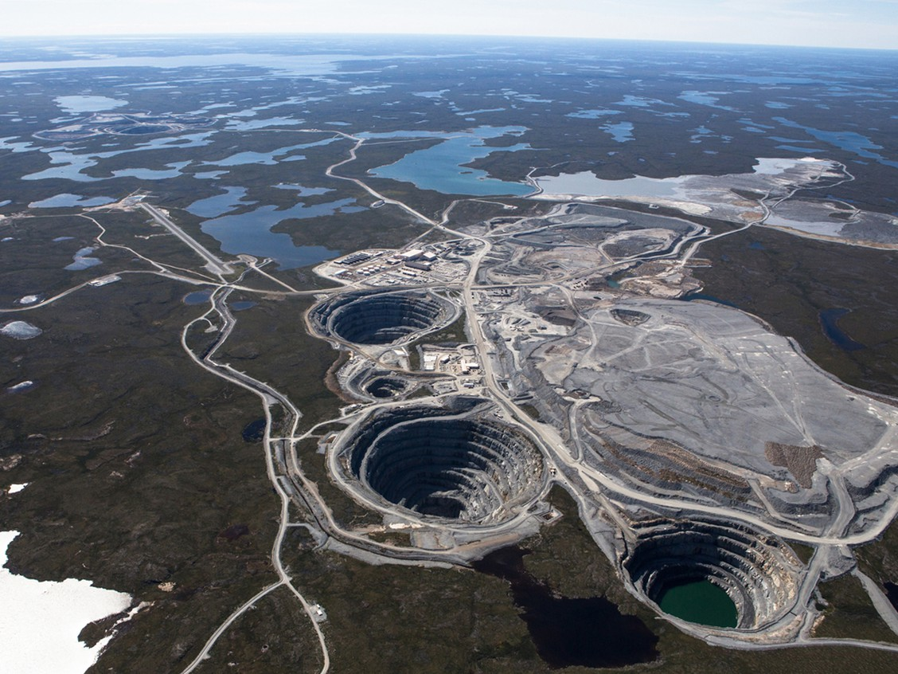
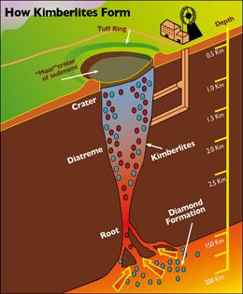
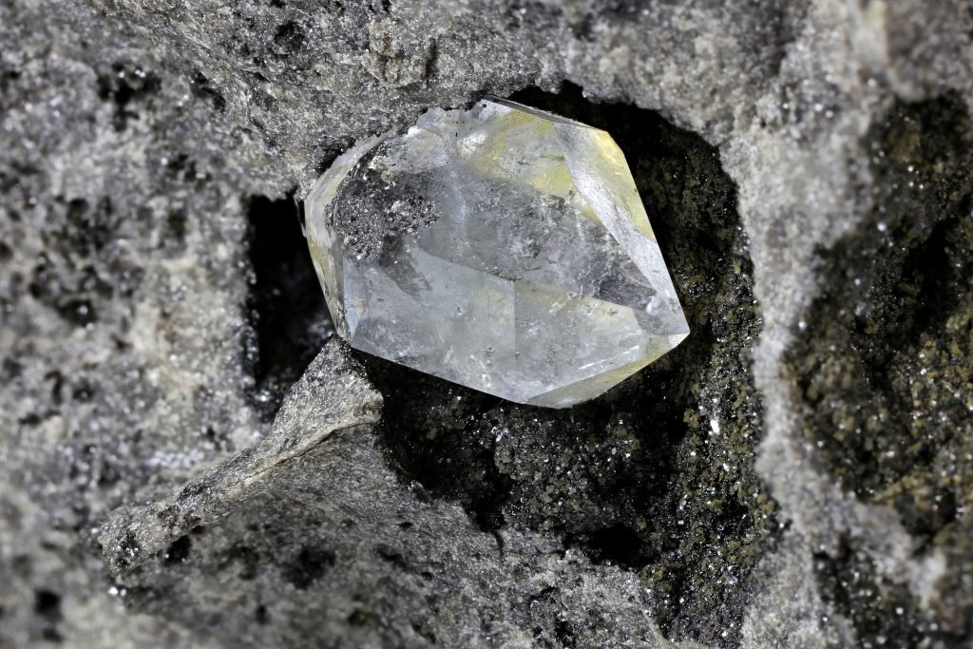
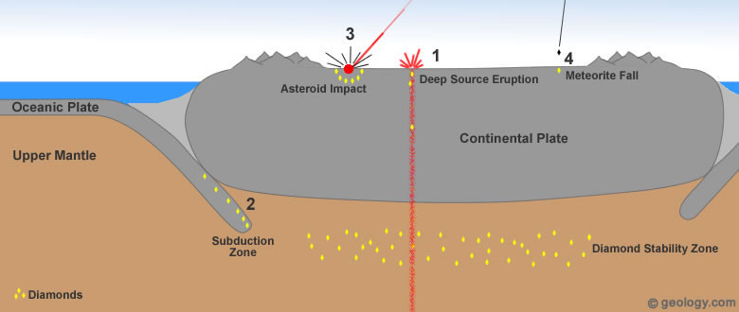
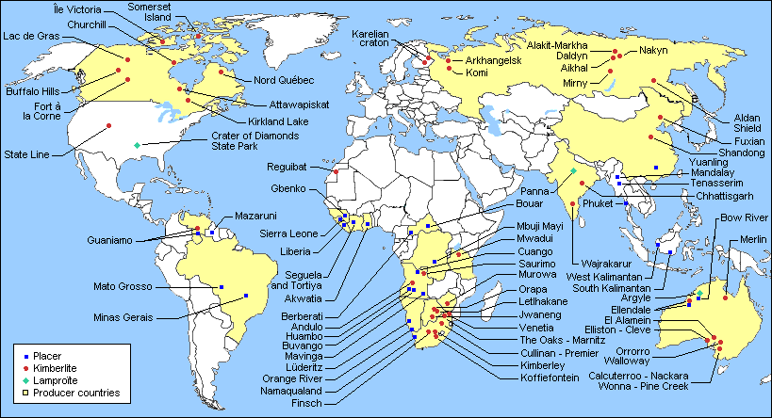
Diamond Genesis
Diamonds created billions of years ago
Brought to surface through deep source eruptions
Mined in open pits, diamonds come out ‘rough’
Diamonds are cut into desired shape

Slide 3
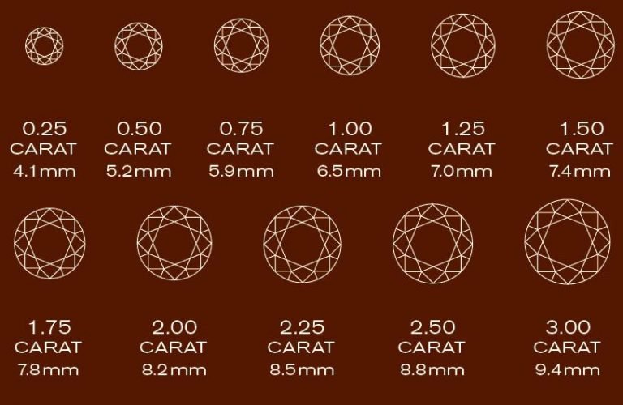
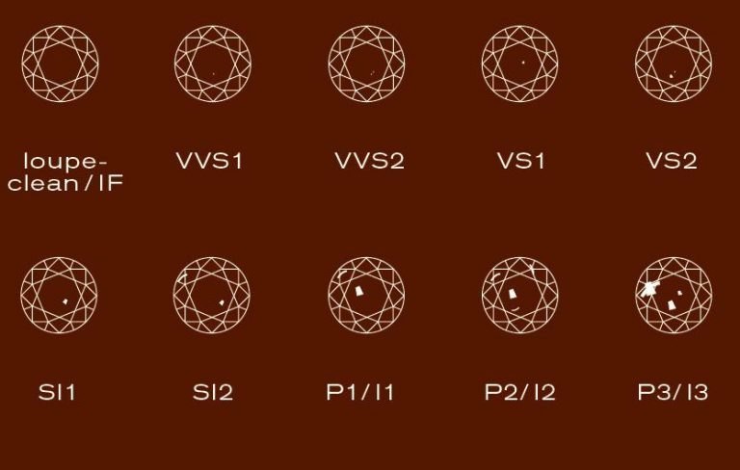
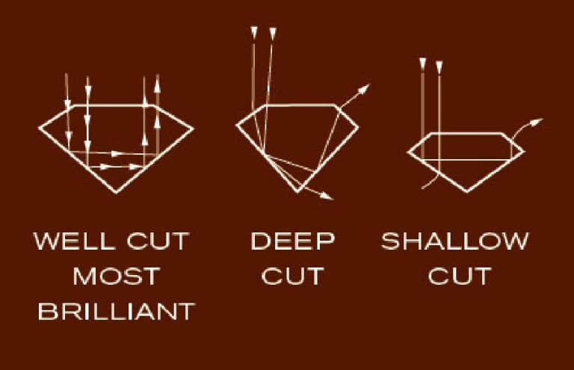
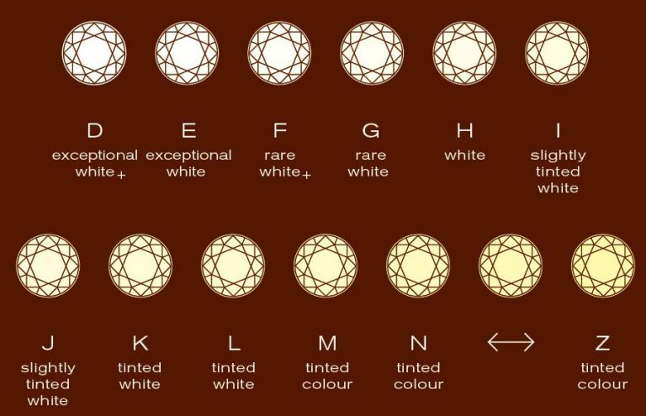
The “Four C’s” of Diamond Quality
Carat
Clarity
Cut
Colour

Slide 4
Objectives
Understand controls on diamond pricing
Identifying any significant outliers in size or symmetry
Create a model to predict diamond price

Slide 5
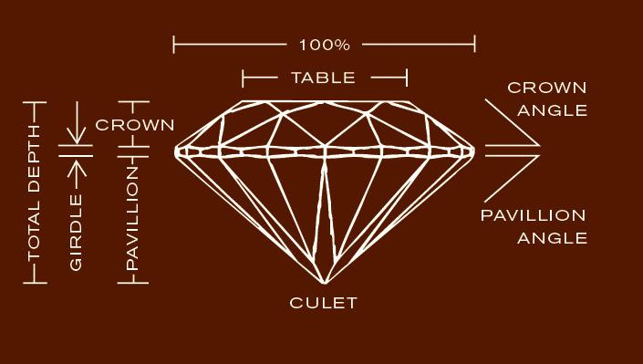
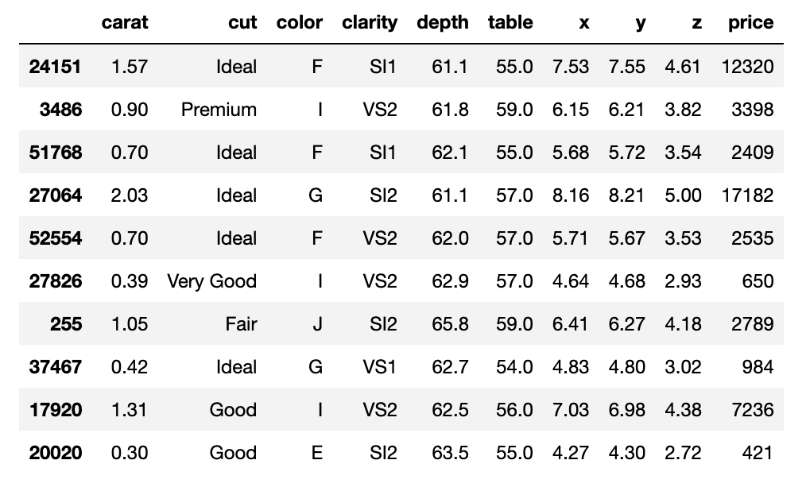
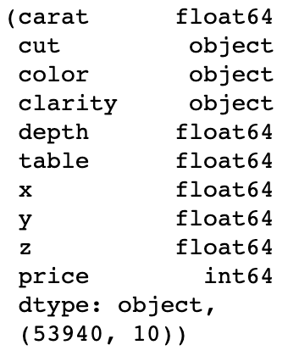
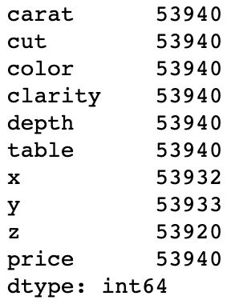
Dataset
Diamond dataset
53,940 diamond records

Slide 6
Training and Testing Considerations

Slide 7
Objectives

Slide 8
Objectives

Slide 9
Objectives

Slide 10
Objectives

Slide 11
Objectives

Slide 12
Objectives

Slide 13
Objectives

Slide 14
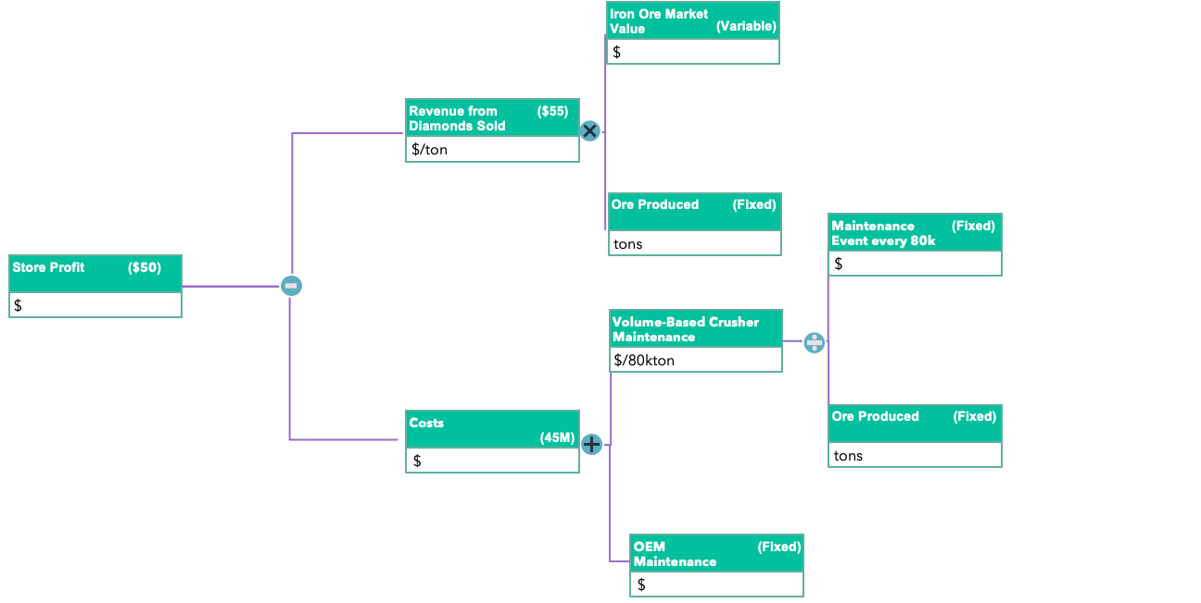
Value Driver Tree
Diamonds Sold
Revenue
Price/Diamond
Store Profit
Fixed Costs
Costs
Variable Costs

Slide 15
Value Driver Tree
Iron Ore Market Value
(Variable)
Coal based costs
($)
$
Revenue from Ore Sold
($55)
Coal based costs
($)
$/ton
Ore Produced
(Fixed)
Coal based costs
($)
tons
Maintenance Event every 80k
(Fixed)
Coal based costs
($)
Breakeven Price
($50)
Coal based costs
($)
$
$/ton
Volume-Based Crusher Maintenance
Coal based costs
($)
$/80kton
Production Maintenance Costs
Coal based costs
($)
Ore Produced
(Fixed)
Coal based costs
($)
$
(45M)
tons
OEM Maintenance Recommendation
(Fixed)
Coal based costs
($)
$

