Slide 1

Diamond Price Prediction
Understanding Controls on Diamond Price and Diamond Price Prediction

Slide 2
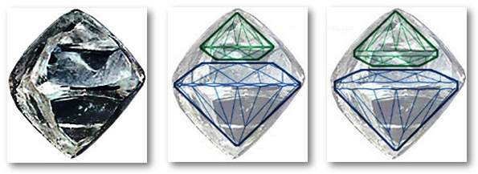
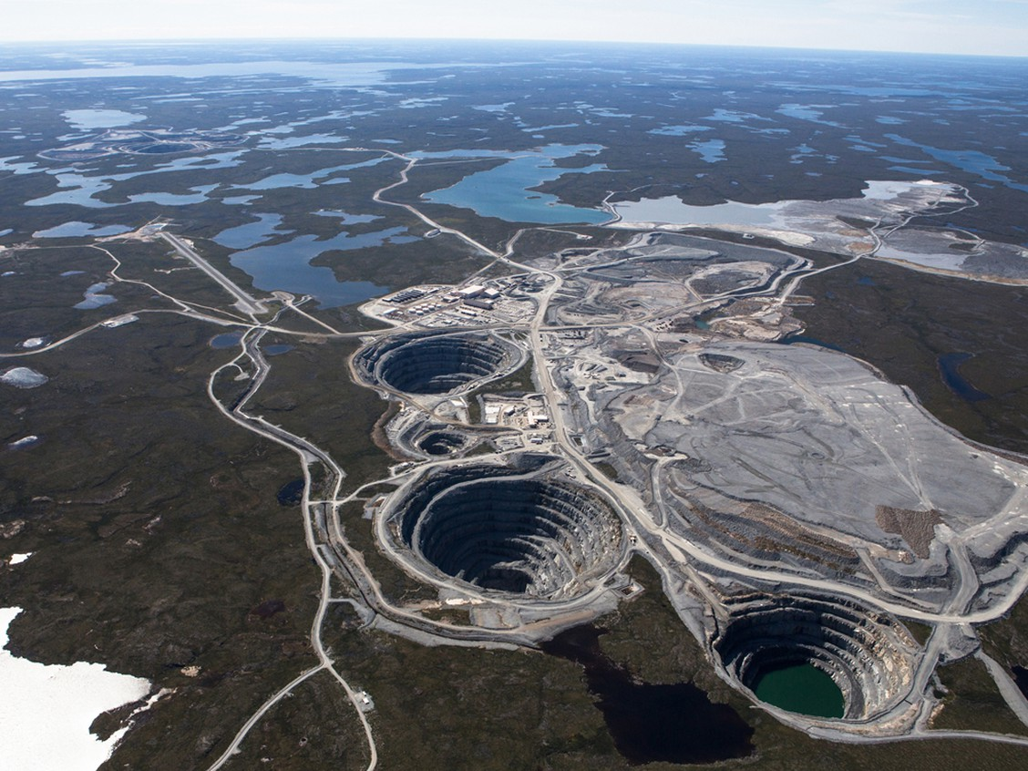
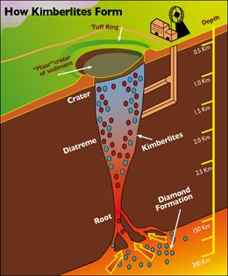
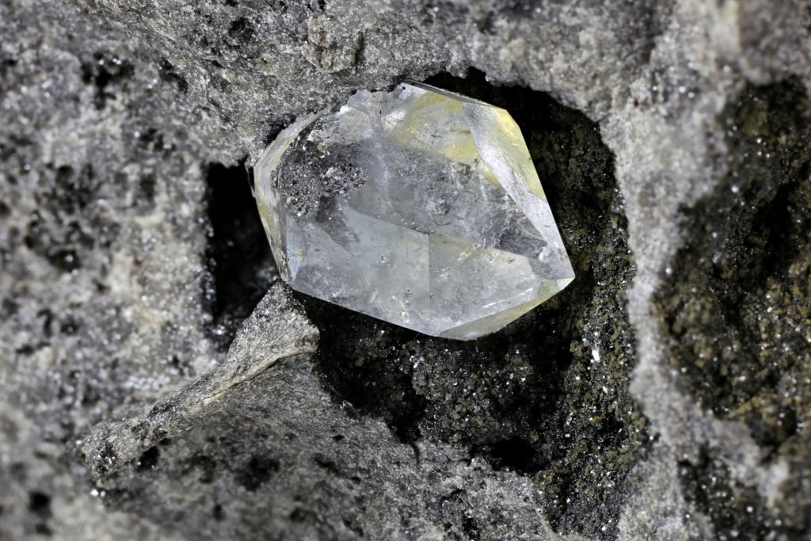
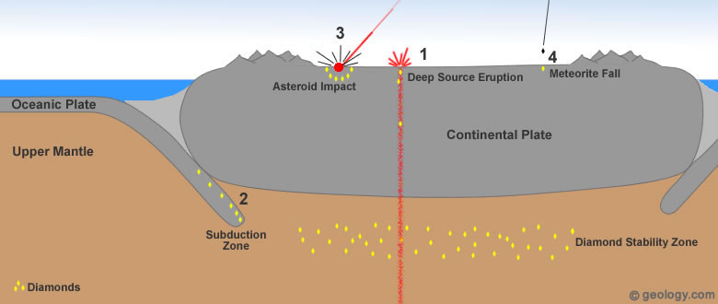
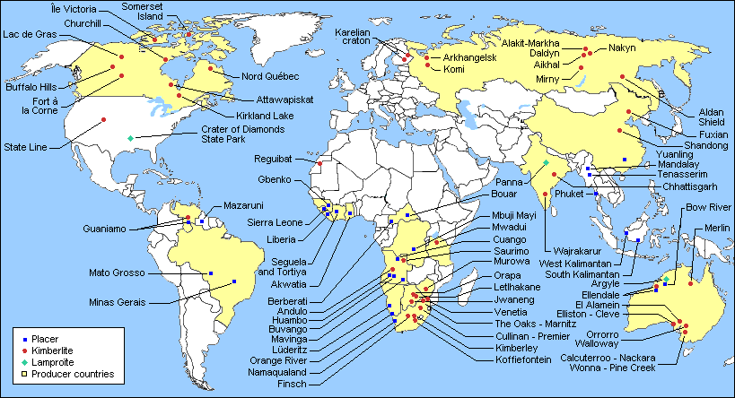
Diamond Genesis
Diamonds created billions of years ago
Brought to surface through deep source eruptions
Mined in open pits, diamonds come out ‘rough’
Diamonds are cut into desired shape

Slide 3
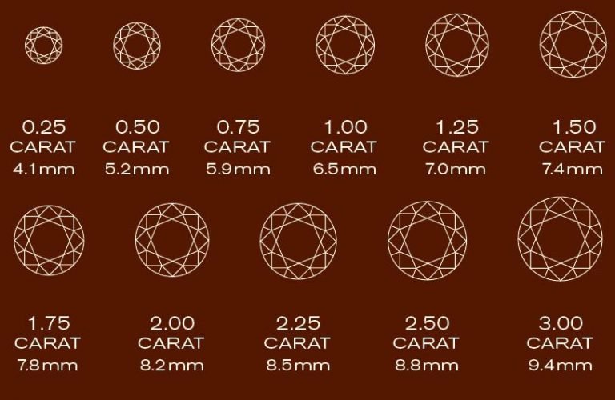
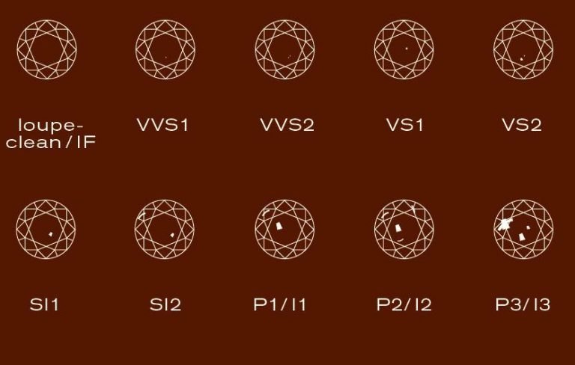
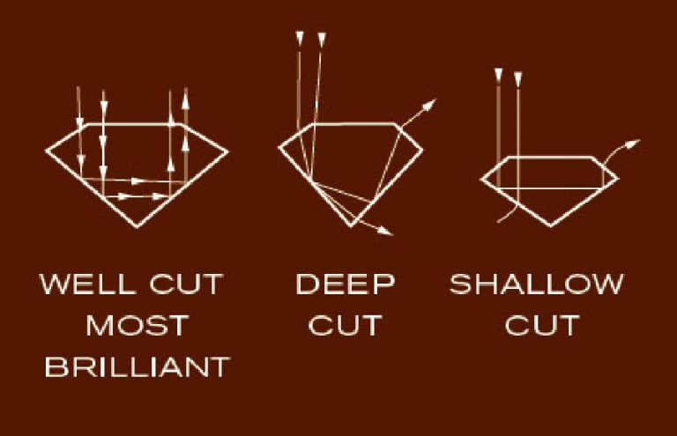
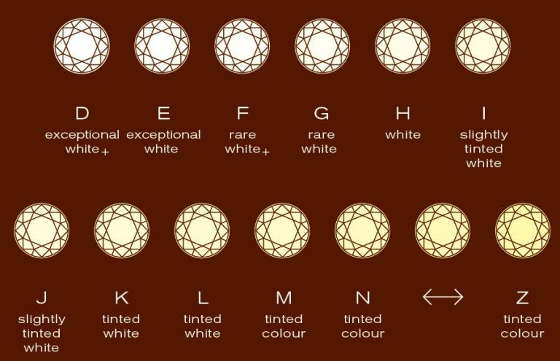
The “Four C’s” of Diamond Quality
Carat
Clarity
Cut
Colour

Slide 4
Objectives
Understand controls on diamond pricing
Identifying any significant outliers in size or symmetry
Create a model to predict diamond price

Slide 5
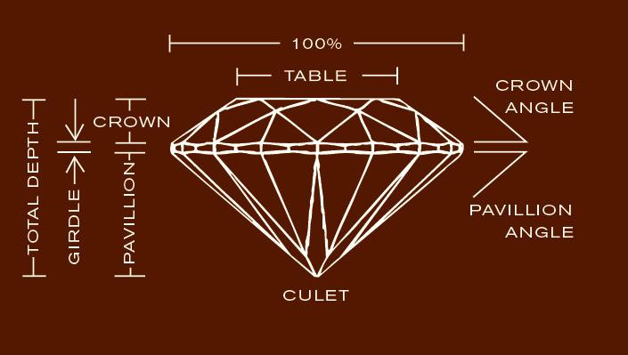
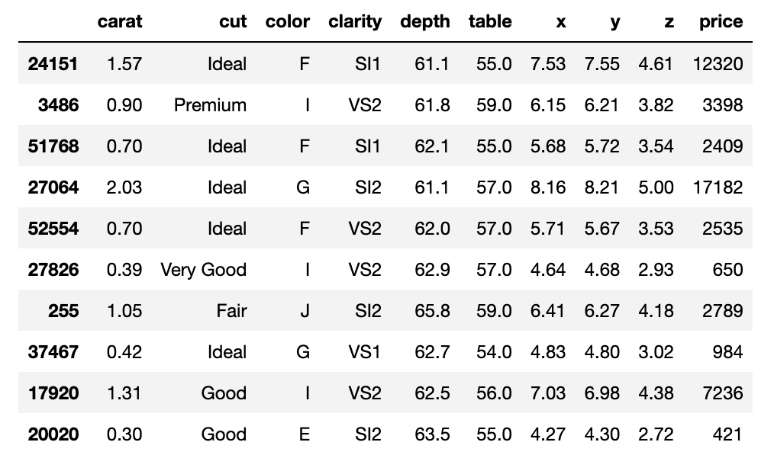
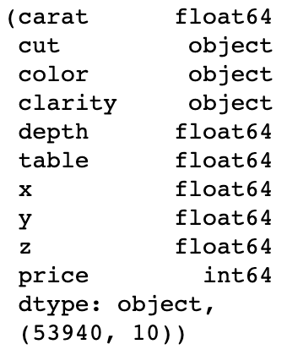
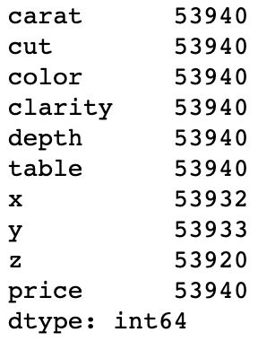
Dataset
Diamond dataset
53,940 diamond records

Slide 6
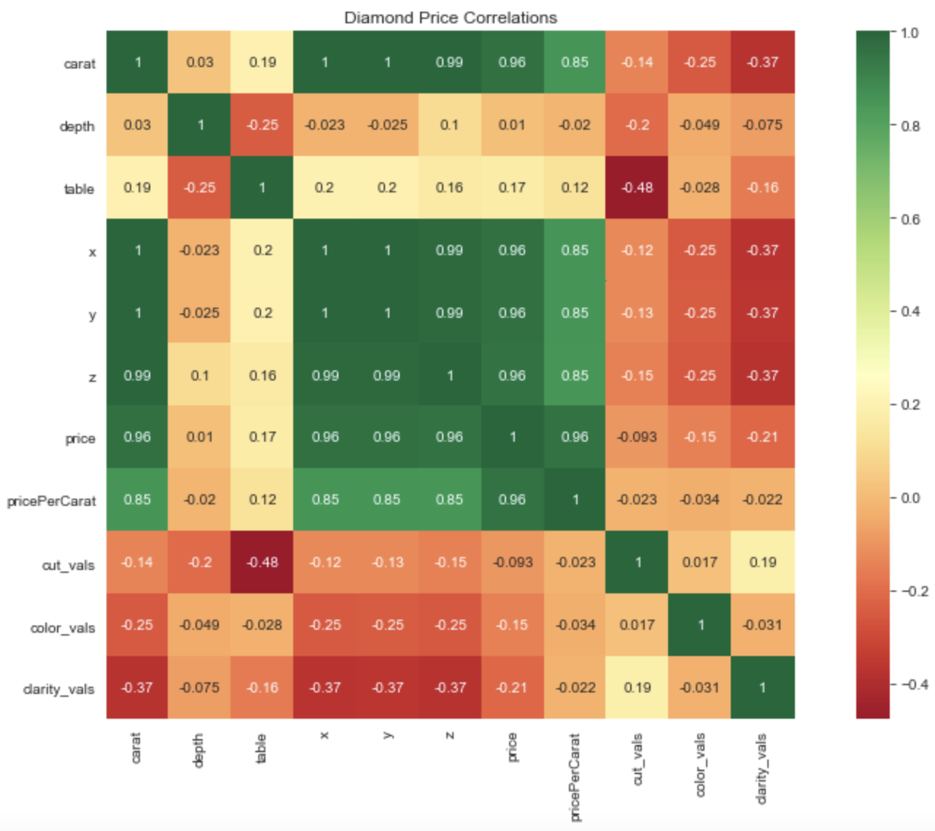
Feature Correlations
Positive Price Correlation
Carat
Dimensions (X,Y,Z)

Slide 7
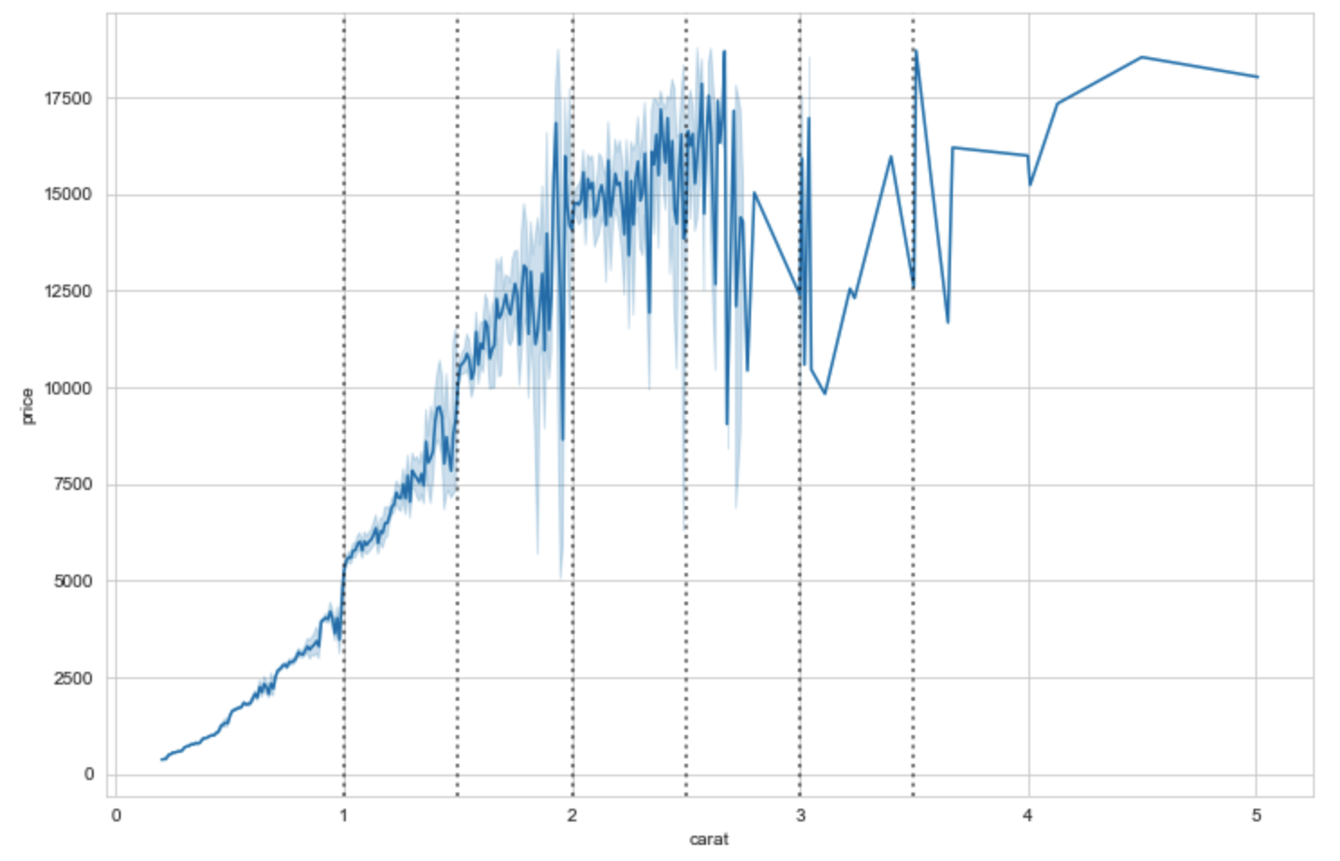
Price vs Carat
Positive correlation
Large jumps, higher price variability at 0.5ct intervals

Slide 8
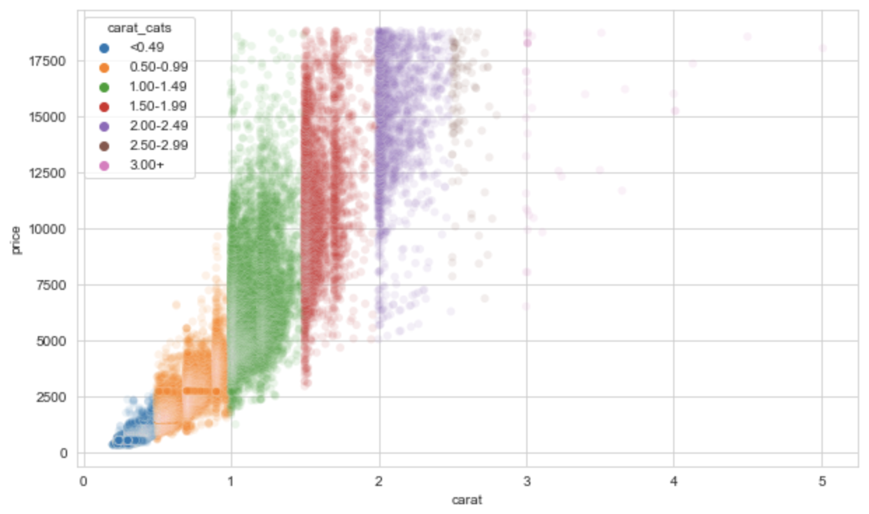
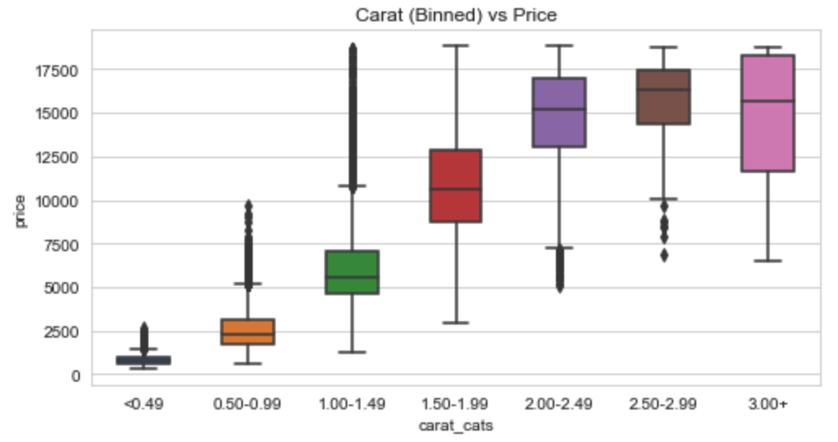
Carat Weight Intervals
Higher carat weight are top-loaded in price
Lower carat weight are bottom-loaded in price

Slide 9
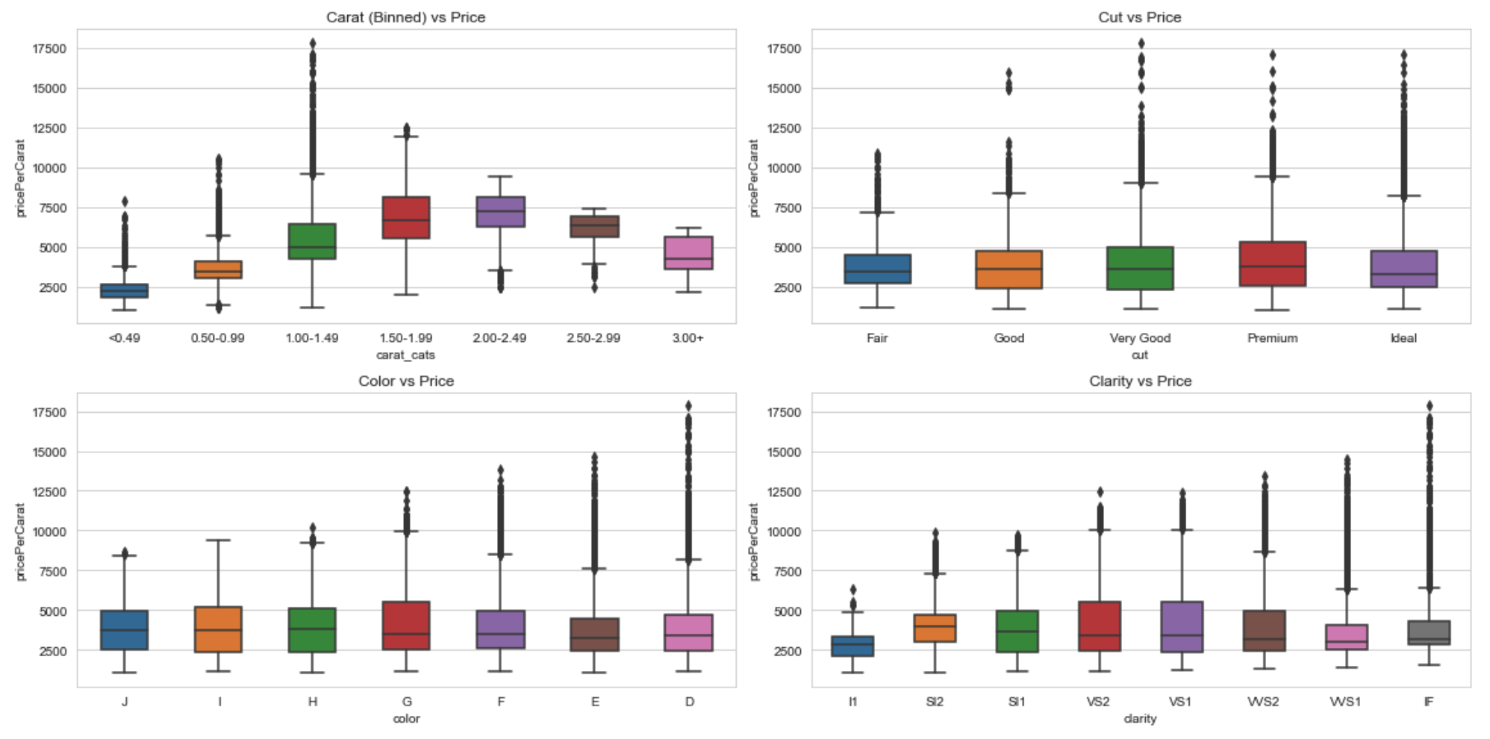
Objectives

Slide 10
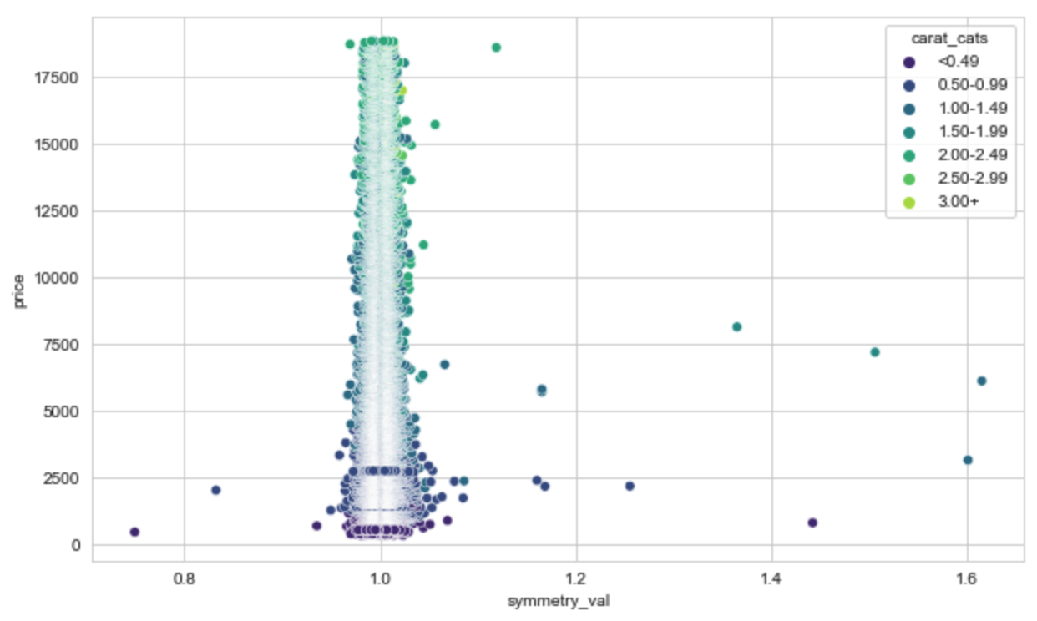
Objectives

Slide 11
Objectives

Slide 12
Training and Testing Considerations

Slide 13
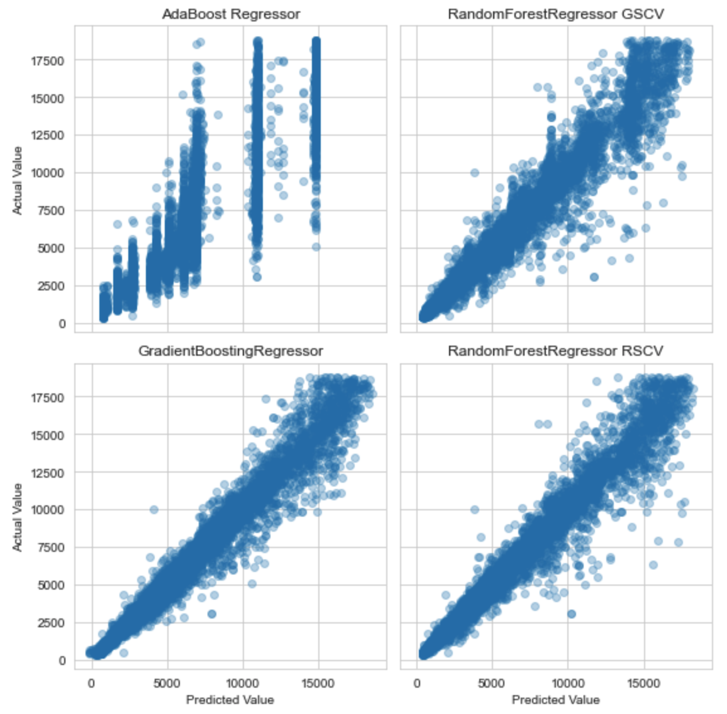
Objectives
Models

Slide 14
Objectives

Slide 15
Objectives

Slide 16
Objectives

Slide 17
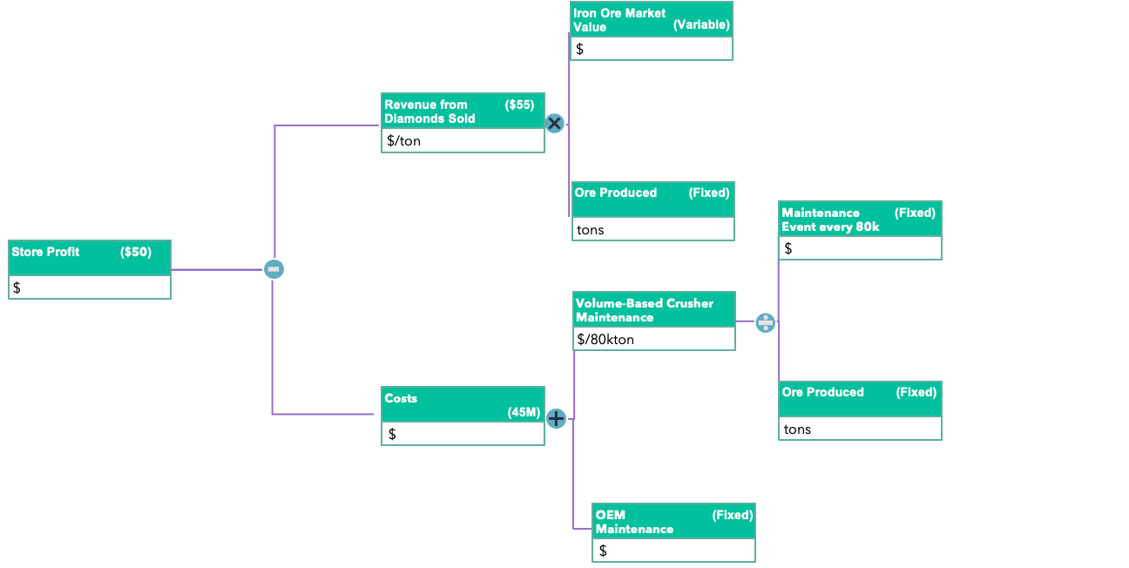
Value Driver Tree
Diamonds Sold
Revenue
Price/Diamond
Store Profit
Fixed Costs
Costs
Variable Costs

Slide 18
Value Driver Tree
Iron Ore Market Value
(Variable)
Coal based costs
($)
$
Revenue from Ore Sold
($55)
Coal based costs
($)
$/ton
Ore Produced
(Fixed)
Coal based costs
($)
tons
Maintenance Event every 80k
(Fixed)
Coal based costs
($)
Breakeven Price
($50)
Coal based costs
($)
$
$/ton
Volume-Based Crusher Maintenance
Coal based costs
($)
$/80kton
Production Maintenance Costs
Coal based costs
($)
Ore Produced
(Fixed)
Coal based costs
($)
$
(45M)
tons
OEM Maintenance Recommendation
(Fixed)
Coal based costs
($)
$

Slide 20
The “Four C’s” of Diamond Quality
Carat
Clarity
Cut
Colour

