Slide 1


Speaker
Nana-Serwaah Nyannor BIA Analyst

Slide 2
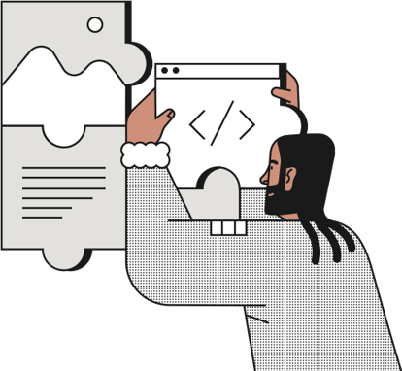
Zombie / Dead Quotes: Overall Impact
What Happens When Quotes Complete But Never Resolve
Nana-Serwaah Nyannor | TripleTen BIA Cohort 14 | Supernova MGU | June 2026
Notes:
Hi everyone, my name is Nana-Serwaah, and I will be kicking things off today. My section focuses on something we are calling zombie quotes, and by the end of my slides, you will understand exactly why that name fits.

Slide 3

The Problem
6,578 quotes reached “complete quote” in our system. 1,086 of them never received a price. Never received a rejection.
They completed the funnel but produced no outcome. At $9,541.57 average premium, these 1,086 records represent $10,362,141 in unresolved revenue. That is 44% of our realized TAM sitting in a data dead zone.
Notes:
Out of 9,817 total records in this dataset, 6,578 reached complete quote. That sounds like a win. But 1,086 of those completions never resolved into anything real. No price. No rejection. They passed every stage and just stopped existing as outcomes. At $9,541.57 average premium, those 1,086 records represent $10,362,141 in unresolved revenue. That is 44% of our realized total addressable market sitting in a data dead zone.

Slide 4
What Makes a Quote a Zombie?
Condition 1 — Complete Quote: Passed all 9 stages.
Condition 2 — No Premium: Total Premium is $0 or blank.
Condition 3 — No Rejection: Rejection log is empty. Underwriting never touched these records.
All three true at once — 1,086 records. Those are our zombie quotes.
Notes:
Keep this slide fast. Say the three conditions clearly and move on. Do not over-explain — Timothy's section builds directly on this definition. Your job here is to define and put the number on the board, nothing more.

Slide 5
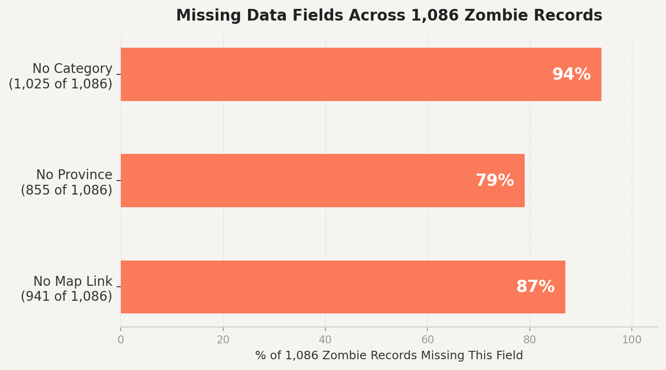

Who Are the 1,086 Zombies?
These records are not random.
They are missing data across multiple fields simultaneously, pointing to a structural pipeline failure.
Notes:
Do not read the percentages like a list. Say it like you discovered something. Pause before the last two sentences. Then say them slowly: These aren't random gaps. The same fields drop out on the same records. That's not messy data -- that's a broken pipeline. Let that land before you move.

Slide 6
The Dollar Impact
Zombie quotes: 1,086 records x $9,541.57 avg. premium = $10,362,141 in unresolved revenue
Realized TAM (Topic 1): $23,081,048 — earned premium from 2,419 accepted, priced quotes
Zombie records alone represent 44% of our realized TAM sitting unaccounted for
For every dollar that enters this pipeline, Supernova captures 36 cents.
Notes:
Walk through the first three bullets at a steady pace. Then slow down completely for the last line. Say it clearly: For every dollar that enters this pipeline, Supernova captures 36 cents. Then stop. Do not keep talking. Let it sit for two full seconds. That is the number the audience will remember. Then move to the last slide.

Slide 7

Timothy will now show you what the corrected metrics look like.
Notes:
Say that one line and stop. Do not summarize yourself. Do not say thank you and keep going. Just say the line and let Timothy start. Your last slide already does the summary, do not repeat it.

