Slide 1
Face Detection & Synthesis using 3D Models & OpenCV
Learning Bit by Bit
Don Miller
ITP, Spring 2010

Slide 2
Game Plan
Face detection
Face synthesis
OpenCV – How it works
Interesting facts from Viola / Jones
Face synthesis using 3D Models:
  OBJ / MTL
  Altered textures & vertices
My experiments / findings

Slide 3
Face detection & synthesis
Detection vs. recognition:
  Detection: finding a face
  Recognition: identifying a person
Synthesis:
  Still images / facial animations
  Applications in games and film
  Used in recognition, too:
    Experiment with different lighting & poses

Slide 4
OpenCV – How it works
OpenCV uses a face detection method developed in 2001 by Paul Viola and Michael Jones, commonly referred to as the Viola-Jones method.
First to provide competitive object detection rates in real-time. Mostly used for faces, but can detect other objects.
Four key concepts:
  Simple rectangular features, called Haar features
  An Integral Image for rapid feature detection
  The AdaBoost machine-learning method
  A cascaded classifier to combine many features efficiently

Slide 5
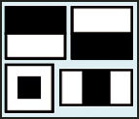
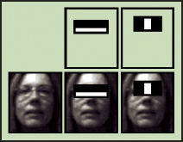
OpenCV – How it works (con't)
The features that Viola and Jones used are based on Haar wavelets. Haar wavelets are single wavelength square waves.
In two dimensions, a square wave is a pair of adjacent rectangles - one light and one dark.

Slide 6
OpenCV – How it works (con't)
The rectangles used for object detection are not true Haar wavelets.
They include rectangle combinations better suited to visual recognition tasks.
So, they are usually referred to as Haar features, or Haarlike features, rather than wavelets.

Slide 7
OpenCV – How it works (con't)
The presence of a Haar feature is determined by subtracting the average dark-region pixel value from the average light-region pixel value.
If the difference is above a threshold (set during learning), that feature is said to be present.
This binary determination is face / not face.

Slide 8
OpenCV – How it works (con't)
To determine the presence or absence of hundreds of Haar features at every image location and at several scales efficiently, Viola / Jones used a technique called an Integral Image.
"Integrating" means adding small units together.
In this case, the small units are pixel values. The integral value for each pixel is the sum of all the pixels above it and to its left. Starting at the top left and traversing to the right and down, the entire image can be integrated with a few integer operations per pixel.
The Haar rectangular features are primitive (compared to more complex filters), but the integrating allows for higher speed than more sophisticated methods.

Slide 9
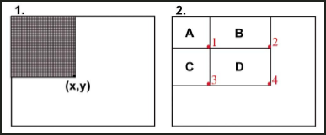
OpenCV – How it works (con't)
After “integrating”, pixel x,y contains the sum of all the pixel values in the rectangle.
To find the average pixel value in this rectangle, you'd only need to divide the value at (x,y) by the rectangle's area.

Slide 10
OpenCV – How it works (con't)
Its possible to find the sum of sub-rectangles, like D = A+B+C+D - (A+B) - (A+C) + A.
You can think of that as being the sum of pixel values in the combined rectangle, A+B+C+D, minus the sums in rectangles A+B and A+C, plus the sum of pixel values in A.

Slide 11
OpenCV – How it works (con't)
Conveniently, A+B+C+D is the Integral Image's value at location 4, A+B is the value at location 2, A+C is the value at location 3, and A is the value at location 1. So, with an Integral Image, you can find the sum of pixel values for any rectangle in the original image with just three integer operations: (x4, y4) - (x2, y2) - (x3, y3) + (x1, y1).

Slide 12
OpenCV – How it works (con't)
To select specific Haar features to use and set threshold levels, Viola / Jones use a machine-learning method called AdaBoost.
AdaBoost combines many "weak" classifiers to create one "strong" classifier.
"Weak" here means the classifier only gets the right answer a little more often than random guessing would.
But if you had a whole lot of these weak classifiers, and each one "pushed" the final answer a little bit in the right direction, you'd have a strong, combined force for arriving at the correct solution.
AdaBoost selects a set of weak classifiers to combine and assigns a weight to each. This weighted combination is the strong classifier.

Slide 13
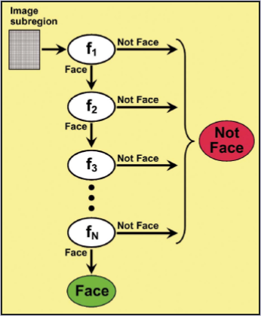
OpenCV – How it works (con't)
Viola and Jones combined a series of AdaBoost classifiers as a filter chain, that they called a cascade.
The cascade is especially efficient for classifying image regions.
Each filter is a separate AdaBoost classifier with a fairly small number of weak classifiers.

Slide 14
OpenCV – How it works (con't)
The acceptance threshold at each level is set low enough to almost all face examples in the training set of about 1000 faces.
If it fails one, it goes to “not face”.
If it passes, it goes on to the next in the cascade. If it passes all, its classified as “face”.
This reduces the total number of times the classifier is accessed and allows for real time detection.

Slide 15
OpenCV – How it works (con't)
The order of filters in the cascade is based on the importance weighting that AdaBoost assigns.
The more heavily weighted filters come first, to eliminate non-face image regions as quickly as possible.
In the image on the right, the first one keys off the cheek area being lighter than the eye region.
The second uses the fact that the bridge of the nose is lighter than the eyes.

Slide 16
OpenCV – How it works (con't)
The first and second features selected by AdaBoost.
The first feature measures the difference in intensity between the region of the eyes and a region across the upper cheeks. The feature capitalizes on the observation that the eye region is often darker than the cheeks.
The second feature compares the intensities in the eye regions to the intensity across the bridge of the nose.

Slide 17
Interesting Facts from Viola / Jones
Training time was weeks long with 5,000 faces and 10,000 non-faces
Final detector has 38 layers in the cascade, 6060 features
They used a 700 Mhz processor:
  Could process a 384 x 288 image in 0.067 seconds (in 2003 when paper was written)

Slide 18
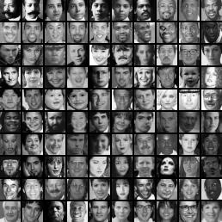
Interesting Facts from Viola / Jones
Some of the original training images, randomly pulled from the web in 2001.

Slide 19
Face synthesis using 3D Models
For my experiments, I used:
  OBJ files: represent 3D geometry, vertices, UV maps, faces that make polygons, etc.
  MTL files: defines light reflecting properties

Slide 20
Face synthesis using 3D Models
Altering textures:
  Throwing off the classifiers
  Darkening areas to reduce contrast and presence of Haar-like features
Results:
  Really had to break OpenCV / Viola & Jones method
  Large areas of black work well, but it is resistant to small changes

Slide 21
Face synthesis using 3D Models
Altering vertices:
  Moving areas of the face around, changing the way light hits and textures map
Results:
  Rotations really change the face / not face detection
  May have been skewed by lack of proper texture

Slide 22
References
Robust Real-time Object Detection (Viola/Jones), PDF
How Face Detection Works, SERVO Magazine, 2007
Wikipedia:
  Viola-Jones object detection framework
  Haar-like features
OpenCV:
  Face Detection using OpenCV

