Slide 1
Application of decision tree in classification analysis
NAME CHETAN BAGRA
MIS 112015033
MENTOR DR.TANMOY HAZRA

Slide 2

Introduction
We are living in age of data where everything is digitally recorded.
Abundance of:
Social Media Data
Business Data
Cyber Security Data
Health Data
Smartphone Data
IOT Data

Slide 3
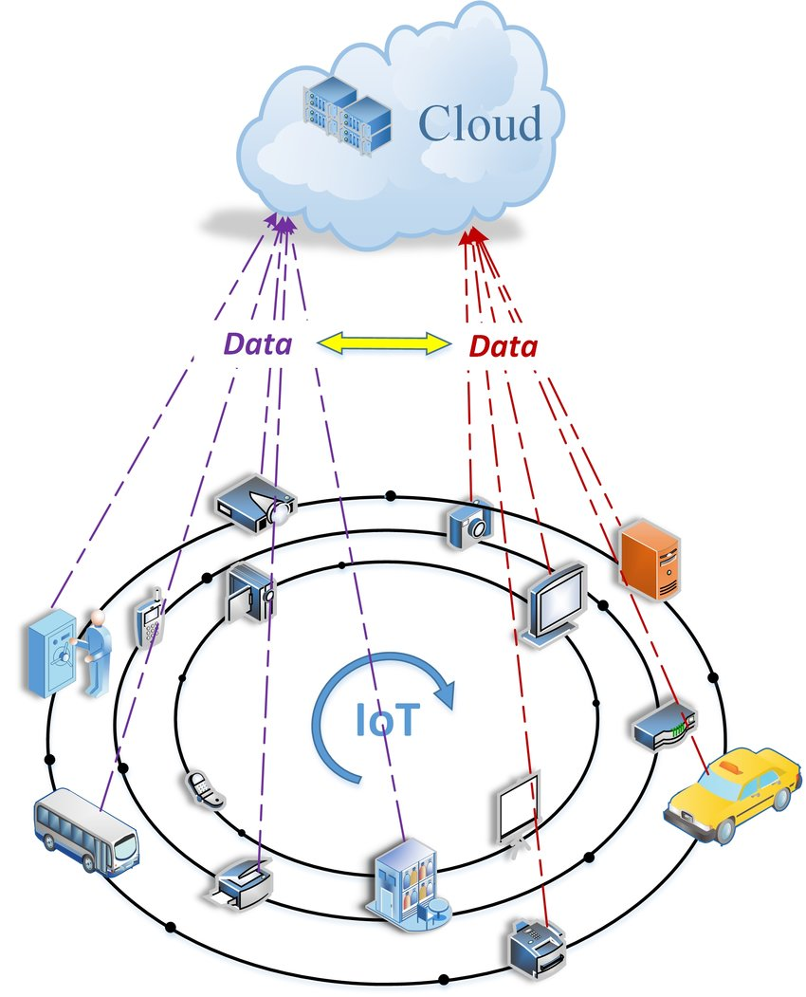
Data Collection from iot

Slide 4

Extracting insights from the data can be used to build intelligent application in the relevant domain.
To build data driven automated and intelligent cyber security system , relevant cyber security data can be used.
To build personalized context aware application relevant smartphone data can be used.

Slide 5
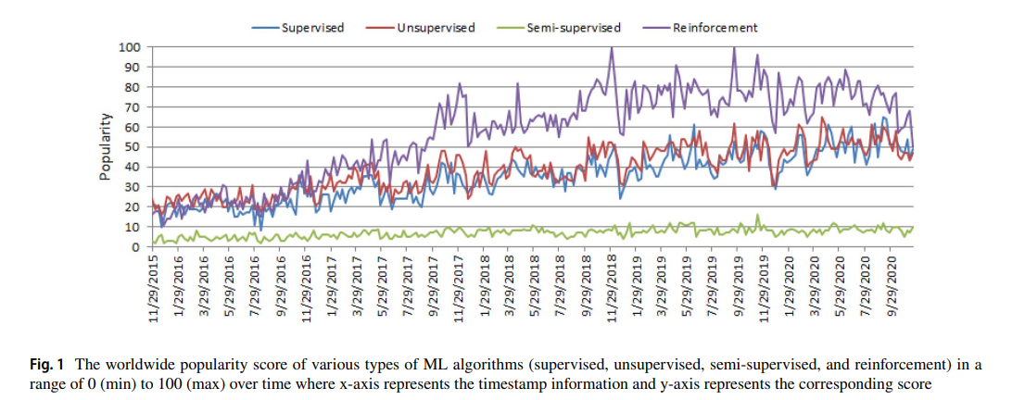
Machine learning (ML) have grown rapidly in recent years in the context of data analysis and computing that typically allows the applications to function in an intelligent manner.
In the area of machine learning algorithms, classification analysis, regression, data clustering, feature engineering and dimensionality reduction, association rule learning, or reinforcement learning techniques exist to effectively build data-driven systems.
The effectiveness and the efficiency of a machine learning solution depend on the nature and characteristics of data and the performance of the learning algorithms.

Slide 6
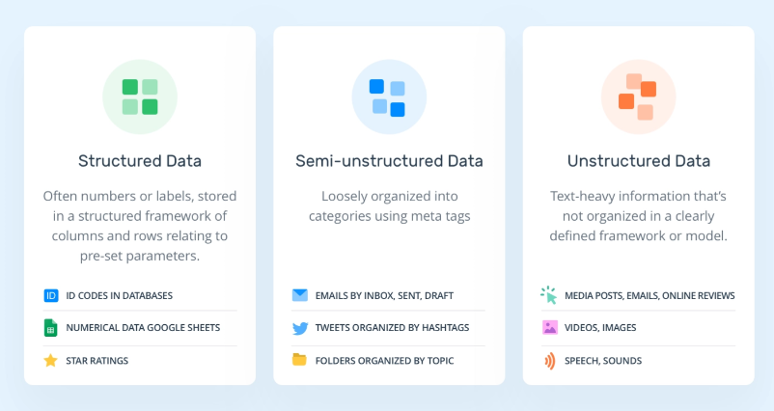
Types of data
Metadata It is not normal form of data. It is the “data about the data”.

Slide 7
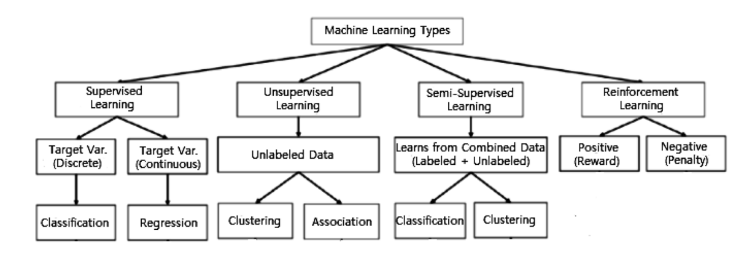

Slide 8
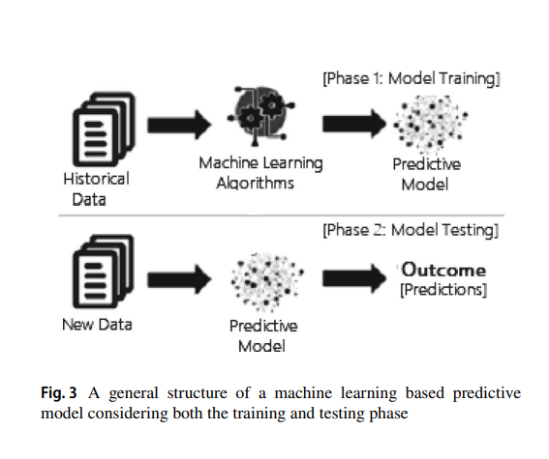
Classification analysis
Classification is regarded as a supervised learning method in machine learning, referring to a problem of predictive modelling as well, where a class label is predicted for a given data set.
It maps a function (f) from input variables (X) to output variables (Y) as target, label or categories.
spam detection such as “spam” and “not spam” in email service providers can be a classification problem.

Slide 9
Types of classification
Binary Classification Multi-Class Classification Multi-Label Classification
It refers to the classification tasks having two class labels such as “true and false” or “yes and no”.
“cancer not detected” is the normal state of a task that involves a medical test, and “cancer detected” could be considered as the abnormal state.
Traditionally, this refers to those classification tasks having more than two class labels.
To classify various types of network attacks in the NSL-KDD dataset, where the attack categories are classified into four class labels, such as DoS (Denial of Service Attack), U2R (User to Root Attack), R2L (Root to Local Attack), and Probing Attack.
Multilabel classification is an important consideration where an example is associated with several classes or labels.
The classes involved in the problem are hierarchically structured, and each example may simultaneously belong to more than one class in each hierarchical level.

Slide 10
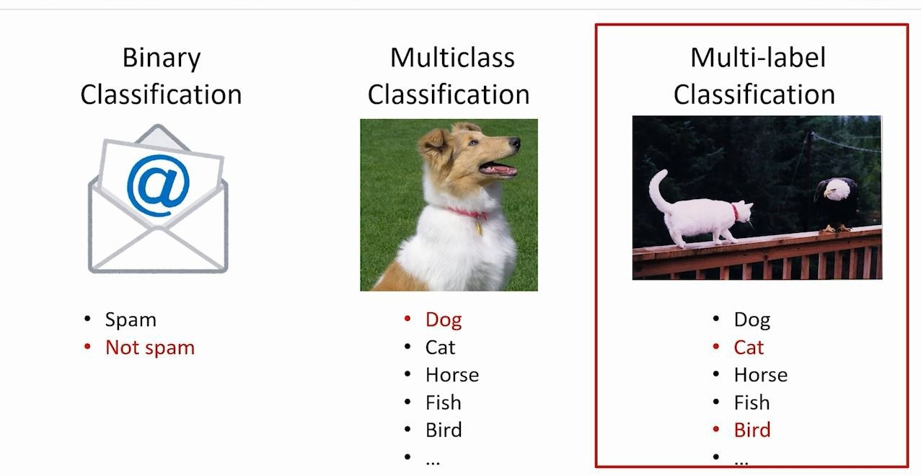

Slide 11
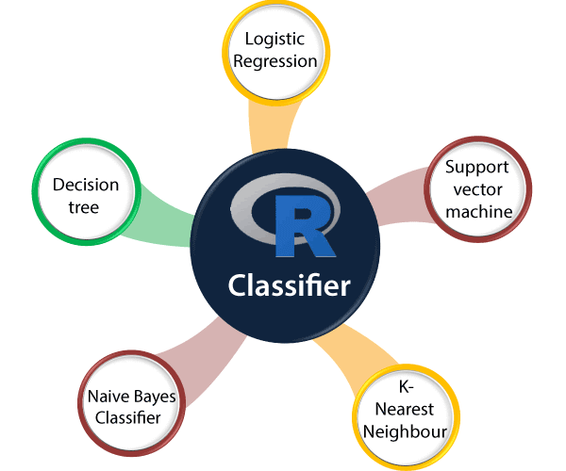
Popular classification techniques

Slide 12
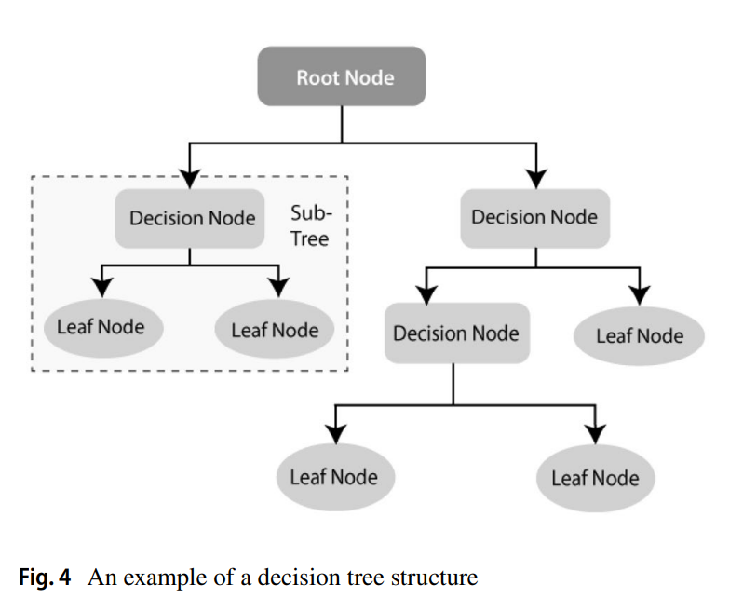
Decision tree
A decision tree is a support tool with a tree-like structure that models probable outcomes, cost of resources, utilities and possible consequences.
Decision trees provide a way to present algorithms with conditional control statements.
They include branches that represents decision making steps that can lead to a favourable result.

Slide 13
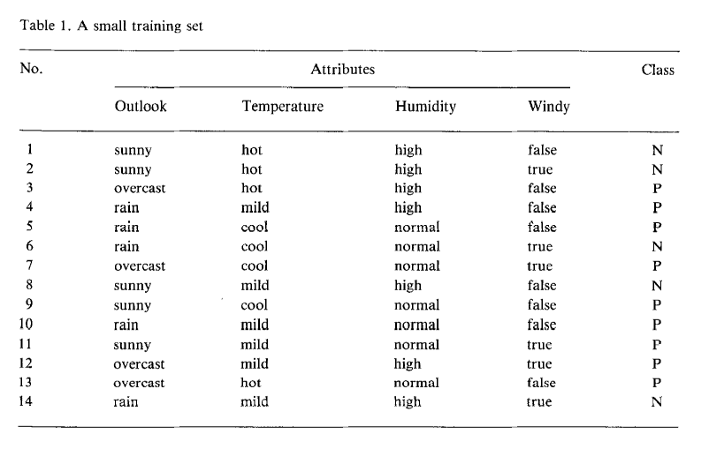
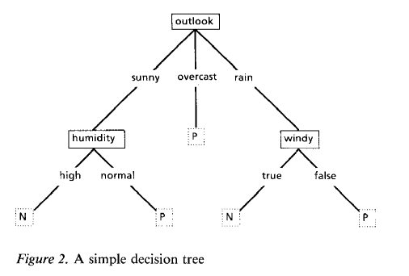
The induction ask
The induction task is to develop a classification rule that can determine the class of any object from its values of the attributes.
Leaves of a decision tree are class name, other nodes represent attribute-based tests with a branch for each possible outcome.
If the attributes are adequate, it is always possible to construct a decision tree that correctly classifies each object in the training set.

Slide 14
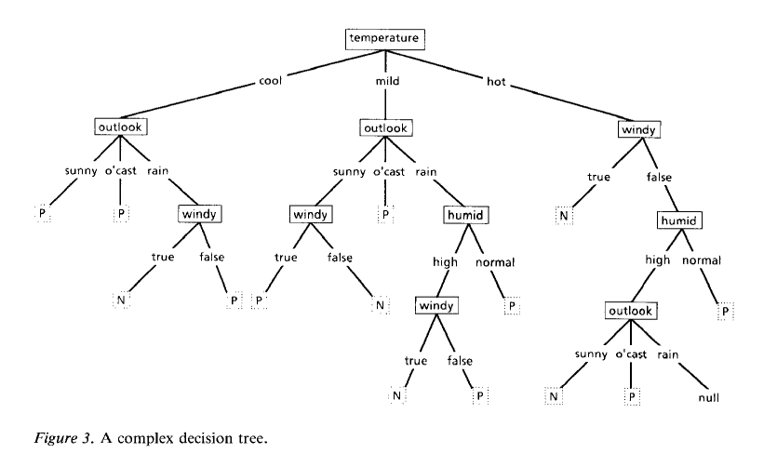
The essence of the induction is to move beyond training set and to construct decision tree that not only classify the training data correctly but also the unseen data.
The decision tree must capture some meaningful relationship between an object’s class and value of it’s attributes.
For small data one approach would be construct all decision tree that classify the objects in training data and select the simplest one.
For data set with many attributes and objects it’s not feasible to construct all decision tree as it requires a lot of mathematic computation.

Slide 15
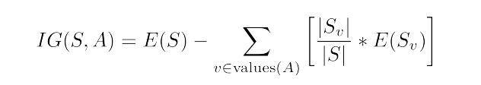
Id3 algorithm
The basic structure of ID3 is iterative.
A subset of the training set called the window is chosen at random and a decision tree formed from it; this tree correctly classifies all objects in the window.
All other objects are classified using this decision tree and one is not classified correctly then it is included in window and again tree is built.
Information Entropy
Information Gain
Information entropy of the given data measures the least amount of the information necessary to represent a data item from given data.
Suppose that we are given a probability space S with the elements 1, 2, ..., n. The probability an element “I” would be chosen from the probability space is P_{i}. Then the information entropy of the probability space is defined as:
The information gain is the amount of the information entropy gained as a result of a certain procedure.
If we group elements by their value of an attribute A, then we define the information gain as:
The ID3 algorithm partitions the set S according to the attribute that yields the highest information gain.

Slide 16
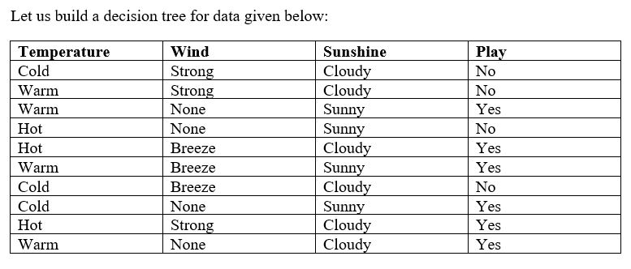
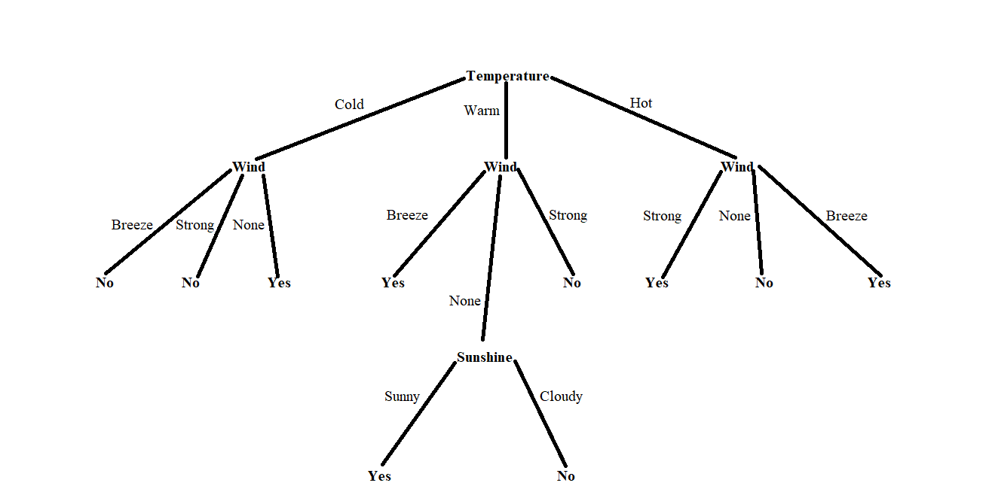
Now if object comes with attributes as (warm, Strong, Sunny,?) then with help of decision tree we can classify that we cannot play the match.

Slide 17
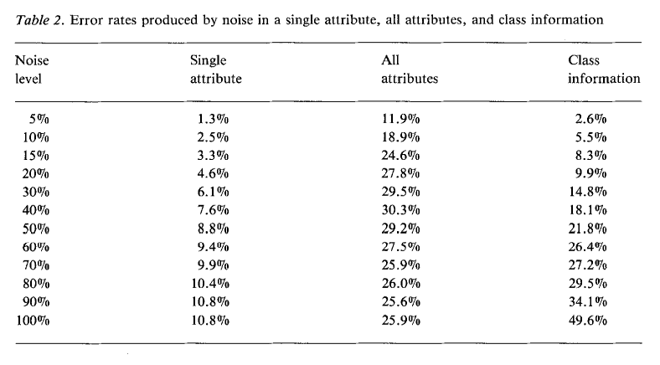
Gaps in ID3 Algorithm
Errors in the training set may cause the attributes to become inadequate or may lead to decision trees of spurious complexity.

Slide 18
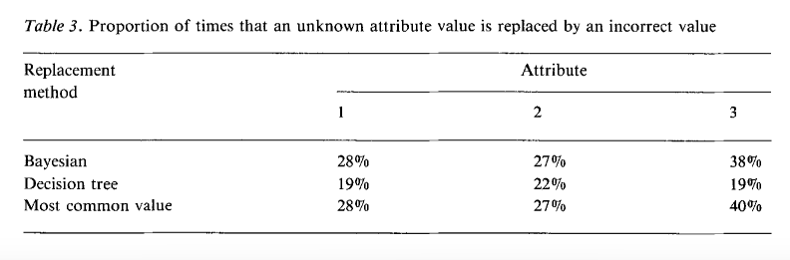
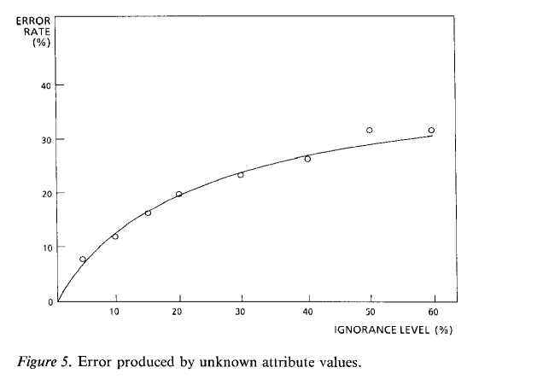
Unknown attribute values.

Slide 19
Using information gain for feature selection, the algorithm tends to select attributes with more values .
In the decision tree building process, it is difficult to control the tree size.
There are several logarithmic calculations in the attribute selection process, this has made the computation of information gain time consuming.
ID3 only work with discrete data, it does not work with continuous data.

Slide 20
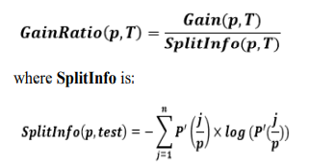
C4.5 algorithm
C4.5 algorithm is the extension of the ID3 algorithm. It was developed to overcome some of the limitations of the ID3.
The IGR(Information gain ratio) which is used in C4.5 algorithm is less biased selection criteria. It takes information gain and normalize it with split entropy.
It creates a possibility to use continuous data.
Pruning of the tree after creation.
P’ (j/p) is the proportion of elements present at the position p, taking the value of j_{th} test.

Slide 21
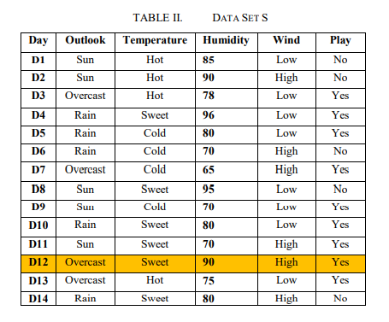
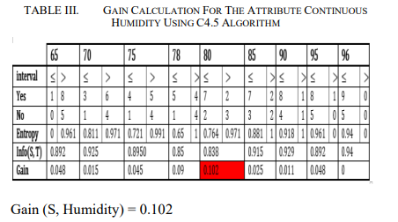
The first 3 steps are similar to ID3 algorithm.
Splitinfo(outlook)=-(4/14)*log(4/14)-(5/14)*log(5/14)-(5/14)*log(5/14)
Interesting part is to calculate Gain(S,Humidity)=?

Slide 22
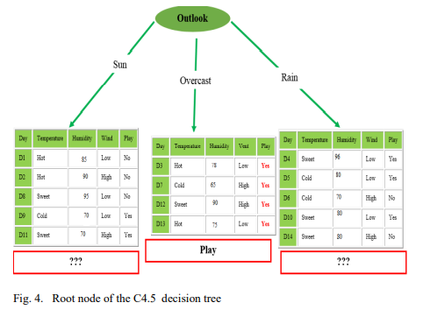

Slide 23
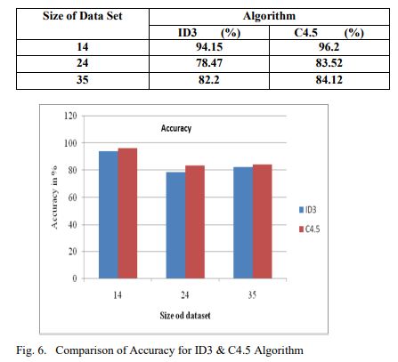
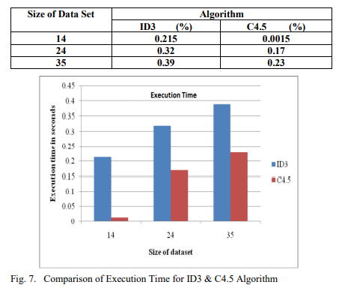
ID3 vs C4.5

Slide 24
Gaps in C4.5 Algorithm
The pruning strategy can be optimized.
The entropy model used in C4.5 has a lot of time-consuming logarithmic operations, continuous values ​​and sorting operations.
C4.5 In the process of constructing the tree, the numerical attribute values ​​need to be sorted according to their size, and a split point is selected from it, so it is only suitable for the data set that can reside in the memory, when the training set is too large to fit in the memory, The program cannot run.

Slide 25
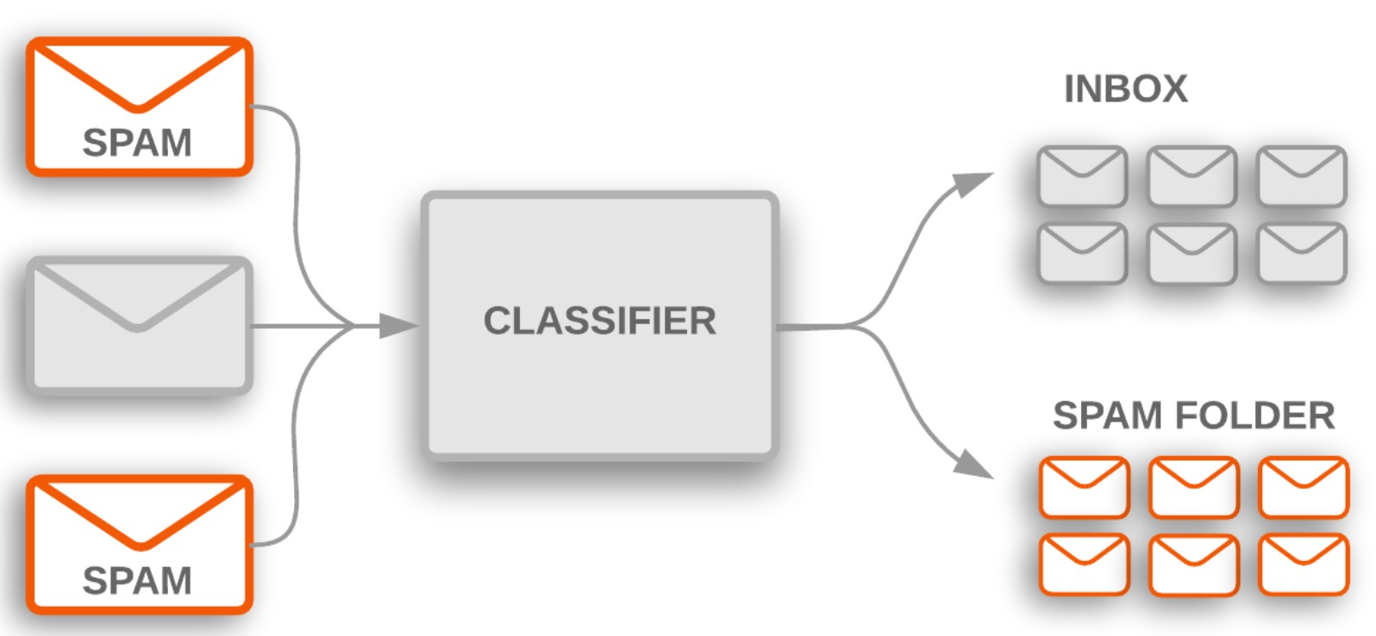
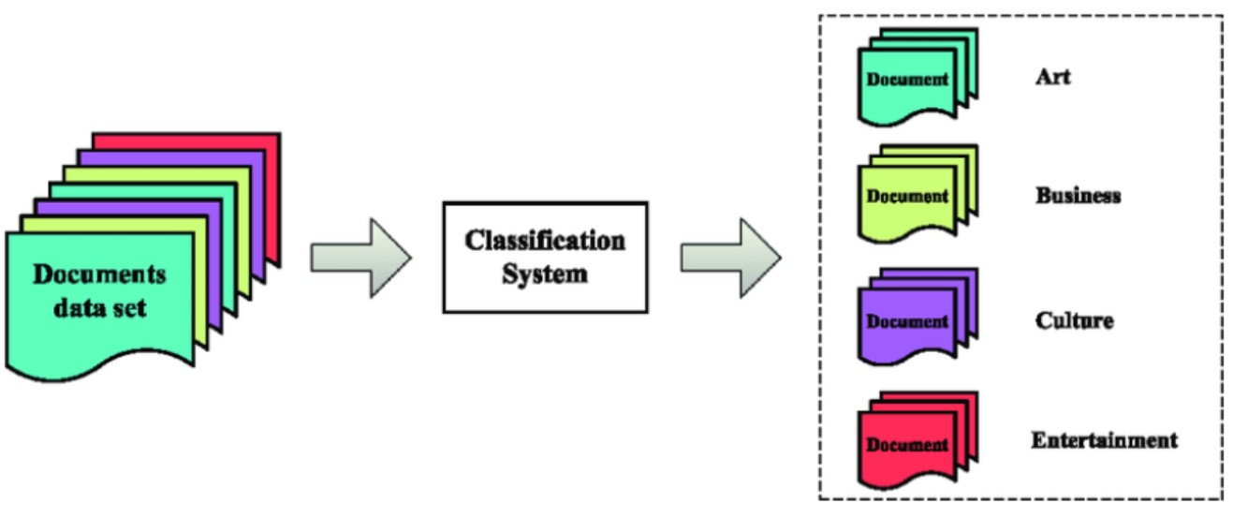
Application of classification technique in real life
Spam Filtering
Web Text Classification
Customer behavior assessment for promotional offers
Credit card fraud detection
Sentiment Analysis
Malware classification
Image classification
Customer behaviour prediction

Slide 26
References to literature survey
Machine learning and real life application
Introduction to induction of tree
ID3 and C4.5
Optimization of ID3 and C4.5

Slide 27
Thank you

