Slide 1

Record Linking
Robert Berry
Twitter: @no0p_
August, 2015
Notes:
Home
Database Users – Design
Real World
Tools to clean data
Talk is about one tool/problem
Relevance

Slide 2
Objectives
Problem definition → Identify
  Informal problem definition
  Formal problem statement
A somewhat general solution → Implementation
  Logistic Regression Theory
  Mechanics
Practical tips → Successful / Painless Implementation
  Various complications and compromises

Slide 3
What is record linking?
Database Context
  Two or more records, referencing the same entity, without a key.
General Statement (Wikipedia)
  “Record linkage refers to the task of finding records in a data set that refer to the same entity across different data sources. Record linkage is necessary when joining data sets based on entities that may or may not share a common identifier.”
https://en.wikipedia.org/wiki/Record_linkage

Slide 4

Common Experience

Slide 5
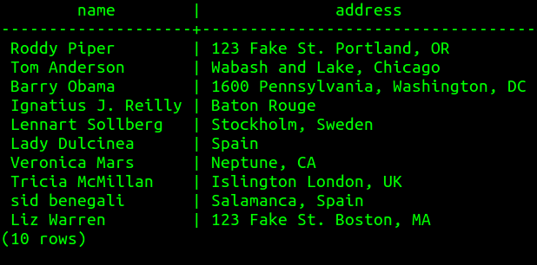
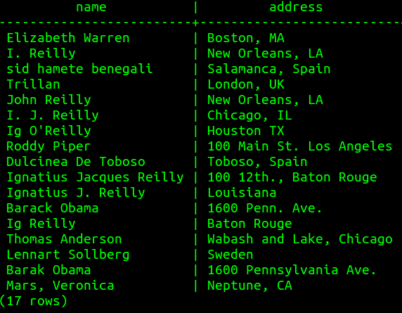
Concrete Example: Two Tables

Slide 6
One of the oldest problems facing civilization
1946 article titled "Record Linkage" published in the American Journal of Public Health.
Census as statecraft
  Censuses in Egypt are said to have been taken during the early Pharaonic period in 3340 BCE and in 3056 BCE
  US Census research

Slide 7
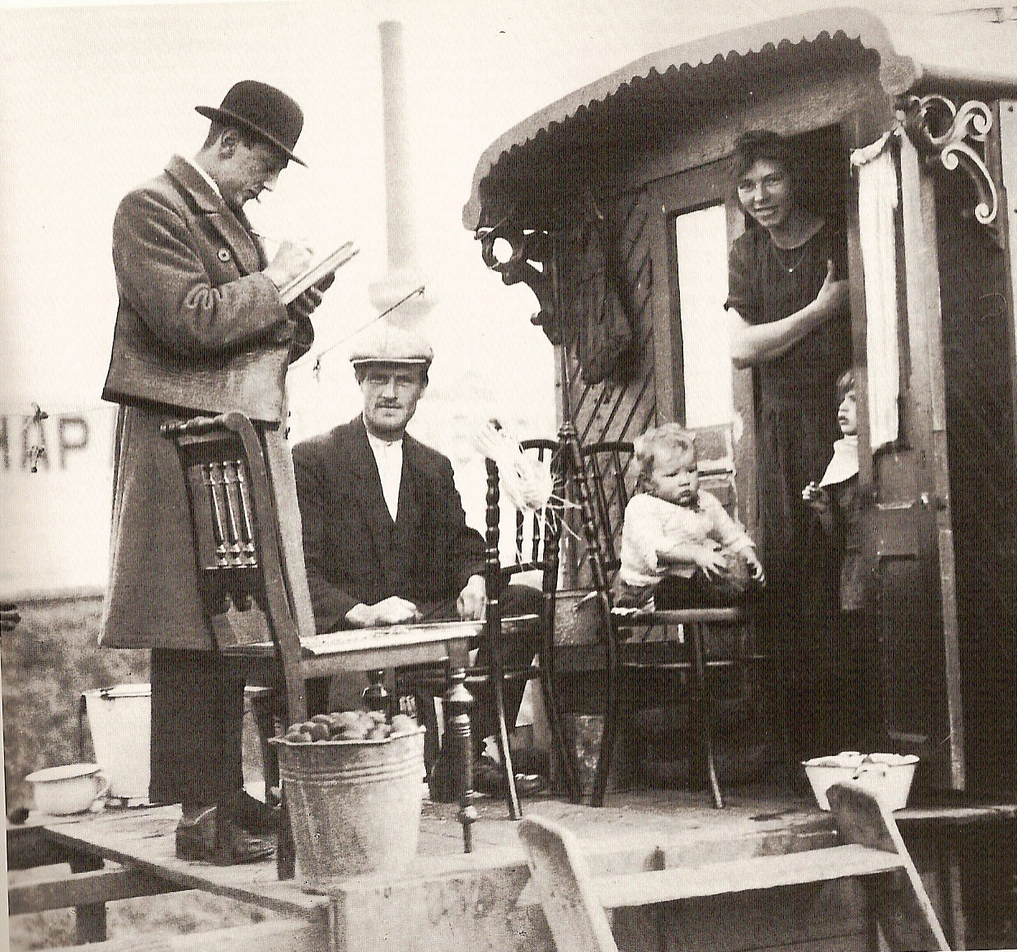
How Problem Emerges for Census
Counting People
Varied Data Sources:
  Interviews
  Mailed Surveys
  Birth Certificates
  Marriage Records
  Death Records

Slide 8
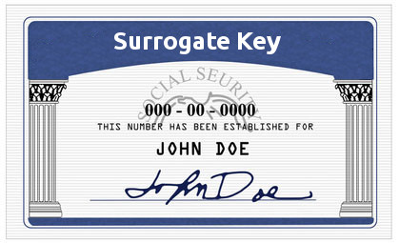
The Many-faced Problem
Typically Entities in data model
  Companies
  Buildings
  People
  Documents
Typically arises from different data sources
  User entries
  Transcription errors
  Divergent data sets (split brain)
  Application Developers
No natural Key
Candidate keys include a set of possible values, including transcription and spelling errors
Text

Slide 9
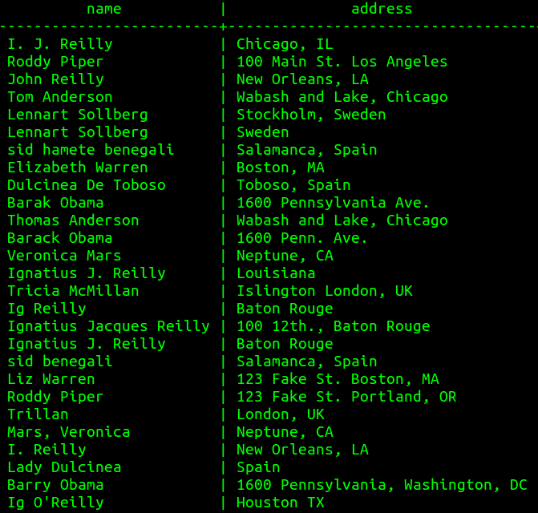
Duplicates Case

Slide 10
Name & Conquer
Label the records in table1 as set A, and the records in table2 as set B.
Define a set of possible matches as A X B, such that each pair (a∈A,b∈B) is a possible match or non-match.
The set of true pairs is labeled set T where (a=b), and the set of false pairs is labeled set F where (a≠b).
Solve the problem by distinguishing whether a given pair
belongs to set T or set F.
T and F are a partition of A X B.

Slide 11
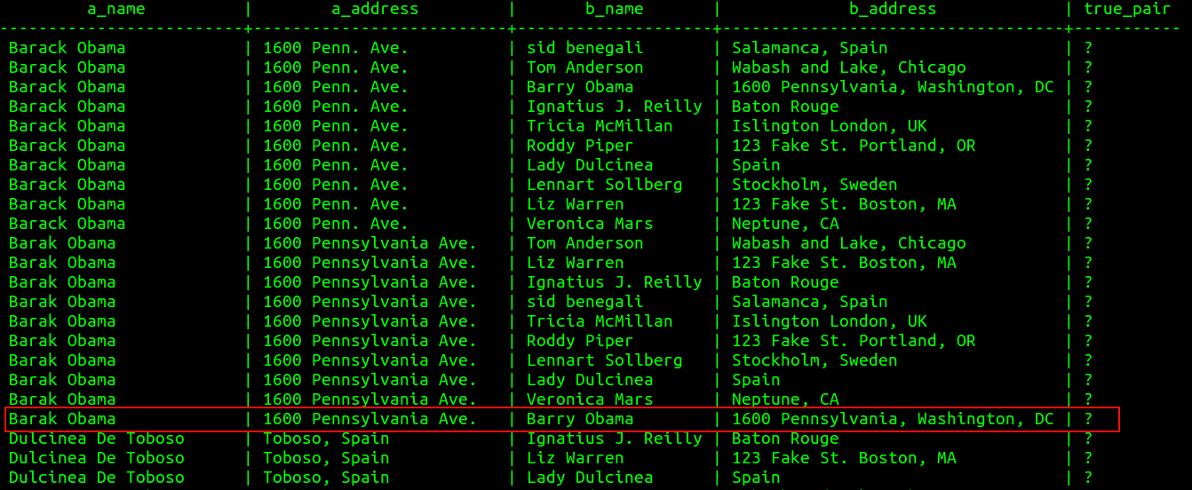
Concrete Pairs

Slide 12
Binary Classification
The problem is now stated as a binary classification problem which is well understood
A solution can take the form of a function which returns a probability that a given pair is a true pair.

Slide 13

Need an Automated Solution

Slide 14
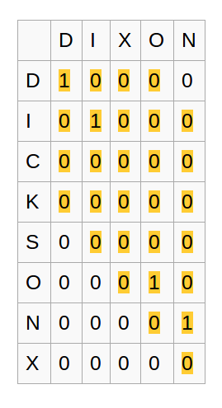
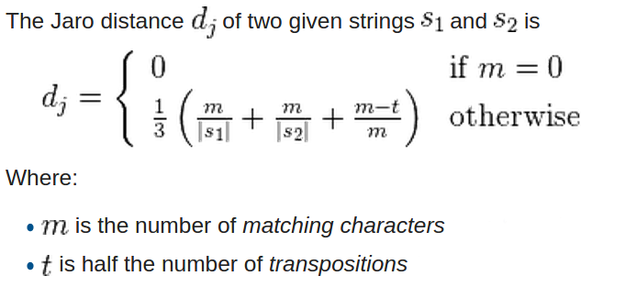
Simple Solution: Discriminant Metric
String distance metrics
  Levenshtein (contrib/fuzzystrmatch)
  Tri-gram (contrib/pg_trgm)
  Jaro-Winkler
    Returns value between 0 and 1
    Developed for '95 Census
https://en.wikipedia.org/wiki/Jaro–Winkler_distance

Slide 15
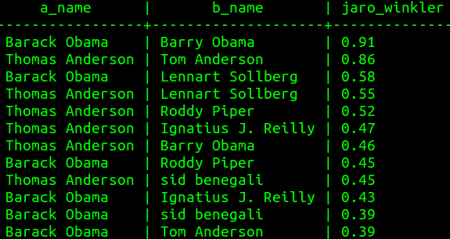
Jaro-Winkler Example

Slide 16
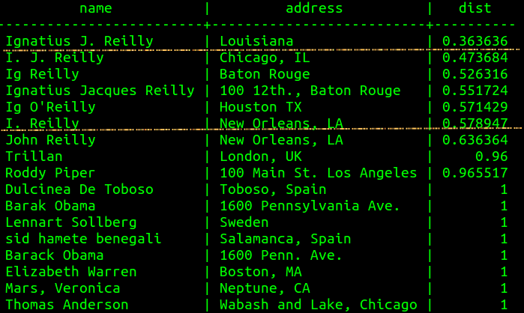
pg_trgm Example
What is the optimal threshold?
Only leverages information present in text field

Slide 17
Black box Logistic Regression
x_1 = Jaro-Winkler distance of name
x_2 = geospatial distance of addresses
x_3 = Share middle initial

Slide 18
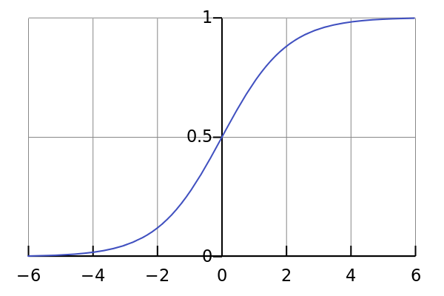
Logistic Regression
Binary Classification
t is a linear function of independent variables
Returns a probability (number between 0 and 1)
Widely Implemented
  Available inside Postgresql through the Madlib extension.
  http://madlib.net/

Slide 19
Feature Selection
Choose a number of independent variables (for pairs)
  x_1, x_2, ...
Some useful string comparison features
Jaro-Winkler Distance | 0-1
Levenshtein Distance | Z
length(Longest Common Substring) | Z
Shared Middle Initial | 0/1
Shared n-gram features (Suffix/Prefix) | R
Word Shape | 0/1
Binned length delta | Z

Slide 20
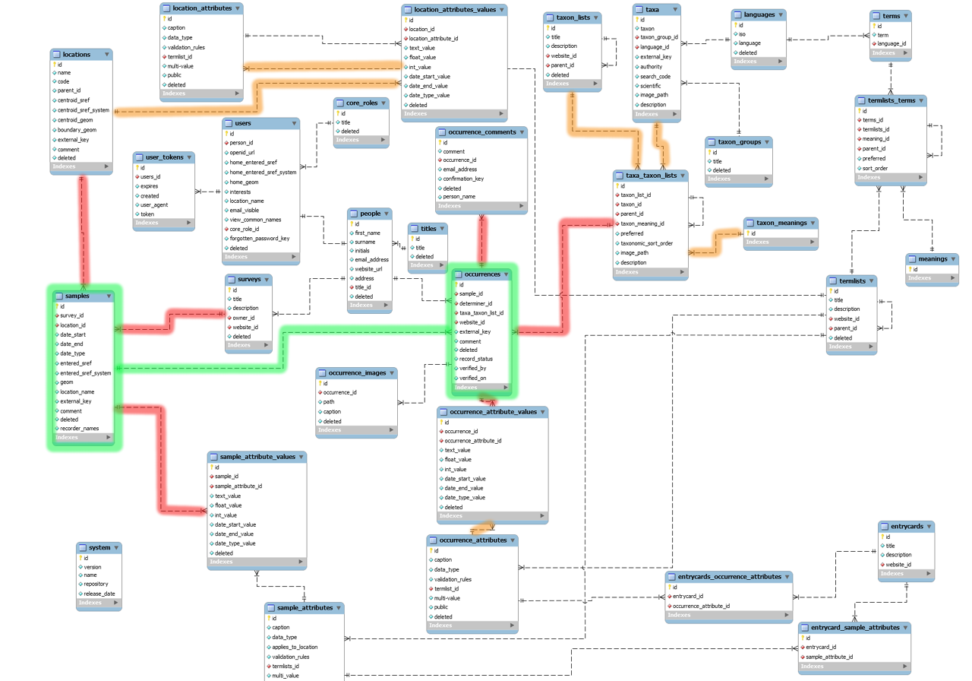
Pair Features From Relations
Same Company or Organization | 1/0
Date of Activity | Z
Average Topic Distance | R
Geospatial Distance | Whatever ST_Distance returns
Same Phone Number | 1/0

Slide 21
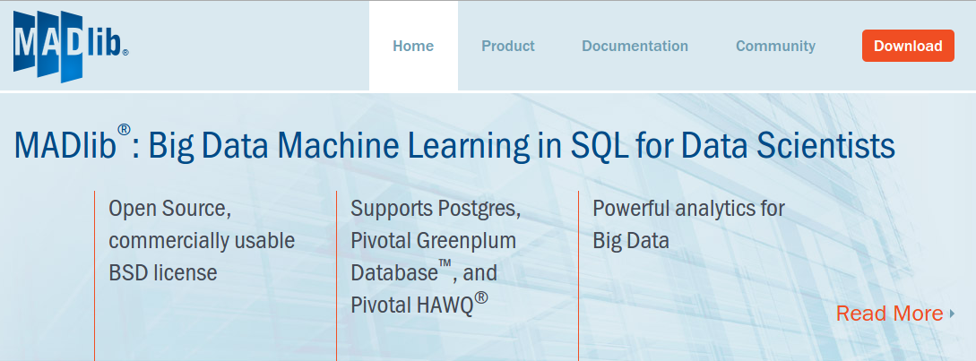
Installing Madlib
  pgxnclient install madlib
  Source:
      https://github.com/madlib/madlib
      Configure; make
      madpack -p postgres -c user@0.0.0.0/db install

Slide 22
Madlib Modules
Regression Models
  Linear
  logistic
Tree Models
Conditional Random Field
ARIMA
Latent Dirichlet Allocation
K-means clustering
Descriptive Statistics
Inference
SVM
Cardinality Estimators
Utility Functions
  Linear algebra operations for arrays as vectors

Slide 23
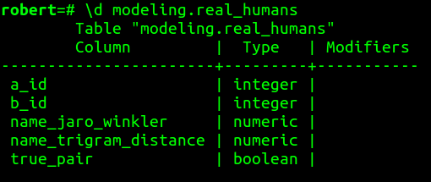
Create Training and Test Sets
Create a utility to manually add records
If available, may be possible to match pairs based on a foreign key.
  E.g. 20% of company_a and company_b records have an IRS TID you can link on, but still have representative typo and alternative spelling examples.

Slide 24
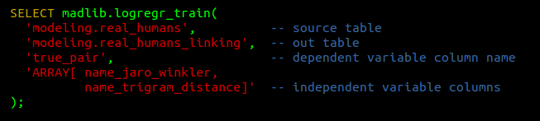
How To Train Your Model

Slide 25

How To Train Your Model

Slide 26
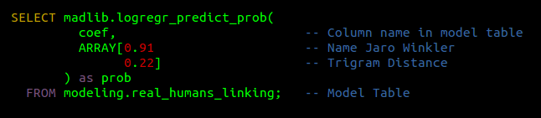
Making Predictions

Slide 27
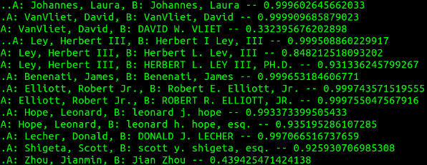
Prediction Examples

Slide 28
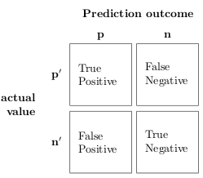
Evaluating the Model

Slide 29
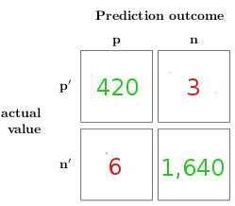
Results for “banks” with name and address

Slide 30
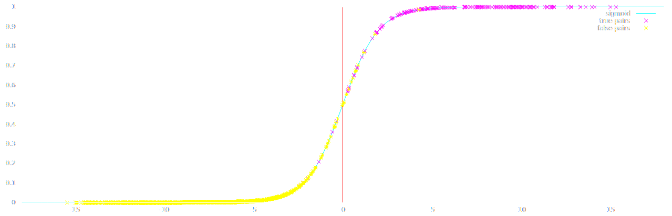
Results Points

Slide 31
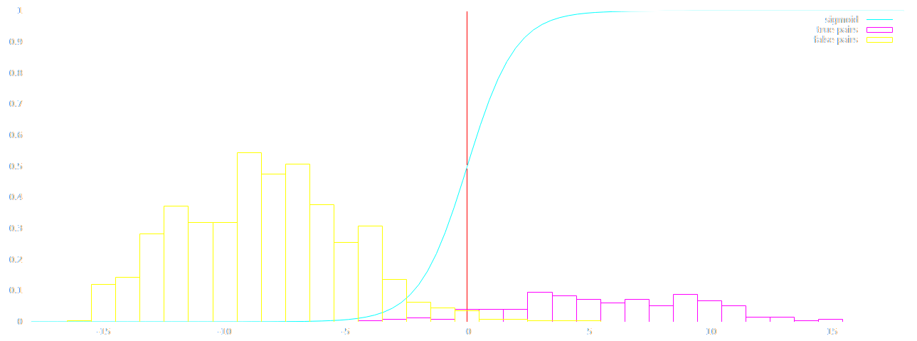
Results Distribution

Slide 32
Generic Company Predictions

Slide 33
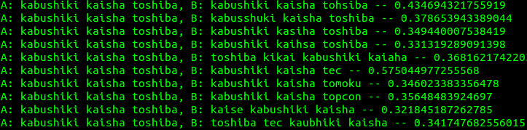
Less Good Generic Company Predictions

Slide 34
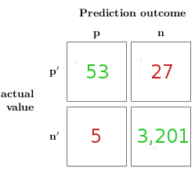
Results for Generic Company Model with Names Only

Slide 35
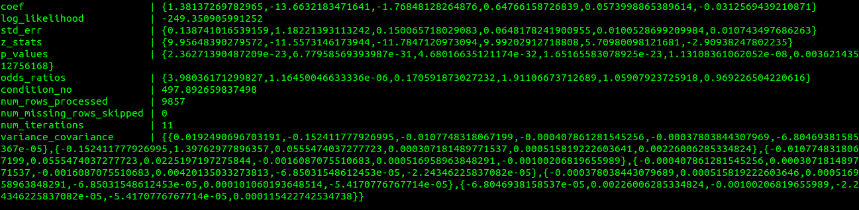
Reviewing Model

Slide 36
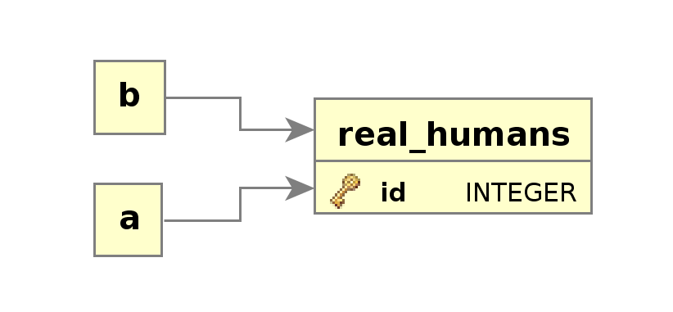
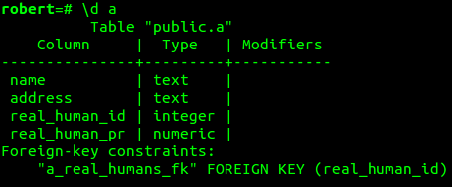
Storing Link Information
Does not require application changes
Preserves Original Information
Separates Speculation From Source Data
  Easy to update
“Probabilistic Foreign Key” Sounds Cool
Reasonably Painless Access Pattern
Duplication and Linking Case
Pluggable Solutions
Manual Review

Slide 37
What about that cross product?
M*N ~ (N^2) pair comparisons to find best match
Compare only against best candidates
  Indexable value that can exclude candidates
    trigram distance
    Geographic restriction
    Kmeans cluster id
    LSH bucket
Probably OK to have fairly loose comparison set
  With 100,000,000 records, comparing 100,000,000 * 100 is quite a bit faster than 100,000,000 * 100,000,000.

Slide 38
Practical Tip: like-like comparisons
Consider linking company pairs.
Better results if comparing specific subset of companies with targeted features.
  Banks
  Blood Banks
May be worthwhile to first classify records because feasible to easily distinguish between classes.

Slide 39
Practical Tip: Organizing
Leverage Postgresql's data organizing features to organize your training and test data
Schemas for isolating model tables and training tables
Materialized views for partitioning examples into training and test sets
  Tablesample
Pair surrogate keys allows for generating new features from data relatively painlessly.

Slide 40
Practical Tip: Probabilistic Foreign Key
Manual review of close calls to minimize human effort
order by real_humans_pr where real_humans_pr < 0.55

Slide 41
Summary
Identify Problem as multiple records for same entity without a key
Set of true pairs in A X B
  Binary Classification of pairs
Solve binary classification in Postgresql with Madlib logistic regression module
  String metric features & features from relations
Create probabilistic foreign keys
  Manual review to taste

Slide 42

Final Thoughts
We should strive for correct data with referential integrity
Be comfortable in a world of imperfect databases
  Slides at http://no0p.github.io/record_linking.pdf

