Slide 1




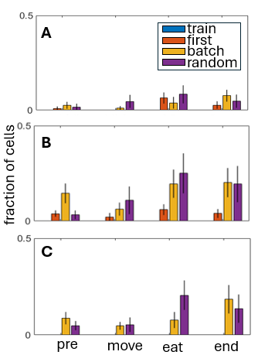
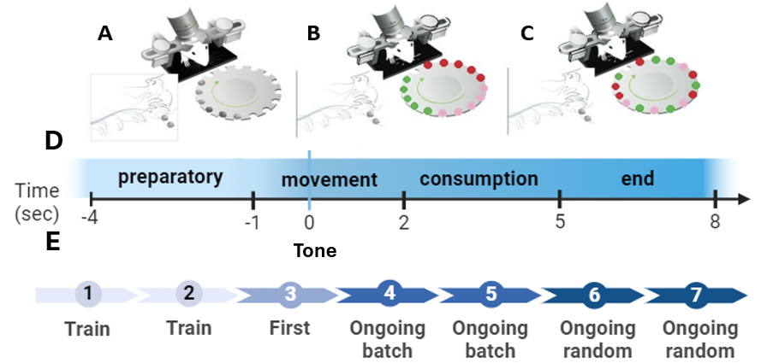
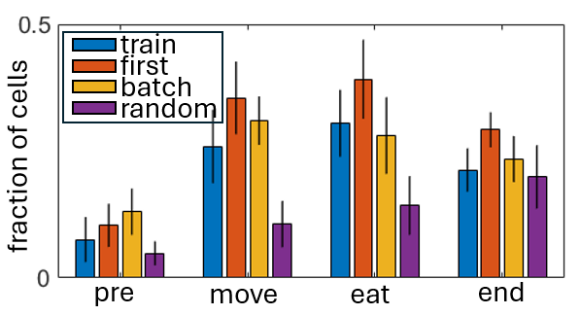
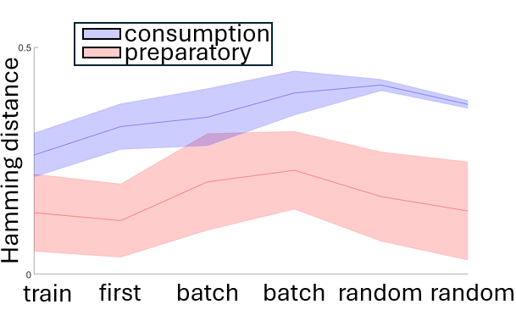
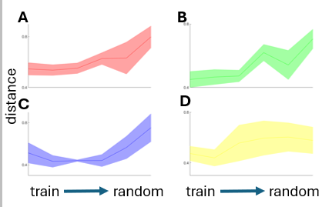
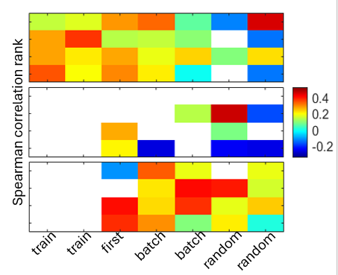
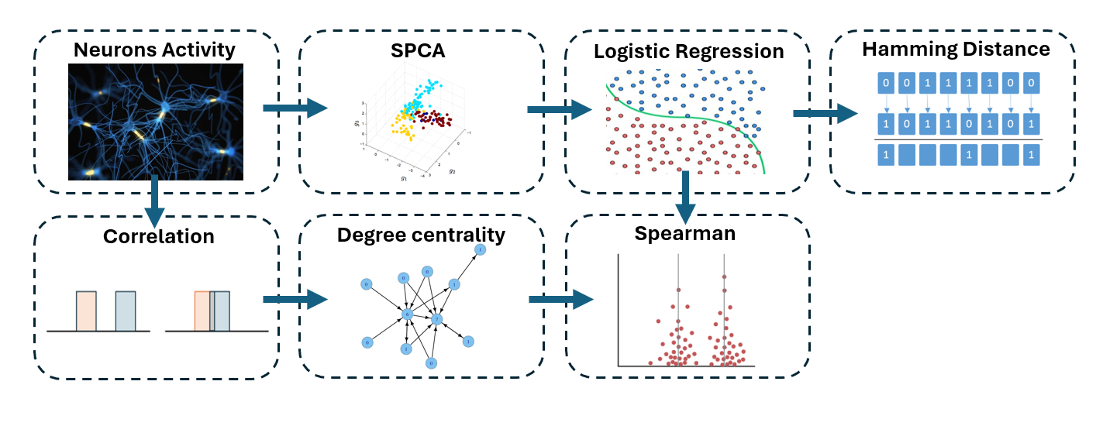
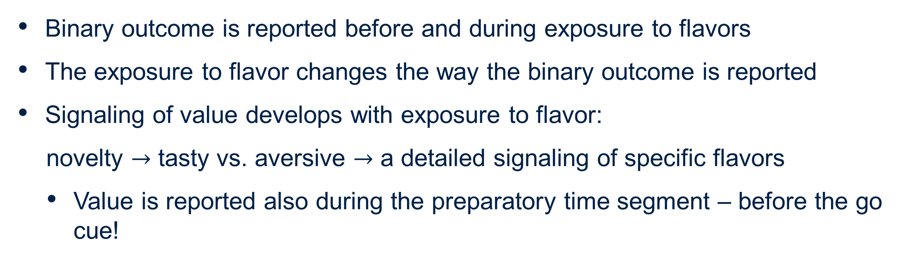
Sparse representations of sensory signals in neuronal networks
Yael Ben Nahum and Noa Elnhorn, Supervised by Hadas Benisty
Introduction
Results
The primary motor cortex (M1) is crucial for motor performance. The central nervous system monitors action outcomes to adapt and improve performance.
Our project explores the relationship between binary signaling of outcome and signaling of outcome value.
We analyze imaging data recorded from pyramidal neurons in layer 2-3 of M1 in mice performing a hand-reach task of a food pellet (Fig. 1). Recent results show that binary outcome (success/failure) is reported by this cells population during this task. Here we explore the effect of exposure to flavored pellets and the existence of value signaling.
We use Sparse Principal Component Analysis (SPCA), classical classifiers, and network centrality to quantify if and how signaling of value (i.e. flavor) emerges with exposure to flavor and its relationship to binary signaling.
Binary outcome representation
Binary outcome is encoded in all time segments and stages.
About 15-20% of cells encode outcome in the final segment – higher than previously published results (based on univariate analysis) [1].
Encoding of value
At first the network mostly encode novelty based on a relatively small fraction of cells.
With exposure to flavor more and more cells encode the value – tasty vs. aversive
Encoding of specific flavors – emerges later
Figure 3. Binary outcome encoding. Fraction of cells encoding successful/failed execution of the task.
Figure 4. Value encoding. Fraction of cells encoding: A. novelty (grain vs. quinine and sucrose). B. Tasty vs. aversive (grain and sucrose vs. quinine). C. Specific flavors.
Exposure to flavors induces a shift in binary outcome signaling
The Hamming distance between the representation of binary outcome during the preparatory in the first session and all other sessions – increases.
This indicates a monotonic change in outcome signaling, induced by exposure to flavor.
Degree Centrality
The distance between the ensemble centrality in the first session and the ensemble centrality in all other sessions increases.
Indicates a monotonic change in the correlational configuration
Figure 1. Illustration of the experimental setup and timelines. Mice perform a hand-reach task of grabbing and consuming food pellets positioned on a rotating table. A. “Train” – no flavor. B. Batch sessions. C. Randomized sessions. D. Trial timeline and time segments. E. Training stages.
Objectives
How does exposure to different values affect (binary) outcome signaling?
Does the network report value as well?
What is the relationship between binary and value signaling of outcome?
Methods
Figure 6. Distance between correlation degree at different stages of training. A. Preparatory segment. B. Movement. C. Consumption. D. End of trial.
Representation – extract a low-dimensional representation of the population dynamics using Sparse Principal Component Analysis (SPCA):
max⁡〖𝑣^𝑇 Σ𝑣〗
𝑠.𝑡 ‖𝑣‖_2=1, ‖v‖_0≤STOP
Detect decoding components – train a logistic regression model per component to identify which cells encode binary outcome or value.
Encoding barcode – label neurons that were detected as encoding outcome
Compare representation using Hamming distance applied to barcodes
Network dynamics –degree centrality of the correlation matrices across different stages
Network dynamics to encoding barcode using Spearman's rank correlation coefficient.
Figure 5. Hamming distance between barcode representation of binary outcome for the preparatory segment (red) and the consumption segment (blue)
Flavor exposure alters the relationship between degree centrality and encoding
Significant and high correlation between the degree and outcome encoding (top) at early stages indicates that network is focused on reporting binary outcome.
With exposure flavor novelty (middle) becomes significant
With exposure flavor value becomes higher than outcome and novelty (bottom).
Figure 7. Spearman correlation rank between degree centrality and encoding of: top - binary outcome, middle - novelty (grain vs. quinine and sucrose) and bottom - tasty vs. aversive (grain and sucrose vs. quinine).
Conclusions
Binary outcome is reported before and during exposure to flavors
The exposure to flavor changes the way the binary outcome is reported
Signaling of value develops with exposure to flavor:
novelty $→$ tasty vs. aversive $→$ a detailed signaling of specific flavors
Value is reported also during the preparatory time segment – before the go cue!
Figure 2. Analysis pipeline.
References
[1] Levy, S., Lavzin, M., Benisty, H., Ghanayim, A., Dubin, U., Achvat, S., ... & Schiller, J. (2020). Cell-type-specific outcome representation in the primary motor cortex. Neuron, 107(5), 954-971.‏ Hantman,3, * and Jackie Schiller1,5
[2] Dynamic representation of task variables by layer 2-3 neurons in the primary motor cortex Research thesis, Zohar Lotan
[3] Lin, X. X., Nieder, A., & Jacob, S. N. (2023). The neuronal implementation of representational geometry in primate prefrontal cortex. Science Advances, 9(50), eadh8685.‏
Acknowledgements
Guidance and support from prof. Hadas Benisty.
Imaging data collected by Zohar Lotan from Jacky Shiller’s - Technion Faculty of Medicine.
Guidance and support from Gaia Levin.

