Slide 1
Midterm Presentation Sparse representations of sensory signals in neuronal networks
Students: Noa Elnhorn, Yael Ben Nahum
Supervisor: Hadas Benisty
Semester: Winter, 2024
Date: [12/03/2024]

Slide 2
Outline
Project Background
Chosen Solution
Intermediate Results
Conclusion

Slide 3
Background
Previous results show that outcome is encoded in layers 2-3
Experiments
Prof. Jackie Schiller, Zohar Lotan.
Flavor can be decoded from neuronal activity (Lotan, 2023)
Motivation

Slide 4
Project Goal
Understand how flavors affect encoding of outcome
Is flavor encoded?
Identify sub-networks for flavor outcome
Dynamics
Stability
Which characteristics of flavors? (tasty, aversive?)
In which stage of the experiment?

Slide 5
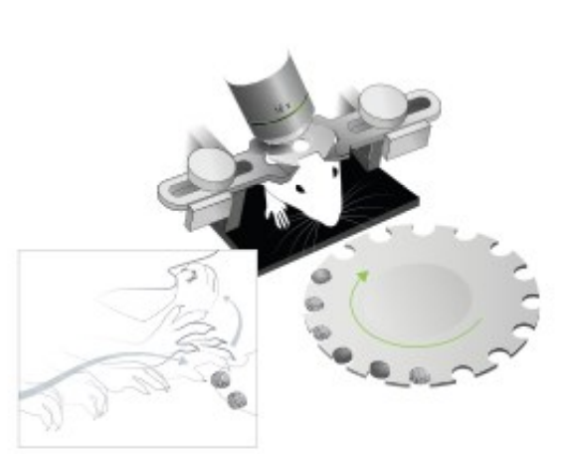
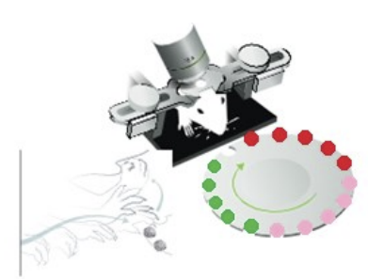
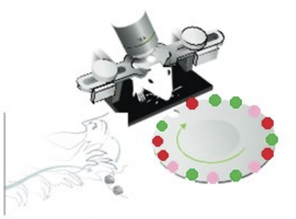
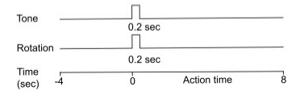
Background
Experiment
Train
First
Batch
Random
(Adopted from Lotan, 2023)

Slide 6
Literature Survey
Cell-type-specific outcome representation in the primary motor cortex (Levy et al., 2020)
Success & Failure encoding
The neuronal implementation of representational geometry in primate prefrontal cortex. (Lin et al., 2023)
SPCA

Slide 7

Chosen Solution

Slide 8
Chosen Solution
Neurons' Activity
SPCA
classifier

Slide 9
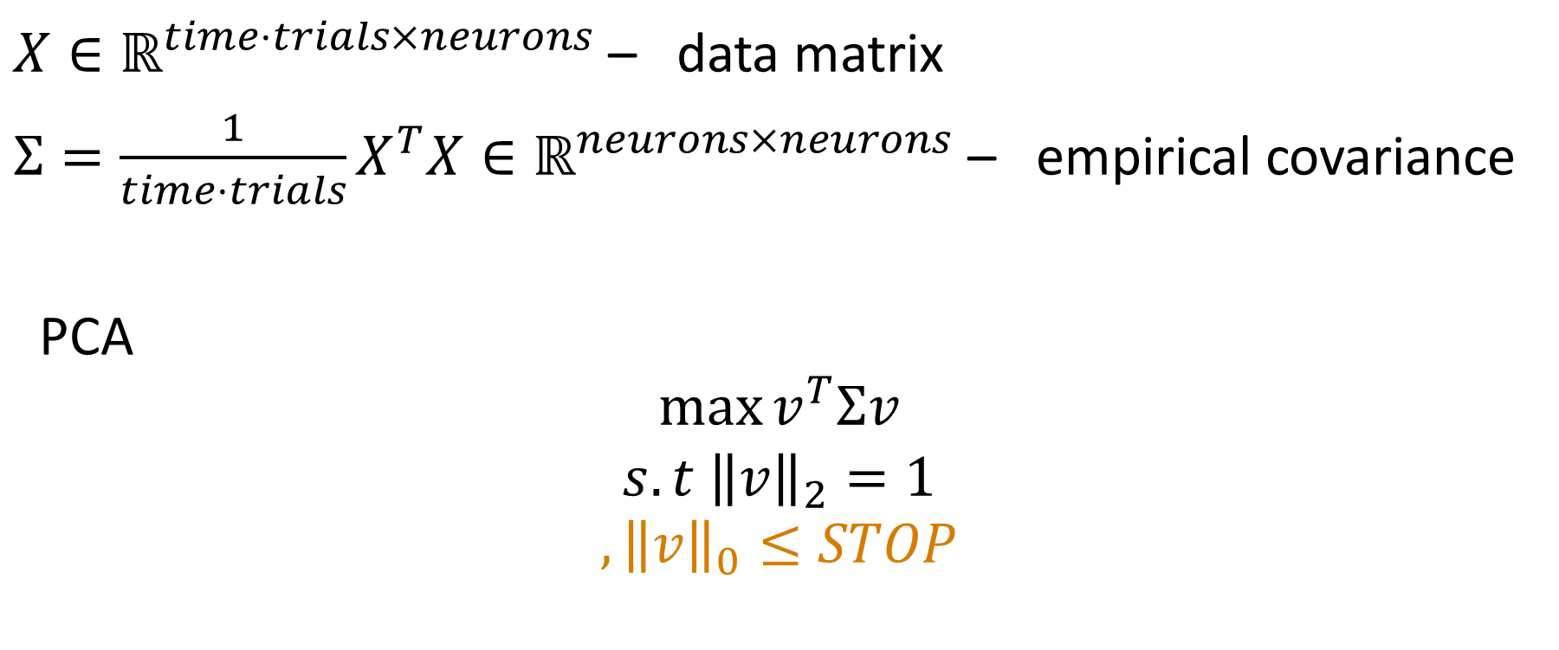
Chosen Solution
SPCA VS PCA
$X∈ℝ^{time⋅trials×neurons}$ – data matrix
$Σ=\frac{1}{time⋅trials}X^{T}X∈ℝ^{neurons×neurons}$ – empirical covariance
PCA
$$\max{v^{T}Σv}$$
$$s.t {\left\|v\right\|}_{2}=1$$
$$,{\left\|v\right\|}_{0}≤STOP$$
S

Slide 10
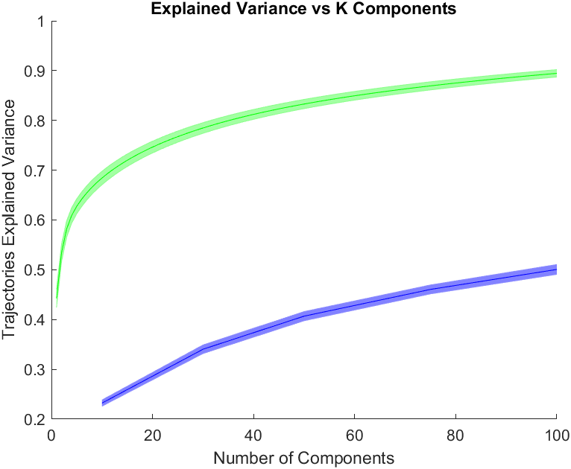
Intermediate Results
SPCA VS PCA
PCA
SPCA

Slide 11
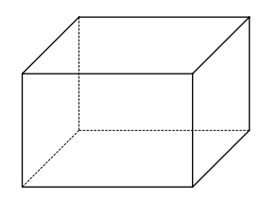
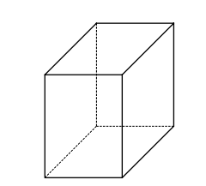
Chosen Solution
SPCA
Original Data
Projection
Reconstruction
Kernel
Kernel
neurons x time x trials
components x time x trials
neurons x time x trials

Slide 12
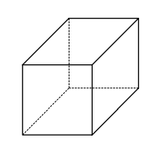
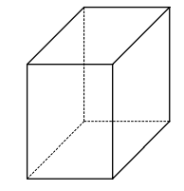
Chosen Solution
Classifier
Accuracy
Projection
SVM
Projection
accuracy - chance
components x time x trials
time windows x questions x components

Slide 13

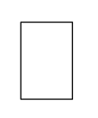

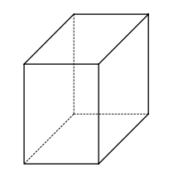
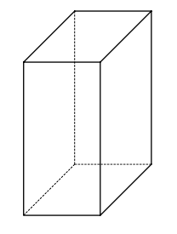
Chosen Solution
Bookkeeping single and groups of neurons
accuracy - chance
Components Bookkeeping
Neurons Bookkeeping
Threshold
Kernel
time windows x questions x components
time windows x questions x neurons

Slide 14
Encoding Neurons fraction
Chosen Solution
Neurons Bookkeeping
for time window and for question:
$$fraction of neurons=\frac{\text{Neurons} \text{Bookkeeping} (i,j,:)>0}{neurons}$$
time windows x questions x neurons

Slide 15

Intermediate Results

Slide 16
Intermediate Results
Present your results compared to other solutions and emphasize the advantages (and disadvantages) of your solution
Give examples
Illustrate the idea in action
Show extreme cases

Slide 17
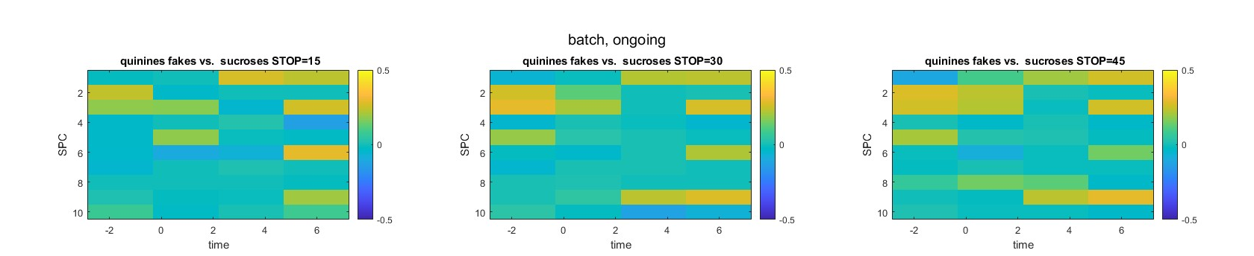
Stop parameter
Intermediate Results

Slide 18
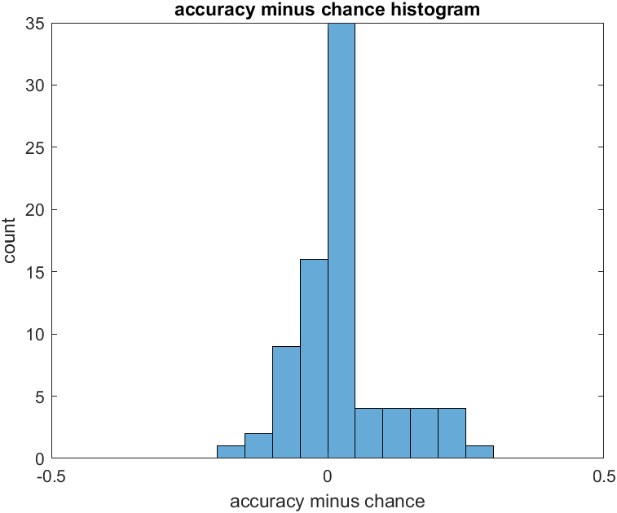
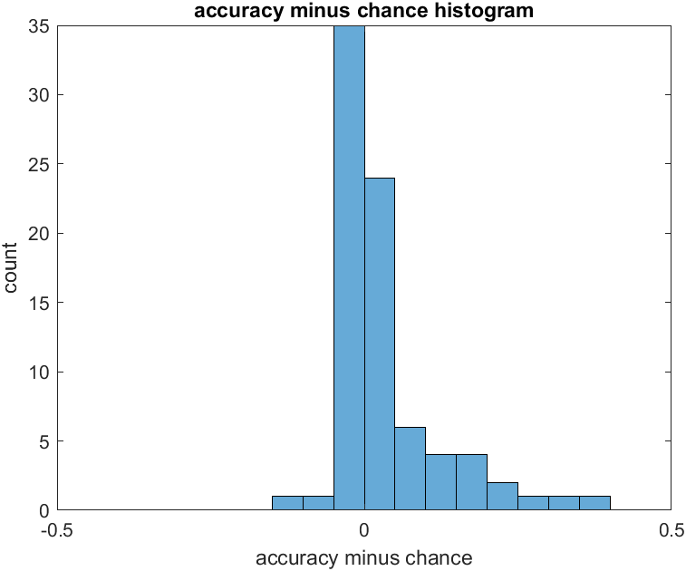
Threshold decision
Intermediate Results

Slide 19
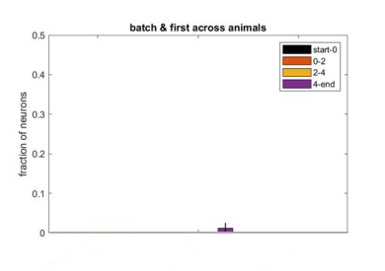
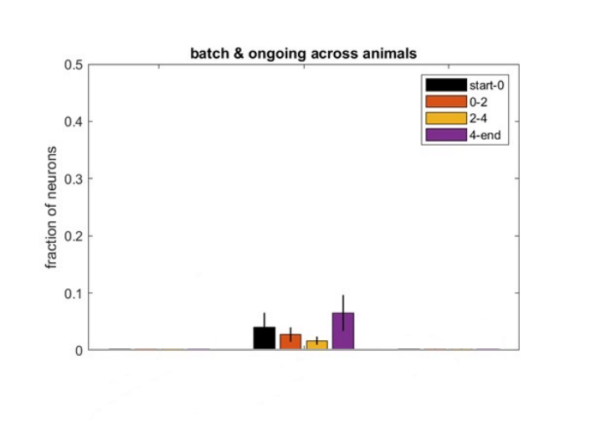
Encoding Neurons fraction
Intermediate Results
Flavors – batch
Quinine fake VS sucrose
Quinine fake VS sucrose

Slide 20
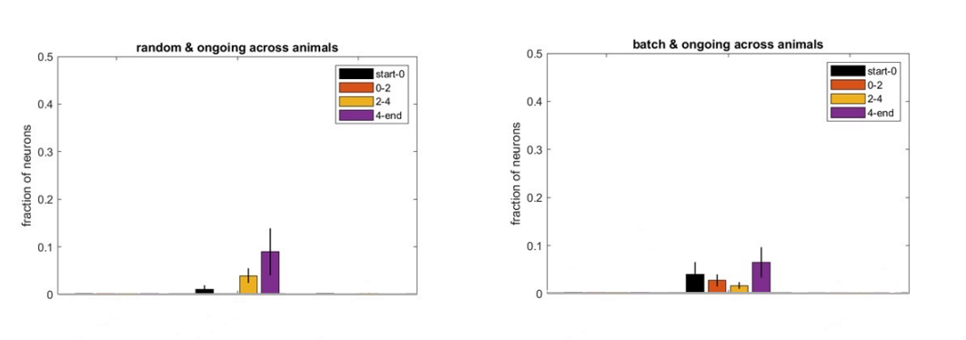
Encoding Neurons fraction
Intermediate Results
Flavors – ongoing
Quinine fake VS sucrose
Quinine fake VS sucrose

Slide 21
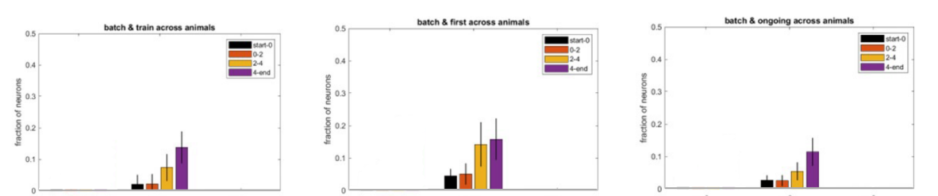
Encoding Neurons fraction
Intermediate Results
Success VS Failure
Failure VS All
Failure VS All
Failure VS All

Slide 22
Conclusion
Flavors classification using sparse sub-space:
Highest accuracy after tasting
Encoding of flavor emerges with exposure
Batches of flavors are encoded during pre-tone segment
Outcome encoding is not affected (accuracy)

Slide 23
Work So Far
Literature Survey
Get to know the Data and code foundations
Adapt SPCA and SVM framework
Build code foundations for neurons Bookkeeping
Parameters tuning

Slide 24
Future Work
ZOOM IN
Improve the existing model (try additional methods, Multiclass classification)
Statistical analysis in addition to existing methods
ZOOM OUT
Comparison to analysis in single variable (Lotan, 2023)
Comparison to analysis using neural network (Shira Lifshitz)
Network analysis
Correlation matrix, Network metrics
Network centrality and encoding

Slide 25
References
Dynamic representation of task variables by layer 2-3 neurons in the primary motor cortex Research thesis, Zohar Lotan
Levy, S., Lavzin, M., Benisty, H., Ghanayim, A., Dubin, U., Achvat, S., ... & Schiller, J. (2020). Cell-type-specific outcome representation in the primary motor cortex. Neuron, 107(5), 954-971.‏
Lin, X. X., Nieder, A., & Jacob, S. N. (2023). The neuronal implementation of representational geometry in primate prefrontal cortex. Science Advances, 9(50), eadh8685.‏

