Slide 1
Resolution Bias and Cross-Generator Detection of AI-Generated Images
Noa Keter · Ido Josephsberg
Lecturer: Dr. Shay Maymon
github.com/Ido-Josephsberg/deep-learning

Slide 2
MOTIVATION
A detector that looks excellent, until the generator changes
Train a CNN to separate real photographs from images made by one generator, and it scores almost perfectly on that generator. Point it at a generator it has never seen and the accuracy falls off a cliff.
0.908
0.655
same generator
in-domain accuracy
unseen generator
cross-generator accuracy
The question this project asks
How much of that in-distribution success reflects the generative process,
and how much reflects the way the benchmark was built?
↓
This gap is the published pattern, not our finding
a 25-point drop, from one change:
the generator at test time
What is ours is the explanation — and it is not about the generators.
center_crop arm, mean of two seeds, n = 1,000 balanced images per cell

Slide 3
MOTIVATION
Every generator emits one fixed size. Real photographs do not.
BigGAN
ADM GLIDE VQDM
SD 1.5 Wukong
Midjourney
Real
Native resolution
128²
256²
512²
1024²
variable
So the dimensions alone identify both the class and the generator. A detector can score well without ever examining pixel content.
0.977
The shortcut, made explicit
accuracy on every one of the 49
source → target pairs
Simple square rule results
Predict synthetic whenever the image is square.
Zero parameters. No training. No pixels analysis.
Higher than the cross-generator accuracy
of every trained detector in this talk.

Slide 4
MOTIVATION
Removing the cue is not a neutral act
The fingerprint is high-frequency
Cropping discards context. Rescaling attenuates the very frequencies that
carry the signal. Padding introduces a border of its own.
Do the conclusions
survive that choice?
Prior work applies one correction and reports the corrected number
It does not ask whether the choice of correction changes the answer.
They do not.
We make the correction itself the experimental variable
One architecture, one dataset, one protocol, four ways of equalizing size.

Slide 5
RELATED WORK
Three papers, and where we start
2020
Wang et al. — CNN-generated images are surprisingly easy to spot
Established the pattern: easy in-distribution, uneven transfer to unseen architectures.
2023
GenImage — a million-scale benchmark
Scaled the question and formalized the cross-generator protocol we adopt: train on one generator, evaluate on all.
2024
Grommelt et al. — Fake or JPEG?
Showed GenImage carries two construction artifacts, JPEG compression and image size. Removing both adds >11 points cross-generator.
We take the size bias as established and begin where that work stops. It corrects the bias once, by a single mechanism. Our claim is different: the correction is itself a free parameter, and it changes the published results.

Slide 6
METHOD · DATA
Tiny-GenImage
35,000
7
17,500
1 of 7
images
8.4 GB
generators
2,500 images each
real ImageNet
photographs
generators is PNG
the rest are JPEG
Format cannot separate real from fake here, except in one row
Real photos and six of seven generators are JPEG, so GenImage's format bias is not available as a shortcut. It survives only for ADM, which we return to. Size is the confound we set out to study.
Splits, and why no reported number ever influenced training
3,600 train / 400 validation per run, from the shipped train split. The shipped validation split is held out as our test set: 4,000 images. Model selection uses the internal validation set only.
Every matrix cell is exactly balanced
500 target fakes + the same fixed 500 real images, so n = 1,000 and accuracy is directly interpretable. Binomial standard error ±1.6 pp.

Slide 7
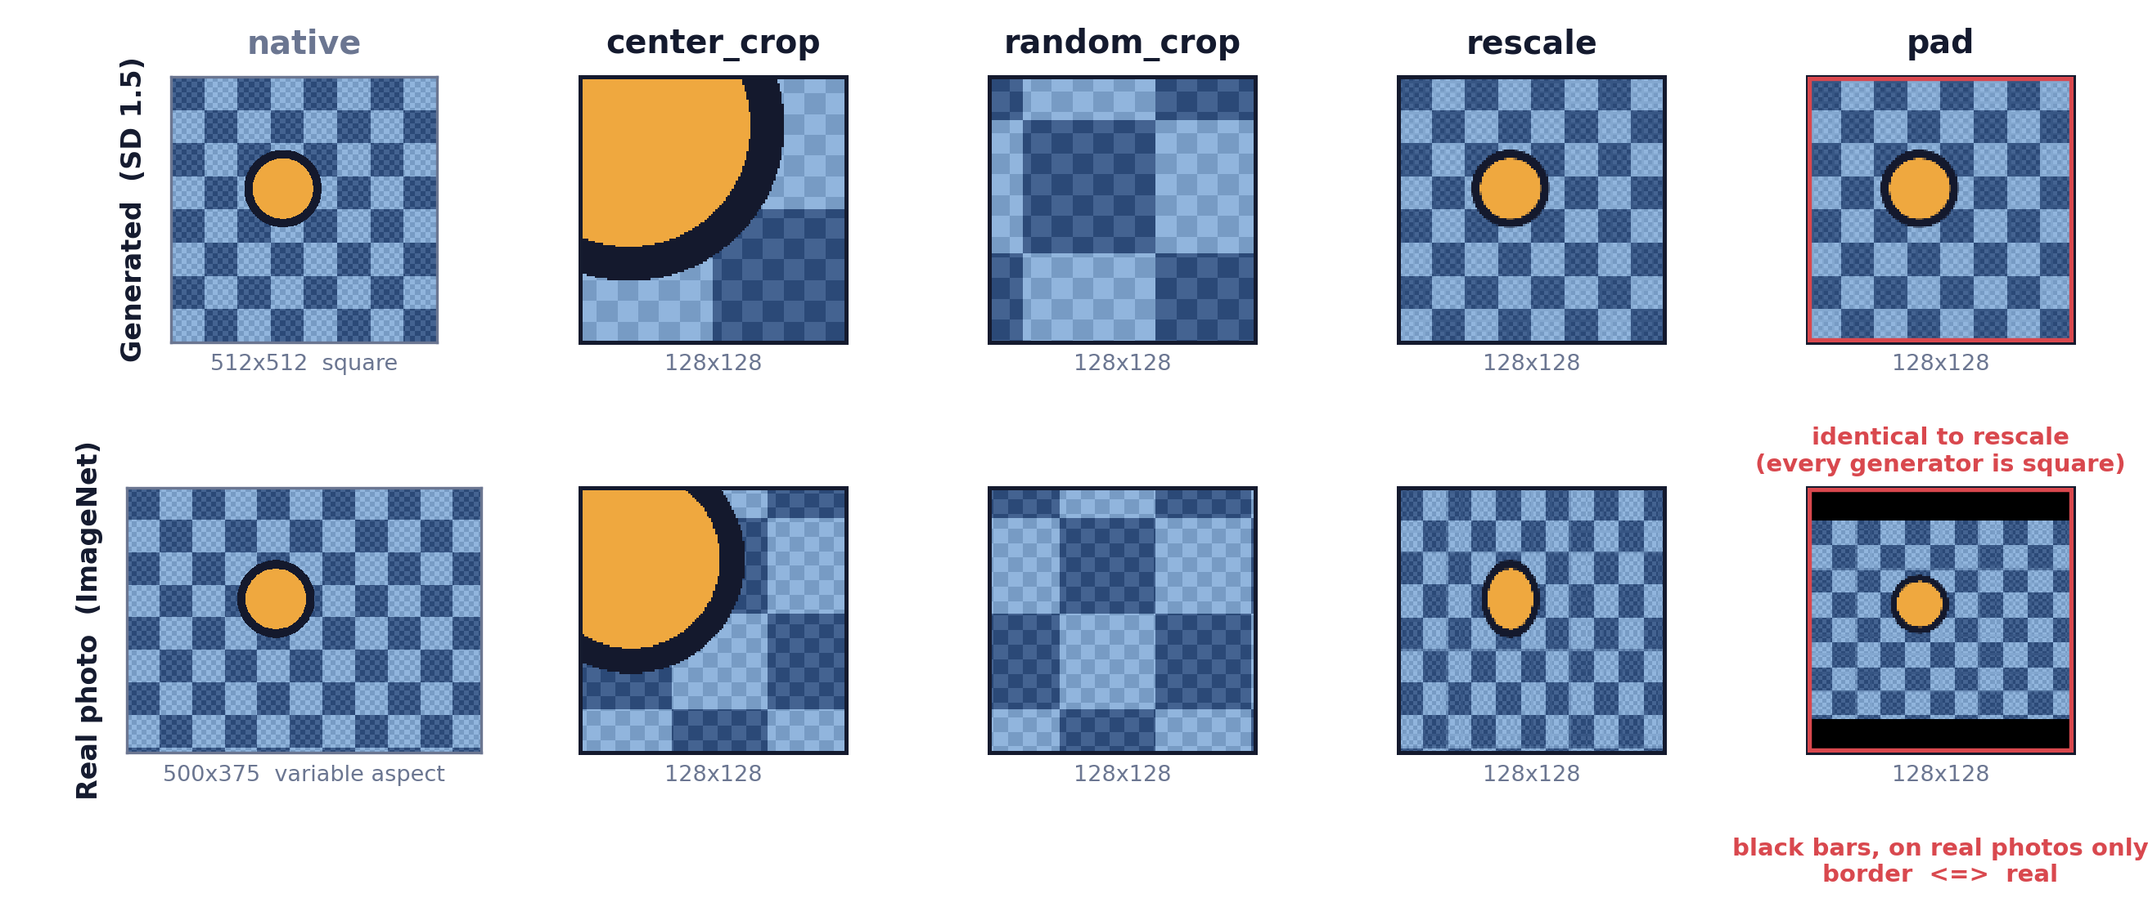
METHOD · PREPROCESSING
Four ways to make every image 128 × 128
The first two preserve native pixel statistics and discard content. The last two resample.

Slide 8
METHOD · MODEL + EXPERIMENTS
One architecture, held fixed, 56 times
Compact CNN, 1.17 M parameters, trained from scratch in PyTorch
Setting
Value
Four blocks of [Conv 3×3, BatchNorm, ReLU] ×2 then 2×2 max-pool, widths 32/64/128/256, global average pooling, dropout 0.3, one linear unit.
Optimizer
AdamW
Learning rate
3×10⁻⁴
From scratch is required, not stylistic
Weight decay
1×10⁻⁴
The real class is ImageNet. An ImageNet-pretrained backbone would arrive having already seen the negative class.
Schedule
cosine to 0, 40 epochs
Batch / precision
128, AMP float16
Two choices follow from the nature of the signal
Augmentation
horizontal flip, p = 0.5
Nothing downsamples before the end of block one, because the cue is high-frequency. The head is global average pooling, because the evidence is a location-free texture statistic.
Selection
best internal validation
4 strategies × 7 sources × 2 seeds
56 runs · ~2 GPU-hours
free-tier Colab T4, 127 s per run, each evaluated on all seven targets

Slide 9
RESULTS
What every trained detector is competing against
0.977
1.000 / 0.619
Neither rule measures
anything about the
generative process.
square rule
the same score on all 49 cells,
diagonal and off-diagonal alike
size-lookup rule
diagonal / off-diagonal
This is the shortcut every
trained detector competes against.
Why the square rule works: TPR 1.000, TNR 0.954
Every generated image in this dataset is square, and 95.4 % of real photographs are not.
The size-lookup rule exposes the mechanism exactly
It scores 1.000 whenever source and target share a native resolution and exactly 0.500 whenever they do not, in 47 of 49 cells. The two exceptions trace to a single 512² Midjourney row.

Slide 10
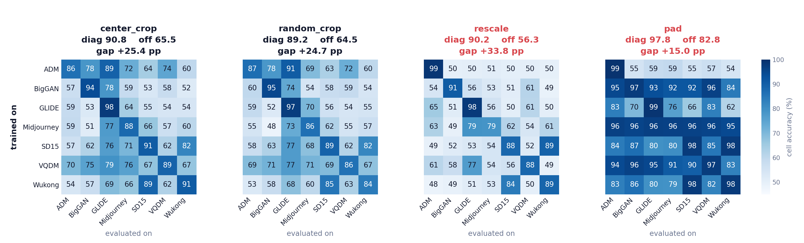
RESULTS
Four corrections, four different pictures
Rows are the generator a detector trained on, columns the generator it was evaluated on. Two seeds, n = 1,000 per cell, one shared color scale.
The diagonals are broadly similar 90.8, 89.2, 90.2. The off-diagonal structure is not, and that difference is the result. ADM's row is the clearest case: strong under both crops, at chance under rescale and pad.

Slide 11
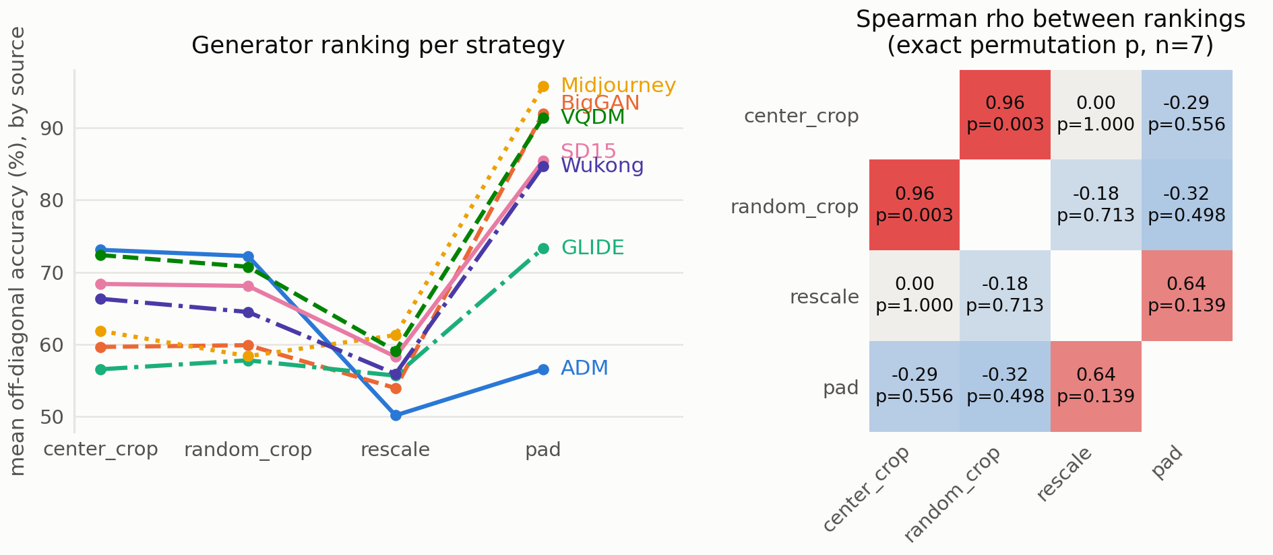
RESULTS · THE MAIN RESULT
The ranking does not survive the correction
ρ = +0.964
the two non-resampling arms agree
p = 0.003
ρ = 0.000
rescale retains none of
that structure
ADM
1st → 7th
best source under both crops,
worst under rescaling
Two papers using the same data, architecture and protocol would disagree about which generator is hardest, purely because one rescaled and the other cropped.

Slide 12
RESULTS
pad scores highest — and that is the failure
Every generator is square
0.977
so padding changes nothing for them
↓
where a pure border-reader
would ceiling: (1.000 + 0.954) / 2
Only real photos get bars
variable aspect ratio, so they alone are padded
0.978
↓
The border becomes a perfect proxy
pad's measured diagonal
border ⇔ real, learnable in a few epochs
Corroboration
Higher accuracy here marks a worse experiment, not a better detector. Padding does not remove the size confound, it re-encodes it as a visible border.
Sharing a native resolution helps transfer by
+0.113, +0.113, +0.135 in the other three arms
— but only +0.007 for pad.

Slide 13
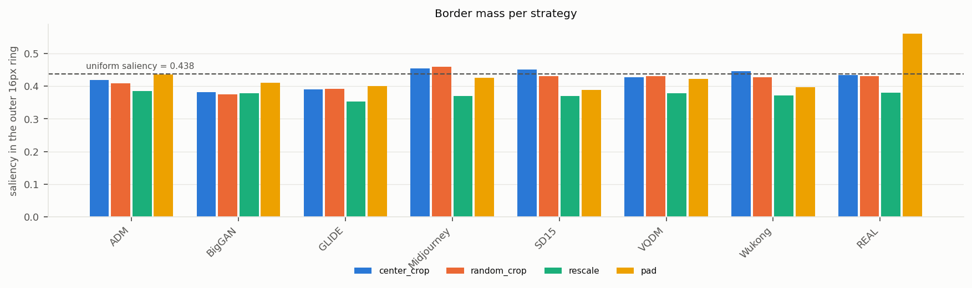
ANALYSIS
The model really is reading its border
Input-gradient saliency, 200 images per tag, seed 0. Border mass is the fraction of the mean saliency map falling in the outer 16-pixel ring, against a uniform null of 0.4375.
Strategy
Real
Generators
Real 1st
center_crop
0.4345
0.4243
0 of 7
random_crop
0.4310
0.4175
1 of 7
rescale
0.3793
0.3721
2 of 7
pad
0.5613
0.4113
7 of 7
All 7 pad runs sit above all 21 others
This confirms from inside the model what the accuracies alone could only imply.
Every pad run exceeds +0.11 over its own generator mean. No run in any other arm reaches +0.04.
Padding does not raise edge saliency in general, only the class that receives a border is affected.
rescale also draws on the most centrally concentrated evidence of the four arms, 0.373 against 0.419 to 0.430.

Slide 14
ANALYSIS
Not an undertrained CNN
Is the weak transfer simply a small network trained badly?
Train
In-domain test
Cross-generator
center_crop
0.967
0.908
0.655
rescale
0.982
0.902
0.563
At 96.7 – 98.2 % train accuracy the network is close to memorizing its 3,600 images, so the modest in-domain number is a variance limit, not a capacity limit.
rescale fits its training set better, matches center_crop on held-out images of the same generator, and collapses only when the generator changes.
Doubling the epoch budget from 40 to 80 on three generators moved in-domain accuracy +0.020 and cross-generator −0.007. More training buys fit, and nothing in transfer.

Slide 15
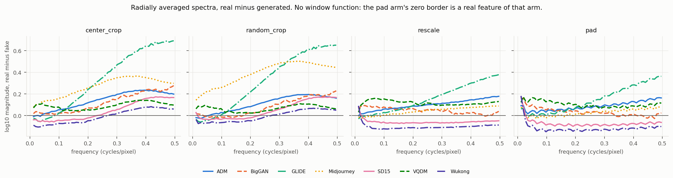
ANALYSIS
Radially averaged spectra close the loop
Real minus fake, mean log₁₀ power above 0.35 cycles / pixel
+0.256
+0.253
+0.075
+0.058
center_crop
random_crop
rescale
pad
Both resampling arms lose roughly three quarters of the high-frequency separation the crops retain. That is the mechanism behind the transfer collapse.

Slide 16
SUMMARY & INSIGHTS
Three findings that survive our controls
A zero-parameter size rule beats every trained detector cross-generator
Recommendation
So cross-generator numbers reported without an explicit size correction are largely uninterpretable.
Treat size equalization
as a first-class
methodological choice -
and report more than one.
The correction is not a neutral preprocessing detail
Strategies preserving native pixels agree on generator difficulty (ρ = +0.964); resampling gives an unrelated ordering. A published ranking depends partly on a choice that is rarely reported.
Limitations
n = 7 generators. Two seeds.
ADM anomaly unexplained.
A correction can raise accuracy while making the experiment worse
pad trades the size cue for a border cue, found by attribution in all seven of its runs, and in none elsewhere.
Code, run instructions, split definitions and every metrics.json from the 56 runs:
github.com/Ido-Josephsberg/deep-learning

Slide 17
Thank You for Listening

