Slide 1
DEEP LEARNING · TEL AVIV UNIVERSITY · 2026B
Resolution Bias and
Cross-Generator Detection
of AI-Generated Images
56
Noa Keter · Ido Josephsberg
training runs
4 strategies x 7 generators x 2 seeds
Lecturer: Dr. Shay Maymon
github.com/noa-keter/deep-learning
Notes:
0:15 | Ido
- Title, both names, repo is public and linked.
- One line only: detecting AI-generated images, and what the benchmark is really measuring.
- Do not explain the 56 here; it is a hook for slide 8.

Slide 2
MOTIVATION
A detector that looks excellent, until the generator changes
Train a CNN to separate real photographs from images made by one generator, and it scores almost perfectly on that generator. Point it at a generator it has never seen and the accuracy falls off a cliff.
0.908
0.655
same generator
in-domain accuracy
unseen generator
cross-generator accuracy
The question this project asks
How much of that in-distribution success reflects the generative process,
and how much reflects the way the benchmark was built?
↓
This gap is the published pattern, not our finding
a 25-point drop, from one change:
the generator at test time
What is ours is the explanation — and it is not about the generators.
center_crop arm, mean of two seeds, n = 1,000 balanced images per cell
Notes:
0:45 | Ido
- Set the scene: this gap is the known, published pattern, not our finding.
- 0.908 -> 0.655 is our own center_crop arm, so the audience meets our numbers early.
- End on the question verbatim: process, or benchmark construction?
- Do not mention size yet. That is the next slide's reveal.

Slide 3
MOTIVATION
Every generator emits one fixed size. Real photographs do not.
BigGAN
ADM GLIDE VQDM
SD 1.5 Wukong
Midjourney
Real
Native resolution
128²
256²
512²
1024²
variable
So the dimensions alone identify both the class and the generator. A detector can score well without ever examining pixel content.
0.977
The shortcut, made explicit
accuracy on every one of the 49
source → target pairs
“Predict synthetic whenever the image is square.”
Zero parameters. No training. No pixels.
Higher than the cross-generator accuracy
of every trained detector in this talk.
Notes:
1:05 | Ido
- Walk the table left to right, then land the punchline: size identifies class AND generator.
- Read the rule aloud. Emphasise zero parameters, no training, no pixels.
- 0.977 beats every trained detector we will show. Let that sit for a beat.
- This is the slide the whole talk hangs on. Do not rush it.

Slide 4
MOTIVATION
Removing the cue is not a neutral act
The fingerprint is high-frequency
Cropping discards context. Rescaling attenuates the very frequencies that
carry the signal. Padding introduces a border of its own.
Do the conclusions
survive that choice?
Prior work applies one correction and reports the corrected number
It does not ask whether the choice of correction changes the answer.
They do not.
We make the correction itself the experimental variable
One architecture, one dataset, one protocol, four ways of equalizing size.
Notes:
0:35 | Ido
- Three beats: the fingerprint is fragile, prior work corrects once, we vary the correction.
- Deliver 'They do not.' flatly and move on. It is the thesis; slide 11 is the evidence.
- Keep this short, it is a hinge slide.

Slide 5
RELATED WORK
Three papers, and where we start
2020
Wang et al. — CNN-generated images are surprisingly easy to spot
Established the pattern: easy in-distribution, uneven transfer to unseen architectures.
2023
GenImage — a million-scale benchmark
Scaled the question and formalized the cross-generator protocol we adopt: train on one generator, evaluate on all.
2024
Grommelt et al. — Fake or JPEG?
Showed GenImage carries two construction artifacts, JPEG compression and image size. Removing both adds >11 points cross-generator.
We take the size bias as established and begin where that work stops. It corrects the bias once, by a single mechanism. Our claim is different: the correction is itself a free parameter, and it reorders published results.
Notes:
0:45 | Ido
- One sentence per paper, do not linger. The audience needs the chain, not the detail.
- Grommelt is the one that matters: it proves the bias is real and worth 11 points.
- Land on the bottom card: they correct once, we vary the correction.

Slide 6
METHOD · DATA
Tiny-GenImage
35,000
7
17,500
1 of 7
images
8.4 GB
generators
2,500 images each
real ImageNet
photographs
generators is PNG
the rest are JPEG
Format bias is largely absent here, which is what makes the subset usable
GenImage's JPEG/PNG confound is gone; ADM alone is PNG. Size is the only substantial surviving confound — exactly the one we want to study.
Splits, and why no reported number ever influenced training
3,600 train / 400 validation per run, from the shipped train split. The shipped validation split is held out as our test set: 4,000 images. Model selection uses the internal validation set only.
Every matrix cell is exactly balanced
500 target fakes + the same fixed 500 real images, so n = 1,000 and accuracy is directly interpretable. Binomial standard error ±1.6 pp.
Notes:
0:45 | Ido
- Four tiles fast. Only the fourth needs a sentence: the format confound is gone.
- Stress that the test split never touches training or model selection.
- Balanced cells matter because every number later is a plain accuracy.
- Licence is CC BY-NC-SA 4.0 if anyone asks.

Slide 7
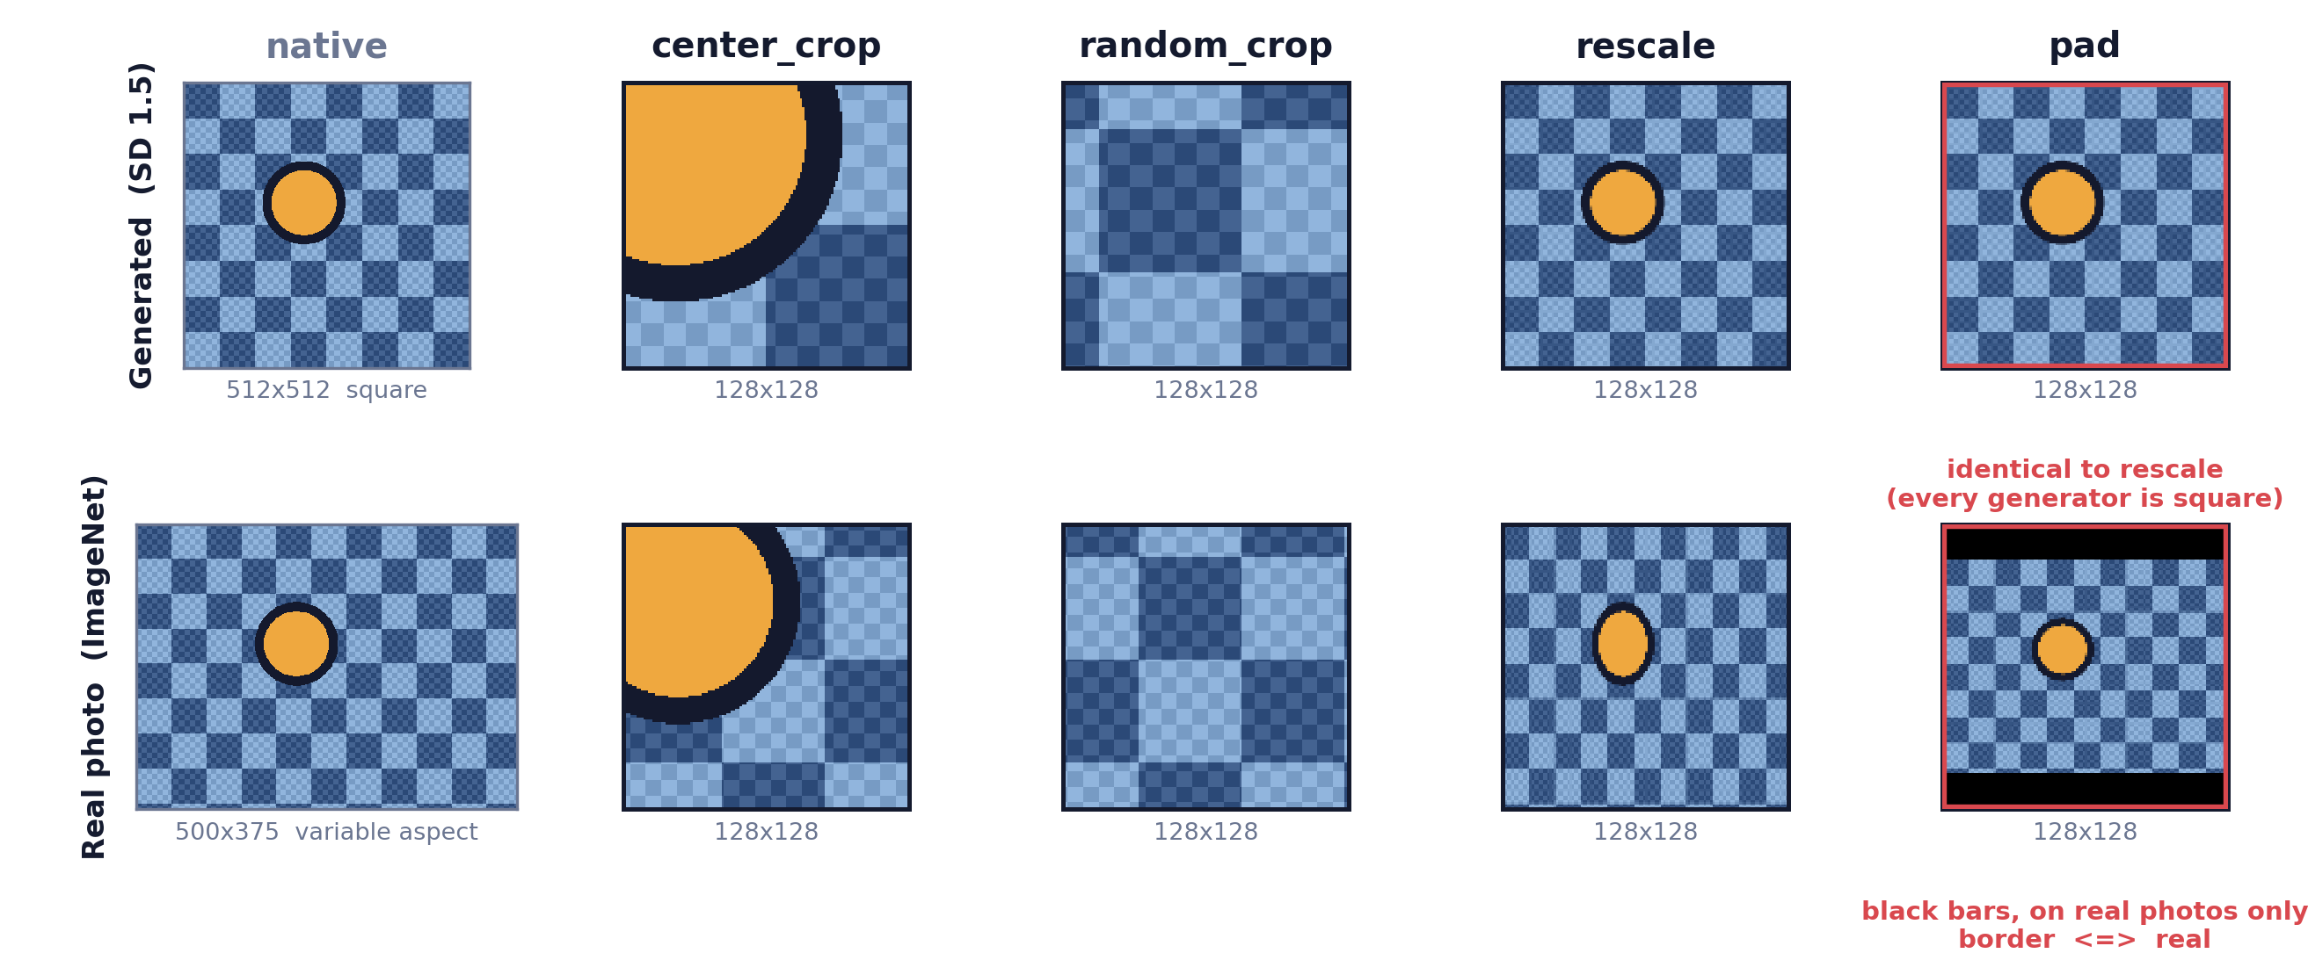
METHOD · PREPROCESSING
Four ways to make every image 128 × 128
The first two preserve native pixel statistics and discard content. The last two resample — and pad adds a border.
Notes:
0:55 | Ido
- Top row a generated image, bottom row a real photo. Same four operations.
- Crops zoom in: fewer, larger grid cells. Rescale keeps the whole frame and squashes it.
- Two red callouts are the payload: pad == rescale on every generator, and only real photos get bars.
- Plant it now, do not explain the consequence. Slide 12 collects it.

Slide 8
METHOD · MODEL + EXPERIMENTS
One architecture, held fixed, 56 times
Compact CNN, 1.17 M parameters, trained from scratch in PyTorch
Setting
Value
Four blocks of [Conv 3×3, BatchNorm, ReLU] ×2 then 2×2 max-pool, widths 32/64/128/256, global average pooling, dropout 0.3, one linear unit.
Optimizer
AdamW
Learning rate
3×10⁻⁴
From scratch is required, not stylistic
Weight decay
1×10⁻⁴
The real class is ImageNet. An ImageNet-pretrained backbone would arrive having already seen the negative class.
Schedule
cosine to 0, 40 epochs
Batch / precision
128, AMP float16
Two choices follow from the nature of the signal
Augmentation
horizontal flip, p = 0.5
Nothing downsamples before the end of block one, because the cue is high-frequency. The head is global average pooling, because the evidence is a location-free texture statistic.
Selection
best internal validation
4 strategies × 7 sources × 2 seeds
56 runs · ~2 GPU-hours
free-tier Colab T4, 127 s per run, each evaluated on all seven targets
Notes:
0:55 | Ido
- Architecture in one breath, then spend the time on WHY from scratch: real == ImageNet.
- That single fact rules out every pretrained backbone. Expect a question on it.
- Config table: point, do not read.
- Close on 56 runs / 2 GPU-hours, then hand over to Noa.

Slide 9
RESULTS
What every trained detector is competing against
0.977
1.000 / 0.619
Neither rule measures
anything about the
generative process.
square rule
the same score on all 49 cells,
diagonal and off-diagonal alike
size-lookup rule
diagonal / off-diagonal
This is the shortcut every
trained detector competes against.
Why the square rule works: TPR 1.000, TNR 0.954
Every generated image in this dataset is square, and 95.4 % of real photographs are not.
The size-lookup rule exposes the mechanism exactly
It scores 1.000 whenever source and target share a native resolution and exactly 0.500 whenever they do not — in 47 of 49 cells. The two exceptions trace to a single 512² Midjourney row.
Notes:
0:40 | NOA STARTS HERE — handover
- Open by re-anchoring: these two rules have no parameters and no training.
- 0.977 flat across all 49 cells; the rule cannot tell in-domain from out-of-domain because it never looked at a generator.
- Size-lookup 1.000 / 0.500 by shared resolution is the cleanest proof the cue is resolution and nothing else.
- Then: so what do the trained detectors do?

Slide 10
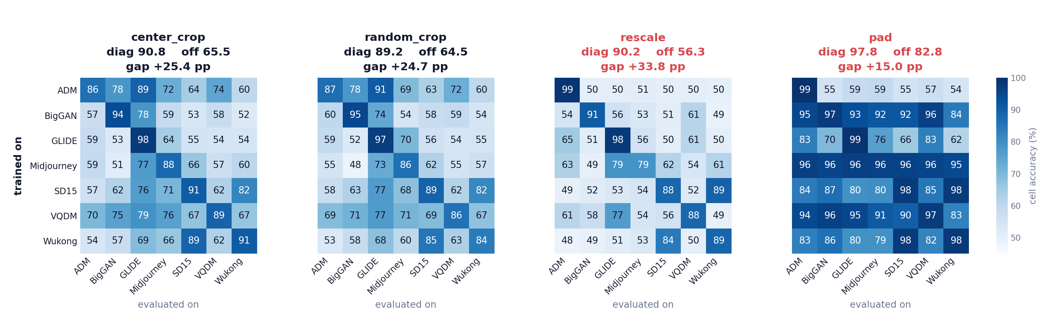
RESULTS
Four corrections, four different pictures
Rows are the generator a detector trained on, columns the generator it was evaluated on. Two seeds, n = 1,000 per cell, one shared colour scale.
The diagonals are broadly similar — 90.8, 89.2, 90.2. The off-diagonal structure is not, and that difference is the result. ADM's row is the clearest case: strong under both crops, at chance under rescale.
Notes:
1:05 | Noa
- Orient the audience first: rows train, columns test, diagonal is in-domain.
- Point at the three similar diagonals, then at the off-diagonals that are not similar.
- Trace ADM's row across the four panels with a finger. 86/87 -> 50s under rescale.
- Do not read cells aloud. The pattern is the message.
- Pad looks best. Flag that you will come back to it, then move on.

Slide 11
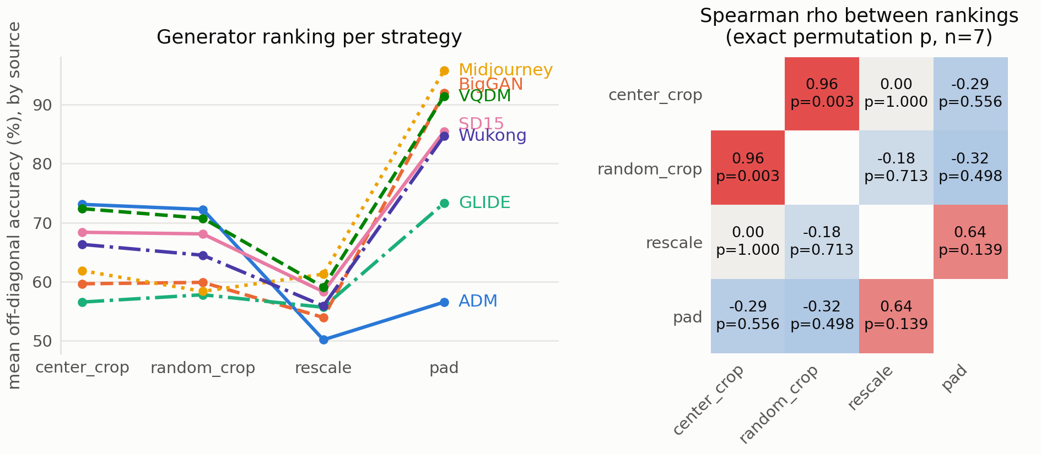
RESULTS · THE MAIN RESULT
The ranking does not survive the correction
ρ = +0.964
the two non-resampling arms agree
p = 0.003
ρ = 0.000
rescale retains none of
that structure
ADM
1st → 7th
best source under both crops,
worst under rescaling
Two papers using the same data, architecture and protocol would disagree about which generator is hardest — purely because one rescaled and the other cropped.
Notes:
1:25 | Noa — the slide that matters most
- Left panel: each line is one generator; vertical order IS the ranking.
- The crops agree almost perfectly. That agreement is the anchor: the ranking is a real, reproducible property of the data.
- Measured against it, rescale produces an unrelated order. ADM goes first to last.
- Honesty, say it out loud: at n = 7, rho = 0.000 is absence of evidence for association, NOT evidence of independence. The claim rests on the +0.964 and on the size of the move.
- Seed disagreement averages 0.012-0.024 and never exceeds 0.076, so a seven-position inversion is far outside noise.
- Close on the bottom line and pause.

Slide 12
RESULTS
pad scores highest — and that is the failure
Every generator is square
0.977
so padding changes nothing for them
↓
where a pure border-reader
would ceiling: (1.000 + 0.954) / 2
Only real photos get bars
variable aspect ratio, so they alone are padded
0.978
↓
The border becomes a perfect proxy
pad's measured diagonal
border ⇔ real, learnable in a few epochs
Corroboration
Higher accuracy here marks a worse experiment, not a better detector. Padding does not remove the size confound — it re-encodes it as a visible border.
Sharing a native resolution helps transfer by
+0.113, +0.113, +0.135 in the other three arms
— but only +0.007 for pad.
Notes:
0:55 | Noa
- Walk the three-step chain slowly; it is a proof, not a list.
- Then the two numbers side by side: predicted ceiling 0.977, measured 0.978. That near-identity is the evidence.
- Corroboration: pad is the ONLY arm whose transfer is indifferent to generator similarity, exactly as a border-reader would be.
- Say the closing sentence verbatim. It is the project's thesis in one line.
- Never call pad the best arm.

Slide 13
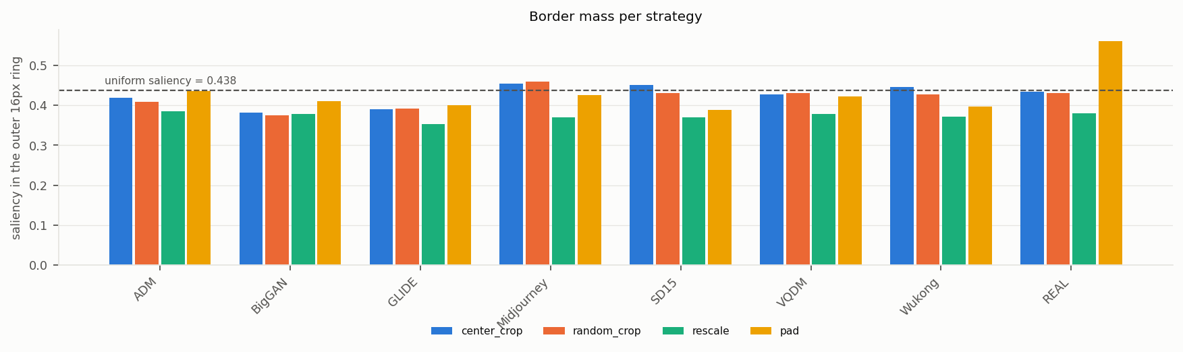
ANALYSIS
The model really is reading its border
Input-gradient saliency, 200 images per tag, seed 0. Border mass is the fraction of the mean saliency map falling in the outer 16-pixel ring — against a uniform null of 0.4375.
Strategy
Real
Generators
Real 1st
center_crop
0.4345
0.4243
0 of 7
random_crop
0.4310
0.4175
1 of 7
rescale
0.3793
0.3721
2 of 7
pad
0.5613
0.4113
7 of 7
The two groups do not overlap
This confirms from inside the model what the accuracies alone could only imply.
Every pad run exceeds +0.11 over its own generator mean. No run in any other arm reaches +0.04.
Padding does not raise edge saliency in general — only the class that receives a border is affected.
rescale also draws on the most centrally concentrated evidence of the four arms, 0.373 against 0.419 to 0.430.
Notes:
0:50 | Noa
- This is the cue-level check: behaviour said border, now the gradients say border.
- In the chart, only the REAL group on the far right has a tall yellow (pad) bar.
- Table's last column is the cleanest summary: real ranks first in 7 of 7 pad runs, 0-2 of 7 everywhere else.
- Note rescale draws on the most centrally concentrated evidence of the four, 0.373.
- Method caveat if asked: seed 0 only.

Slide 14
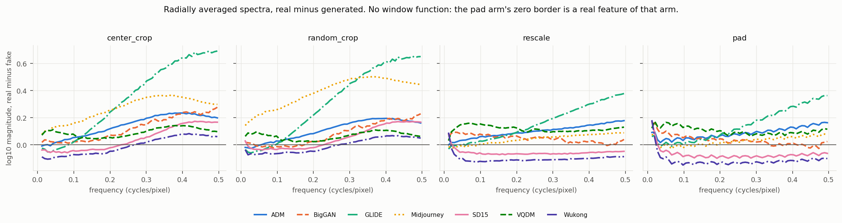
ANALYSIS
Not an undertrained CNN — and here is the mechanism
Is the weak transfer simply a small network trained badly?
Radially averaged spectra close the loop
Train
In-domain test
Cross-generator
center_crop
0.967
0.908
0.655
rescale
0.982
0.902
0.563
At 96.7 – 98.2 % train accuracy the network is close to memorizing its 3,600 images, so the modest in-domain number is a variance limit, not a capacity limit.
Real minus fake, mean log₁₀ power above 0.35 cycles / pixel
+0.256
+0.253
+0.075
+0.058
rescale fits its training set better, matches center_crop on held-out images of the same generator, and collapses only when the generator changes.
center_crop
random_crop
rescale
pad
Both resampling arms lose roughly two thirds of the high-frequency separation the crops retain. That is the mechanism behind the transfer collapse.
Doubling the epoch budget from 40 to 80 on three generators moved in-domain accuracy +0.020 and cross-generator −0.007. More training buys fit, and nothing in transfer.
Notes:
1:00 | Noa — densest slide, keep moving
- Left: kill the obvious objection. Train 0.967 / 0.982 means capacity is not the limit.
- The three-level split is the sharpest form of the headline: rescale is FINE in-domain and only fails cross-generator. A practitioner validating in-distribution sees nothing wrong.
- Right: the spectra confirm the assumption we started from. Resampling really does attenuate the high frequencies that carry the fingerprint.
- Four numbers, two groups. Do not narrate the curves.

Slide 15
SUMMARY & INSIGHTS
Three findings that survive our controls
A zero-parameter size rule beats every trained detector cross-generator
Recommendation
So cross-generator numbers reported without an explicit size correction are largely uninterpretable.
Treat size equalization
as a first-class
methodological choice —
and report more than one.
The correction is not a neutral preprocessing detail
Strategies preserving native pixels agree on generator difficulty (ρ = +0.964); resampling gives an unrelated ordering. A published ranking depends partly on a choice that is rarely reported.
Limitations
One architecture, one input
resolution. Two seeds. n = 7
generators. Attribution on
seed 0. ADM unexplained.
A correction can raise accuracy while making the experiment worse
pad trades the size cue for a border cue — found by attribution in all seven of its runs, and in none elsewhere.
Code, run instructions, split definitions and every metrics.json from the 56 runs:
Thank you — questions?
github.com/noa-keter/deep-learning
Notes:
1:10 | Noa
- Three findings, one sentence each. Do not re-derive them.
- The recommendation is the takeaway you want remembered: report more than one correction.
- State limitations plainly, do not apologise for them. ADM being unexplained is honest, and we say so in the report too.
- Repo is public. Invite questions.
- Running total to here: 13:05. Backup slides follow if questions need them.

Slide 16
BACKUP · B1
Full training configuration
Setting
Value
Setting
Value
Optimizer
AdamW
Loss
BCE-with-logits
Learning rate
3×10⁻⁴
Precision
AMP float16
Weight decay
1×10⁻⁴
Augmentation
h-flip, p = 0.5
Scheduler
cosine to 0
Normalization
(x/255 − 0.5) / 0.5
Batch size
128
Selection
best internal val
Epochs
40
Hardware
Colab T4, torch 2.11
1,173,473 parameters; receptive field 76×76 at the final block, 59 % of the image
Four blocks of [Conv 3×3, BatchNorm, ReLU] ×2 then 2×2 max-pool, widths 32/64/128/256, taking 128×128 down to 8×8; global average pooling; dropout 0.3; one linear unit.
Why horizontal flip is the only augmentation
Random resized cropping, JPEG jitter and blur all resample or re-encode the image — injecting the very artifact under study. Rotations by multiples of 90° are exact, and were tested separately: off-domain accuracy moved 0.009 over the whole orbit.
Notes:
Backup. Identical across all 56 runs.

Slide 17
BACKUP · B2
The ADM anomaly, reported as unresolved
0.863
0.986
0.501
ADM in-domain
under center_crop
ADM in-domain
under rescale
ADM transfer
under rescale
Under center_crop ADM is the hardest generator in the study; under rescale it is nearly trivial
And its transfer falls to chance — the lowest figure anywhere in the 7×7.
The obvious explanation predicts the opposite of what we see
ADM is the only PNG generator in an otherwise JPEG dataset. That asymmetry should make ADM easiest under center_crop, where native pixels and real-image JPEG blocking both survive. We observe the reverse.
ADM's row feeds the ranking, so we report it rather than explain it away
Offering an untested mechanism here would weaken the parts of the analysis we can support. Re-encoding ADM as JPEG and re-running its row would separate format from resolution.
Notes:
Backup. If asked why we did not explain it: we have not tested a mechanism, so we do not claim one.

Slide 18
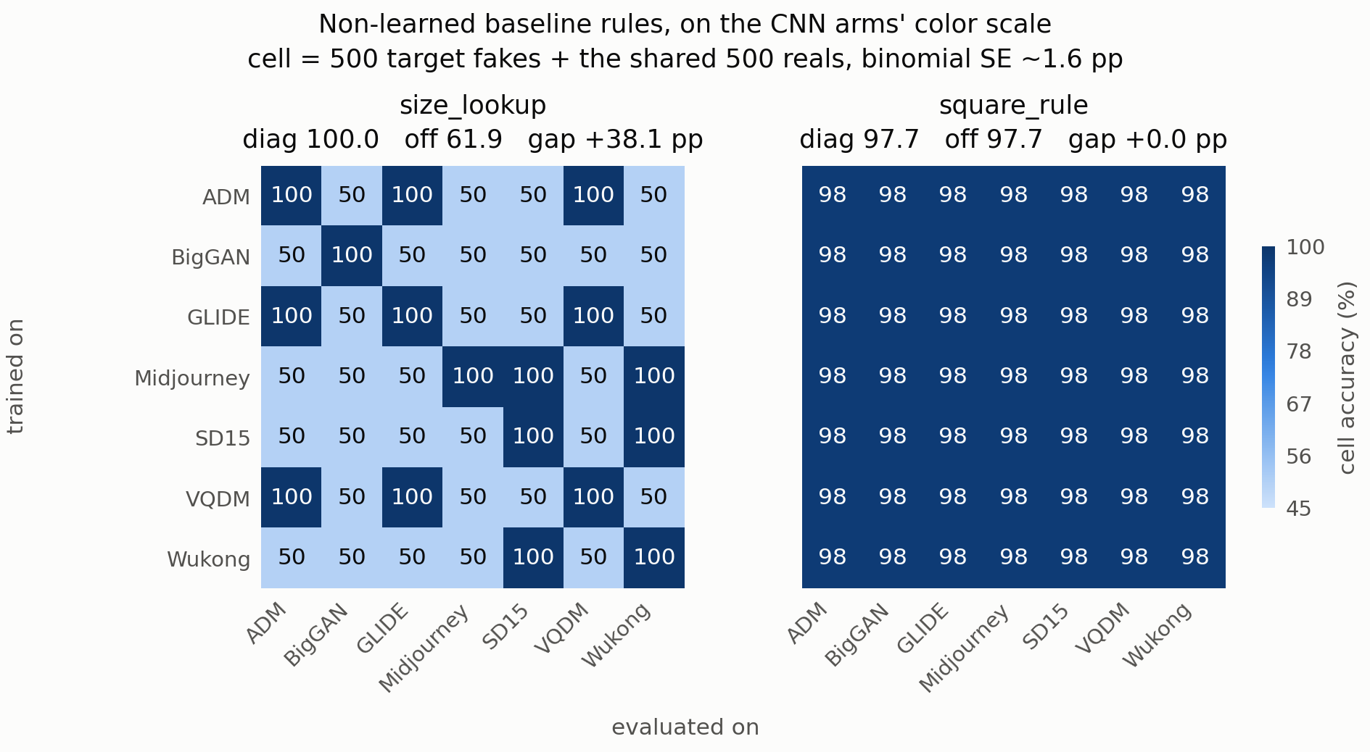
BACKUP · B3
The zero-parameter rules, cell by cell
Notes:
Backup. size_lookup is 1.000 on shared-resolution pairs and 0.500 otherwise, in 47 of 49 cells; the exceptions are the single 512-square Midjourney row. square_rule is flat 0.977 everywhere.

Slide 19
BACKUP · B4
Radially averaged spectra, per generator
No window function is applied
The pad arm's zero border is a real feature of that arm, not an artifact of the analysis, so windowing it away would hide the thing we are measuring.
Rotations cannot be tested this way
Radially averaged spectra are exactly invariant under multiples of 90°: (u, v) → (−v, u) preserves radius. The invariance is a theorem, not a finding.
Notes:
Backup. Curves are real minus fake, per generator, per strategy.

