Slide 1
Netwerken 2 ISB Inleiding Threaded Case Study

Slide 2
Examen Netwerken 2 - ISB
Exam during exam-period P4
Every team presents network design
Deadline: Submit network design and documentation before 23:59:59 the evening before the exam

Slide 3

Threaded Case Study
Design of a network
Redundant routers
Redundant servers
VPN solution
Demo during class : OPGELET LAATSTE LES 21/05 !
Documentation
Presentation during exam period

Slide 4
Demo in class
Demo in class
Show your solutions during classes
You do NOT have to show the full solution at once
Demo redundant router / gateway
Demo redundant servers
Demo VPN solution
Tools:
GNS3
Vyos (juniper)
Packet tracer (limited unstable when combining solutions)

Slide 5



Demo in class
Demo redundant router/gateway
NOT in packet tracer
Minimum setup:
Virtual IP
OR
Load Balancer

Slide 6
Demo in class
Demo redundant server
NOT in packet tracer
Minimum setup:
Virtual IP
Sync
OR
Storage
Load Balancer

Slide 7
Demo in class
Demo VPN solution
NOT in Packet Tracer
Minimum setup:
Not only the tunnel, also connection to internal server
VPN tunnel
VPN concentrator
VPN client

Slide 8
Documentation
Documentation overview
Choose a company (as real as possible)
Network design
Naming/adressing: Logic/Enough
LAN servers DNS DHCP
Firewall rules
Redundant servers
Redundant routers
VPN solution

Slide 9
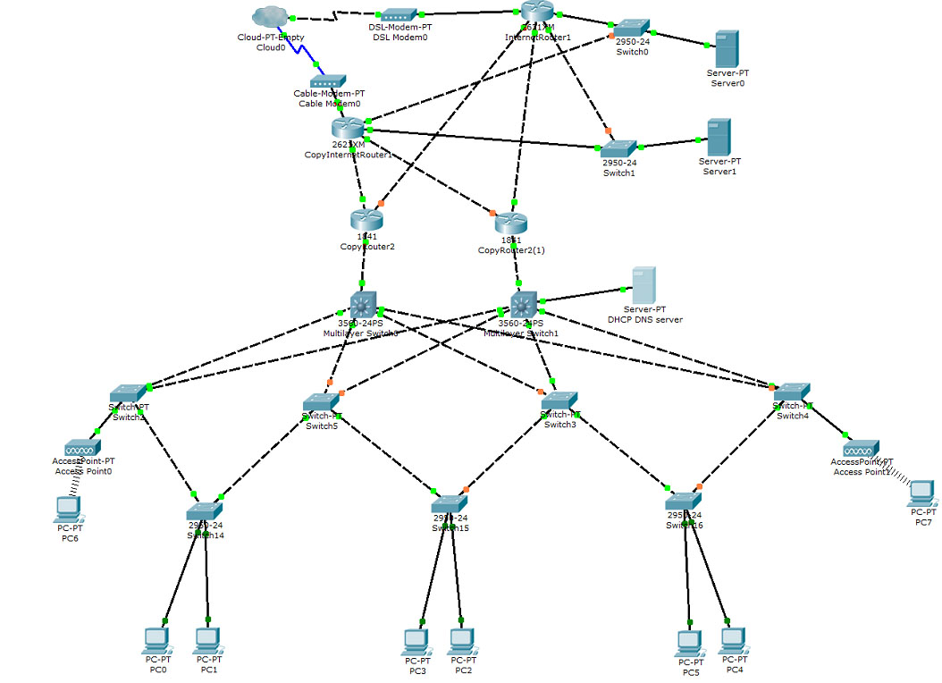
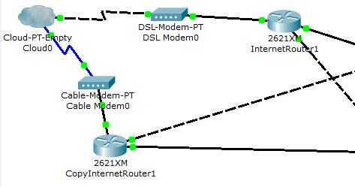
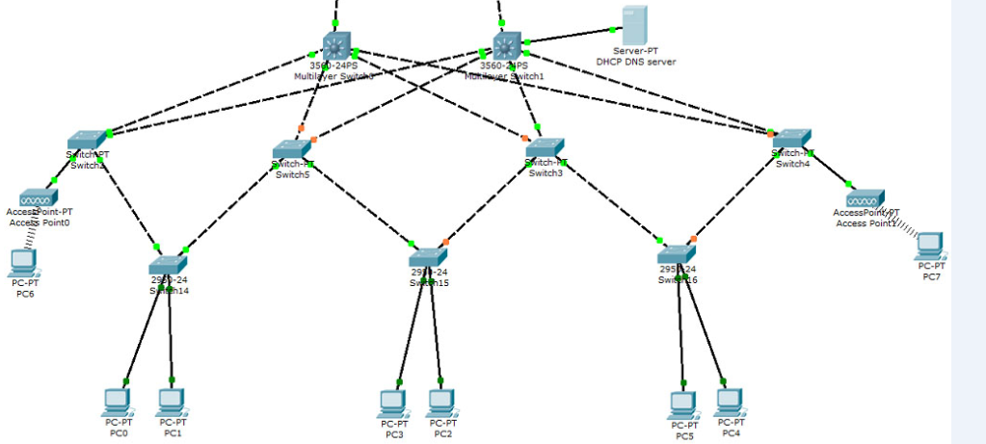
Documentatie
Netwerkdesign global/DMZ/LAN

Slide 10
Documentation
Name/adressing
Router | Port | Ip
InternetRouter1 | FA0/0 | 10.10.1.1 255.255.0.0
 | FA0/1 | 10.10.2.1 255.255.0.0
 | FA0/2 | 10.10.3.1 255.255.0.0
 | FA0/3 | 10.10.4.1 255.255.0.0
InternetRouter2 | FA0/0 | 10.10.5.1 255.255.0.0
 | FA0/1 | 10.10.6.1 255.255.0.0
 | FA0/2 | 10.10.7.1 255.255.0.0
 | FA0/3 | 10.10.8.1 255.255.0.0
Server
Mailserver1 | FA0/1 | 10.10.20.1 255.255.0.0
Mailserver2 | FA0/1 | 10.10.21.1 255.255.0.0

Slide 11
Documentation
LAN servers
How do clients get IP adresses?
How can a client connect to internet?
DNS/DHCP

Slide 12
Documentatie
Firewall rules
Choose two relevant routers to apply rules
Ex
DMZ – INTERNET
DMZ-LAN
Explain IN WORDS the function of the rule(s)
Then write the rules
Choice: vyos/cisco/linux firewall/router

Slide 13
Router Redundantie
Router redundancy
Choice
Redundant DMZ solution
Services important
Redundante Gateway solution
Clients important

Slide 14
Server Redundantie
Server redundancy: DMZ services
Choose any OS
Linux/Win/...
Choose a Service
HTTP/Mail/File
Remark: Has to be dynamic and high available

Slide 15
Server Redundancy
Server configuration
Document with:
Windows appcmd Scripts/Powershell
Linux shell scripts
Configuratiefile(s)
Screenshots
Do not show standard installation steps

Slide 16
VPN solution
VPN solution
Provide a VPN oplossing for clients connecting from home to DMZ server(s)
Solution for multiple clients (NOT point to point)
Should be able to connect to a server within the company network
Vyos or Linux
NOT in Packettracer

Slide 17

Documentation
X factor
Deep dive into one aspect (security, price, technology, IPv6, VoIP, super redundant...)

Slide 18
Documentation
Timesheets
Divide all tasks
Add a short description of the things you did
Who did what

Slide 19
Presentation
Presentation during exams P4
Maximum 5 minutes
Global
Define company assets, core business
Show global network design
No slides with IP addresses or firewall rules
OK if you show words
Show redundant solutions
servers, routers
demo if possible
Show X factor

