Slide 1
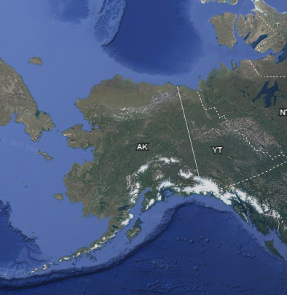
Chukchi Borderlands
Chukchi Sea
Beaufort
Sea
Chukotka (Russia)
Bering Sea
Aleutian Islands
Gulf of Alaska

Slide 2
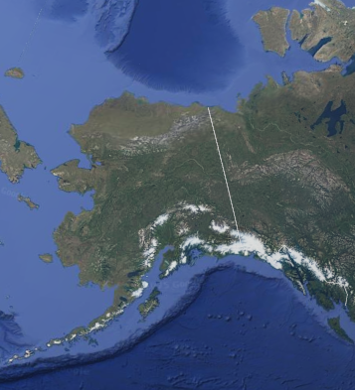
Chukchi Borderlands
Chukchi Sea
Beaufort
Sea
USA (Alaska)
Canada
Bering Sea
Gulf of Alaska

Slide 3
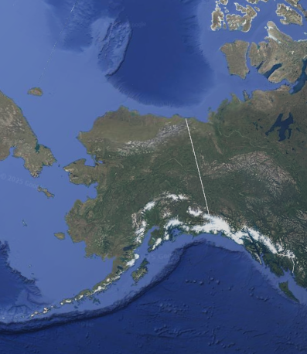

Slide 4
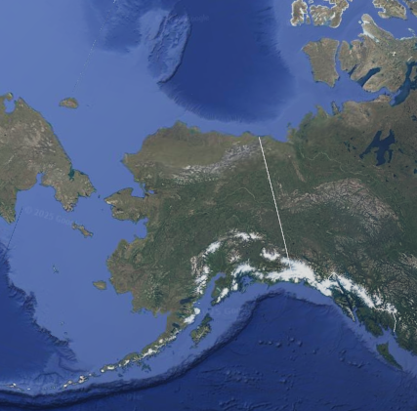
Chukchi Borderlands
Chukchi Sea
Beaufort
Sea
Russia
Alaska (USA)
Canada
Bering Sea
Aleutian Islands
Gulf of Alaska

