Slide 1
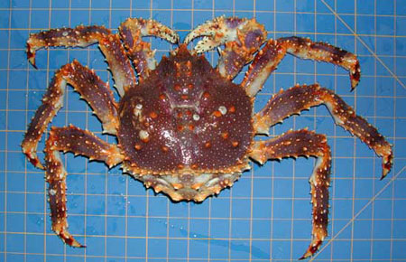
2025-05 Pribilof Islands Blue King Crab Report TO CPT
William Stockhausen
NOAA/NMFS/AFSC
May 14, 2025

Slide 2
CPT and SSC Comments
The SSC looks forward to the report on the blue king crab stock structure template in the near future.
response: staff capacity has not permitted progress on this request.

Slide 3
Topics
crabpack comparisons
loss of “corner” stations
dealing with survey MMB time series 0’s

Slide 4
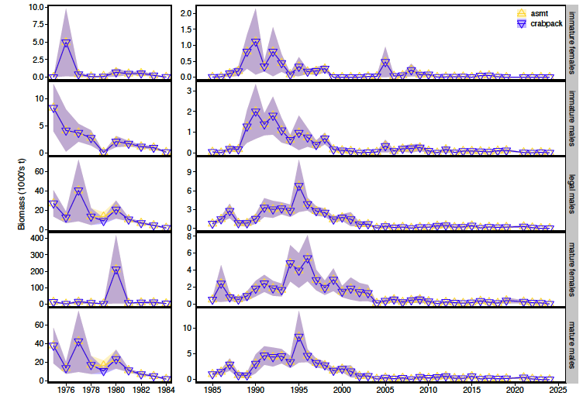
crabpack comparisons

Slide 5
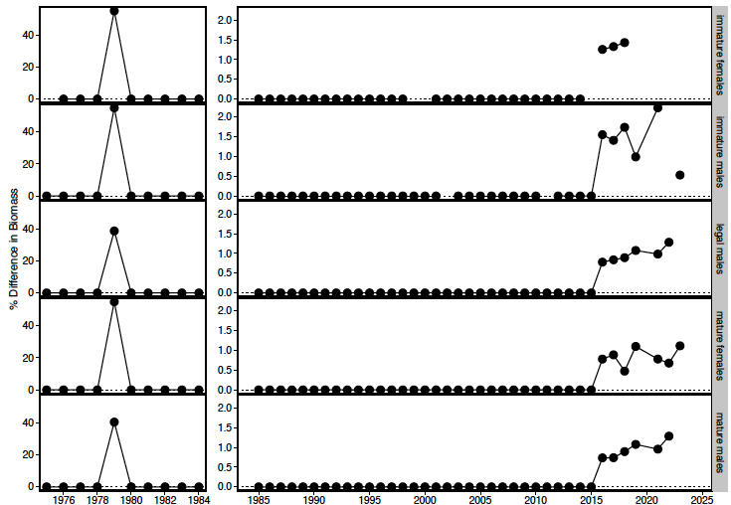
crabpack comparisons

Slide 6
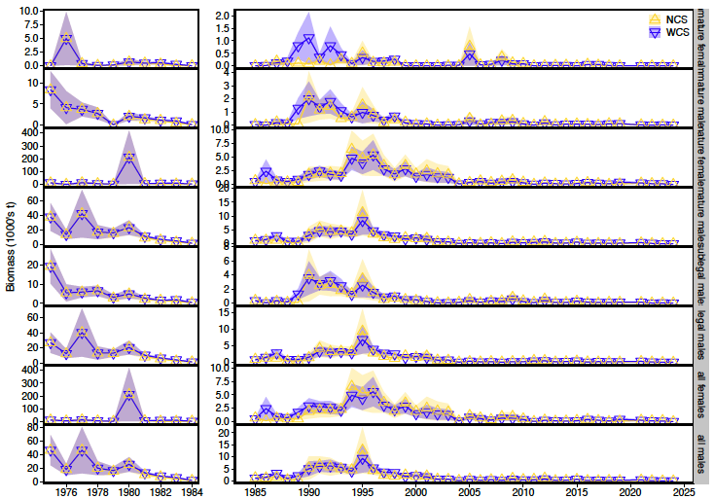
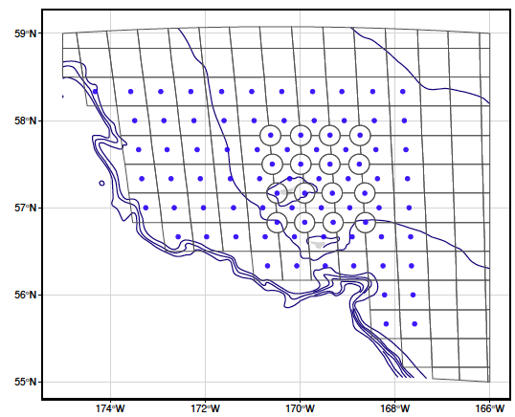
no corner stations

Slide 7
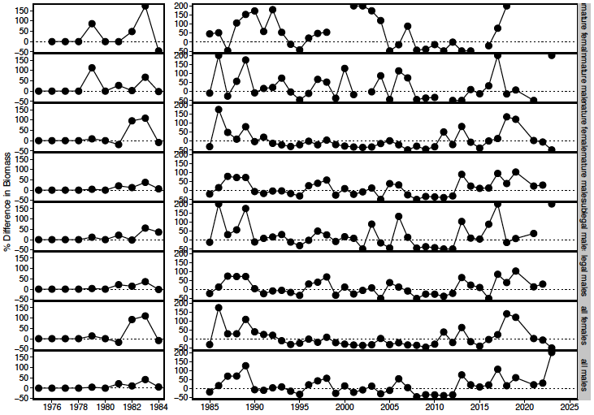
no corner stations

Slide 8
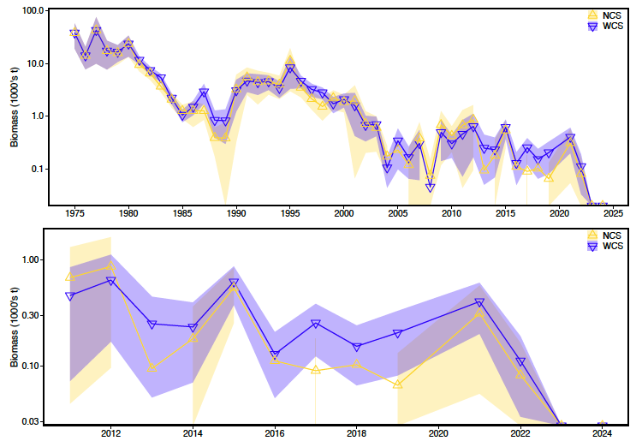
no corner stations
MMB

Slide 9
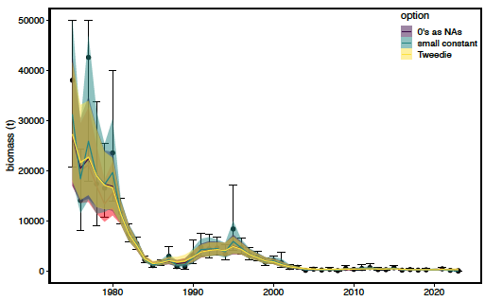
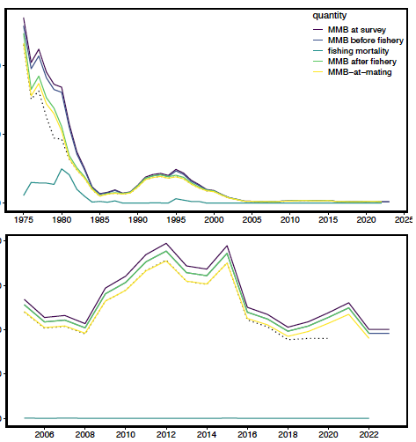
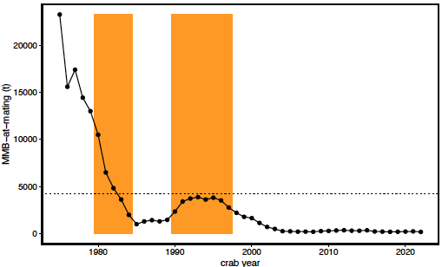
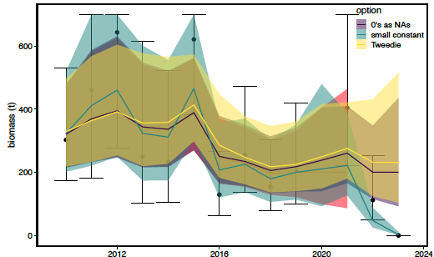
Tier 4 part of PIBKC Assessment: Determine B_{MSY}
Step 1
Step 2
fit model to survey MMB
reduce observation errors
fill in missing surveys (i.e., 2020)
project to mating
account for M & F mortality
Step 3
Determine
B_{MSY}
Averaged to get B_{MSY}
Projected to MMB-at-Mating
SS/RE RW rema model fit to Survey MMB

Slide 10
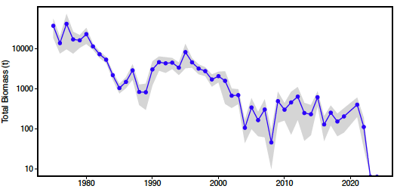
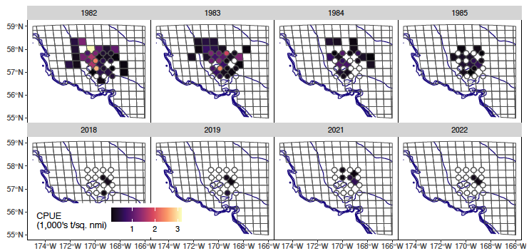
dealing with time series 0’s
NMFS Survey MMB
MMB is basis for Tier 4/5 assessment
NMFS EBS survey provides “raw” data
`rema` provides “smoothed” time series
recent 0’s are problematic?
missing
“Hard” 0’s
2023, 2024

Slide 11
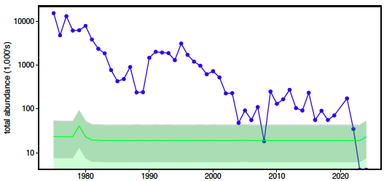
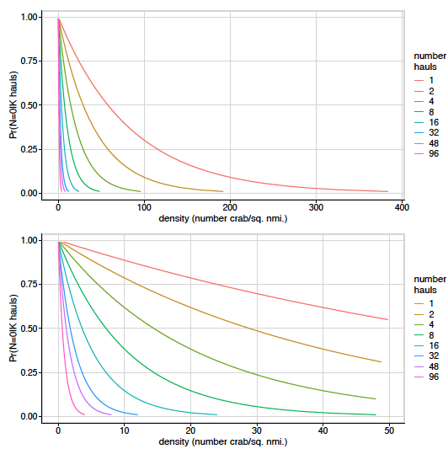
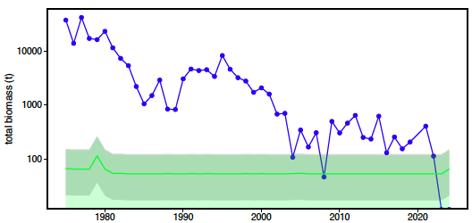
dealing with time series 0’s: ad hoc approaches
Notes:
left column
The probability of non-detection (zero catch), by crab density (x-axis) and number of
hauls (color scale). Densities (x axis) were calculated as a function of the probability
of non-detection (y axis) and the number of hauls, but the plot has been transposed.
The lower plot is limited to density < 50 crab/sq. nmi to better show details at low
densities.
right column
The estimated time series of mature male total abundance (upper) / biomass (lower) from the NMFS survey (blue
line and points), with total abundance/biomass corresponding to non-detection probabilities of
0.5 (green line) and 0.8 and 0.2 (lower and upper bounds of grey shading), based on the
number of hauls conducted for PIBKC each year. The green shading indicates the +/-
1 CV interval for the 0.5 non-detection values.

Slide 12
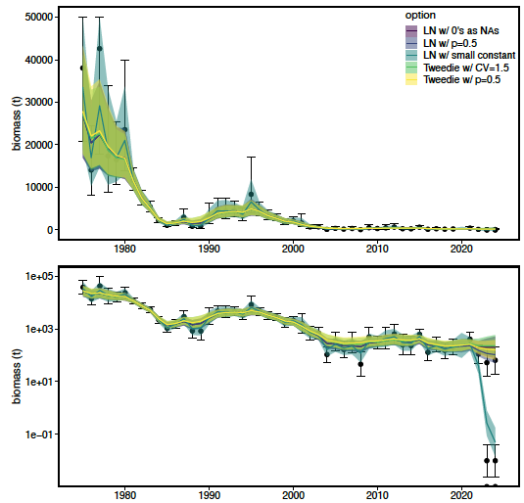
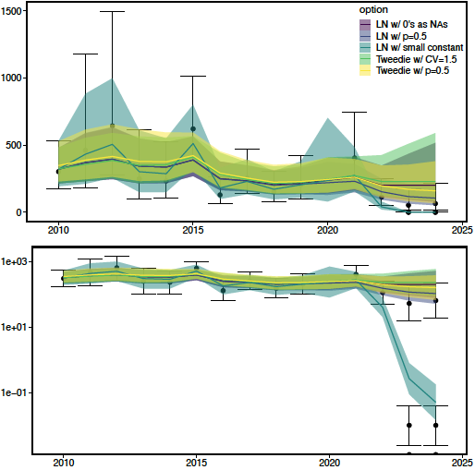
dealing with time series 0’s: ad hoc approaches

Slide 13
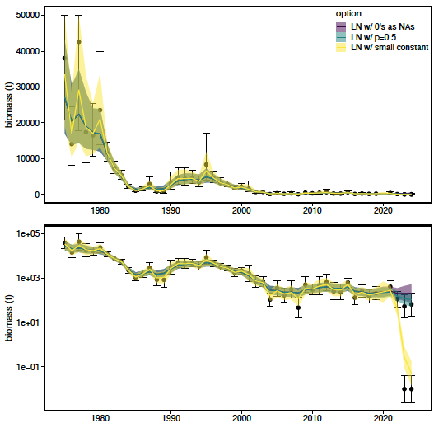
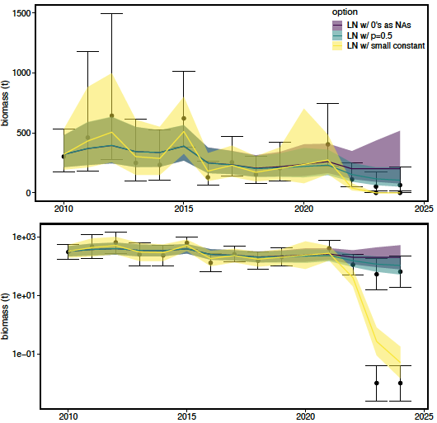
dealing with time series 0’s: ad hoc approaches

Slide 14
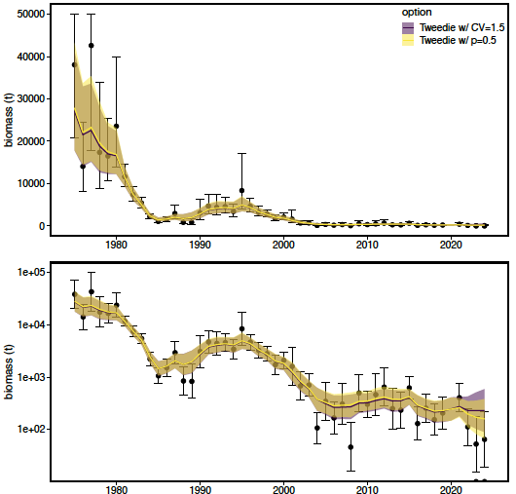
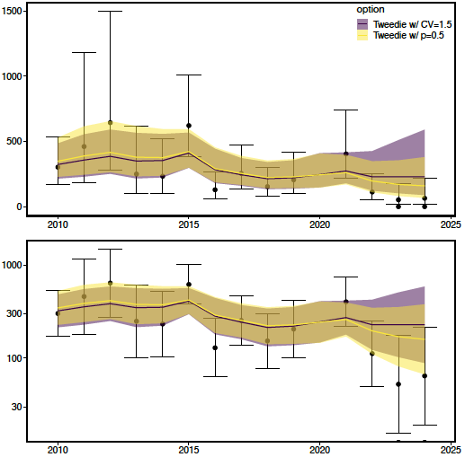
dealing with time series 0’s: ad hoc approaches

Slide 15


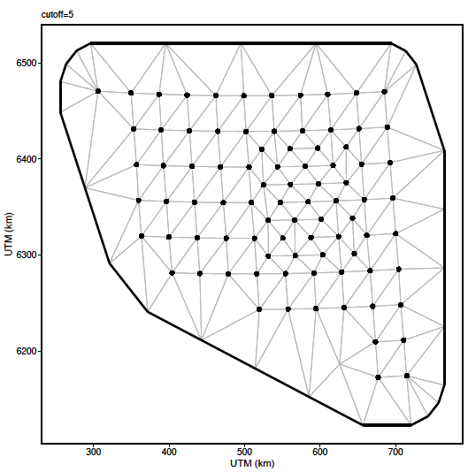
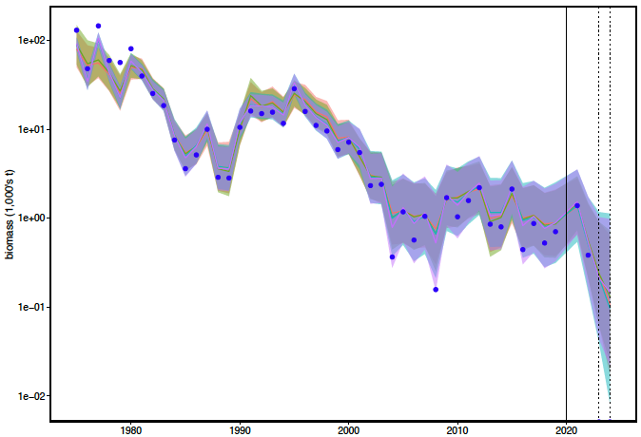
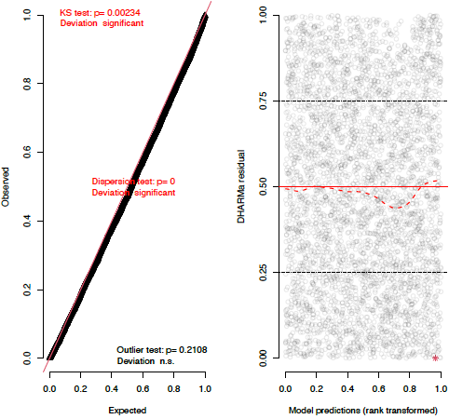

dealing with time series 0’s: sdmTMB
ln(CPUE) ~ s(ln(bottom depth))

Slide 16
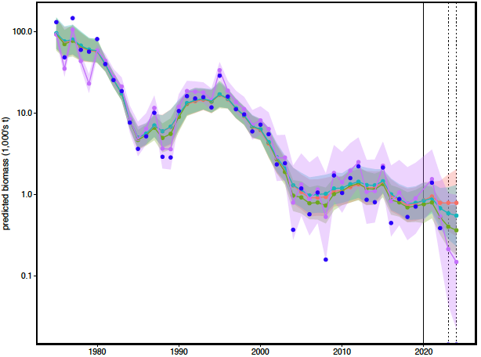

dealing with time series 0’s

Slide 17
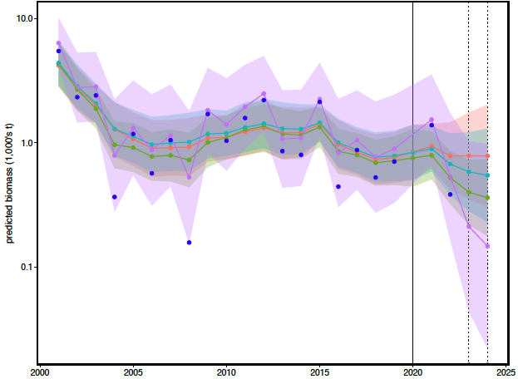
dealing with time series 0’s
sdmTMB

Slide 18
Recommendations
dealing with 0’s
use sdmTMB Tweedie AR1 model (tw-ar) to provide MMB-at-survey time series
diagnostics?
corner stations
keep historical data from (discontinued) corner stations
use sdmTMB to reduce changes in survey design?
crabpack
use full-precision CL measurements with length-weight regressions to determine biomass
drop “extra” stations in 1979

