Slide 2
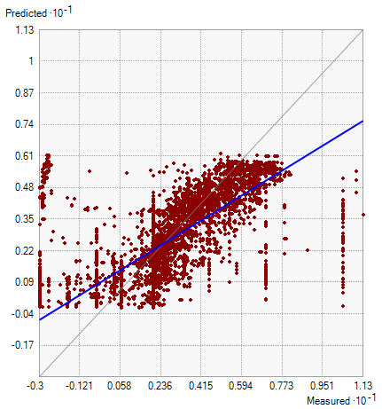
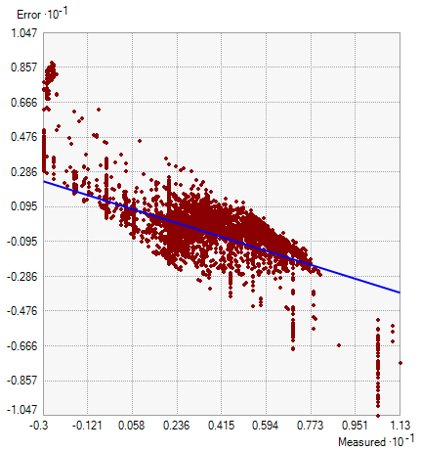
Mean phi: diffusion with barriers smoothing
Results from Diffusion with Barriers smoothing on combined mean phi dataset.

Slide 3
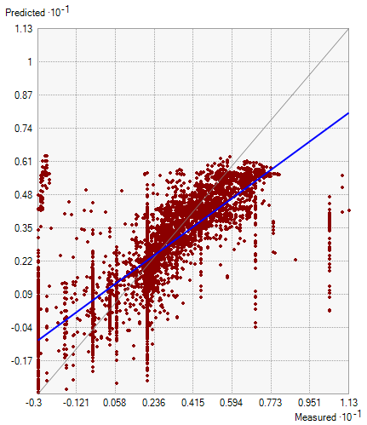
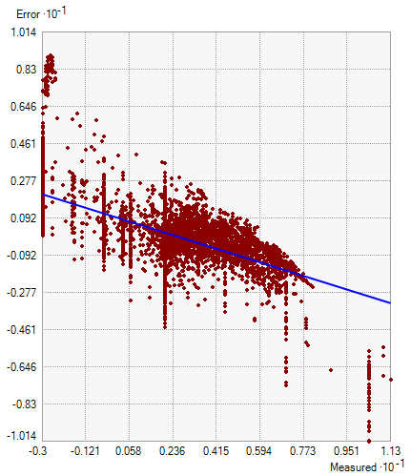
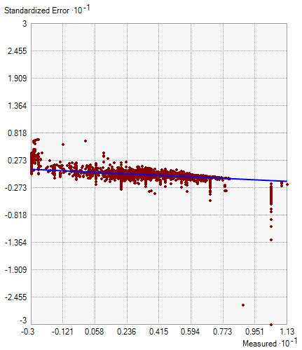
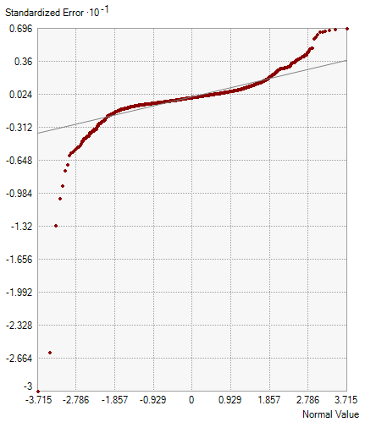
Mean phi: EBK
Regression function ‎0.622688365091644 * x + 0.967728749011698
Prediction Errors
Samples 4921 of 4921
Mean -0.026527333507674306
Root-Mean-Square 1.8783225922750417
Mean Standardized -0.01916284741530884
Root-Mean-Square Standardized 1.176946975399284
Average Standard Error 1.9733537082082615
Export Result Table
Results from EBK smoothing on combined mean phi dataset.

Slide 4
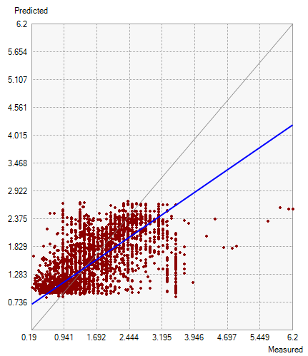
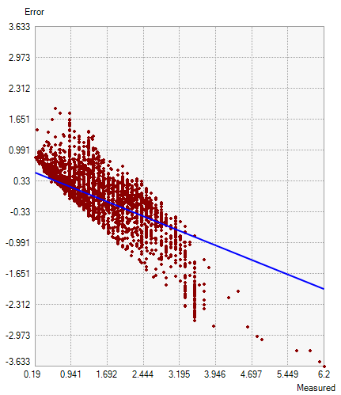
sorting: diffusion with barriers smoothing
Results from Diffusion with Barriers smoothing on combined sorting dataset. RMS = 0.5709 on 4642 samples.

Slide 5
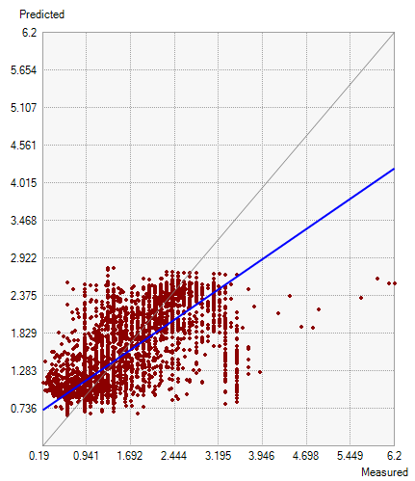

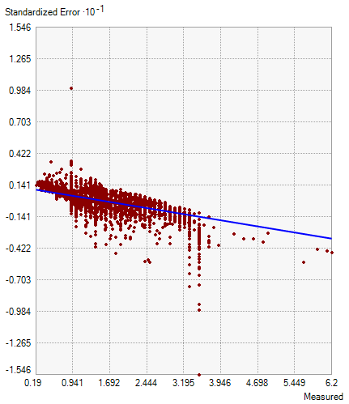
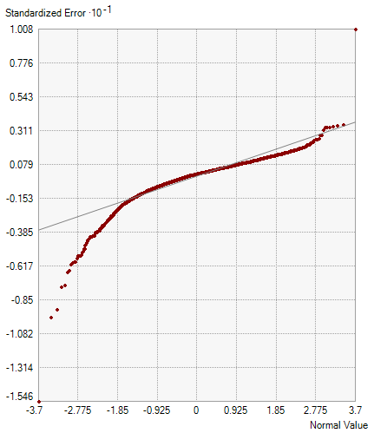
sorting: EBK
Regression function ‎0.584267352965334 * x + 0.600161505600515
Prediction Errors
Samples 4642 of 4642
Mean 0.0031325278556508136
Root-Mean-Square 0.5638289269109275
Mean Standardized -0.004982829737767966
Root-Mean-Square Standardized 1.076090549748276
Average Standard Error 0.5597357203998979
Export Result Table
Results from Diffusion with Barriers smoothing on combined sorting dataset. RMS = 0.5597 on 4642 samples.

