Slide 1
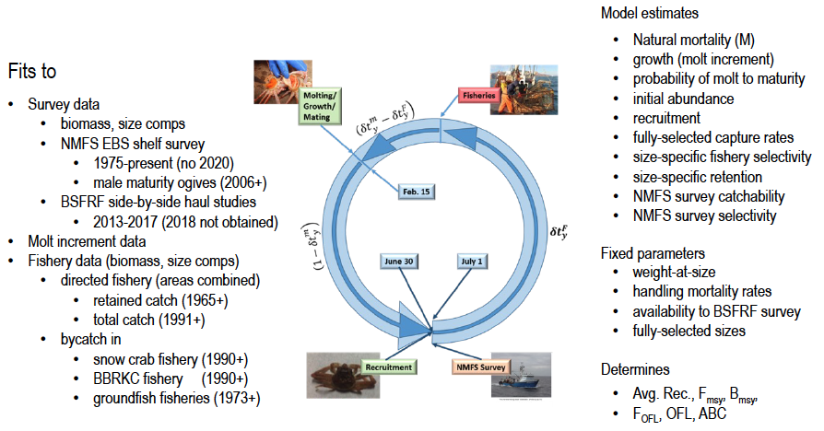

Slide 2
Notes:
model processes

