Slide 1
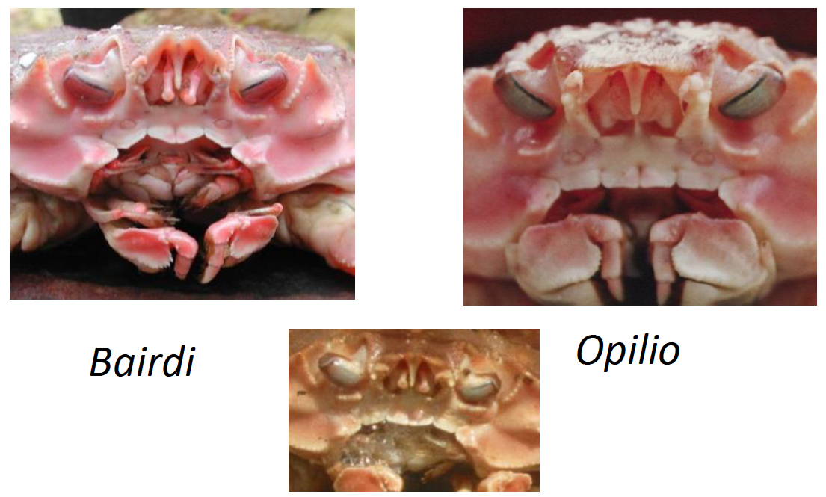
Chionoecetes spp. hybrids

Slide 2
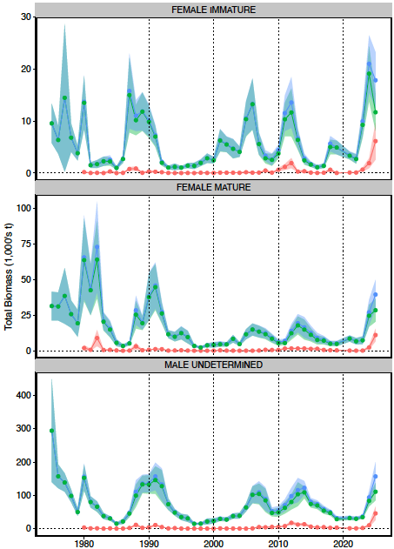
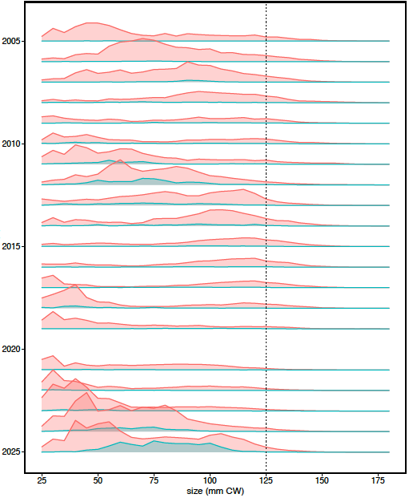
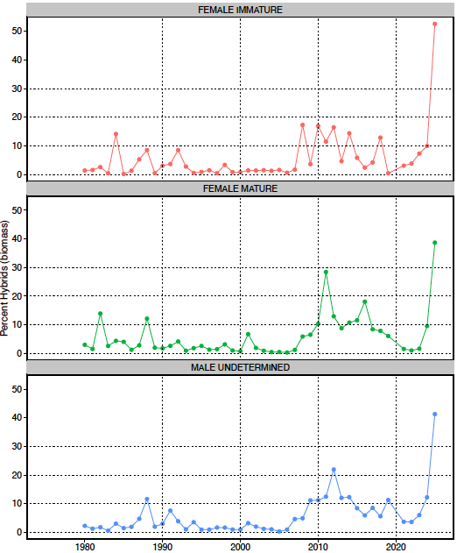

Hybrids in survey data
Males

Slide 3
Chionoecetes spp. hybrids
Tanner + snow crab cross-species mating produces hybrids
NMFS survey classifies all as “hybrids”
ADFG classifies
Tanner-like (minority): “M”-shaped episotme, red eyes, other snow crab-like features (carapace shape, etc)
snow-like (majority): Not Tanner-like, but with other Tanner features
Legally, hybrids do not exist
Tanner crab: “M”-shaped episotme, red eyes
snow crab: all other Chionoecetes

Slide 4
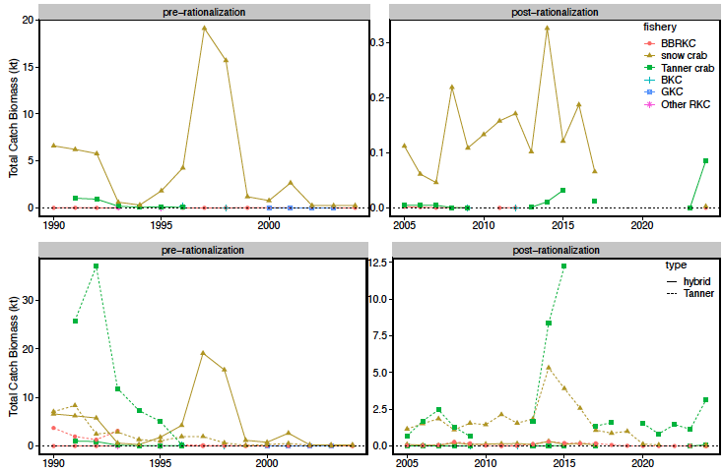
Hybrids in fishery data

Slide 5
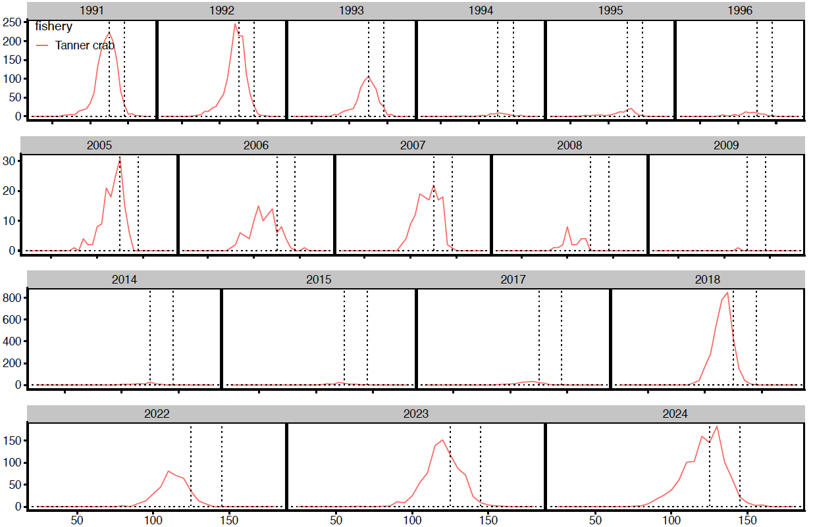
Hybrids: total catch data

Slide 6
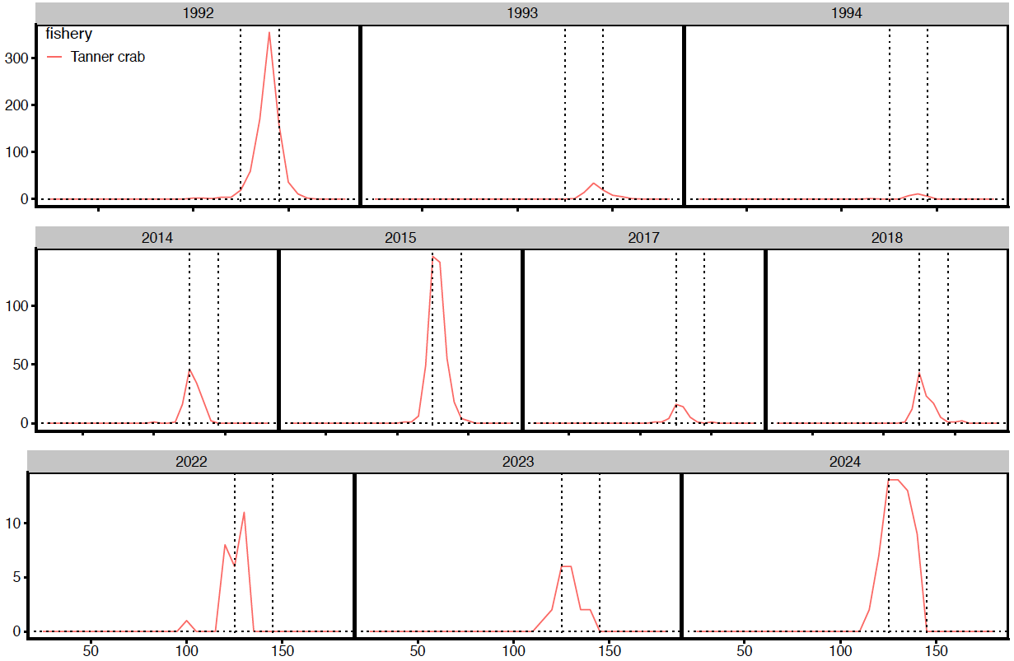
Hybrids: retained catch data

Slide 7
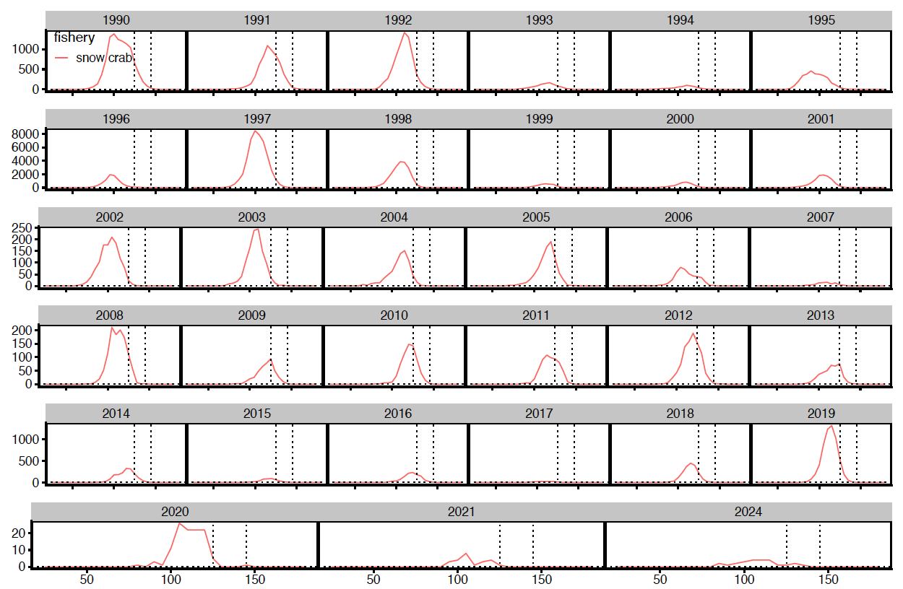
Hybrids: total catch data
directed fisheries closed

Slide 8
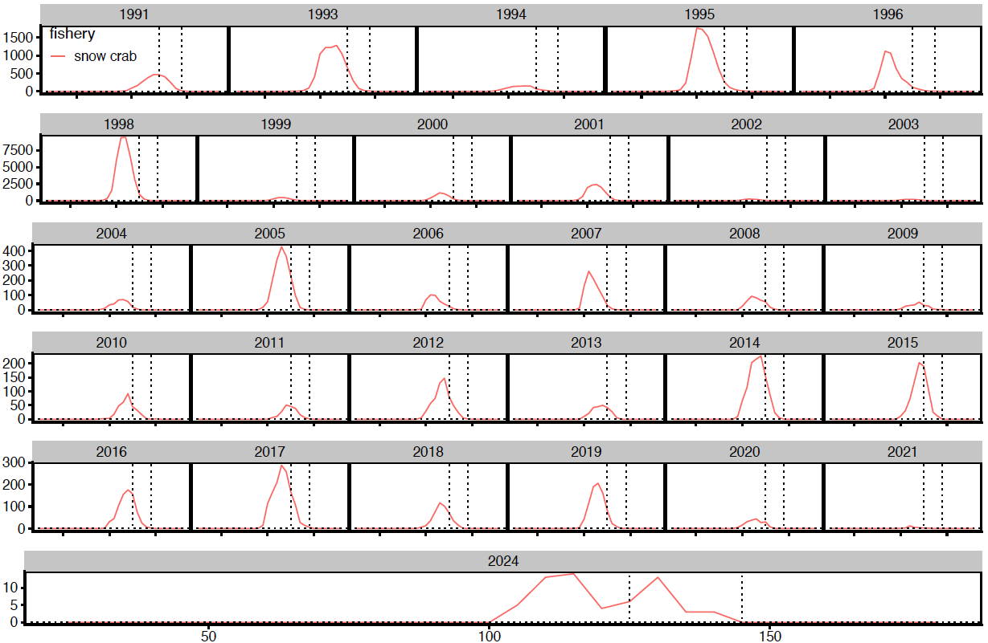
Hybrids: retained catch data
1997?
directed fisheries closed

Slide 9
Tanner crab model sensitivity runs
2025 assessment model
2025AM + (Hybrid+Tanner) survey data
all hybrids treated as Tanner crab
2025AM + (Hybrid+Tanner) fishery data
all hybrids in ADFG at-sea observer coverage treated as Tanner crab
all hybrids in retained catch size comps treated as Tanner crab
retained catch not apportioned between hybrids and species
2025AM + (Hybrid+Tanner) survey + fishery data

Slide 10
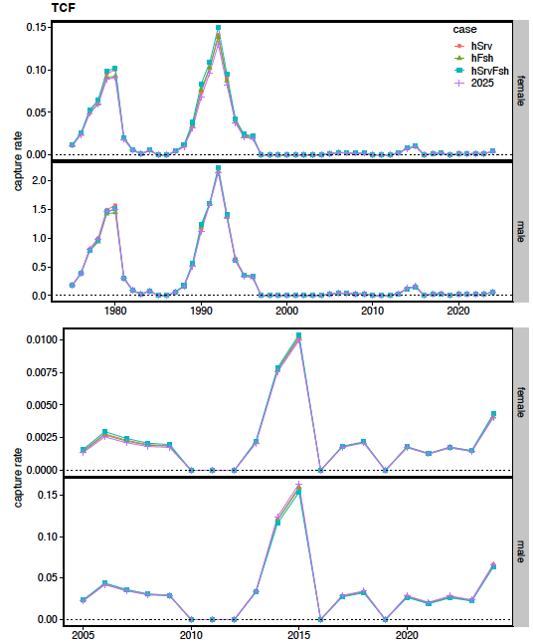
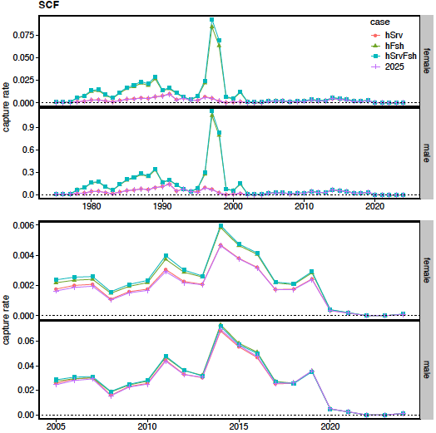
Tanner crab model sensitivity runs: estimated capture rates

Slide 11
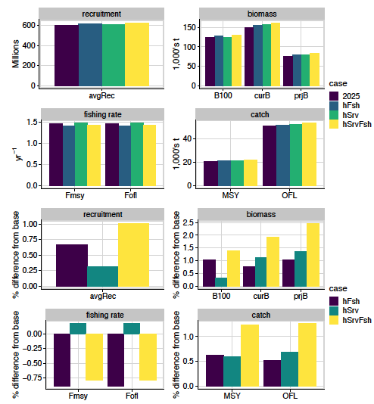
Tanner crab model sensitivity runs: management quantities

