Slide 1
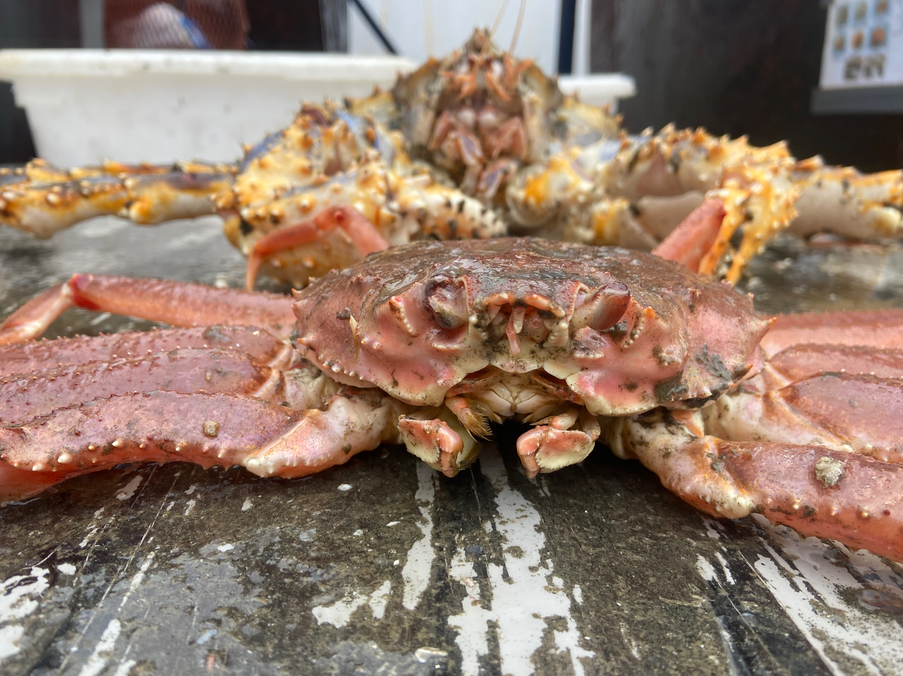
2026 Tanner Crab CIE Review Management and Tier Considerations
William Stockhausen
AFSC/NMFS/NOAA

Slide 2
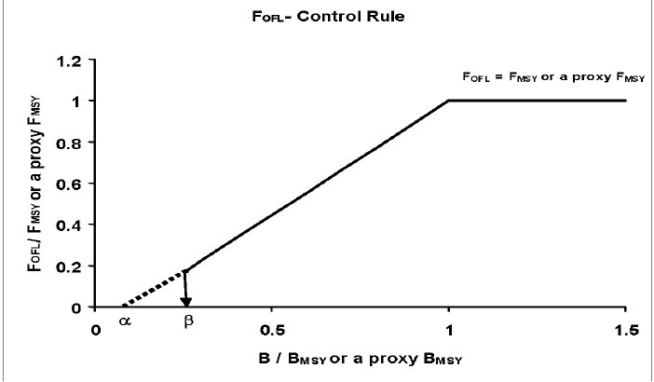
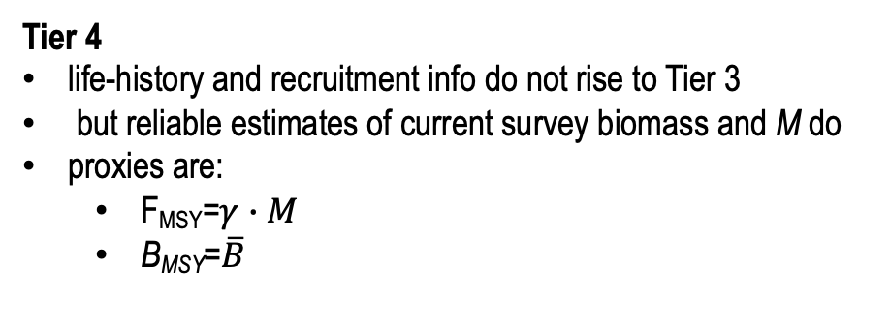
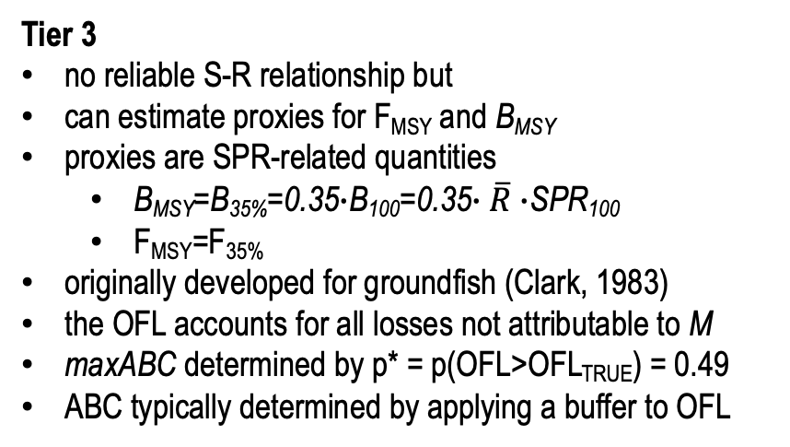
Crab Management Tiers 1-4
Tier 3
no reliable S-R relationship but
can estimate proxies for F_{MSY} and B_{MSY}
proxies are SPR-related quantities
B_{MSY}=B_{35%}=0.35$∙$B₁₀₀=0.35$∙\overline{R}∙$SPR₁₀₀
F_{MSY}=F_{35%}
originally developed for groundfish (Clark, 1983)
the OFL accounts for all losses not attributable to M
maxABC determined by p* = p(OFL>OFL_{TRUE}) = 0.49
ABC typically determined by applying a buffer to OFL
Tier 4
life-history and recruitment info do not rise to Tier 3
but reliable estimates of current survey biomass and M do
proxies are:
F_{MSY}=$γ∙M$
B_{MSY}=$\overline{B}$
Notes:
Updated 2024

Slide 3
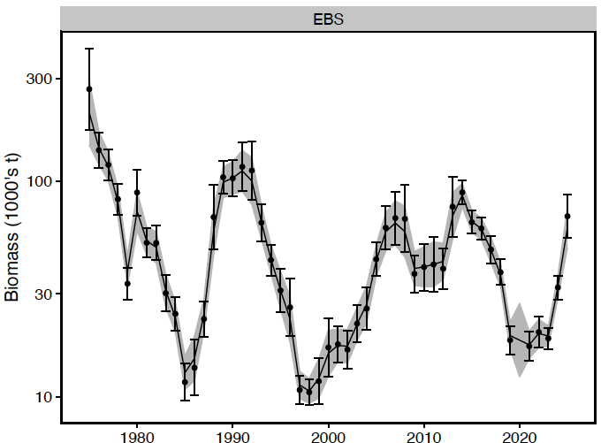
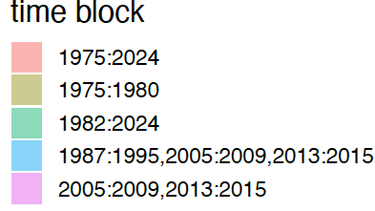
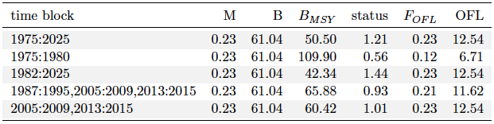
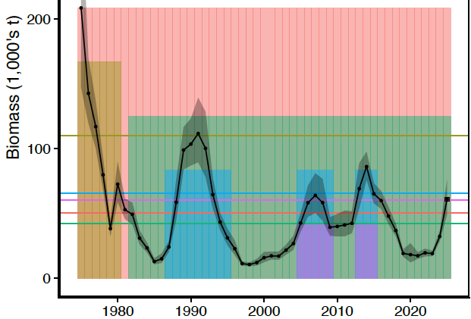
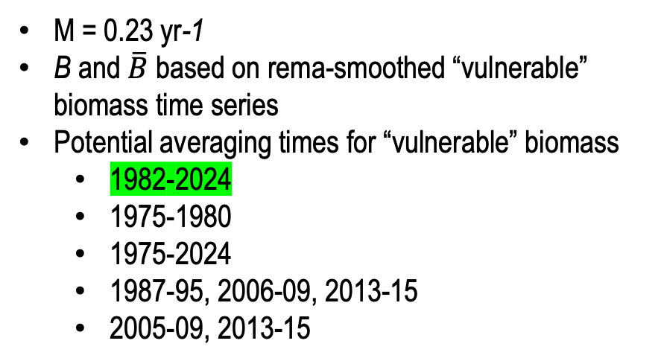
Tier 4 Backup Model
M = 0.23 yr-1
B and $\overline{B}$ based on rema-smoothed “vulnerable” biomass time series
Potential averaging times for “vulnerable” biomass
1982-2024
1975-1980
1975-2024
1987-95, 2006-09, 2013-15
2005-09, 2013-15
vulnerable
vulnerable
biomass units: 1000’s t
Notes:
Updated 2024

Slide 4
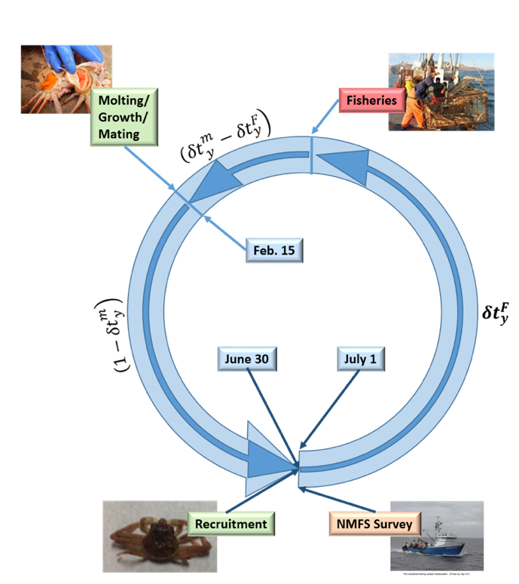
Tier 3 Assessment Model
Size-structured, two-sex model with terminal molt
Survey data
NMFS EBS shelf survey: 1975-present
BSFRF 2013-2018 side-by-side haul studies
growth data
male maturity data
Fishery data
directed fishery (areas combined)
retained catch
total catch
bycatch in
snow crab fishery
BBRKC fishery
groundfish fisheries
Estimates:
Annual recruitment
Annual numbers-at-size (M,F)
mature biomass (MMB, MFB)
Notes:
Updated 2024

Slide 5
Assessment time frames: data
Notes:
Updated 2024

Slide 6
Assessment time frames: model processes
Notes:
updated 2024

Slide 7
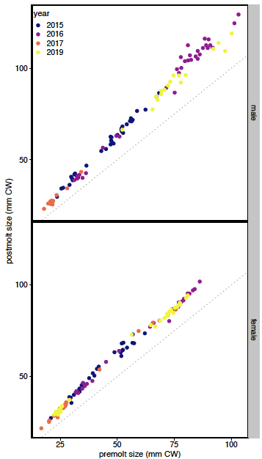
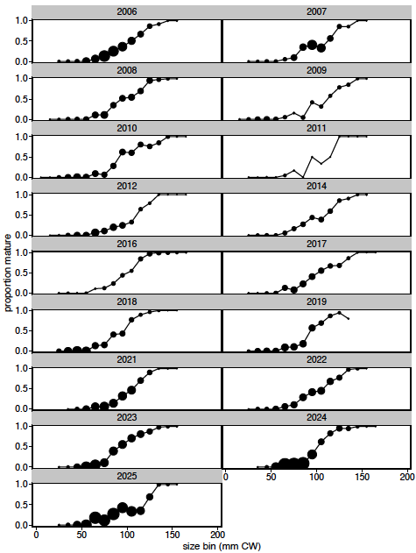
Life History Data
male maturity ogives
growth
Notes:
updated 2024

Slide 8
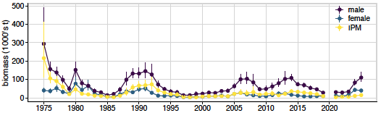
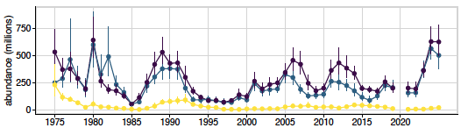
NMFS EBS Survey Data
IPM: Industry-preferred males (> 125 mm, 5 inch CW)
Notes:
Updated 2024

Slide 9
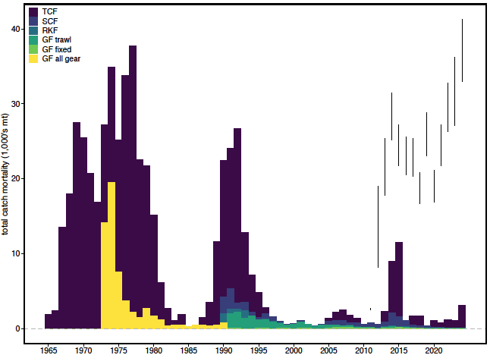
OFLs and ABCs
Total Catch Mortality
vertical lines:
upper end: federal OFL
lower end: federal ABC
Notes:
Updated 2024

Slide 10
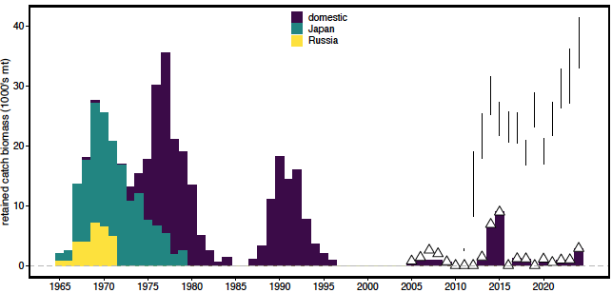
OFLs, ABCs, and TACs
vertical lines:
upper end: federal OFL
lower end: federal ABC
triangles:
combined State TAC
Retained Catch Mortality
Notes:
Updated 2024

Slide 11
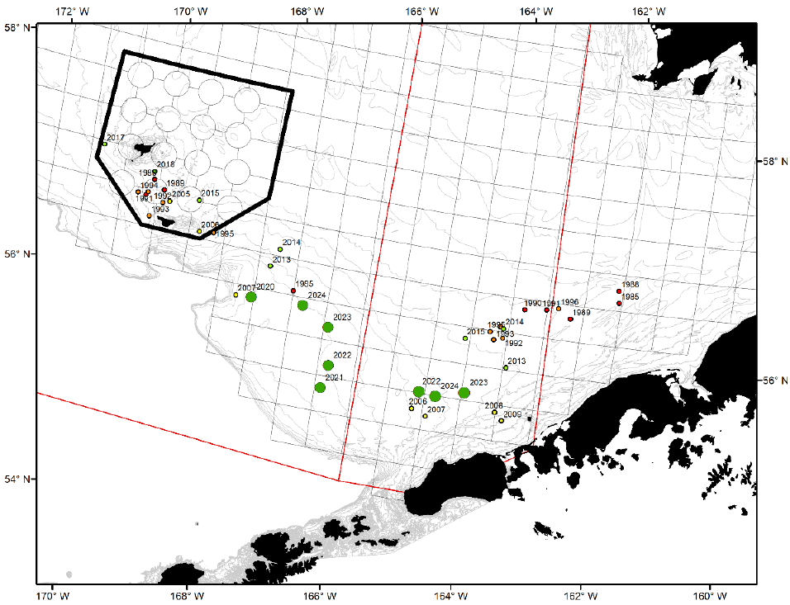
Retained catch and effort
slide 8 from TAC setting
Courtesy of Ben Daly, ADFG
Notes:
Updated 2024

Slide 12
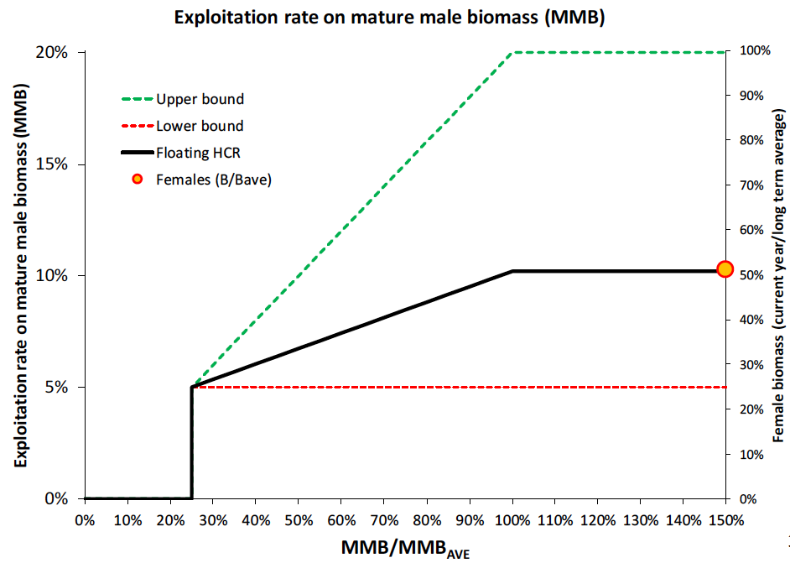
State Harvest Strategy
Exploitation rates on MMB
5% lower bound
20% upper bound
Applied by State area (E/W 166W)
“Floating” control rule determined by female biomass (entire EBS)
Additional considerations: caps on exploitation rate for “exploitable” legal males
100% new shell crab > 5in CW
40% old shell crab > 5 in CW
cap: 50% by weight
Requires:
MFB for entire EBS
MMB by E/W 166W
5” male abundance by shell condition E/W 166W
Avg weight of 5” males E/W 166W
Courtesy of Ben Daly, ADFG
Notes:
Updated 2024

