Slide 1
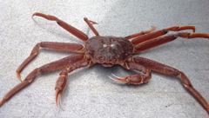
2026 Tanner Crab Transition To GMACS
William Stockhausen
AFSC/NMFS/NOAA

Slide 2
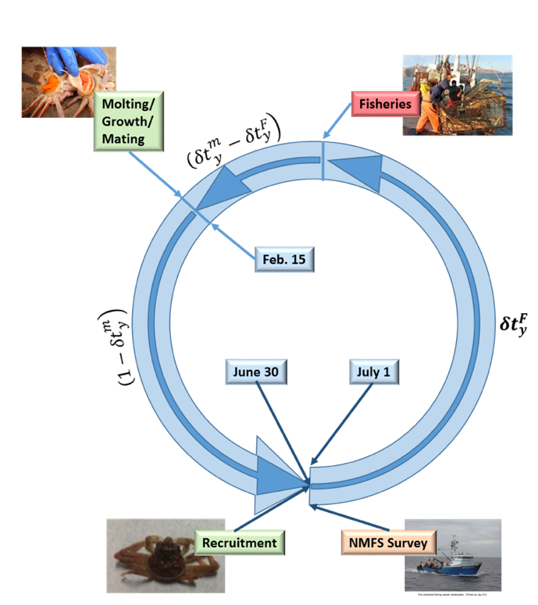
Tier 3 Assessment Model
Tier 3 size-structured model
Survey data
NMFS EBS shelf survey: 1975-present
BSFRF 2013-2018 side-by-side haul studies
Fishery data
directed fishery (areas combined)
retained catch
total catch
bycatch in
snow crab fishery
BBRKC fishery
groundfish fisheries
Estimates:
Annual recruitment
Annual numbers-at-size (M,F)
mature biomass (MMB, MFB)
Determines:
F_{MSY}, B_{MSY}, F_{OFL}, OFL
Notes:
Updated 2024

Slide 3
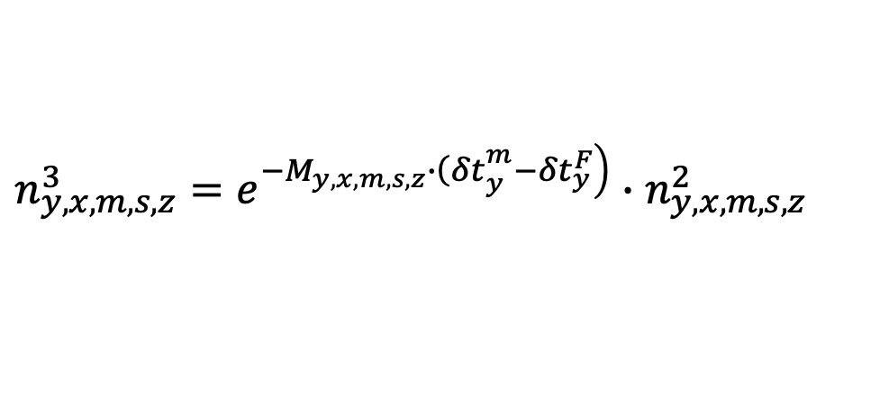

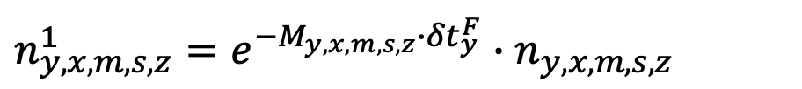
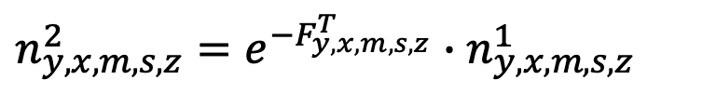
Population dynamics (1)
Population abundance at start of year
y: year
x: sex
m: maturity state (immature, mature)
s: shell condition (new shell, old shell)
z: size (5 mm CW bins, cutpoints: 25-185)
$$n_{y,x,m,s,z}^{}$$
$$n_{y,x,m,s,z}^{1}=e^{−M_{y,x,m,s,z}^{}∙{δt}_{y}^{F}}∙n_{y,x,m,s,z}^{}$$
Step A1.1: Survival prior to fisheries
Step A1.2: Prosecution of the fisheries
$$n_{y,x,m,s,z}^{2}=e^{−F_{y,x,m,s,z}^{T}}∙n_{y,x,m,s,z}^{1}$$
Step A1.3: Survival after fisheries to time of molting/growth/mating
$$n_{y,x,m,s,z}^{3}=e^{\left.−M_{y,x,m,s,z}^{}∙{\left(δt\right.}_{y}^{m}−{δt}_{y}^{F}\right)}∙n_{y,x,m,s,z}^{2}$$
Notes:
Updated 2024

Slide 4
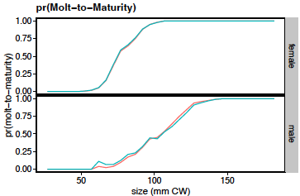
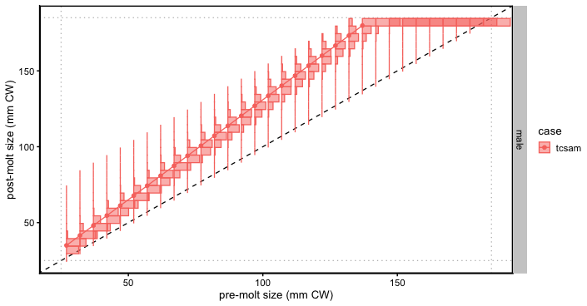
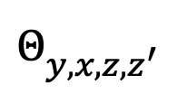



Population dynamics (2)
$$φ_{y,x,z}^{}$$
Step A1.4: Molting, growth, and maturation
$$n_{y,x,IMM,NS,z}^{4}=\left(1−φ_{y,x,z}^{}\right)∙\sum_{z^{′}}{Θ_{y,x,z,z^{′}}^{}∙n_{y,x,IMM,NS,z^{′}}^{3}}$$
$$n_{y,x,MAT,NS,z}^{4}=φ_{y,x,z}^{}∙\sum_{z^{′}}{Θ_{y,x,z,z^{′}}^{}∙n_{y,x,IMM,NS,z^{′}}^{3}}$$
$$Θ_{y,x,z,z^{′}}^{}$$
$$n_{y,x,MAT,OS,z}^{4}=n_{y,x,MAT,OS,z}^{3}+n_{y,x,MAT,NS,z}^{3}$$
Notes:
Updated 2024

Slide 5
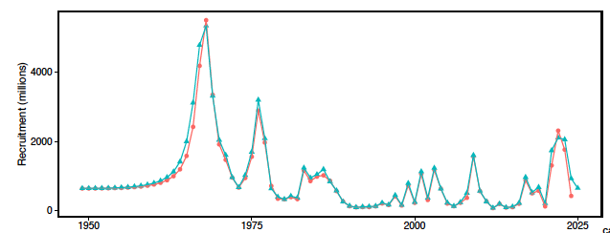
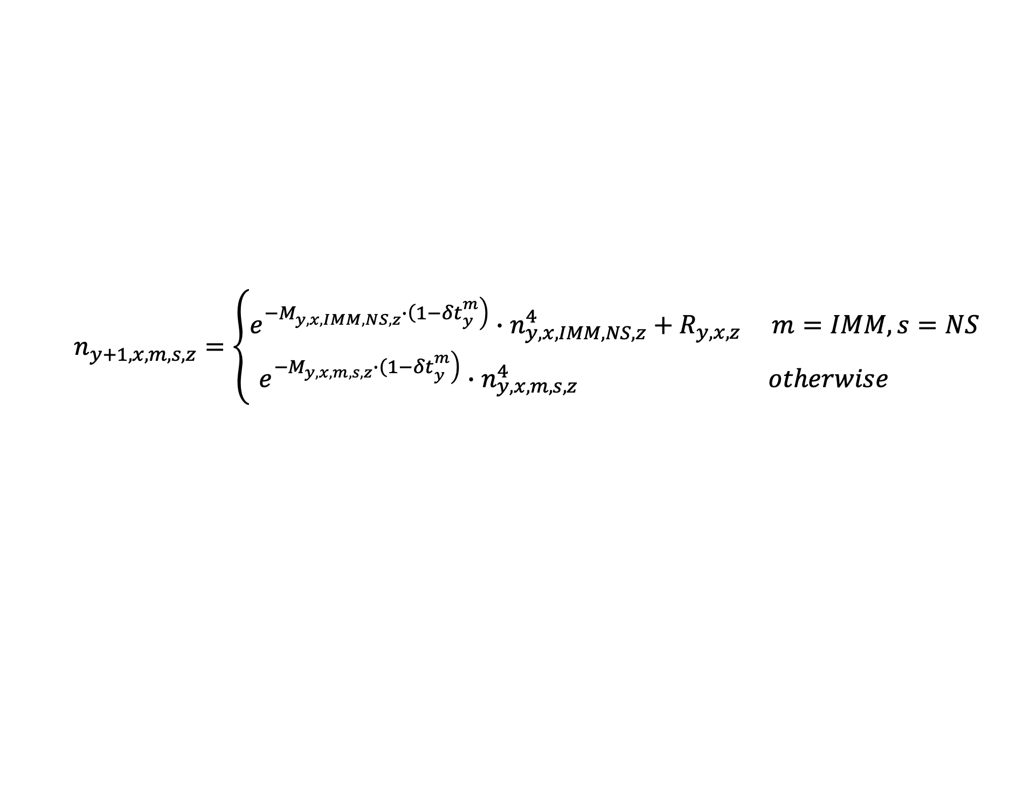
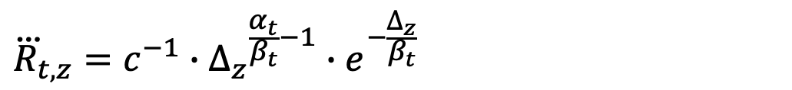
Population dynamics (3)
Step A1.5: Survival to end of year, recruitment, and update to start of next year
$$n_{y+1,x,m,s,z}^{}=\left\{\begin{matrix}e^{\left.−M_{y,x,IMM,NS,z}^{}∙{\left(1−δt\right.}_{y}^{m}\right)}∙n_{y,x,IMM,NS,z}^{4}+R_{y,x,z} & m=IMM, s=NS \\ e^{\left.−M_{y,x,m,s,z}^{}∙{\left(1−δt\right.}_{y}^{m}\right)}∙n_{y,x,m,s,z}^{4} & otherwise \end{matrix}\right.$$
$${\dot{R}}_{y}=\begin{matrix}e^{{pLnR}_{t}+{δR}_{t,y}} & y∈t\end{matrix}$$
$$R_{y,x,z}={\dot{R}}_{y}∙{\ddot{R}}_{y,x}∙{\overset{⃛}{R}}_{y,z}$$
$${\ddot{R}}_{y,x}=0.5$$
$${\overset{⃛}{R}}_{t,z}=c^{−1}∙{∆_{z}}^{\frac{α_{t}}{β_{t}}−1}∙e^{−\frac{∆_{z}}{β_{t}}}$$
Notes:
Updated 2024

Slide 6
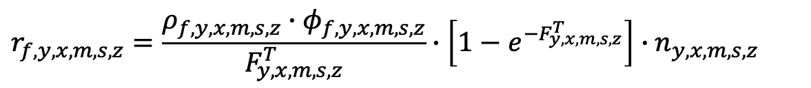
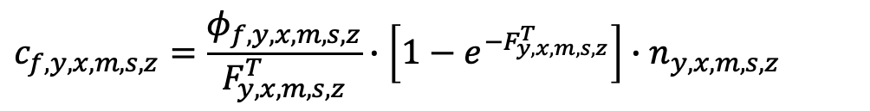

Fishery dynamics (1)
“Instantaneous” fisheries (no M)
Fishing mortality:
$$F_{f,y,x,m,s,z}=\left\lceil h_{f,t}∙\left(1−ρ_{f,y,x,m,s,z}\right)+ρ_{f,y,x,m,s,z}\right\rceil ∙φ_{f,y,x,m,s,z}$$
Handling (discard) mortality:
$$h_{f,t}$$
Retention probability:
$$ρ_{f,y,x,m,s,z}$$
Capture rate:
$$φ_{f,y,x,m,s,z}=φ_{f,y,x,m,s}∙S_{f,y,x,m,s,z}$$
$$c_{f,y,x,m,s,z}=\frac{φ_{f,y,x,m,s,z}}{F_{y,x,m,s,z}^{T}}∙\left[1−e^{−F_{y,x,m,s,z}^{T}}\right]∙n_{y,x,m,s,z}$$
Numbers caught:
$$r_{f,y,x,m,s,z}=\frac{ρ_{f,y,x,m,s,z}∙φ_{f,y,x,m,s,z}}{F_{y,x,m,s,z}^{T}}∙\left[1−e^{−F_{y,x,m,s,z}^{T}}\right]∙n_{y,x,m,s,z}$$
Numbers retained:
$${dm}_{f,y,x,m,s,z}=\frac{h_{f,y}∙\left(1−ρ_{f,y,x,m,s,z}\right)∙φ_{f,y,x,m,s,z}}{F_{y,x,m,s,z}^{T}}∙\left[1−e^{−F_{y,x,m,s,z}^{T}}\right]∙n_{y,x,m,s,z}$$
discard mortality:
Notes:
Updated 2024

Slide 7
Assessment time frames: data
Notes:
Updated 2024

Slide 8
Assessment time frames: model processes
Notes:
updated 2024

Slide 9
Population dynamics
Notes:
2025

Slide 10
Fisheries
Notes:
2025

Slide 11
Surveys
Notes:
2025

Slide 12
Likelihoods
Notes:
2022

Slide 13
Some Major Differences Between TCSAM02 and GMACS
Notes:
2022

Slide 14
GMACS Modifications To Match TCSAM02
Added alternative multinomial likelihood as option to fit size comps (option 7) to match TCSAM02 calculation.
Added male maturity data section to data file.
Added "doTCSAM02EffExp" flag to data file (right after flag to read catch data in new format). If "on" (1), effort extrapolation for missing catch is based on average catch divided by average effort for years specified by new "avg_eff" column in new-format CatchDFs.
Added growth transition options 9 and 10 to provide same functionality as TCSAM02
Added alternative 4-parameter double normal selectivity option (SELEX_DOUBLENORM4a = 15) to match TCSAM02. The plateau is determined from a scale parameter and the distance between the max possible size and the size at the ascending limb.
Added new options for calculating/extending size comps to provide sample size scaling/no scaling options for input size comps.
The growth options TCSAM02A and TCSAM02B (=9 and 10) that provide similar functionality as TCSAM02 for the growth transition matrices were reassigned and additional options TCSAM02C and TCSAM02D (11 and 12) were added. A and B apply to the case where the molt increment is assumed to be gamma-distributed while C and D apply to the case where postmolt size is gamma-distributed. All of the options limit growth to a maximum number of size bins but treat probabilities from the "excluded" size bins differently: A and C drop them, then normalize the remaining probabilities to sum to 1 whereas B and D treat the max size bin as an accumulator for "raw” probabilities at larger size bins before dropping them.
Fixed calculation of predicted fishery size comps in calc_predicted_composition by including fully-selected F's (ft(k,h,i,j)) in the calculations.
Added new option for averaging fishing mortality rates before calculating the OFL
Notes:
2022

Slide 15
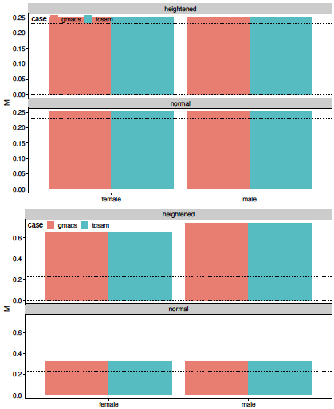
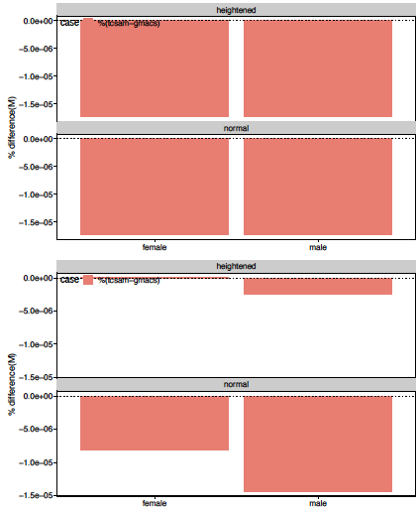
Natural Mortality
immature crab
mature crab
% differences
values
Notes:
2022

Slide 16
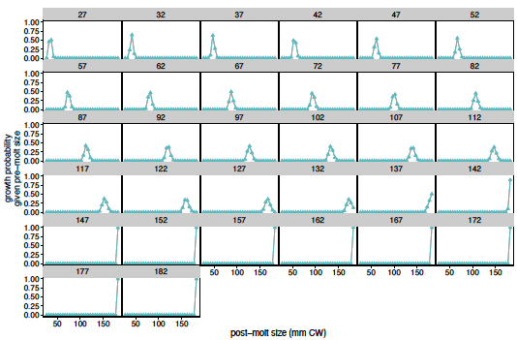
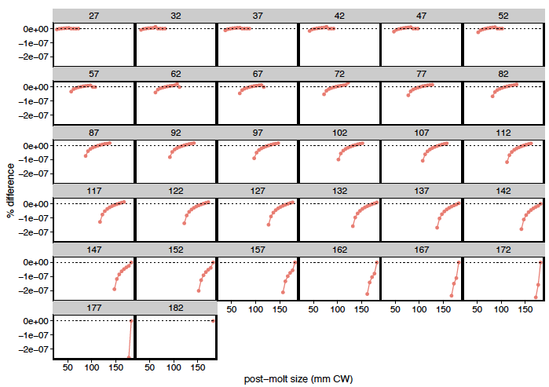

Male growth
Notes:
2022

Slide 17
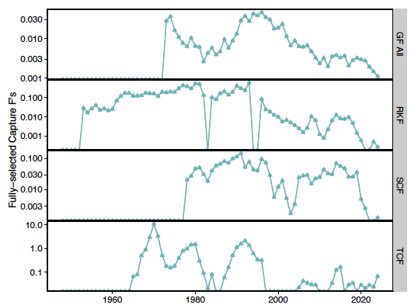
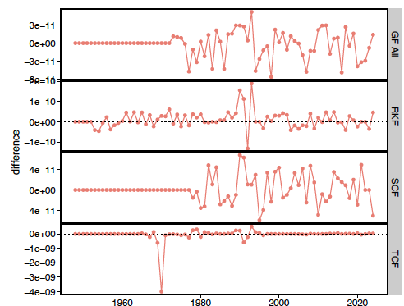
Fully-selected Male Capture F’s
Notes:
2022

Slide 18
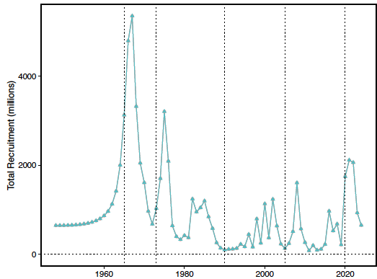
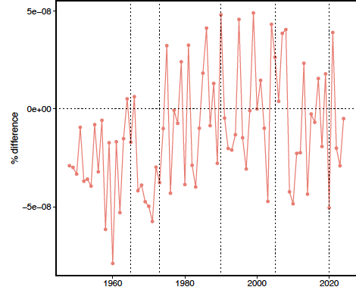
Recruitment
Notes:
2022

Slide 19
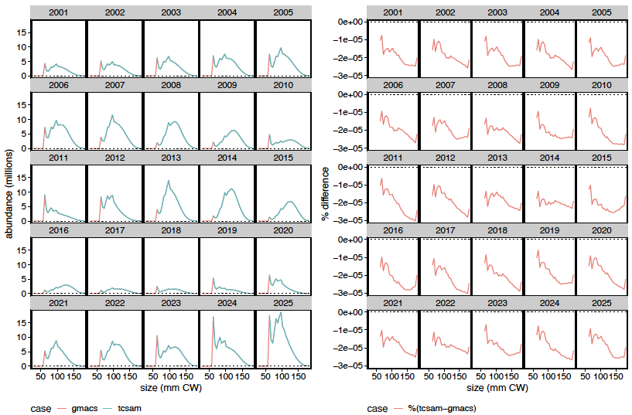
Population abundance-at-size for mature males
Notes:
2022

Slide 20
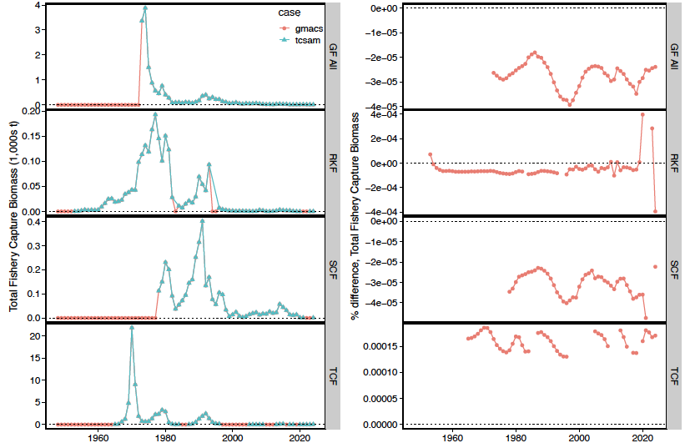
Predicted total catch biomass, by fishery
Notes:
2022

Slide 21
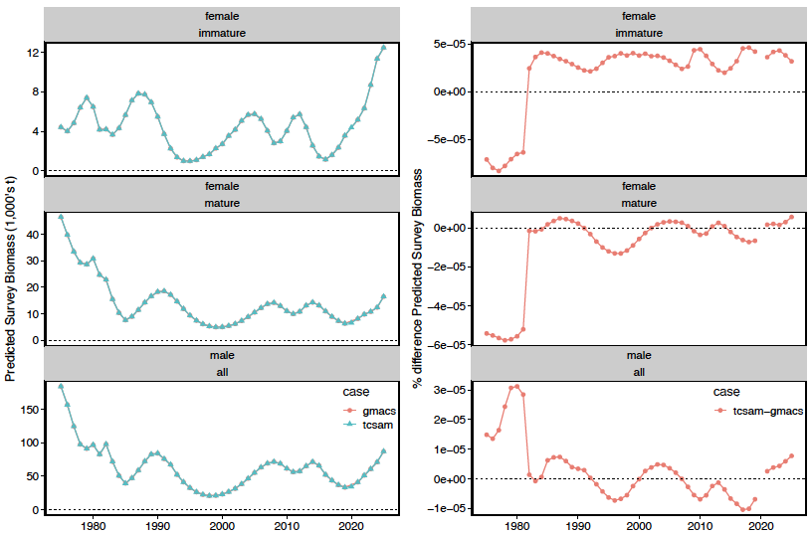
Predicted NMFS Survey Biomass
Notes:
2022

Slide 22
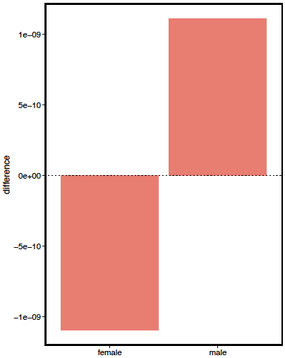
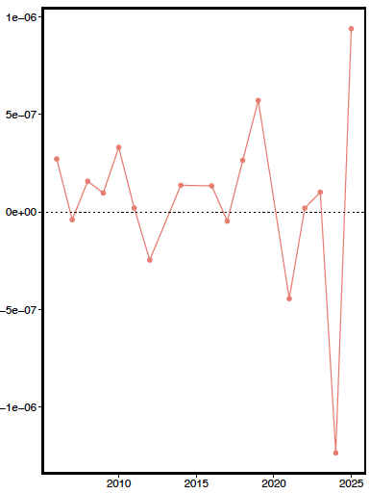
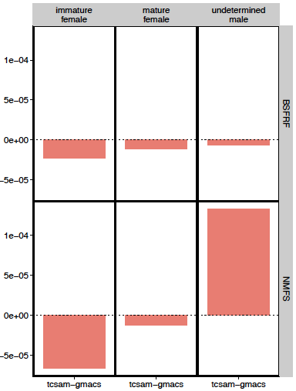
Likelihood differences
growth
male maturity ogives
survey biomass
Notes:
2022

Slide 23
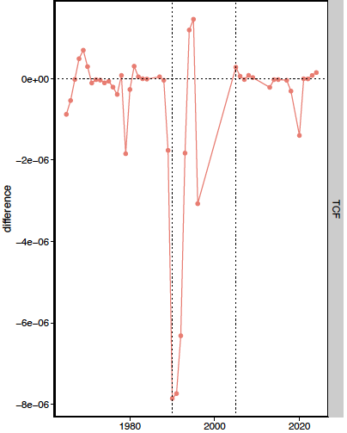
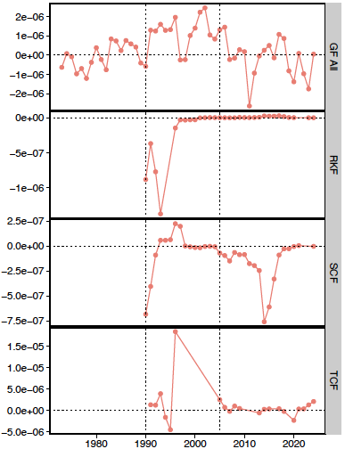
Likelihood differences
retained catch biomass
total catch biomass
Notes:
2022

Slide 24
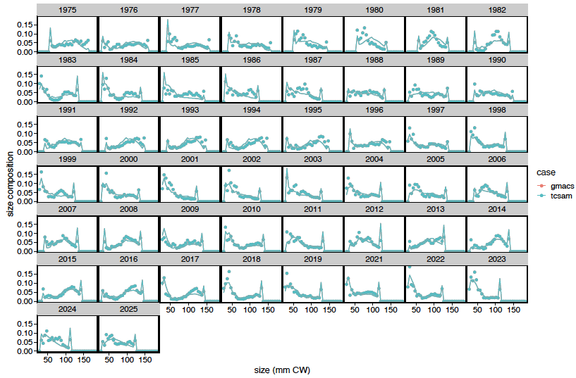
Fits to NMFS survey male size comps
lines: predicted values
points: observed values
Notes:
2022

Slide 25
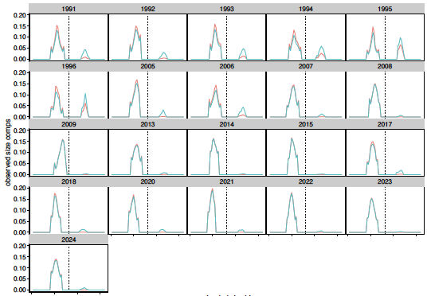
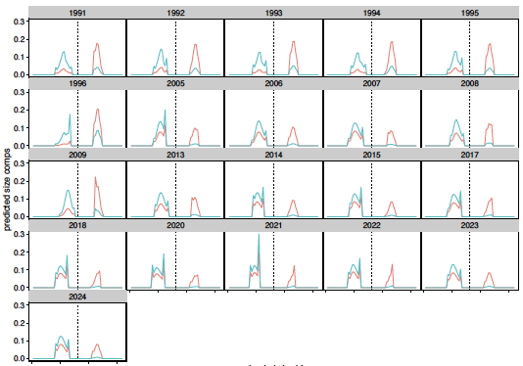
Directed fishery “extended” total catch size comps
observed size comps
predicted size comps
without scaling by sex-specific fishery capture rates
Notes:
2022

Slide 26
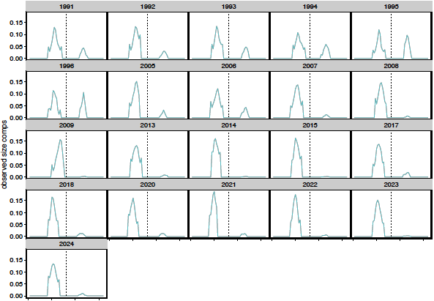
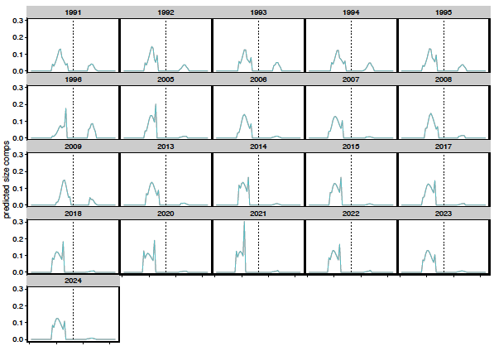
Directed fishery “extended” total catch size comps
observed size comps
predicted size comps
with scaling by sex-specific fishery capture rates
Notes:
2022

Slide 27
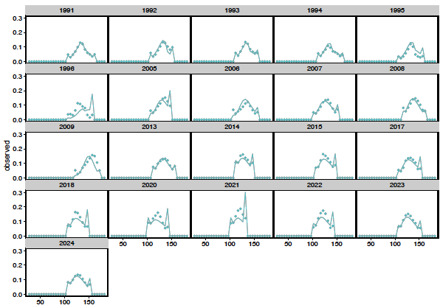
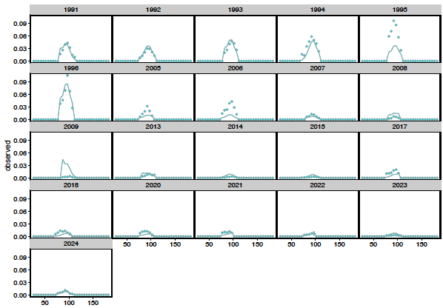
Fits to directed fishery total catch size comps
males
females
Lines: predicted
points: observed
Notes:
2022

Slide 28
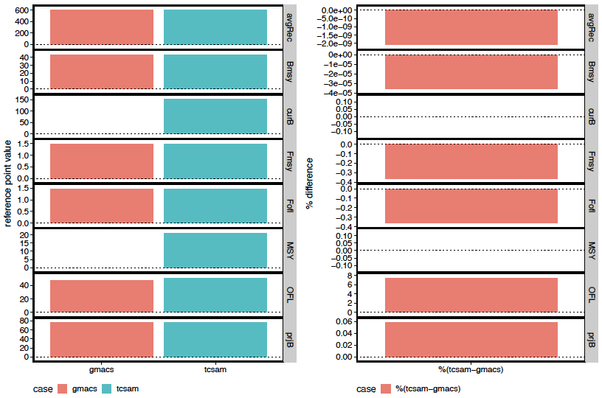
Management Quantities
Old Results
Notes:
2022

Slide 29
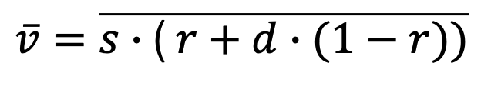
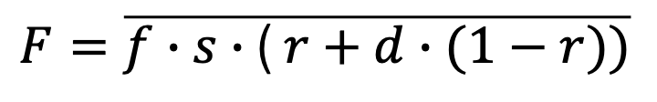


OFL Resolution
GMACS
uses average fleet/sex specific
fully-selected capture rates
“vulnerability”
TCSAM02
uses average fleet/sex specific
fully-selected capture rates
selectivity
retention probability
$$\overline{v}=\overline{s∙\text{( }r+d∙(1−r))}$$
$$F=\overline{f}∙\overline{v}$$
$$F=\overline{f}∙\overline{s}∙\text{( }\overline{r}+d∙(1−\overline{r}))$$
default
$$F=\overline{f∙s∙\text{( }r+d∙(1−r))}$$
alternative
Notes:
2022

Slide 30
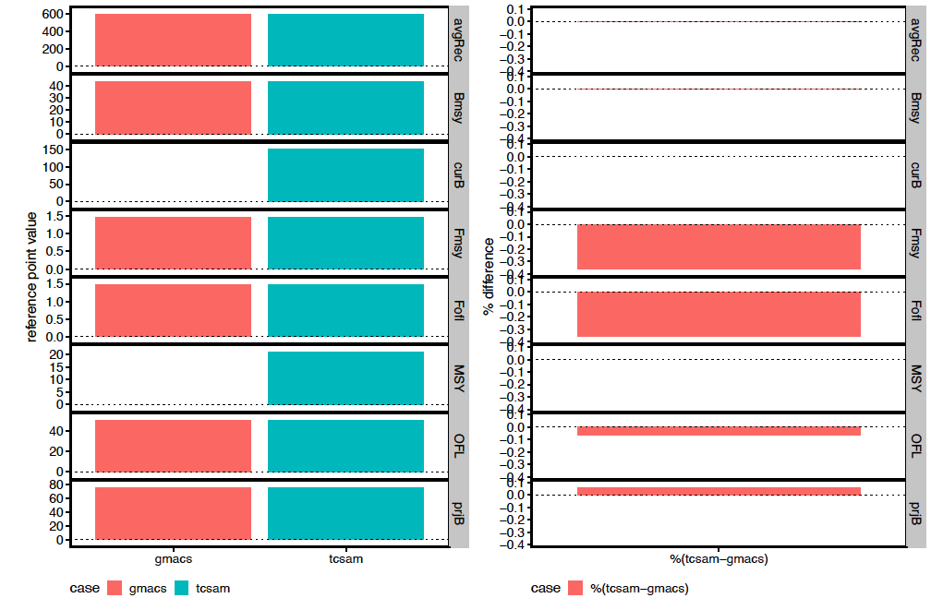
Management Quantities
New Results
Notes:
2022

Slide 31
Wrap-up
GMACS Estimation
GMACS model converges, but not to TCSAM02 MLE
Need to ensure priors and penalties are equivalent between the frameworks
Reviewers
how close if “good enough”?
other thoughts?
Notes:
2022

