Slide 1
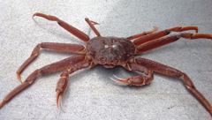
2026-05 Tanner Crab Report
William Stockhausen
AFSC/NMFS/NOAA
May 14, 2026

Slide 2
Topics
SSC/CPT Comments
New Analyses
“new” maturity workflow
Chionoecetes hybrids: discussed separately
GMACS Tanner model development

Slide 3
CPT/SSC Comments
Chionoecetes stock assessment authors were asked to present a comparison of results
from models using the legacy versus new maturity workflow data sets at the May 2026 CPT meeting.
Results discussed in document and here
Tanner and snow crab stock authors were asked to complete three model sensitivity runs (including size composition and abundance data) with hybrids: 1) included in survey data; 2) included in catch data; 3) included in both survey and catch data.
Results discussed in document and during “Hybrids” topic
The SSC recommends that authors and CPT provide a justification if catches are set to the OFL in projections, or use a more realistic estimate of future catches as is done in groundfish assessments.
The Tanner crab assessment results provide projection results from a range of fishing mortality rates (fractions of F_{OFL})
Notes:
2022

Slide 4
CPT/SSC Comments
The SSC thanks the assessment author for their extensive work documenting and addressing previous
SSC and CPT requests. While the SSC appreciates the author’s attention to detail, the SSC highlights that the SAFE and the included appendices are over 400 pages long. The SSC suggests additional streamlining of the material included in future assessment documents.
2025 assessment doc was reduced from 800 pages in 2024. Concrete suggestions for how/where to reduce the document further are welcome. Recent requested additions (ESPs, risk tables, likelihood profiles, Tier 4 alternative models) necessarily increase the size of the document, as does the requirement to document the sequential addition of new data and model changes from the base model to the candidate model(s).
The SSC agrees (with the CPT) that focus should remain on transitioning this assessment into the GMACs framework...The CPT suggested starting from inputting parameters via a .PIN file in the bridging analyses
and then work towards estimating parameter values
Sept 2025: G25.05 was not brought forward due to unexpected (and currently unresolved) problems encountered with optimizing the model (the optimization failed after ~150 steps after generating an invalid gradient vector required to update the parameter values).
May 2026: A number of issues have been resolved including: adding Tanner-like features to GMACS (maturity ogives as data and likelihood components; selectivity curves, comparable output); initial parameter values, R code to directly compare GMACS and TCSAM02 model results. Results are discussed in the document and here.
Notes:
2022

Slide 5
Assessment Model Results with “New” Maturity Workflow
Notes:
2022

Slide 6

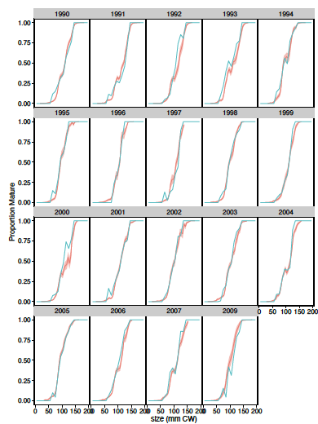
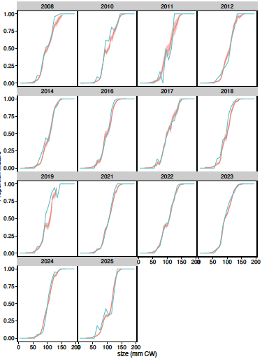
Male Maturity Ogives
based on CH, CW measurements
Old
no accounting for spatial structure or sampling
10 mm bin sizes
no estimates of uncertainty
New
uses sdmTMB to account for spatial structure and sampling
5 mm bin sizes
estimates uncertainty
Notes:
2022

Slide 7
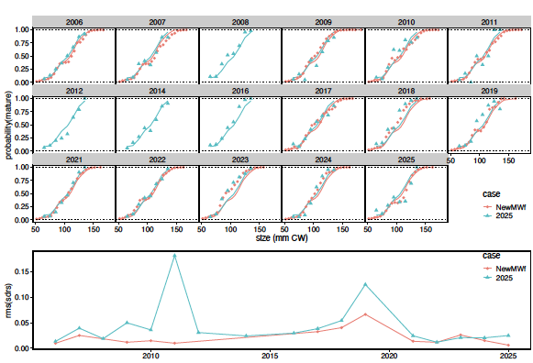
Model fits
Ogives
Notes:
2022

Slide 8
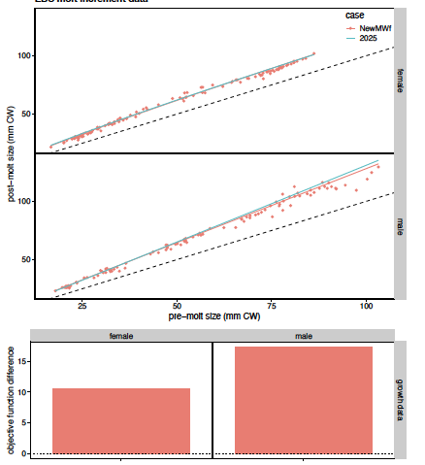
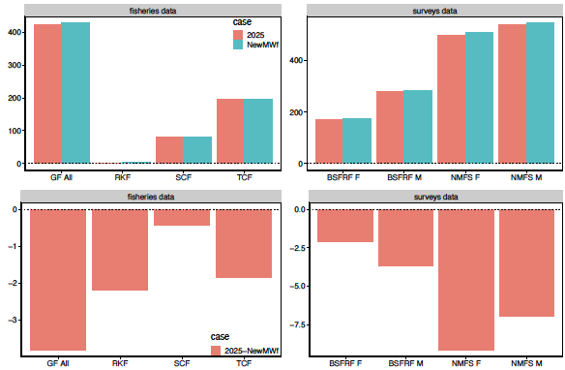
Fits to data
Growth data
Fisheries data
Survey data
worse fits
better fits
Notes:
2022

Slide 9
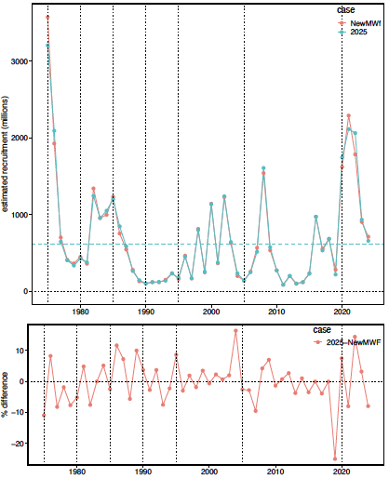
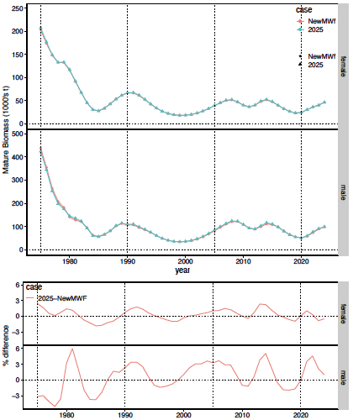
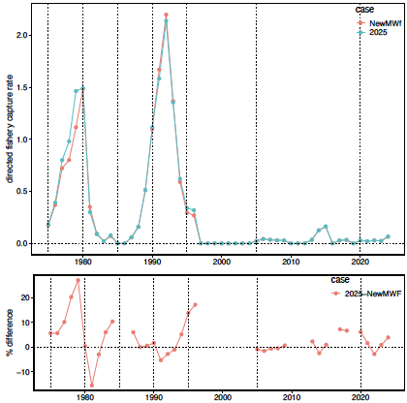
Estimated quantities
Recruitment
Mature Biomass
Directed Fishery Capture Rates
Notes:
2022

Slide 10
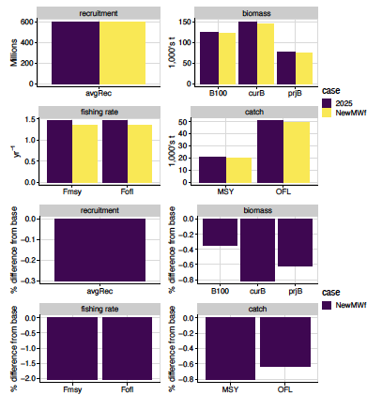
Management Quantities
Notes:
2022

Slide 11
Progress toward a GMACS model for Tanner crab
Notes:
2022

Slide 12
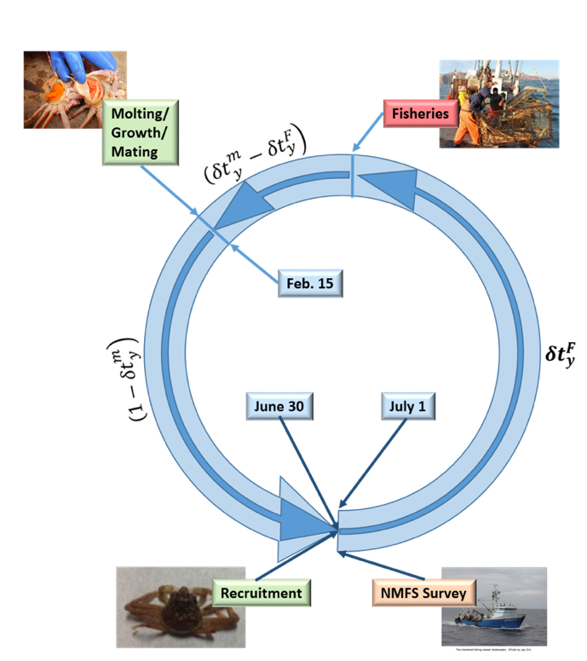
Tier 3 Assessment Model
Tier 3 size-structured model
Survey data
NMFS EBS shelf survey: 1975-present
BSFRF 2013-2018 side-by-side haul studies
Fishery data
directed fishery (areas combined)
retained catch
total catch
bycatch in
snow crab fishery
BBRKC fishery
groundfish fisheries
Estimates:
Annual recruitment
Annual numbers-at-size (M,F)
mature biomass (MMB, MFB)
Determines:
F_{MSY}, B_{MSY}, F_{OFL}, OFL
Notes:
Updated 2024

Slide 13
Assessment time frames: data
Notes:
Updated 2024

Slide 14
Assessment time frames: model processes
Notes:
updated 2024

Slide 15
Population dynamics
Notes:
2025

Slide 16
Fisheries
Notes:
2025

Slide 17
Surveys
Notes:
2025

Slide 18
Likelihoods
Notes:
2022

Slide 19
GMACS Modifications To Match TCSAM02
Added alternative multinomial likelihood as option to fit size comps (option 7) to match TCSAM02 calculation.
Added male maturity data section to data file.
Added "doTCSAM02EffExp" flag to data file (right after flag to read catch data in new format). If "on" (1), effort extrapolation for missing catch is based on average catch divided by average effort for years specified by new "avg_eff" column in new-format CatchDFs.
Added growth transition options 9 and 10 to provide same functionality as TCSAM02
Added alternative 4-parameter double normal selectivity option (SELEX_DOUBLENORM4a = 15) to match TCSAM02. The plateau is determined from a scale parameter and the distance between the max possible size and the size at the ascending limb.
Added new options for calculating/extending size comps to provide sample size scaling/no scaling options for input size comps.
The growth options TCSAM02A and TCSAM02B (=9 and 10) that provide similar functionality as TCSAM02 for the growth transition matrices were reassigned and additional options TCSAM02C and TCSAM02D (11 and 12) were added. A and B apply to the case where the molt increment is assumed to be gamma-distributed while C and D apply to the case where postmolt size is gamma-distributed. All of the options limit growth to a maximum number of size bins but treat probabilities from the "excluded" size bins differently: A and C drop them, then normalize the remaining probabilities to sum to 1 whereas B and D treat the max size bin as an accumulator for "raw” probabilities at larger size bins before dropping them.
Fixed calculation of predicted fishery size comps in calc_predicted_composition by including fully-selected F's (ft(k,h,i,j)) in the calculations.
Notes:
2022

Slide 20
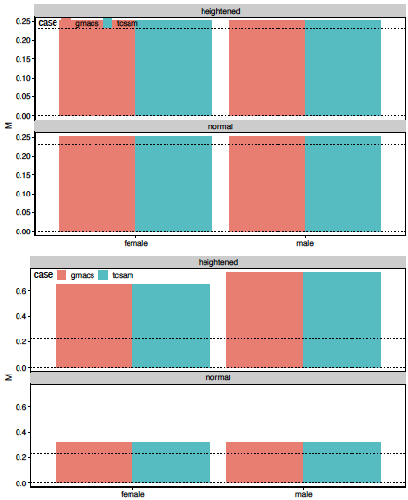
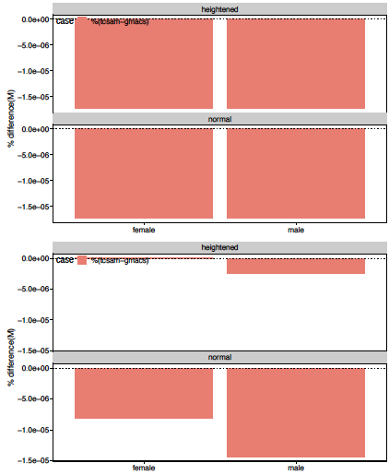
Natural Mortality
immature crab
mature crab
% differences
values
Notes:
2022

Slide 21
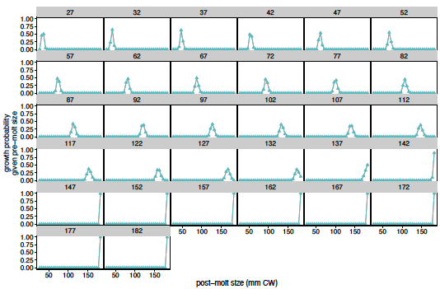
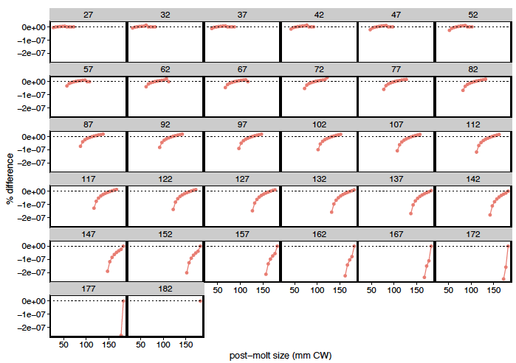

Male growth
Notes:
2022

Slide 22
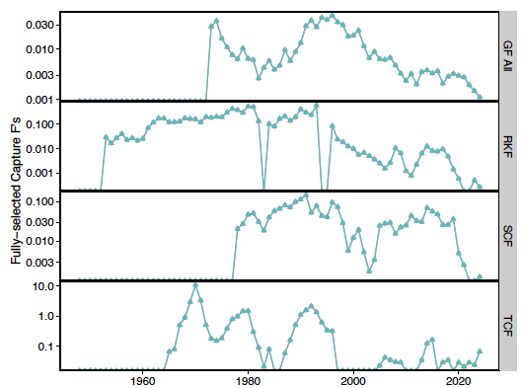
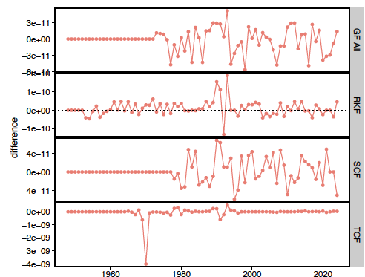
Fully-selected Male Capture F’s
Notes:
2022

Slide 23
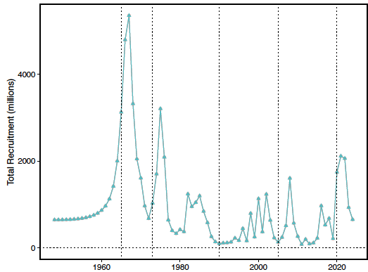
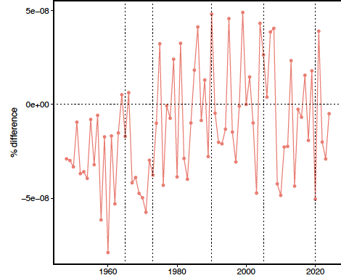
Recruitment
Notes:
2022

Slide 24
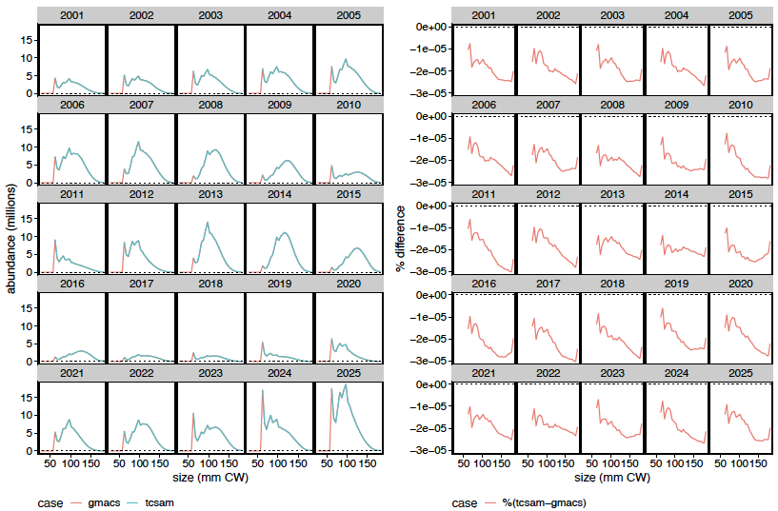
Population abundance-at-size for mature males
Notes:
2022

Slide 25
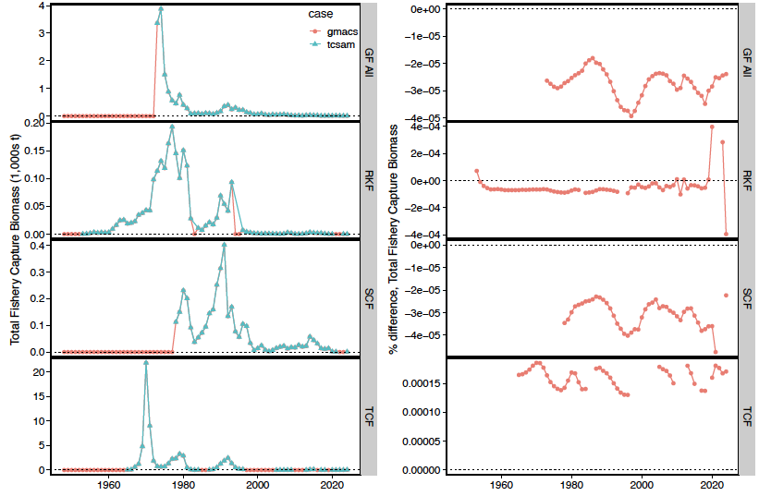
Predicted total catch biomass, by fishery
Notes:
2022

Slide 26
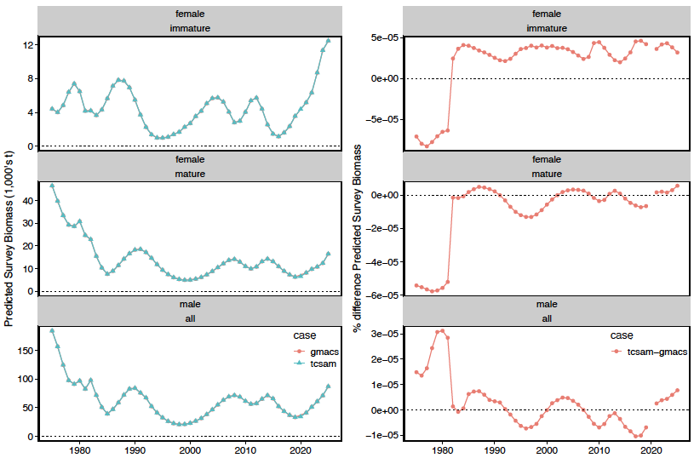
Predicted NMFS Survey Biomass
Notes:
2022

Slide 27
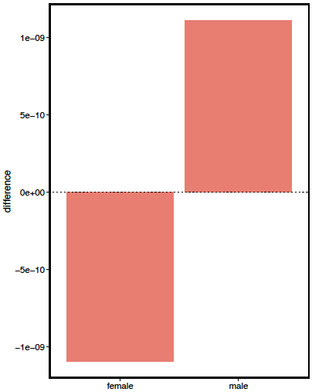
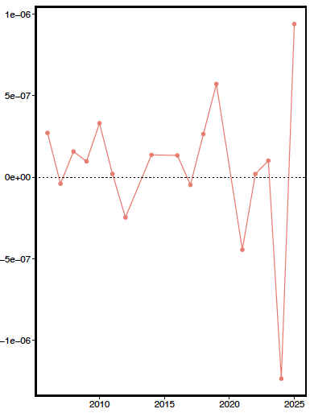
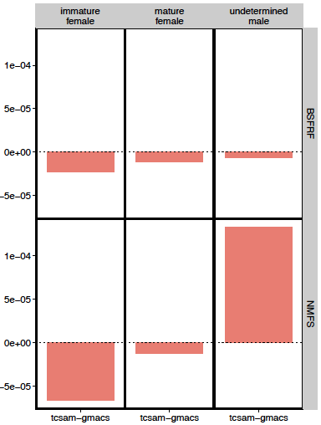
Likelihood differences
growth
male maturity ogives
survey biomass
Notes:
2022

Slide 28
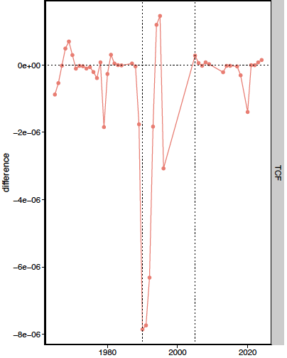
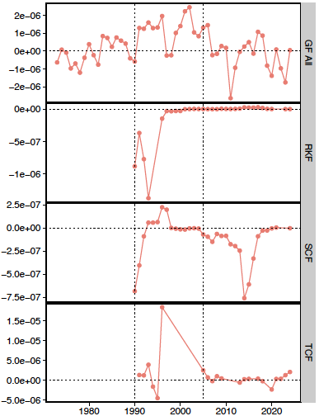
Likelihood differences
retained catch biomass
total catch biomass
Notes:
2022

Slide 29
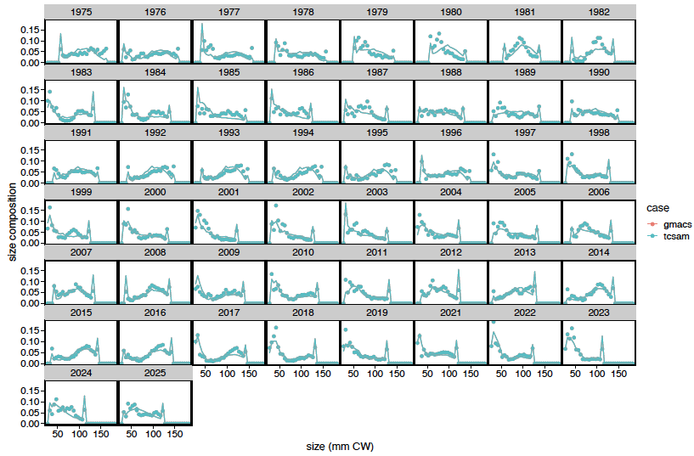
Fits to NMFS survey male size comps
lines: predicted values
points: observed values
Notes:
2022

Slide 30
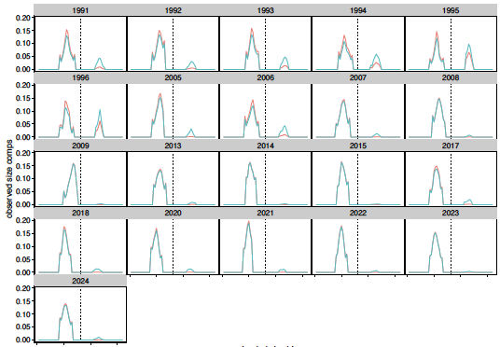
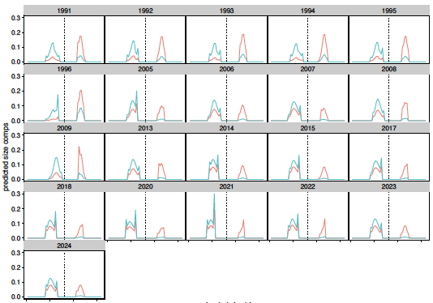
Directed fishery “extended” total catch size comps
observed size comps
predicted size comps
without scaling by sex-specific fishery capture rates
Notes:
2022

Slide 31
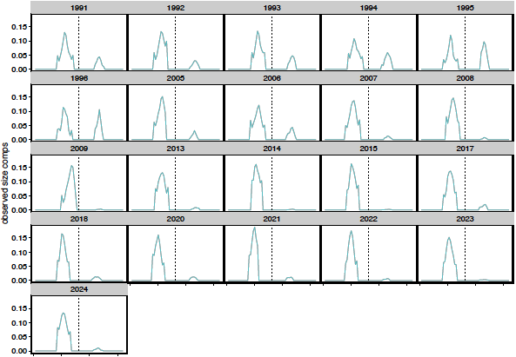
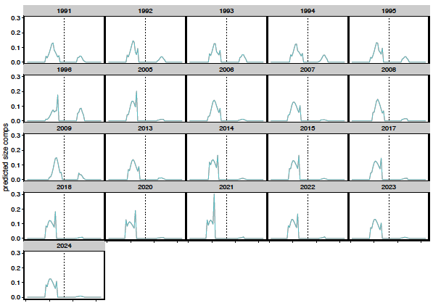
Directed fishery “extended” total catch size comps
observed size comps
predicted size comps
with scaling by sex-specific fishery capture rates
Notes:
2022

Slide 32
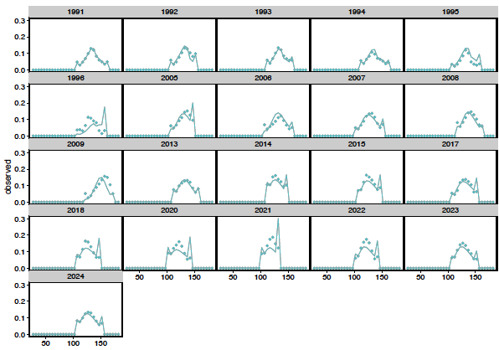
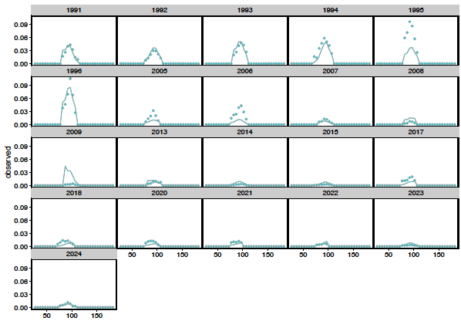
Fits to directed fishery total catch size comps
males
females
Lines: predicted
points: observed
Notes:
2022

Slide 33
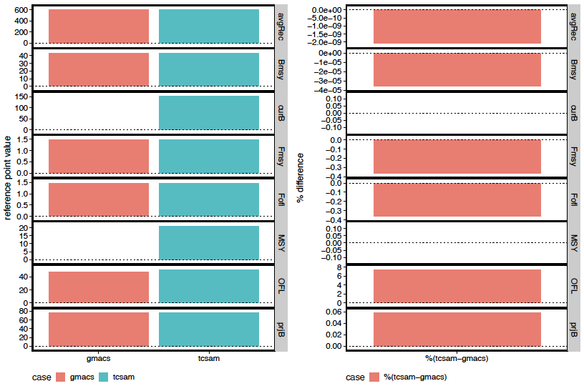
Management Quantities
Notes:
2022

Slide 34
Wrap-up
GMACS
Estimation
GMACS model converges, but not to TCSAM02 MLE
Need to ensure priors and penalties are equivalent between the frameworks
Further work (before September)
reconcile OFL calculations
Proposed models
use new maturity workflow
bespoke TCSAM02 model updated with 2025/26 fishery and survey data
matching GMACS model with 2025/26 fishery and survey data
priors, penalties to match TCSAM02 as closely as possible
use GMACS OFL calculations
Notes:
2022

Slide 35
TCSAM02 Models
Notes:
2022

Slide 36
Proposed Tier 3 models for September
2024 assessment model (TCSAM02 22.03d5) is “base” model
update with 2024/25 fishery/survey data
TCSAM02 25_02 model
with SBS-derived NMFS survey capture probabilities
GMACS G25_05
resolve scaling differences with TCSAM02 model
provide complete analysis
management quantities,
retrospective patterns, etc
Notes:
2022

