Slide 1
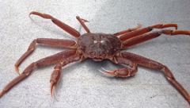
Assignments: Day 1
William Stockhausen
AFSC/NMFS/NOAA

Slide 2
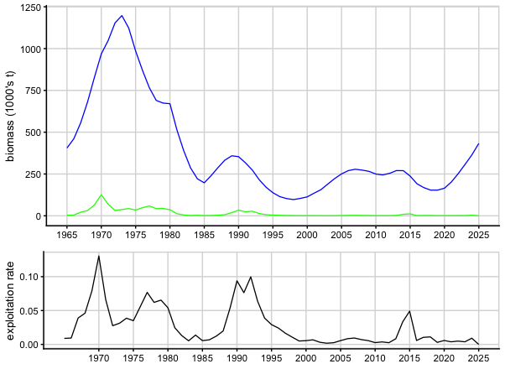
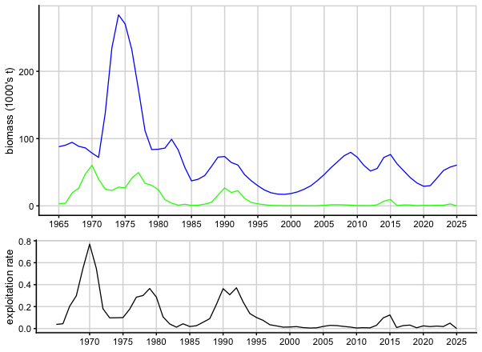
Pop biomass, catch mortality, exploitation rates (1)
All Tanner Crab
Preferred Males
Pop biomass
total catch mortality
Pop biomass
total catch mortality
Notes:
2022

Slide 3
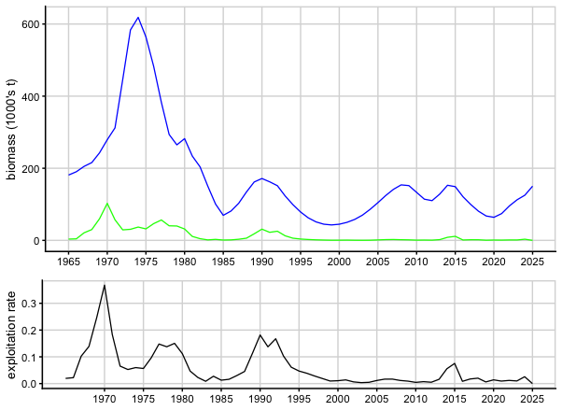
Pop biomass, catch mortality, exploitation rates (2)
Mature Males
Preferred Males
Pop biomass
total catch mortality
Pop biomass
total catch mortality
Notes:
2022

Slide 4
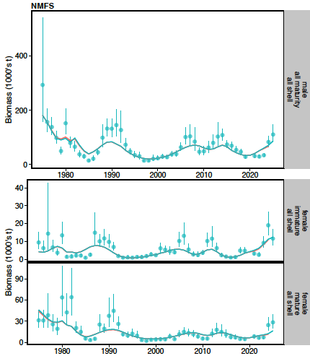
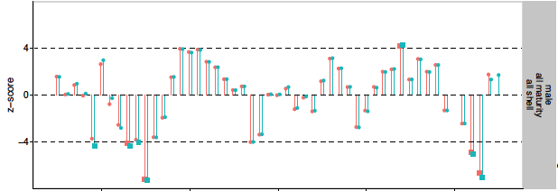
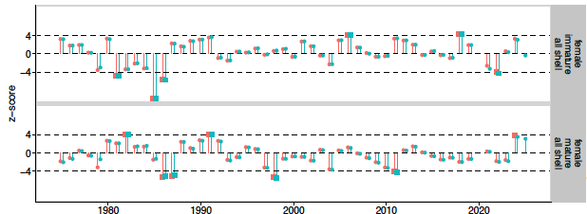
Fits to NMFS Survey Biomass
Notes:
Updated 2024

