Slide 1
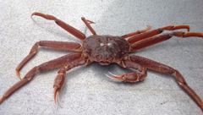
Assignments: Day 2
William Stockhausen
AFSC/NMFS/NOAA

Slide 2
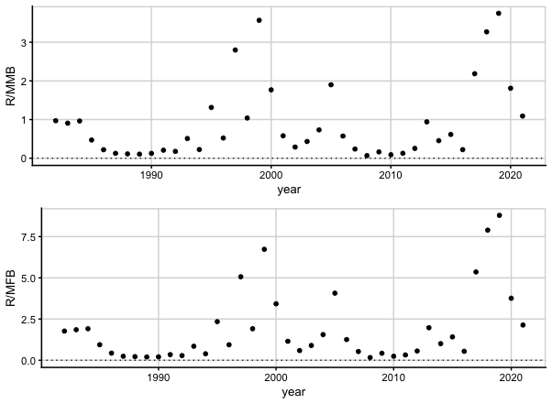
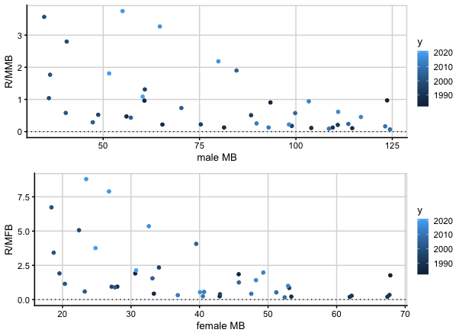
R/MB
Notes:
2022

Slide 3
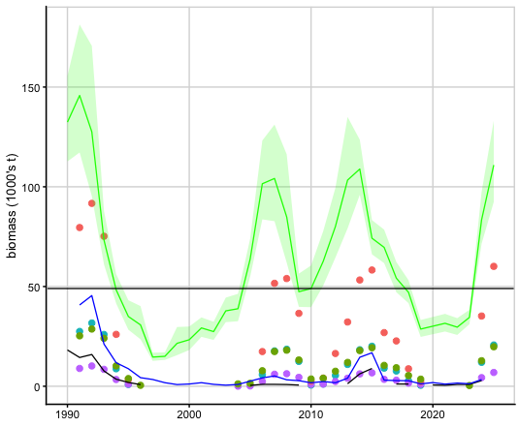
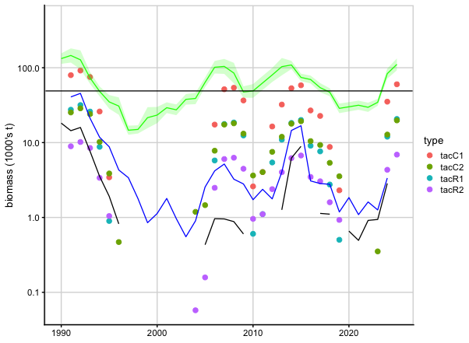
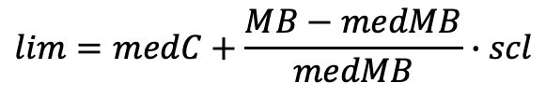
Simple catch limits
C1: total catch, scl=range
C2: total catch, scl=std dev
R1: ret. catch, scl=range
R2: ret. catch, scl=std dev
$$lim=medC+\frac{MB−medMB}{medMB}∙scl$$
Notes:
2022

