Slide 1

2026 Tanner Crab CIE Review Spatial Considerations
William Stockhausen
AFSC/NMFS/NOAA

Slide 2
Stock structure and spatial considerations
For federal management purposes,
Tanner crab is considered one stock in the eastern Bering Sea
Somerton (1980) and subsequent work hypothesized two stocks
166ºW longitude as dividing line
Based on area-specific differences in aggregated characteristics
mean size, weight
size-at-maturity
spatial patterns of abundance and biomass
Prior to recognition of male terminal molt
Spatial patterns result of
stock structure?
movement?
Evidence for stock structure?
Johnson (2019) genetics study found no structure
no concerted tagging studies
But…
Notes:
Updated 2024

Slide 3
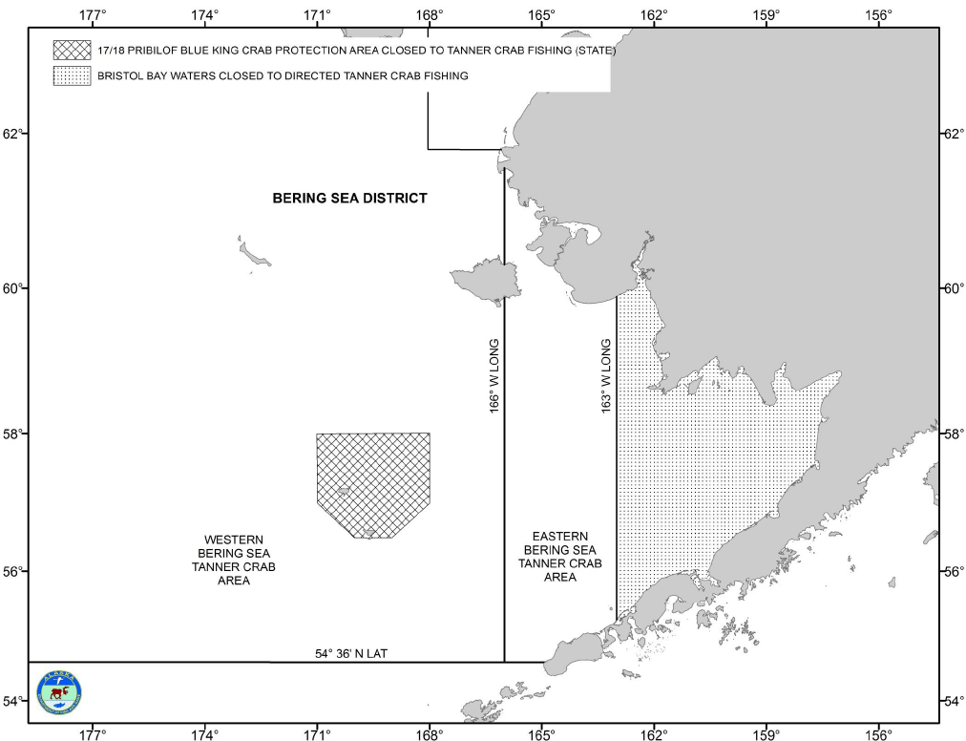
Tanner crab fishery management
Federal
Considered one stock
Single OFL, ABC
Single stock assessment model
State
Sets TACs separately for areas east and west of 166ºW
required: sum(TACs) < ABC
Area-specific harvest control rules
mature female biomass for entire EBS
area-specific mature male biomass
east: > 113 mm CW
west: > 103 mm CW
area-specific 5-inch males
abundance
average weight
new shell/old shell proportions
Courtesy of Ben Daly, ADFG
Notes:
Updated 2024

Slide 4
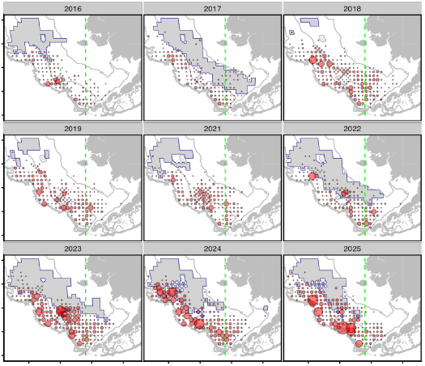
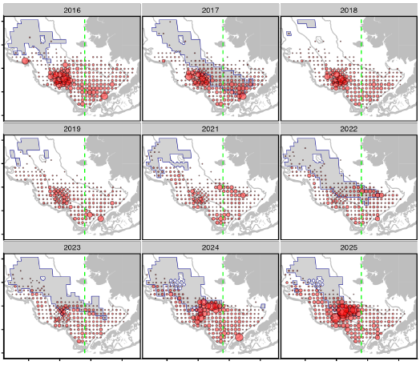
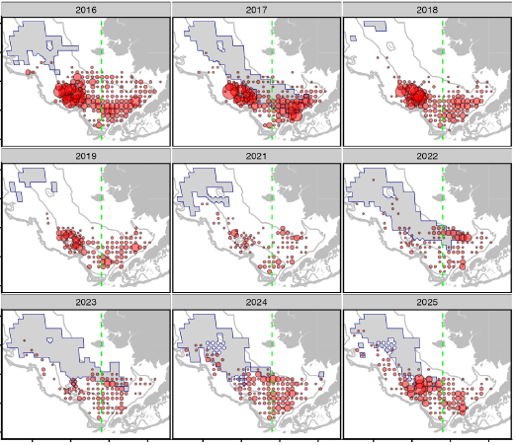
Survey Spatial Patterns
small males (< 60 mm CW)
large males (> 60 mm CW)
IPMs
different groups: different scales
Notes:
Updated 2024

Slide 5
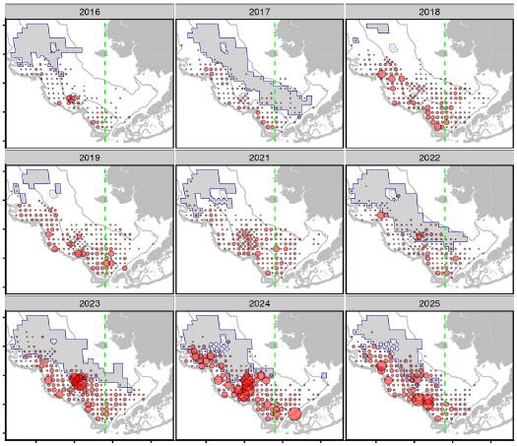
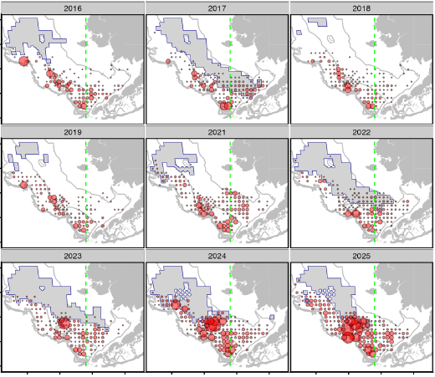
Survey Spatial Patterns
immature females
mature females
different groups: different scales
Notes:
Updated 2024

Slide 6
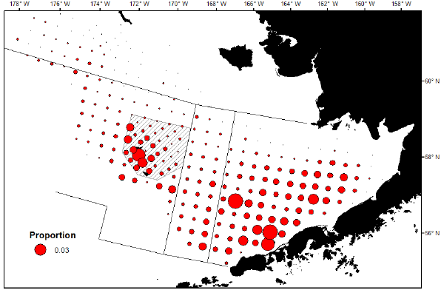
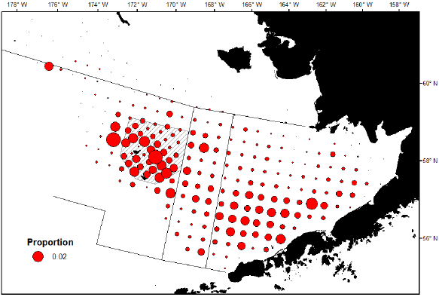
East/West Differences: Mature Male Biomass
1975-2014
2015-2019
Courtesy of Ben Daly, ADFG
Notes:
Updated 2024

Slide 7
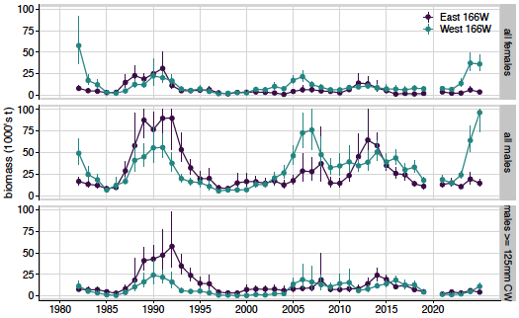
Survey Data By Management Region
Notes:
Updated 2024

Slide 8
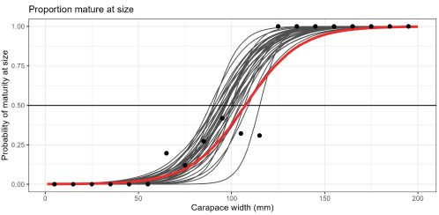
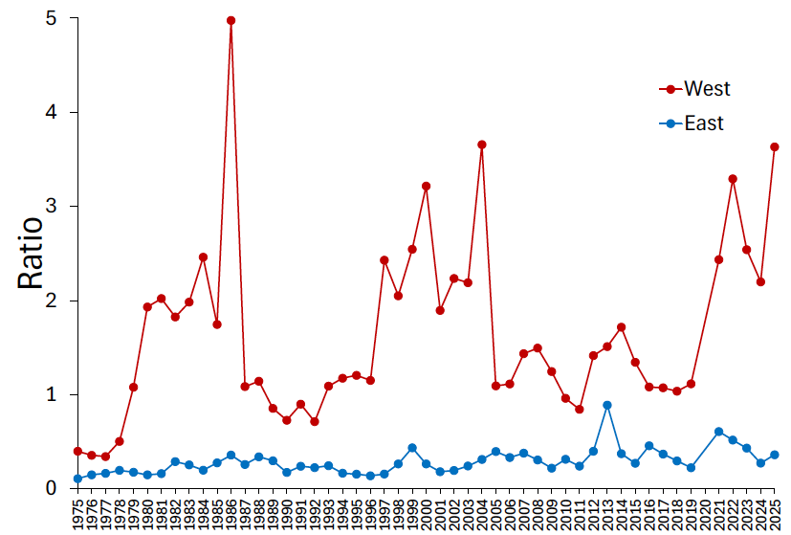
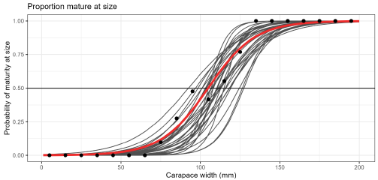
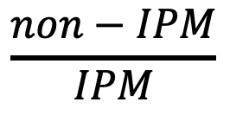
East/West Differences
Males West
$$\frac{non−IPM}{IPM}$$
Males East
IPM: Industry-preferred males (>125 mm CW)
Courtesy of Ben Daly, ADFG
2025 Survey Tech Memo
Notes:
Updated 2024

Slide 9
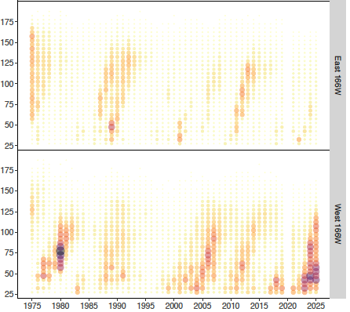
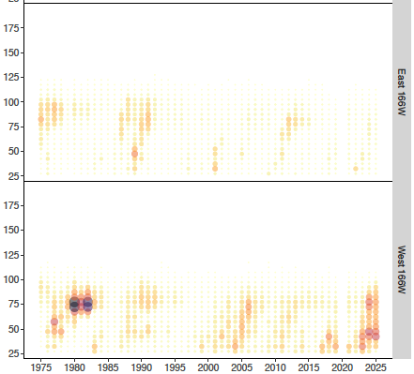
Survey Size Comps: Synchronous recruitment?
Males
Females
East 166W
West 166W
Notes:
Updated 2024

Slide 10
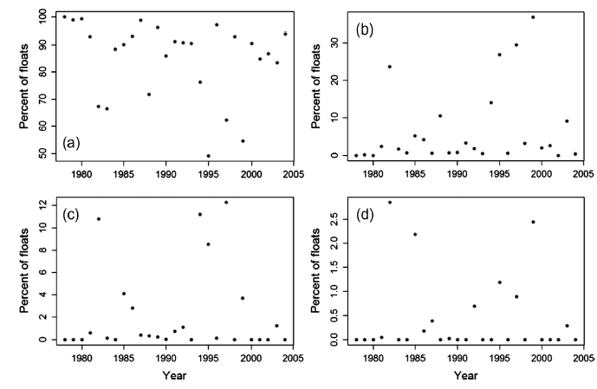
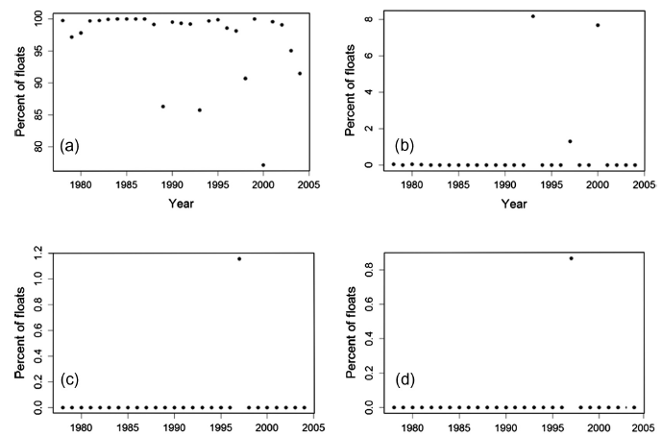
Asymmetric larval transport?
Originating East of 166W
Originating West of 166ºW
retention
1ºW advection
retention
1ºE advection
2ºW advection
3ºW advection
2ºE advection
3ºE advection
From Richar et al. 2015

Slide 11
Spatial Patterns and Stock Structure
Spatial patterns exist: do they suggest multiple stocks in the EBS?
Johnson (2019) genetics study suggests no
Spatial patterns exist: do they suggest the need for a spatial assessment?
Suggested research directions?
Priorities?
Notes:
Updated 2024

