Slide 1
Observer statements calculated as rates, and ODDS trip-logging compliance rates
Andy Kingham
Craig Faunce
Jennifer Ferdinand
Fisheries Monitoring Advisory Committee Meeting
27 May 2019
U.S. Department of Commerce | National Oceanic and Atmospheric Administration | NOAA Fisheries | Page 1

Slide 2
Background and Purpose
Attempts to answer the question:
“how often do incidents occur in some of the different deployment situations in which observers find themselves placed into, and how do patterns change when we group the data by factors associated with certain fisheries?”
… have proven difficult to answer without controlling for how many observers are deployed, and how many days they are deployed.

Slide 3
Standard Metric: Number of StatementsC
What does it mean when the number of statements changes from year to year in a given statement category?
Changes in fishing effort
Changes in coverage rate
Differences in total time spent deployed to vessels/plants across varying vessel/plant types

Slide 4
Alternative Approach: Incidents per…
Factors were identified from observer and CAS data (e.g., gear type, vessel type, observer role, general fishing area) to summarize by
Statements may incorporate multiple incidents of a potential violation (e.g, number of hauls). This method used ‘number of incidents’ rather than ‘number of statements’
The number of incidents were linked to the factors where they applied (i)
The number of total deployment days were linked to the factors where they applied (d)
The number of observer assignments (cruise/vessel combinations) were linked to the factors where they applied (a)
For each factor:
(i/d)*1000 = incidents per 1000 deployed days
(i/a) = incidents per observer assignment
Factors are independent of each other

Slide 5
Factor | Value | Statement types: OLE PRIORITY (Inter-Personal)
 |  | Incidents per assignment | Incidents per 1000 deployed days
COVERAGE TYPE | FULL | 0.22 | 5.7
 | PARTIAL | 0.02 | 3.2
VESSEL TYPE | CP/MS | 0.34 | 7
 | CV | 0.04 | 3.2
 | PLANT | 0.07 | 2.1
OBSERVER ROLE | LEAD | 0.59 | 12.2
 | SECOND | 0.15 | 3.6
 | SOLE | 0.06 | 3.2
NMFS REGION | AI | 0.29 | 11.4
 | BS | 0.2 | 5.8
 | GOA | 0.03 | 4.2
 | PLANT | 0.07 | 2.1

Slide 6
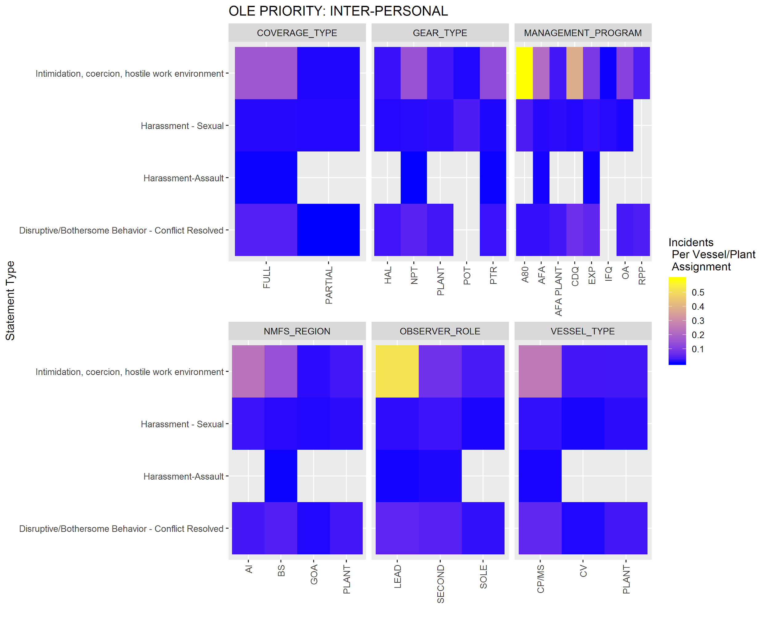

Slide 7
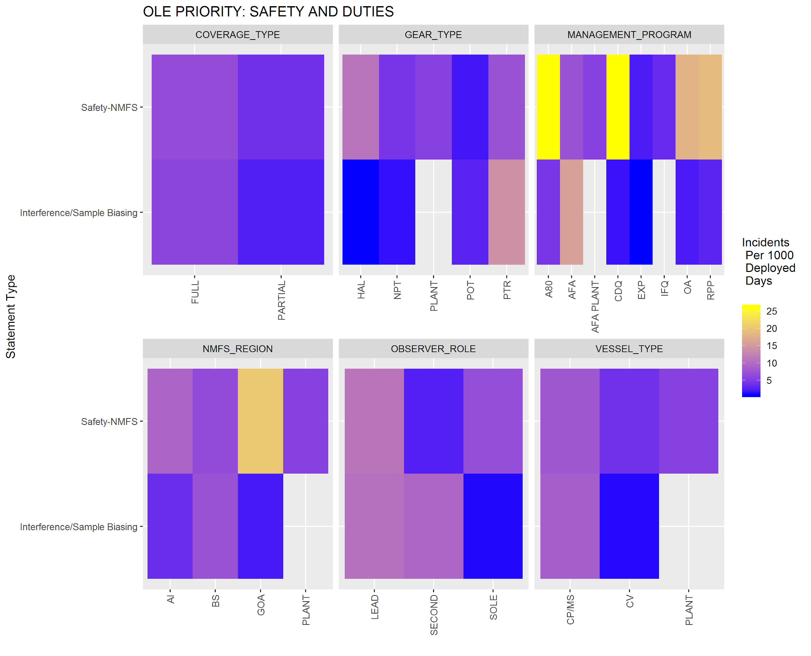

Slide 8
Discussion
Future direction for fisheries analysis team:
Determine which factors are most informative and report incident rates for those factors in annual reports
Explore time trends for these rates
Continue to work with OLE to identify the best use of this information
Overhaul the observer statement database to more clearly define the ‘incident units’, as applicable to various statement types (2020)

Slide 9
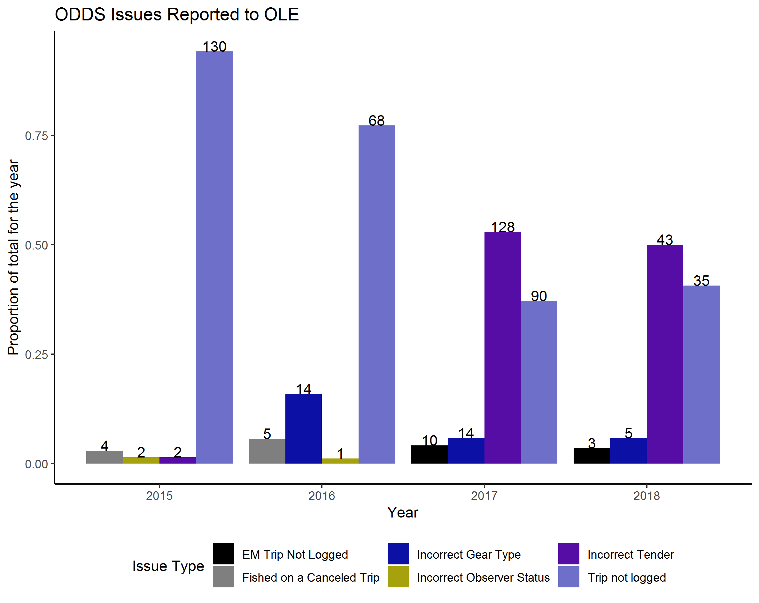
ODDS trip-logging compliance rates

