Slide 1

JClass Desktop Tutorial
Topics Covered
Resources, how to learn and develop with JClass
Examples of JClass used in the verification project.
Resources for help
JClass and this tutorial was not endorsed by Bill Cosby.

Slide 2
Resources – How to learn/develop with JClass
Read overview of the JClass pdf
This is in the /docs of where JClass is installed on your machine. (ie. JClassDesktopViews/docs/chart/pdf)
There is also the online JClass API. This is in /docs, view this in the browser by using the intranet to access the html file (ie. www2.cpc.ncep.noaa.gov/export/lnx369/JClassDestopViews/docs/api)

Slide 3
Things you need to know before tackling JClass
Before you tackle learning JClass, there are essential Java and programming things you need to know. If you do not know what any of the following items mean, you need to research (google, online tutorials, books) them!
API
What Java Swing GUI is and how components of them work. JClass utilizes many Swing pieces! You will need to distinguish what you can manipulate using Swing vs. the JClass specific classes. Also, most of these graphical components in JClass are built out of Swing components! Such as panels, shapes, etc. that JClass has created special designed wrappers or classes for.
Java packages, how to reference them, how to import them.

Slide 4
Things you need to know before tackling JClass (cont’d)
How to use and reference packages, classes, methods in Java
How to read Java API documentation and use the information. Some will be covered in this tutorial.
The difference between static and non-static methods. Object classes and non-object classes – what are the difference?
Variable scope in Java

Slide 5
Using Java API documentation
A demo will now be shown on how to use Java API formatted documentation and how this translates to using it.
This includes :
Understanding hierarchy in Java (packages, classes, methods)
Once you find the method you want to use, how to use this in your code.

Slide 6
Using Java API documentation
Look at the Method Summary. This includes a method name and possibly parameters to pass in :
getInfo(Settings settingsObj, String infoType)
Identify what pieces are above.
Form your call in your code properly. This means that to use this method, it is either a method based on an object (and an associated package, such as chart) or a static library Class.
If the above method is a method of chart, then create a chart object in JClass, do chartObj.getInfo(settingsObj, infoType).

Slide 7
Learn these JClass Basics
What do you need to know/learn to start using JClass?
In the pdf documentation, you must learn the hierarchy of how JClass creates charts and the parent/child methods and attributes.
What Swing components are used in JClass and specific JClass objects are used (ie. JCAxis, for the axis object in JClass). Learn what methods JClass has built in, and which you can edit by Swing. This is especially important in understanding how to alter chart pieces.

Slide 8
Learn these JClass Basics
What do you need to know/learn to start using JClass?
How to create a desktop version of Java JClass code (with a main method).
How to use this in the framework of a web application. See the PlotChart.java in verification software for a good example and the TimeseriesApplet.java in the applet package to see how an applet creates an initial chart object, etc.

Slide 9
Using JClass
The main items you must do to use JClass in your Java code :
Import the appropriate packages and associated classes. (ie. import com.klg.jclass.chart.*)
Some JClass classes use Swing components. Often you can manipulate these. Import these components as well.
Create an object if necessary to use the associated JClass functionality.
Find the method(s) that you would like to use methods.
Call these methods passing arguments that you want. For example there are a lot of set methods in JClass to set attributes of the chart object. You must understand the hierarchy of these JClass objects and attributes by reading the documentation carefully to code with JClass.
Using the documentation provided by JClass is essential. It will explain the usage and the hierarchy associated with the method you want to use.

Slide 10
JClass Features and How it Works
The JClass pdf documentation explains how the chart object works and how to use the methods associated with the chart.
Read all about relevant chart attributes and how you can set and manipulate them.
* Demo PlotChart.java, show framework and example usages of methods. http://lnx92/Verif_System/browser/trunk/source/gov/noaa/ncep/cpc/display/PlotChart.java

Slide 11
Start practicing JClass
Get the JClass software
Read the pdf documentation and get used to the API. This includes examples and output you would get from the example code.
Open the examples on your machine.
Use template examples to create your own basic chart as a simple command line run program.
Add features to this chart, utilizing all the available documentation.
When you get comfortable with this, convert your program to an applet that you can either run on command line or in a browser.

Slide 12
Development with JClass
Guidelines for how to develop with JClass :
Identify the type of chart
Create the chart
Read the pdf and API on specific methods and features you can add, change, or remove from the default JClass object.
As you code use these methods to create the chart look and feel and functionality that you want.
A good method is using the JClass Chart Customizer to dynamically change attributes in the chart like a mock-up and then finding the appropriate methods and syntax you can use to code it into your code.
There are 2 methods of creating a chart, options and attributes set by an XML settings file, or hard-coded features in the Java code itself. This XML file that can be read in has not been used yet. Stick to coding it in using various methods.

Slide 13
Lessons learned in the verification project
Sometimes the JClass documentation between API, pdf, and actual methods differ and are not completely correct. Contact JClass if something is definitely not agreeing between documentation and the errors you’re getting.
There are update methods you should use to update chart attributes, rather than creating a new chart object. See the PlotChart.java code in the verification project (display package) for code that JClass built in that does updates.
Use the forums and support help for JClass for questions that no documentation, co-workers, forums, etc. can solve.

Slide 14
Lessons learned in the verification project (cont’d)
Many errors in trying to create a chart and manipulating it occurs because the developer did not understand the hierarchy of the object or attribute they are trying to work with.
This is why you must be able to know what is directly a Swing component vs. JClass component and spend time really understanding the hierarchy of chart features.

Slide 15
Lessons learned in the verification project (cont’d)
In some chart attributes, you have to do chained syntax (calling multiple methods on a single line of syntax) or similarly, do multiple steps to change what you want.
For example, getting a part of an object and then setting it, or in separate lines get the appropriate attribute(s) and then set what you want. In this example you want to make the
y-axis invisible.
// Get the ChartDataView
ChartDataView dataView = chart.getDataView(0);
// Create Y-axis label
JCAxis yaxis = dataView.getYAxis();
yaxis.setVisible(false);

Slide 16
Lessons learned in the verification project (cont’d)
In some chart attributes, you have to do chained syntax, ie. getting a part of an object and then setting it, or in separate lines get the appropriate attribute(s) and then set what you want :
By using the JClass Chart Customizer (see next slide) method, you can dynamically make changes to a chart like a mock-up and then code the changes in.

Slide 17
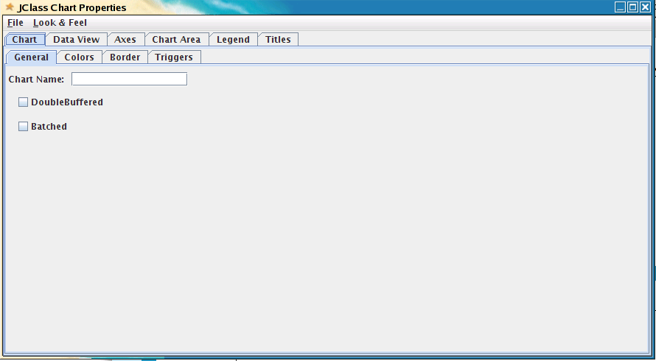
Using JClass Chart Customizer
Access the JClass Chart customizer by creating/displaying a JClass chart. Make sure that the customizer is enabled:
ie. chart.setAllowUserChanges(true);
Where “chart” is a JCChart object. Then right-click on the chart to bring up the pop-up customizer. Below is a screenshot of what the customizer looks like:

Slide 18
Using JClass Chart Customizer (cont’d)
Use the names of properties to help figure out what the name of the objects that make up the components are, as well as hints for hierarchy (by seeing the level of the option in the chart customizer). Click around and change selections to figure out what the name of properties are and available options.
By figuring out what objects contain what components, you can figure out how to retrieve objects and then manipulate their properties.

Slide 19
Example Using JClass Chart Customizer
Task : We wanted to add a horizontal line at y=0 to the chart.
Approach Steps :
Step 1: Open the JClass Chart Customizer on any displayed chart

Slide 20
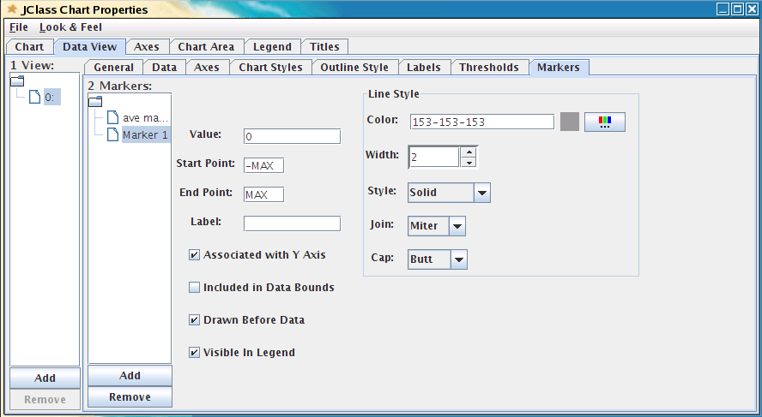
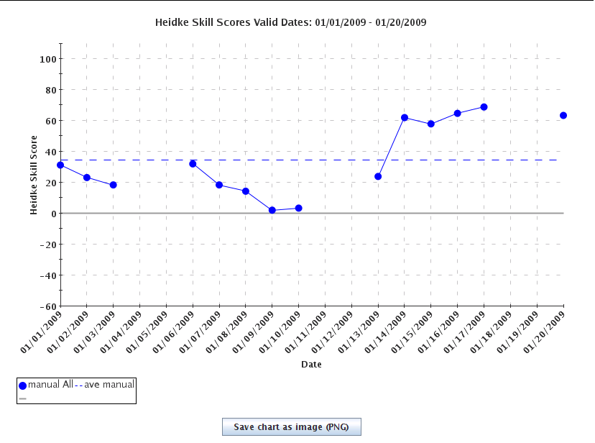
Example Using JClass Chart Customizer
Step 2: Try changing various properties to try to create the line. We found that by changing these options, it produced the desired line.
These options produced the below chart

Slide 21
Example Using JClass Chart Customizer
Translating properties to code
Step 3: We find out that the tab label is “Markers”, and that this is what any additional lines are referred to. By looking this up in the jcchart.pdf, it explains how to create and modify markers in JClass. We learn that object JCMarker is responsible for this.
2
4
1
3
Properties options selected:
1) Clicking “Add” added a new Marker (Marker 1)
2) By entering “0” in the “Value” box and hitting Enter, a new line on the chart was drawn
3) Checked a few desired options
4) Clicking on the color button allows selection of line color, gray chosen
The width of the line is set to “2”.

Slide 22
Example Using JClass Chart Customizer
Translating properties to code
Tips :
The tabs in the customizer typically represents JClass objects.
If the chart does not change after making changes in the properties box, try hitting the Enter button while the cursor is in a textbox field.
Other times, checkboxes or an “Ok” button is available. Usually these items update the chart automatically.
Sometimes, you may have to check and uncheck a “Show” button to see changes (ie. Under Axes > Grid)

Slide 23
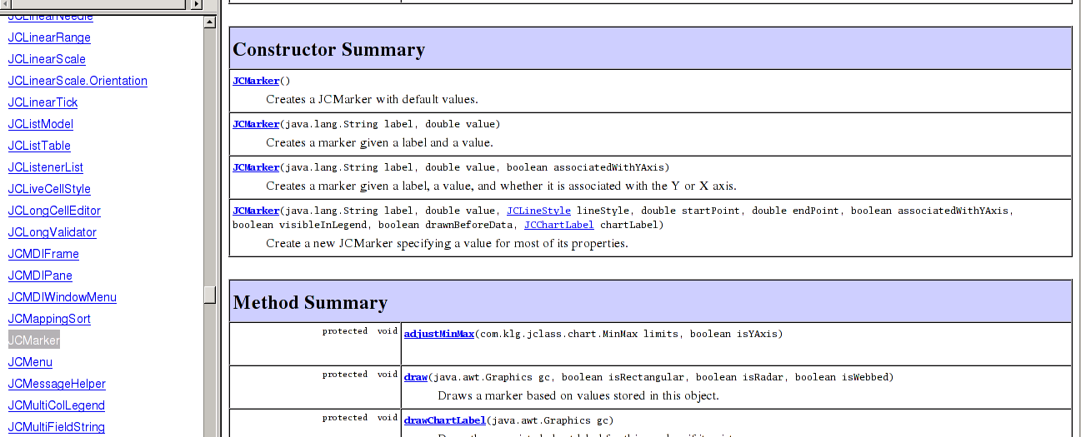
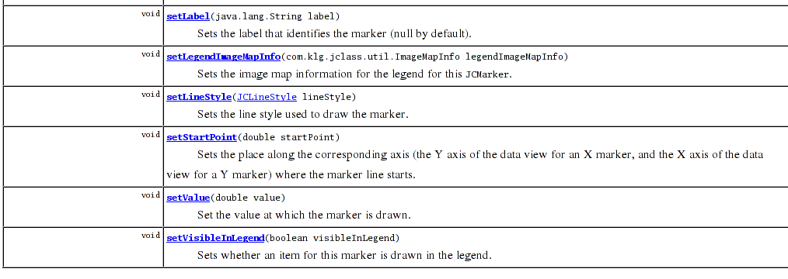
Example Using JClass Chart Customizer
Translating properties to code
Step 4: We can now look up JCMarker in the doc API to view available methods and how to use them.
We used the first constructor version, this is the simplest.
We saw that setValue(double value) method allows us to set the value of where the line is drawn. Other set methods look like the properties we want set.

Slide 24
Example Using JClass Chart Customizer
Translating properties to code
Step 5: We can now try to use the various methods in the code to create the desired line. Below is some code that would be used to create the desired line. These methods were seen in the JClass docs API! (previous slide)
// Import necessary packages (there may be more than what is listed below)
import com.klg.jclass.chart.*;
import com.klg.jclass.chart.JCChart;
public void updateChartData(String xmlDataString) {
.
.
JCMarker markerZeroValue = new JCMarker(); // Create new marker using a constructor method
markerZeroValue.setValue(0); // Set value of line to y=0. The below line ensures that this is the value of the y-axis, not the x-axis.
markerZeroValue.setAssociatedWithYAxis(true); // The above value is associated with the y-axis (y=0)
// These will display in the legend if the markers are set to visible in legend
markerZeroValue.setLabel("Zero skill"); // Set the label associated with the marker line
markerZeroValue.setVisibleInLegend(true); // Set whether the markers are visible in the legend
markerZeroValue.getLineStyle().setColor(Color.BLACK); // Set color of line
markerZeroValue.getLineStyle().setWidth(2); // Set width of line to
// Add the marker to the plot
try {
markerZeroValue.setDrawnBeforeData(true); // Set so the lines are drawn before data, allowing lines of scores to take priority
dataView.addMarker(markerZeroValue);
}
catch (Exception e) {
logger.warn("Could not display marker at y=0 to dataView.");
Log.error("Could not display the line at y=0. " ,"#errorPanelText");
}

Slide 25
Chart Tips & Common Developer Mistakes
*Copy from Readme

Slide 26
Resources for Help
Quest website – forums, online API here as well:
http://www.quest.com/jclass-desktopviews
Java and JClass API and pdf
co-workers
If you cannot find a solution, and neither can your co-workers, contact Melissa Ou. She can help you contact a Quest staff member to put in a trouble/help ticket for Quest staffers (Not sure if our support has run out yet).

