Slide 1
CPC Verification Web Tool (VWT)
The developers introduction

Slide 2
Languages used
Web application (PHP, Javascript, HTML)
Driver, back-end (Javac [1.6.0_20], JClass [v6.4.2])
Output data input into chart creation methods (XML)
Back-end database (MySQL)

Slide 3
Latest scoop
Mike : rewriting front-end web scripting to be simpler, complicated options and logic. Improving it to make it easier to scale and edit.
Sarah : added QC for stats package, adding documentation
Melissa : implemented text content information in web GUI
Scott/Adam : writing Perl/shell scripts to generate settings.xml files for many settings on the fly. Currently running static processing.
Josh (intern) : writing static graphics web page. This will be transitioned to rest of web team after he leaves.

Slide 4
Developer Resources
Readme (manual) in Google Docs currently:
https://docs.google.com/a/noaa.gov/document/d/1n5q2-so1wr7Rd5M6yFH1vJYJy6_QHYpQQtz9APg72Dw/
If you do not have a not have a Gmail account, you can view the pdf at: https://svn-gburg/cpc-trac/projects/Verif_System , it is also in the /docs dir of the process.
This covers many topics, from how to install and run the process to the details of the code.

Slide 5
Developer Resources
Trac pages:
  Main page: https://svn-gburg/cpc-trac/projects/Verif_System
  From the main page you can view pages of different sub-teams.
    “data team” link contains documentation of database standards, data input requirements to add new data to VWT, backup and sync procedures, etc.
    “coding team” link has a lot of good links to development information, especially the “VWT Developer Notes” link.
    “web team” contains documentation regarding the web portion.

Slide 6
Developer Resources
/docs process sub-directory
  This has lots of documentation files. These will likely be condensed better in the future. JClass_Desktop_Tutorial.pptx helps start learning how the charts are created by JClass software.
Javadoc API
  Running >ant doc.java (and doc.javascript, doc.perl) will create the HTML version of software documentation. To browse, access the /docs area in a browser (ie. on lnx321).
  This contains the detailed documentation and method usages.

Slide 7
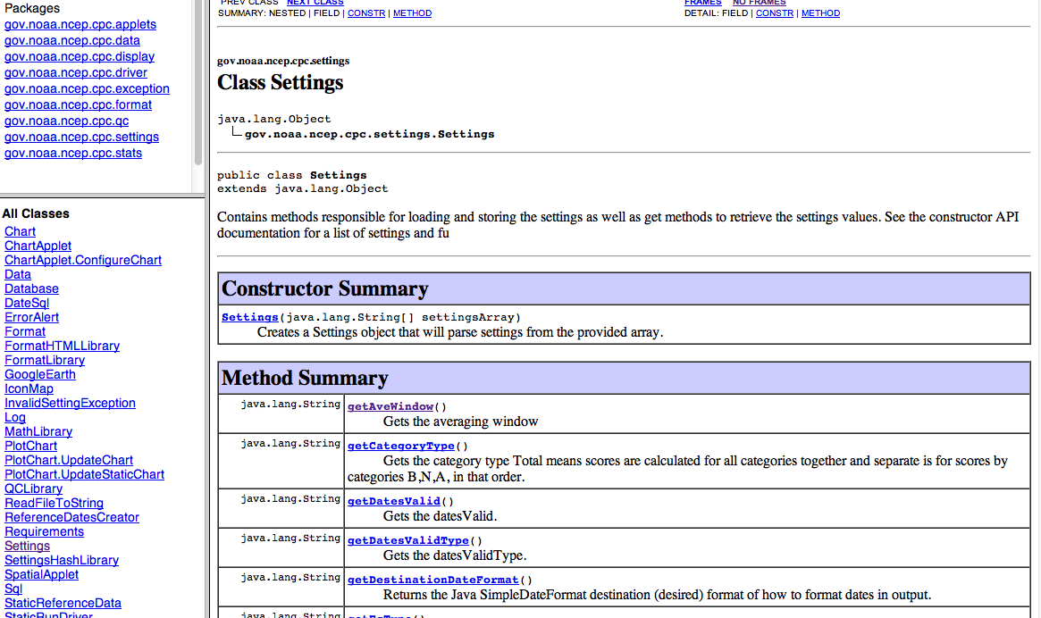
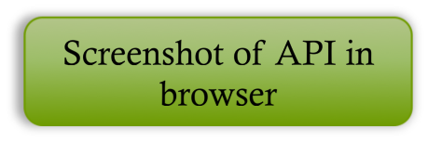
Developer Resources
Javadoc API

Slide 8
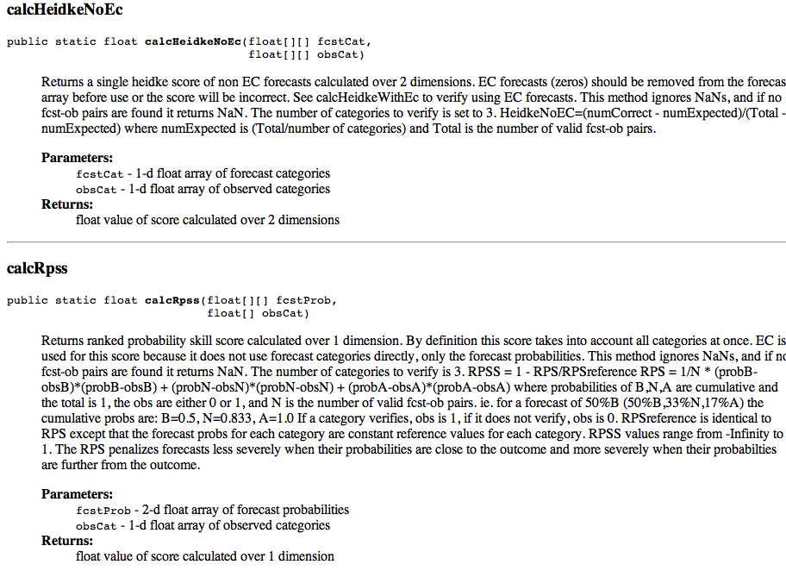
Developer Resources
Javadoc API (cont’d)

Slide 9
Features of verification software
Multiple initiation methods
Multiple output formats
Multiple output dimensions
Multiple options (settings) to calculate scores for
Scalable code
Well documented software
Multiple logging options
Designed for automated cron processing to make graphics as well as a dynamic web tool version for users.

Slide 10
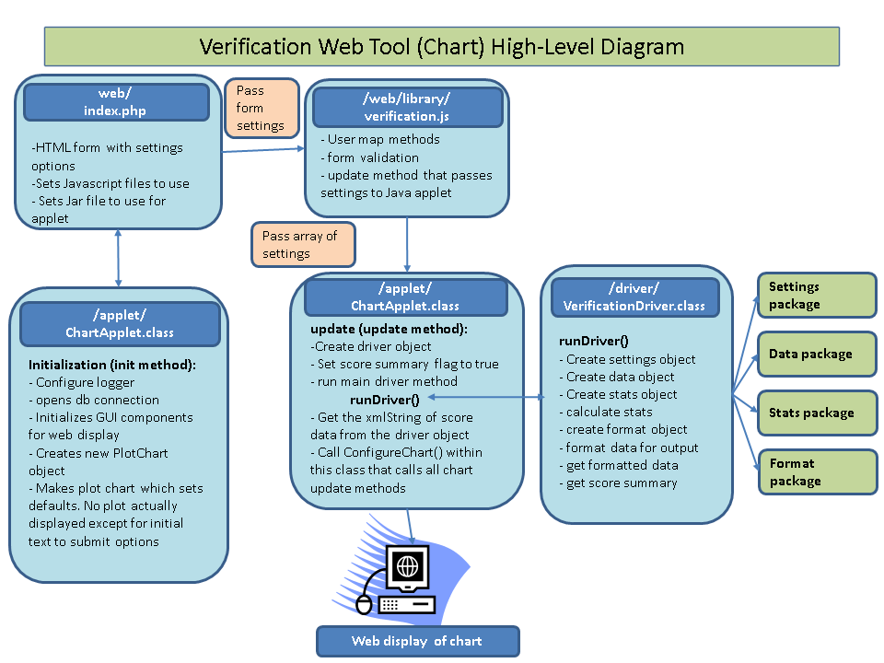
High-level diagram

Slide 11
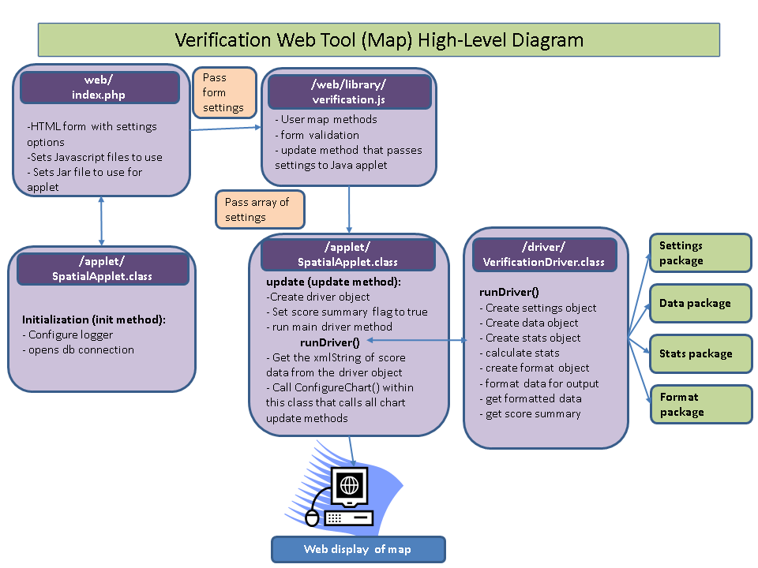

Slide 12
Overview of Java packages
Package - mechanism for organizing Java classes into namespaces similar to modules. Typically used to organize classes belonging to the same category or providing similar functionality. [In the VWT, a package often has an object representing it].
The package names follow /gov/noaa/ncep/cpc/$packageName, where $packageName is the name of the package. This is under the /source directory.

Slide 13
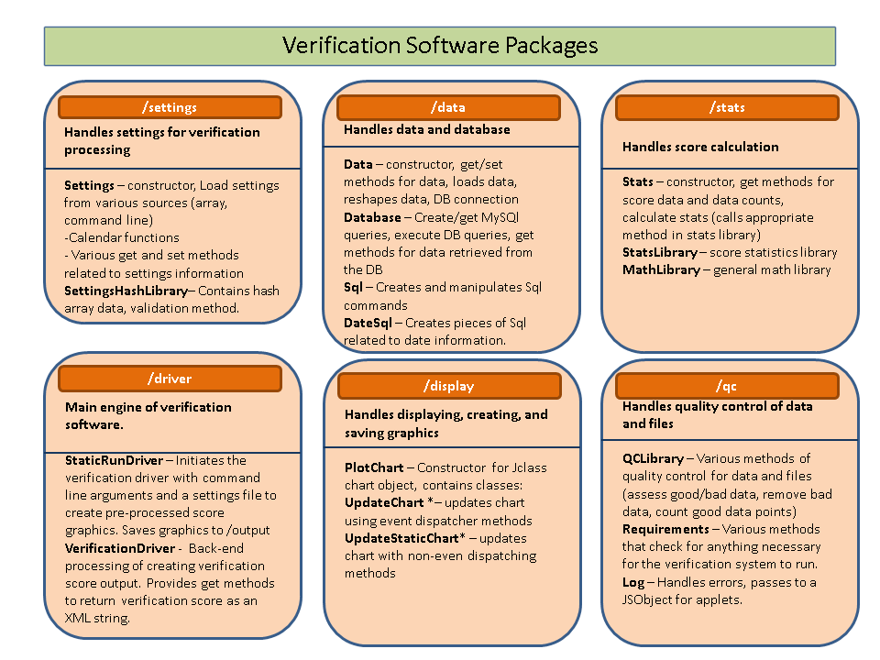
Overview of Java packages

Slide 14
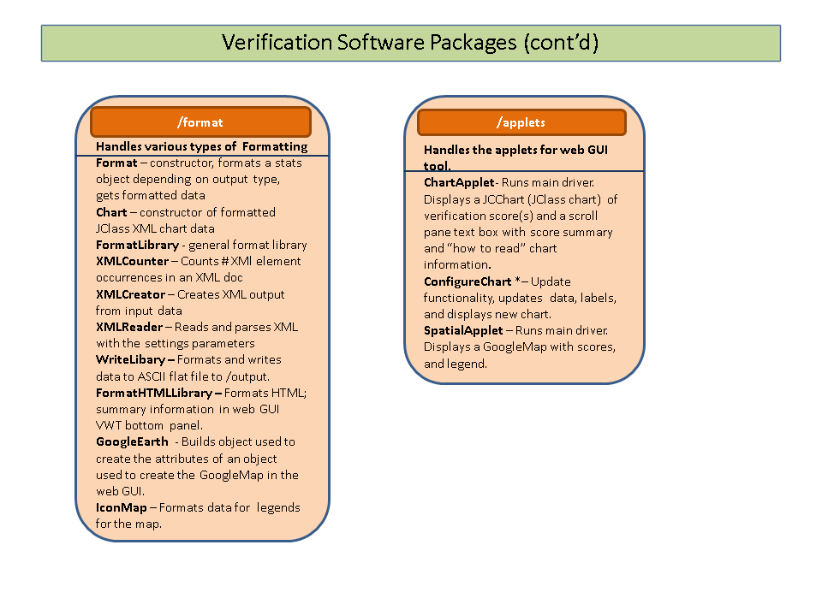

Slide 15
Front-end
Front end of the web GUI consists of HTML, Javascript, and Jquery. An applet communicates between the user and the back-end code. Submission of options is passed as an array from the Javascript to the Java applet, then driver.
Front end of the command-line run processing is done by initiating a command and inputting settings from a settings XML file.

Slide 16
Back-end overview
Java and more Java! The charts utilize JClass, Java software we use which contain methods we call to create the charts we want on the fly. Basically they’re more classes and methods.
Objects are used to manipulate and extract information efficiently between packages and points of processing.
Extreme modularization! Java is based on having “black box” methods which often has very specific and contained purposes. The code is done this way in the VWT, with the object classes of packages acting almost like “mini drivers” that call other classes.
It only takes a Jar file to run the back-end. Think of this like a bundled series of executables. The main Jar is /classes/verification.jar which is created every time you re-compile using the build.xml file. (>ant clean;ant compile)

Slide 17
Back-end - drivers
There are 2 Java driver codes – one for the chart, one for the map : ChartApplet.java and SpatialApplet.java.
There is a driver for the command-line run version, StaticRunDriver.java.
All the above drivers run the main driver – VerificationDriver.java

Slide 18
Data
All data is stored in a MySQL database. This contains forecast data, observation data, and reference data (stations, geographical information, etc.)
Data is typically originally provided to the data team as flat ASCII files, then Perl scripts in the /scripts directory are on a cron to import the data into the database. There is quality control, and filling of all possible dates and locations with ‘NULL’ data, which is required by the VWT.

Slide 19
Driver Process Flow – VerificationDriver.java
(In readme of /docs VWT)
In the driver constructor :
Get Logger – Configuration of logger is not in the driver itself but in the application initializing the driver. This enables the application of verification to specify the configuration and format of logging according to the application.
In method runDriver() – This accepts a String array of settings. runDriver() does the following steps :
1. Create new settings object.
2. Set the ‘home’ variable value. This is the root path of the software location. The default null value is only overwritten for the command line run-time application (StaticRunDriver.class). The applet ignores this.
3. The passed settings are loaded into the settings object.
4. Create a new data object.
5. Set the database connection
6. Load the data by passing the settings object. The loadData() method in the data package will use the settings information to load the data on the data object. (Detailed documentation of how the data package works is in Appendix C)
7. Create a new stats object.
8. Perform the score calculation by passing the data object (with loaded data) and the settings object (with loaded settings). Logic in the stats package will perform the correct score calculation on the data. This method is calcStats(dataObj, settingsObj). Nothing is returned from this method.

Slide 20
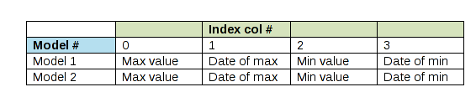
Driver Process Flow
(In readme of /docs VWT)
In method runDriver() (cont’d)
9. Create a new format object.
10. Execute formatData() on the format object. This is part of the format package. The stats and settings object is passed to this method to format the statistics results accordingly.
11. The formatted data from the prior step is retrieved using a get method on the format object (formatObj.getFormattedData()).
12. An ‘if’ statement determines whether the flag determining whether to return a score summary is 0 or 1. By default this flag (scoreSummaryFlag in the driver) is set to 0. An application that is executing runDriver() can set this flag to 1 (driverObject.setScoreSummaryFlag(true), where ‘true’ is a Boolean and can also be set to ‘false’). * Details in readme
getScoreSummaryEachMode() method in StatsLibrary.class). This returns a 2-d String array of maximum score values for each model. getScoreSummaryEachMode() method in StatsLibrary.class). This returns a 2-d String array of maximum score values for each model.

Slide 21
Driver Process Flow
(In readme of /docs VWT)
There are get methods in the driver that accesses information :
  Get method to retrieve the score summary array (getSummaryArray()) which wil return the 2-D String array of score summary.
  Get method to retrieve the summary text involving the score summary information, formatted in HTML (getSummaryHTMLText).
  Get method to retrieve the XML formatted String of score data (getXMLString).
There are set methods in the driver :
  Set score summary flag to Boolean value true or false. This will set the integer form of the score Summary flag.
There is a main method in the driver that can be ran but does not produce graphics or returns any score results output. It is left up to the application initiating the driver is responsible for obtaining the output in a desired format. This main method is not used by the applet or the static driver (StaticRunDriver.class). It simply performs steps that end in running the runDriver() method. The main method can be ran on the command line to test running the runDriver() method.

Slide 22
Pre-requisites / Requirements
Prior to maintaining/developing on VWT there are certain things you should know:
Java basics – object oriented programming, methods, packages, common and best practices, where source code vs. classes are in the VWT software
JClass basics, MySQL querying
Database structure and convention (Trac data page)
Get used to using the Javadoc API and using it to create and edit code.
Understanding how logging works (log4j, web logging)
Understanding how process killing works (throw exception solution, see readme)
Reading the VWT readme
Subversion, tagging convention

Slide 23
Summary
Best learning resource – readme for VWT (Google Doc) , files in /docs
Best developing resources - Javadoc API (Javascript, and Perl API), Trac links (VWT developers page), coding comments
Debugging resources – Trac links, coding comments
JClass – ppt intro in /docs, JClass manual (online) and pdf, coding comments
Pre-requisites are essential to maintaining and adding to code. It is important to continue using the current development tools (Subversion, GoogleDoc, Javadoc API) in real-time to prevent degrading and un-standardized code.
Developers *must* keep the readme up to date, use sufficient documentation.

Slide 24
Upcoming training topics
Common bugs and issues; solutions/possible solutions
logging, gracefully killing process
Settings package code
Data package, MySQL, code design and logic used to retrieve data
Statistics package, statistics, equal chances logic, quality controlling of stats, array manipulation
Format & display package (JClass, GoogleMaps, ASCII writing)
Build file – build.xml and how it works
Future improvements, current issues

