Slide 1
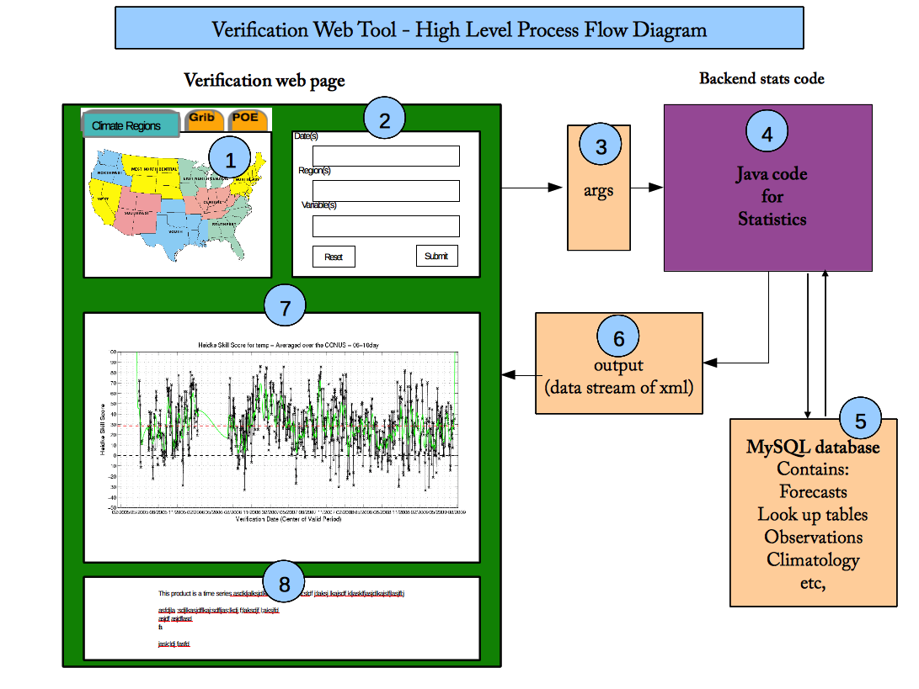
Web Page (PHP)
Contains JavaScript and HTML.
Index.php (main script) includes external php files (in include dir).
JavaScript
Region Chooser Map
JavaScript uses mapper.js and others within main PHP
Settings Chooser
Contains JavaScript/HTML within main PHP
Plot (JClass)
Applet called from main PHP
Uses Java, jcchart.jar
Typing ant compile creates java classes in class dir (like Plot.class). Classes will not be there when code is checked out.
Summary information
JavaScript/HTML
Notes:
Insert names of scripts that are used in prototype

Slide 2
Extra info on this one for my own use
Web Page (PHP)
Contains JavaScript and HTML.
Index.php (main script) includes external php files (in include dir).
Viewable on web wherever build.xml resides.
JavaScript
Region Chooser Map
JavaScript uses mapper.js and others within main PHP
Part of java code
Settings Chooser
Contains JavaScript/HTML within main PHP
Plot (JClass)
Applet called from main PHP
Uses Java, jcchart.jar
Typing ant compile creates java classes in class dir (like Plot.class). Classes will not be there when code is checked out.
JavaScript/HTML
Notes:
Insert names of scripts that are used in prototype

