Slide 1
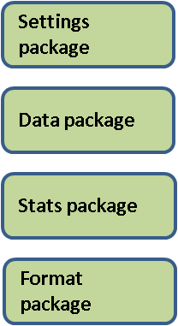

Verification Web Tool (Chart) High-Level Diagram
HTML form with settings options
Sets Javascript files to use
Sets Jar file to use for applet
Pass form settings
User map methods
form validation
update method that passes settings to Java applet
web/
index.php
/web/library/
verification.js
Pass array of settings
update (update method):
Create driver object
Set score summary flag to true
run main driver method
runDriver()
Get the xmlString of score data from the driver object
Call ConfigureChart() within this class that calls all chart update methods
runDriver()
Create settings object
Create data object
Create stats object
calculate stats
create format object
format data for output
get formatted data
get score summary
Initialization (init method):
- Configure logger
opens db connection
Initializes GUI components for web display
Creates new PlotChart object
Makes plot chart which sets defaults. No plot actually displayed except for initial text to submit options
/applet/
ChartApplet.class
/driver/
VerificationDriver.class
/applet/
ChartApplet.class
Web display of chart

Slide 2
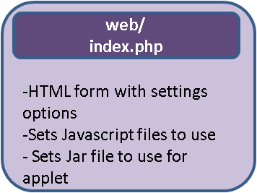
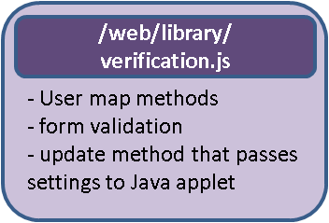
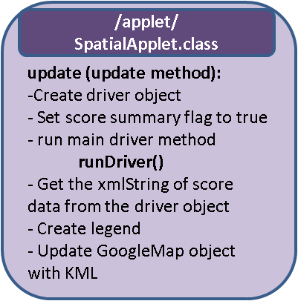
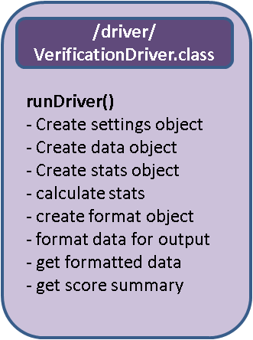
Verification Web Tool (Map) High-Level Diagram
Pass form settings
Pass array of settings
Initialization (init method):
- Configure logger
opens db connection
/applet/
SpatialApplet.class
Web display of map

Slide 3
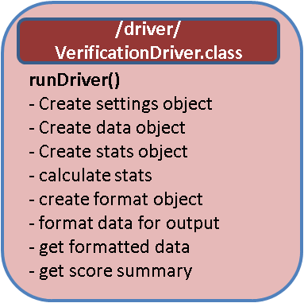
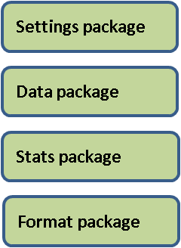

Verification Web Tool Command-Line Run High-Level Diagram
Initialization (main method):
- Look for existence of global environment variable ${VERIF_HOME}
Retrieve name of settings XML file and log configuration file from the command line
Run constructor
Constructor method
Opens db connection
Read settings from passed XML file
Create new VerificationDriver.java driver object
run main driver method
runDriver()
Get the stats, settings, and data object
Format and produce output based on the outputType. Puts output in the process /output directory.
/driver/
StaticRunDriver.class
writeToAscii()
Build file name and path to output file to
Write header with file information to a String
Append column headers to a String
Append statistics results to a String
Print String to file
/format/
WriteLibrary.class
ASCII file

Slide 4
Verification Software Packages
Handles settings for verification processing
Settings – constructor, Load settings from various sources (array, command line)
Calendar functions
Various get and set methods related to settings information
SettingsHashLibrary– Contains hash array data, validation method.
Handles data and database
Data – constructor, get/set methods for data, loads data, reshapes data, DB connection
Database – Create/get MySQl queries, execute DB queries, get methods for data retrieved from the DB
Sql – Creates and manipulates Sql commands
DateSql – Creates pieces of Sql related to date information.
Handles score calculation
Stats – constructor, get methods for score data and data counts, calculate stats (calls appropriate method in stats library)
StatsLibrary – score statistics library
MathLibrary – general math library
/settings
/data
/stats
Main engine of verification software.
StaticRunDriver – Initiates the verification driver with command line arguments and a settings file to create pre-processed score graphics. Saves graphics to /output
VerificationDriver - Back-end processing of creating verification score output. Provides get methods to return verification score as an XML string.
Handles displaying, creating, and saving graphics
PlotChart – Constructor for Jclass chart object, contains classes:
UpdateChart *– updates chart using event dispatcher methods
UpdateStaticChart* – updates chart with non-even dispatching methods
Handles quality control of data and files
QCLibrary – Various methods of quality control for data and files (assess good/bad data, remove bad data, count good data points)
Requirements – Various methods that check for anything necessary for the verification system to run.
Log – Handles errors, passes to a JSObject for applets.
/driver
/display
/qc

Slide 5
Verification Software Packages (cont’d)
Handles various types of Formatting
Format – constructor, formats a stats object depending on output type, gets formatted data
Chart – constructor of formatted JClass XML chart data
FormatLibrary - general format library
XMLCounter – Counts # XMl element occurrences in an XML doc
XMLCreator – Creates XML output from input data
XMLReader – Reads and parses XML with the settings parameters
WriteLibary – Formats and writes data to ASCII flat file to /output.
FormatHTMLLibrary – Formats HTML; summary information in web GUI VWT bottom panel.
GoogleEarth - Builds object used to create the attributes of an object used to create the GoogleMap in the web GUI.
IconMap – Formats data for legends for the map.
Handles the applets for web GUI tool.
ChartApplet- Runs main driver. Displays a JCChart (JClass chart) of verification score(s) and a scroll pane text box with score summary and “how to read” chart information.
ConfigureChart *– Update functionality, updates data, labels, and displays new chart.
SpatialApplet – Runs main driver. Displays a GoogleMap with scores, and legend.
/format
/applets

